Slide 1


Password-Protected Door Lock Using STM32 Microcontroller
Presented By :
ANAMIKA P - KMW24CS004
09/09/2026
B.Tech CSE
1

Slide 2
Table of Contents
  Introduction
  Problem Statement
  Objectives
  Methodology
  System Block Diagram
  Flowchart
  System Design
  Circuit Diagram and Pin Connections
  Output and Demonstration
  Result Analysis
  Challenges Faced and Solutions
  Conclusion
  Future Scope
09/09/2026
B.Tech CSE
2

Slide 3
Introduction
  Door security is important for protecting homes, offices, laboratories, and other restricted areas.
  Traditional keys can be lost, stolen, or duplicated, reducing security.
  The proposed system uses an STM32 microcontroller as the main control unit.
  A 4×4 matrix keypad is used for password entry, and a 16×2 LCD displays the system status.
  The system verifies the password and uses a relay module to control the solenoid lock, displaying “Access Granted” or “Access Denied” on the LCD.
09/09/2026
B.Tech CSE
3

Slide 4
Problem Statement
To develop a password-protected door lock system using an STM32 microcontroller that provides secure, simple, and reliable access control by allowing only authorized users to unlock the door using a predefined password.
09/09/2026
B.Tech CSE
4

Slide 5
Objectives
  To develop a password-protected door lock using STM32.
  To provide secure and controlled access.
  To allow password entry using a 4×4 keypad.
  To display authentication results using a 16×2 LCD.
  To provide a simple, reliable, and cost-effective security system.
09/09/2026
B.Tech CSE
5

Slide 6
Methodology
The system is divided into the following modules:
  Keypad Module – Used to enter the password.
  STM32 Module – Reads the password and verifies it.
  LCD Module – Displays instructions and authentication results.
  Door Lock Module – Unlocks or locks the door based on the password.
  Power Supply Module – Supplies power to all components.
09/09/2026
B.Tech CSE
6

Slide 7
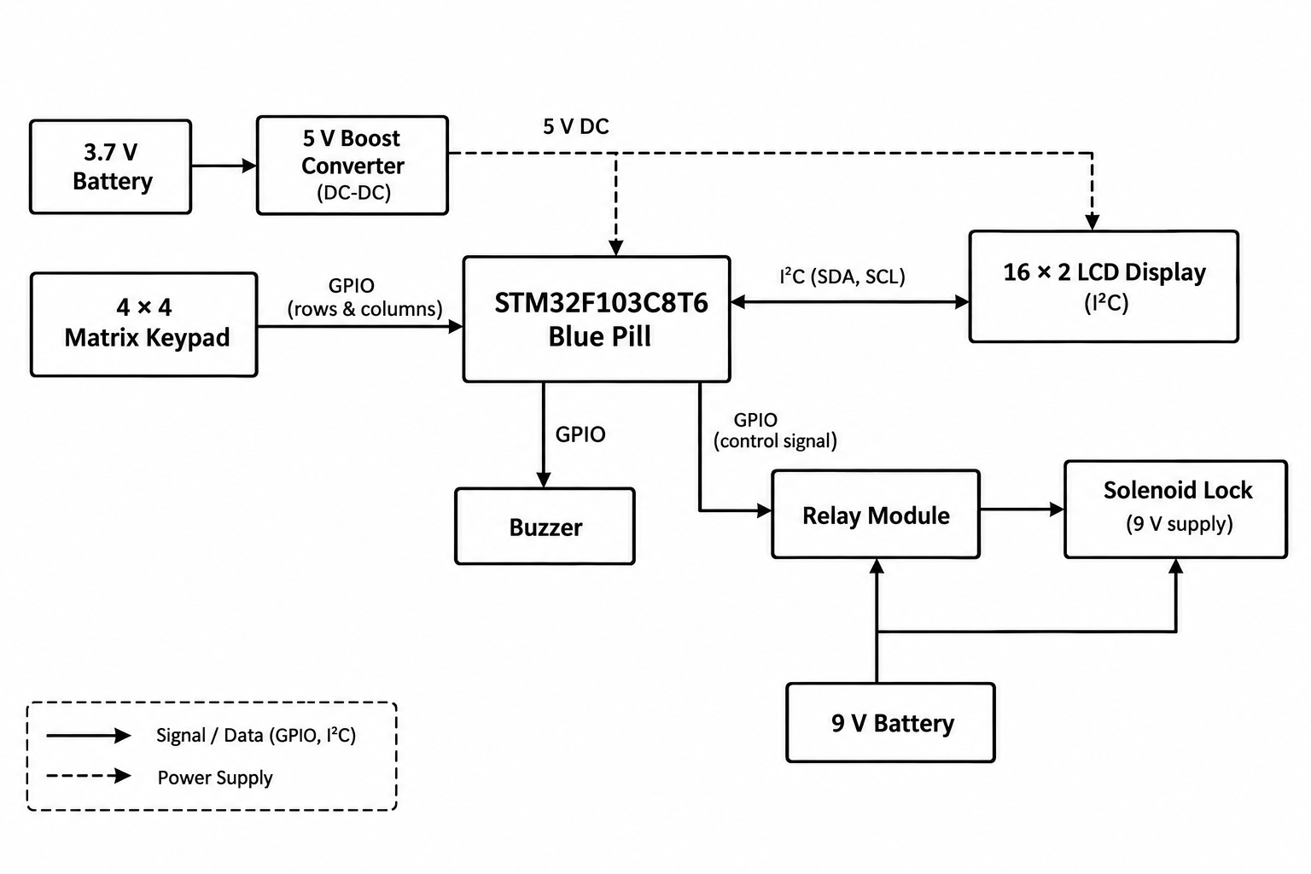
System Block Diagram
10/26/2026
B.Tech CSE
7

Slide 8
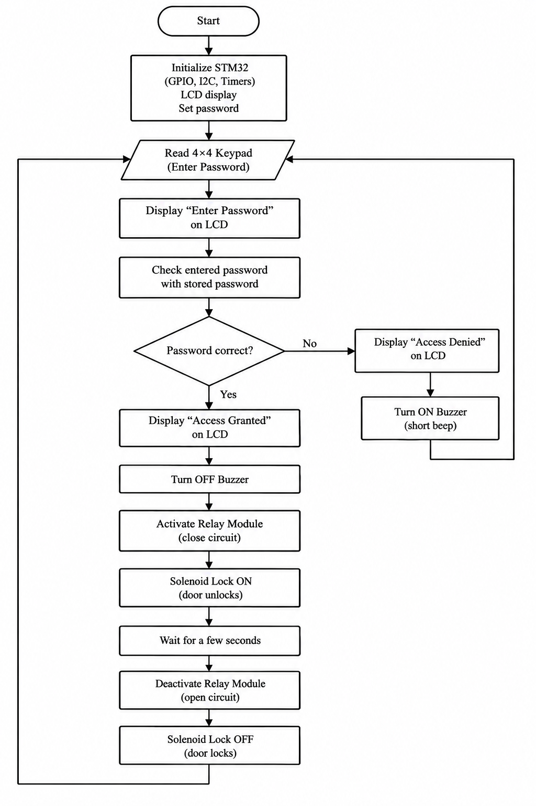
Flowchart
10/26/2026
B.Tech CSE
8

Slide 9
System Design
Hardware Requiements:
  STM32F103C8T6 Blue Pill – Main microcontroller board
  4×4 Matrix Keypad – Password input
  16×2 LCD with I²C Module – Displays messages
  5V Relay Module – Controls door lock
  Solenoid Door Lock – Locking/unlocking mechanism
  Buzzer – Audio indication
  ST-Link V2 – Programming
  Connecting Wires – Circuit connections
  Battery and Boost Converter – Power supply
10/26/2026
B.Tech CSE
9

Slide 10
Software Requirements:
  STM32CubeIDE – For program development and STM32 programming.
  Arduino IDE – For writing, compiling, and uploading code to the STM32 board.
  Embedded C/C++ – For writing the firmware.
  STM32 HAL Libraries – For peripheral control in STM32CubeIDE.
  GPIO – For keypad, buzzer, and relay interfacing.
  I²C – For the 16×2 LCD interface.
  ST-Link Driver – For programming and debugging the STM32 microcontroller.
10/26/2026
B.Tech CSE
10

Slide 11
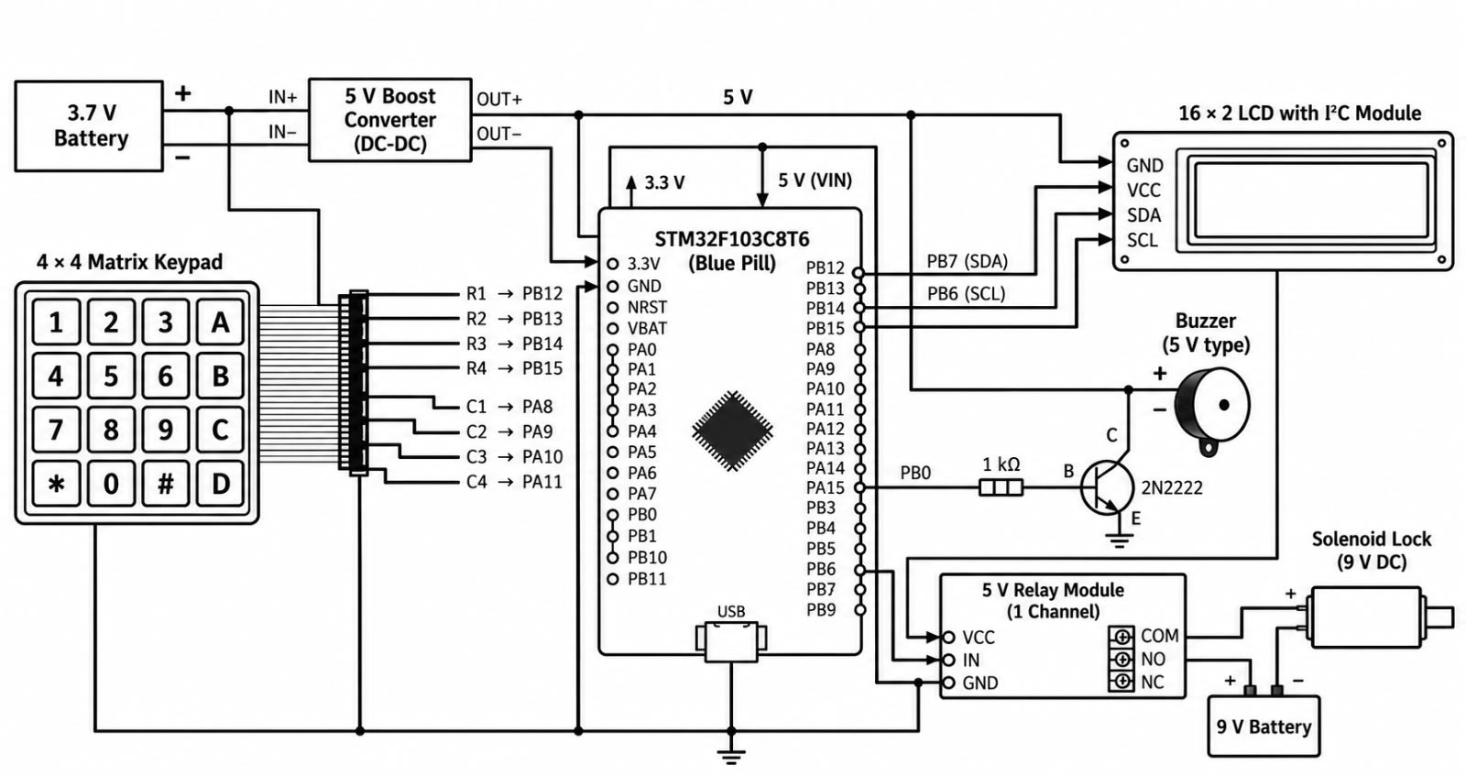
Circuit Diagram
10/26/2026
B.Tech CSE
11

Slide 12
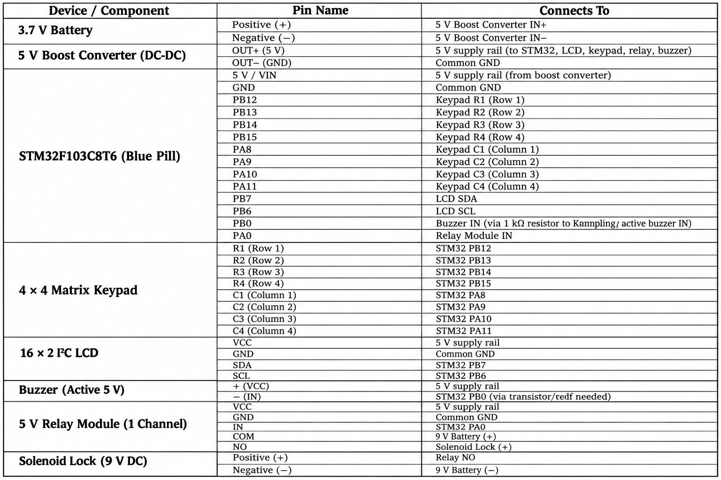
Pin Connections
10/26/2026
B.Tech CSE
12

Slide 13
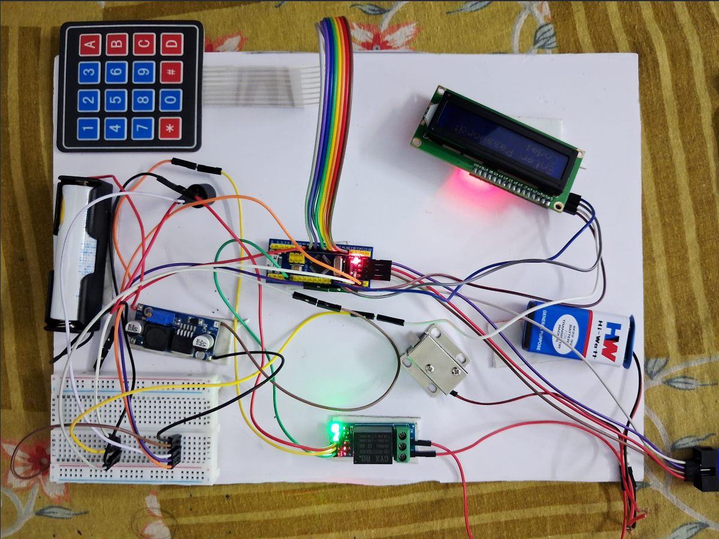
Output and Demonstration
10/26/2026
B.Tech CSE
13

Slide 14
Result Analysis
  The STM32 microcontroller controls the door-lock system.
  The keypad allows users to enter the password.
  The LCD displays password entry and access status.
  Correct password grants access to unlock the door.
  Incorrect password displays an error message.
  The locking mechanism is controlled through a suitable driver circuit.
  The system provides basic security for restricted access.
10/26/2026
B.Tech CSE
14

Slide 15
Challenges Faced and Solutions
  Incorrect keypad input: Verified wiring and corrected pin assignments.
  Lock not working: Checked the power supply and driver connections.
  Power supply issues: Ensured the correct voltage for each component.
  Code errors: Corrected the program and tested it again.
  LCD not displaying text: Checked I2C connections and adjusted the contrast.
  Loose connections: Reconnected jumper wires securely.
10/26/2026
B.Tech CSE
15

Slide 16
Conclusion
  The STM32-based password-protected door lock provides a simple and reliable security system.
  The system provides secure door access using password authentication.
  The STM32 microcontroller controls the entire system.
  The keypad allows users to enter the password.
  The LCD displays system status and messages.
  The relay controls the solenoid door lock.
  The buzzer provides audio feedback.
  The project improves security and reduces manual effort.
09/09/2026
B.Tech CSE
17

Slide 17
Future Scope
  Add a limited number of password attempts and a temporary lockout.
  Allow secure password changing instead of a fixed password in firmware.
  Add an alarm or event log for repeated incorrect attempts.
  Add RFID, Bluetooth or Wi-Fi monitoring if required and designed securely.
  Use a suitable enclosure, backup power and a mechanically safe lock arrangement.
10/26/2026
B.Tech CSE
18

Slide 18
Thank you
09/09/2026
B.Tech CSE
19

