Slide 1
MSc Project • 2026
Handwritten
Digit Recognition
Using HOG Features, Pixel Intensity & SVM
Anu Gopal V — MSc Data Science & Bio AI
Anamika A — MSc Computer Science (Data Analytics)
Ardra VS — MSc Data Analytics & Computational Science
MNIST
70,000 Images

Slide 2
Problem Statement
What are we solving?
Classification Task
Real-World Applications
Identify handwritten digits (0–9) from 28×28 grayscale images. Each image is classified into one of ten digit classes using machine learning.
🏦 Bank Cheque Reading
📮 Postal Code Sorting
INPUT: 784 pixel values → CLASSIFY → OUTPUT: Digit (0–9)
📄 Document Digitization
🔢 Form Data Entry
Dataset: MNIST via OpenML (Scikit-learn) — 70,000 images, 10 classes, 28×28 pixels

Slide 3
Dataset & Exploration
MNIST — Structure & Key Statistics
70,000
60,000
10,000
28×28 px
Total Samples
Training Set
Test Set
Image Size
Feature Details
Data Split (Notebook)
Property | Detail
Feature Type | Pixel Intensity (784 values)
Normalization | Standard Scaling
Classes | 10 (digits 0–9)
Task Type | Multi-class Classification
Train
49,000
70%
Validation
7,000
10%
Test
14,000
20%

Slide 4
Methodology Pipeline
End-to-end machine learning workflow
01
02
03
Problem
Definition
Data
Exploration
Feature
Extraction
Multi-class classification
of digits 0–9
MNIST analysis,
class distribution
HOG + Pixel
Intensity + PCA
04
05
06
Model
Training
Evaluation
Deployment
SVM, KNN, Logistic Regression,
Random Forest
Accuracy, Precision,
Recall, F1
Streamlit
Web App

Slide 5
Feature Extraction
HOG • Pixel Intensity • Zernike Moments • PCA
HOG Features
Pixel Intensity
Histogram of Oriented Gradients
Raw pixel values (784 features)
Captures edge structure and shape information from each image cell. Output shape: (49000, 1296) — 1,296 gradient features per image.
Each 28×28 image flattened to a 784-dimensional vector. Standard scaled for normalization before input to classifiers.
Zernike Moments
PCA Reduction
Shape descriptors
Principal Component Analysis
25 rotation-invariant moments describing image shape. Used alongside HOG for richer structural representation.
HOG features reduced to 100 principal components explaining 75.28% of variance. Final train shape: (49000, 100).

Slide 6
Model Training
Four classifiers trained on HOG + PCA features
Model | Train Time | Hyperparameters | Val Accuracy
SVM | 5.55s | C = 1.0 (tuned: C = 100) | 96.31%
KNN | 0.02s | n_neighbors = 5 | 97.89%
Logistic Regression | 4.97s | C = 1.0, max_iter = 1000 | 96.57%
Random Forest | 9.25s | n_estimators = 50 | 96.01%
Training Pipeline
1. Load MNIST → 2. Normalize pixels → 3. Extract HOG → 4. Apply PCA (100 components) → 5. Fit classifiers → 6. Save .pkl models

Slide 7
Model Performance Results
Evaluated on unseen test data — Accuracy · Precision · Recall · F1
🏆 Best Model
KNN
97.89% Accuracy
Precision
Correct positive predictions
Recall
True positives captured
F1-Score
Harmonic mean of P & R

Slide 8
Deployment
Streamlit Web Application — Live Predictions
🌐 https://handwritten-digit-recognition-duk.streamlit.app/
📤 Image Upload
🤖 Model Choice
Upload PNG / JPG handwritten digit images for instant classification
Switch between KNN, SVM, Logistic Regression and Random Forest
🖼️ Image Preview
⚡ Real-time Results
View the processed (normalized) image used for prediction
Instant digit classification with model confidence output

Slide 9
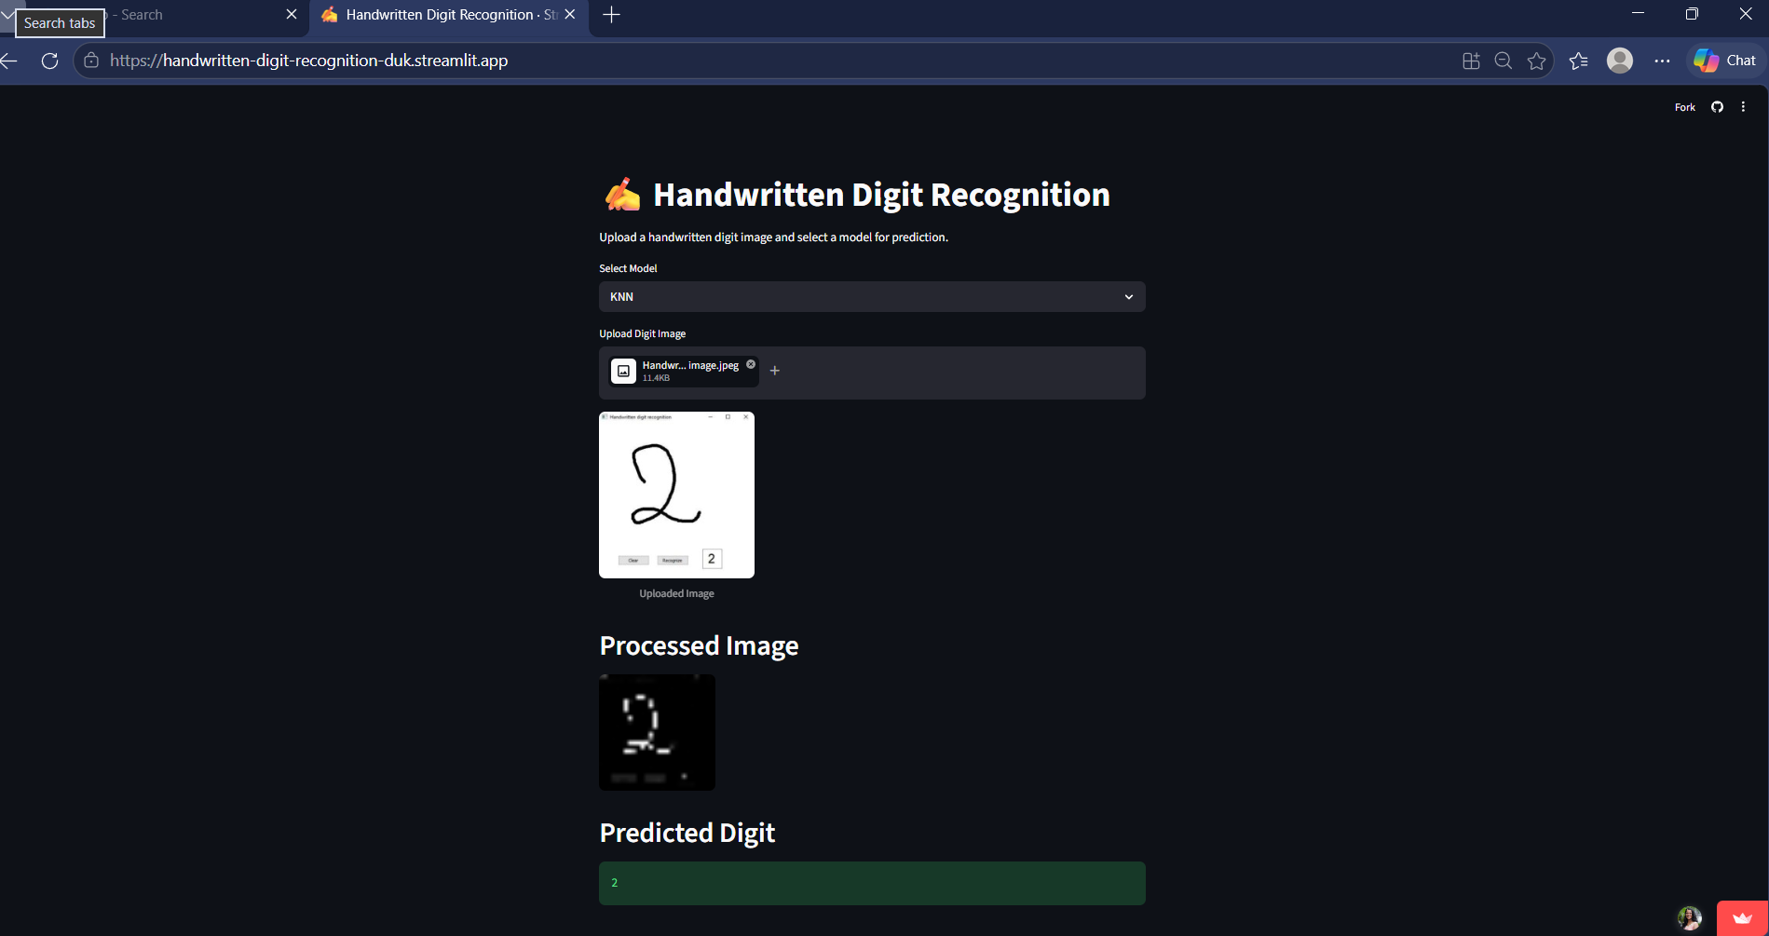

Slide 10
Key Takeaways
1
KNN led with 97.98% accuracy
All four models exceeded 96% — a strong baseline for handwritten digit recognition.
2
HOG features proved highly effective
Capturing edge and shape structure from digit images significantly boosted classifier performance.
3
PCA improved efficiency
Reducing 1,296 HOG features to 100 principal components (75.28% variance) cut training time with negligible accuracy loss.
4
End-to-end pipeline deployed
Streamlit app enables real-time predictions with selectable models — accessible from any browser.
GitHub: anamikaa0818-hash / Handwritten-Digit-Recognition-Using-HOG-Pixel-Intensity-and-SVM

