Slide 1
Digital Alpha Platforms
Project Assessment
-by Anamika Kumari (20AE10003)
Objective: To observe the given housing dataset by Zillow and gain some insights about it using python.

Slide 2
APPROACH:
Read all the csv files
Data observation
Data cleaning and processing
Data visualisation
Gain insights
Platform used: Google colab
Libraries used: pandas, seaborn, matplotlib, os, numpy
Github link: https://github.com/anamikak22/Digital-Alpha-Assessment

Slide 3
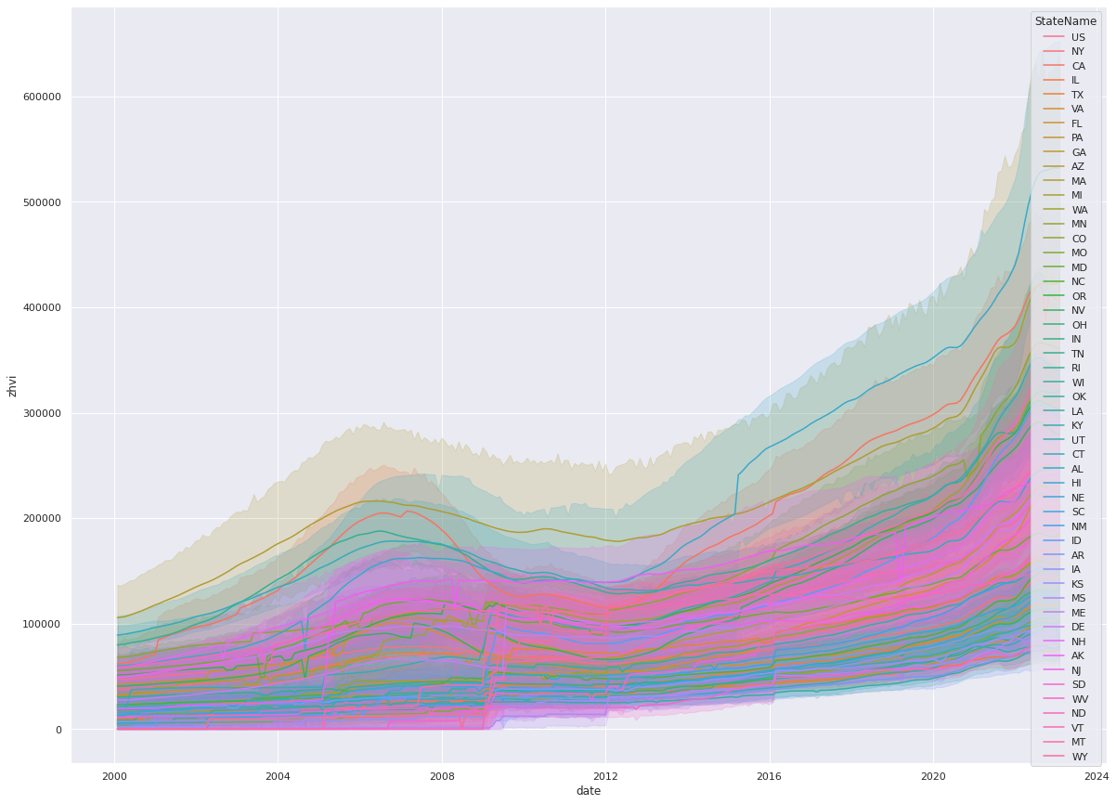
DATA VISUALISATION
Insights:
This is the plot of ZHVI vs date for various State Names for Low-tier homes.
We can see that upto 2006, the ZHVI value is increasing and after that it starts to decrease upto 2012 and then again starts rising for almost every state.

Slide 4
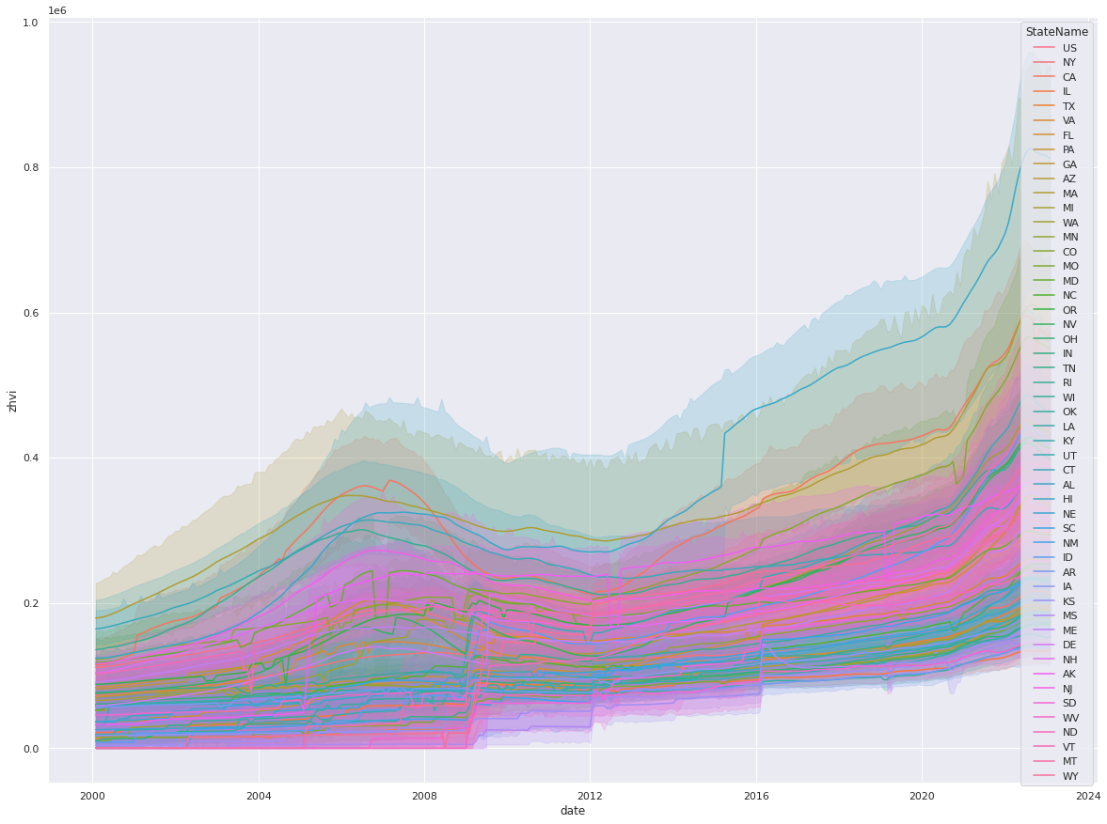
DATA VISUALISATION
Insights:
This is the plot of ZHVI vs date for various State Names for Mid-tier homes.
We can see the similar behaviour of ZHVI values varied across time as seen for Low-tier homes.
Similar behaviour is also observed for High-Tier homes.
The only difference is that the ZHVI values are greatest for High-tier and lowest for low-tier.

Slide 5
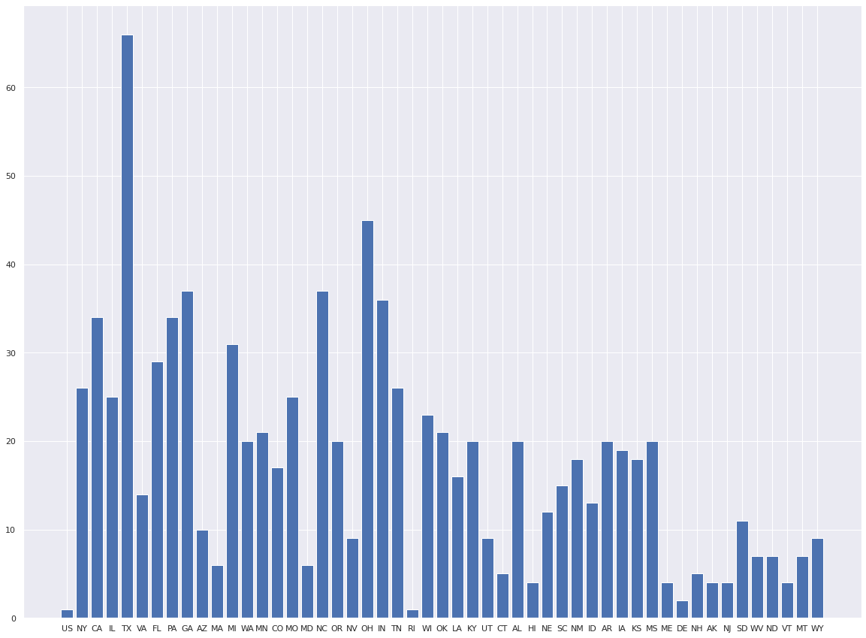
DATA VISUALISATION
Insights:
This is the bar plot of number of homes in different states.
TX is observed to have the highest number of homes followed by OH.
Similar approach can be applied to the other datasets and trend for the home market values, rental values and sale prices can be observed for different regions and different houses with different number of families, bedrooms, etc.

Slide 6
THANK YOU

