Slide 1
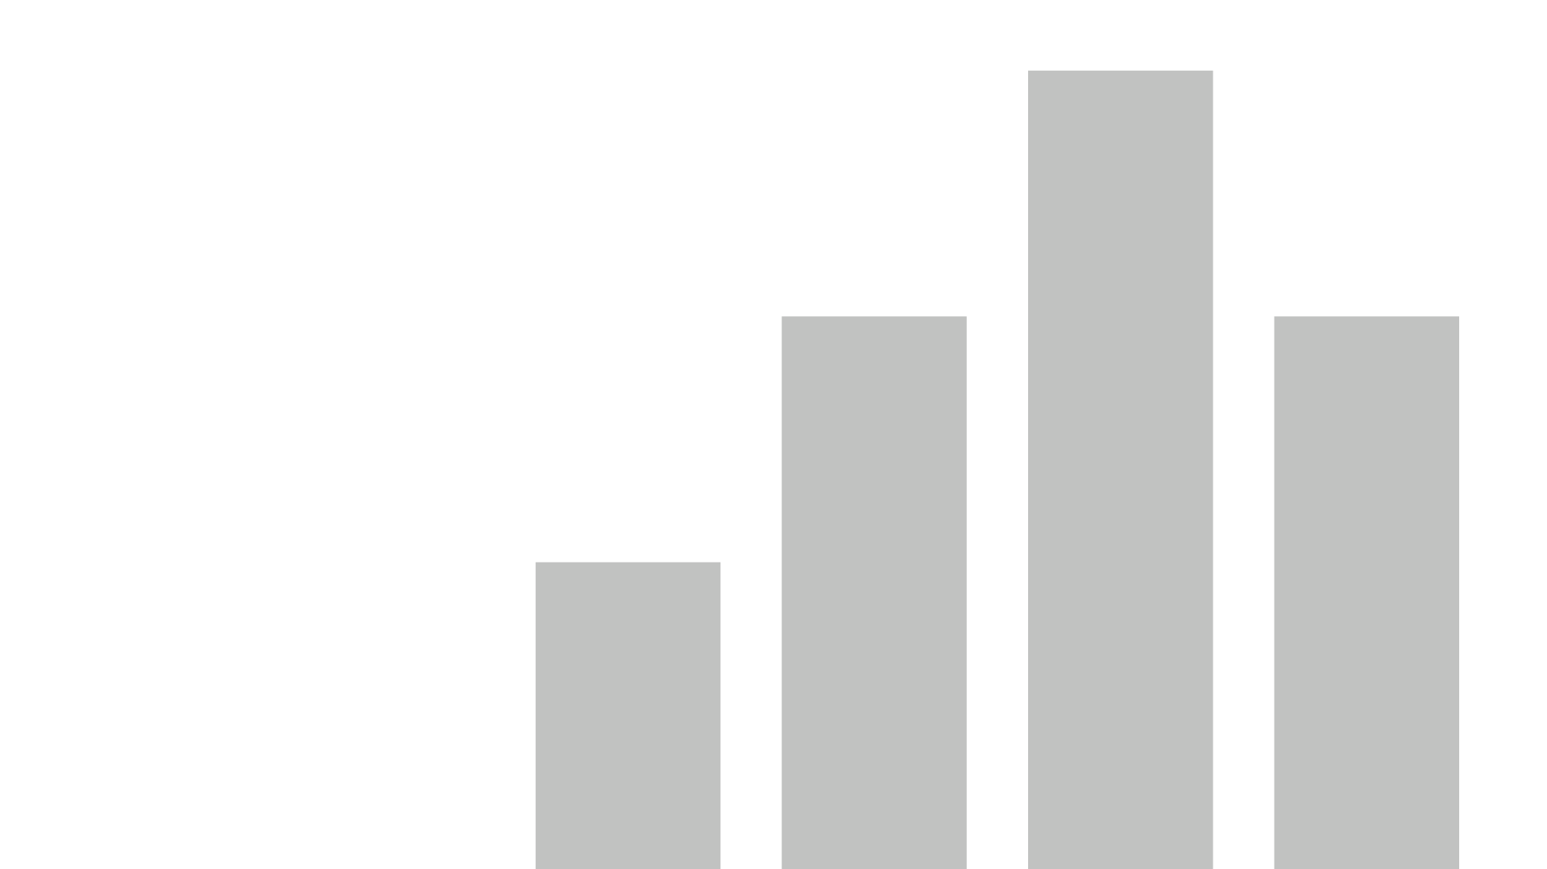


Coinbase_Data_Report
View in Power BI
Last data refresh:
9/14/2023 4:30:40 AM UTC
Downloaded at:
9/21/2023 2:26:29 AM UTC

Slide 2
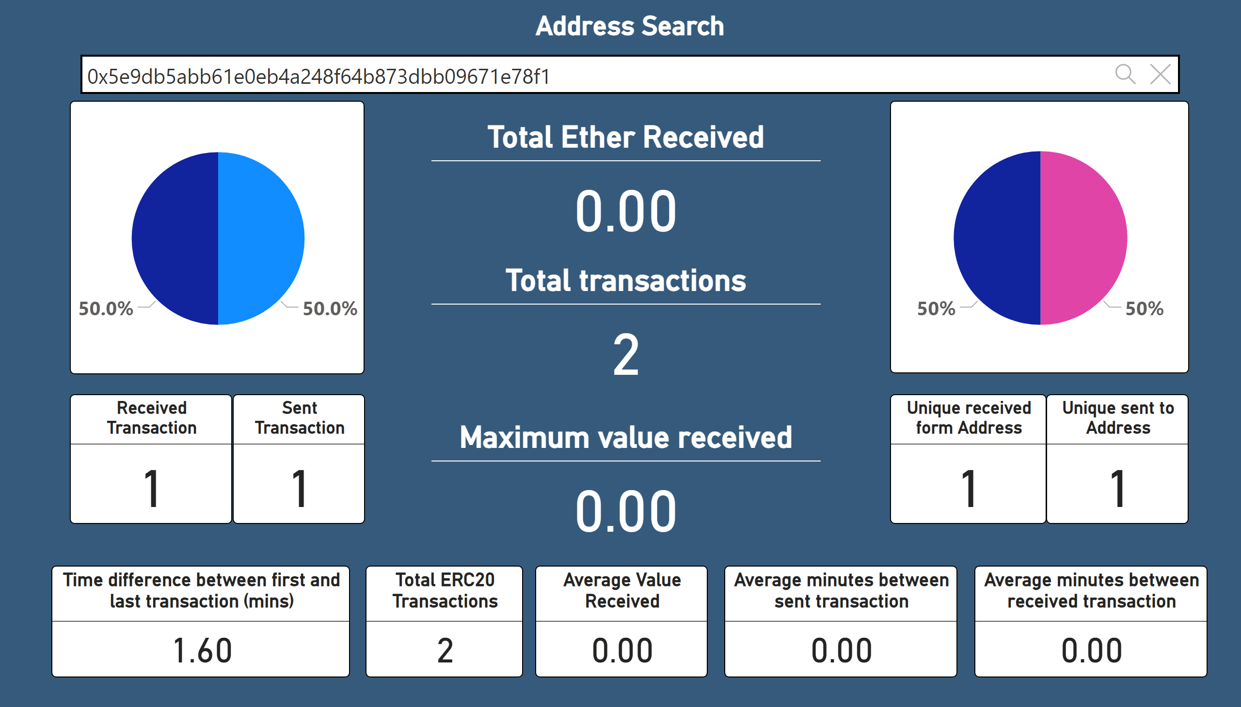
Illicit_add_search
Notes:
Address Search
No alt text provided
Received Transaction
No alt text provided
Sent Transaction
No alt text provided
Total Ether Received
No alt text provided
Total transactions
No alt text provided
Maximum value received
No alt text provided
Unique received form Address
No alt text provided
Ratio: Unique received to unique sent
No alt text provided
Unique sent to Address
No alt text provided
Ratio: Unique received to unique sent
No alt text provided
Time difference between first and last transaction (mins)
No alt text provided
Total ERC20 Transactions
No alt text provided
Average Value Received
No alt text provided
Average minutes between sent transaction
No alt text provided
Average minutes between received transaction
No alt text provided

Slide 3
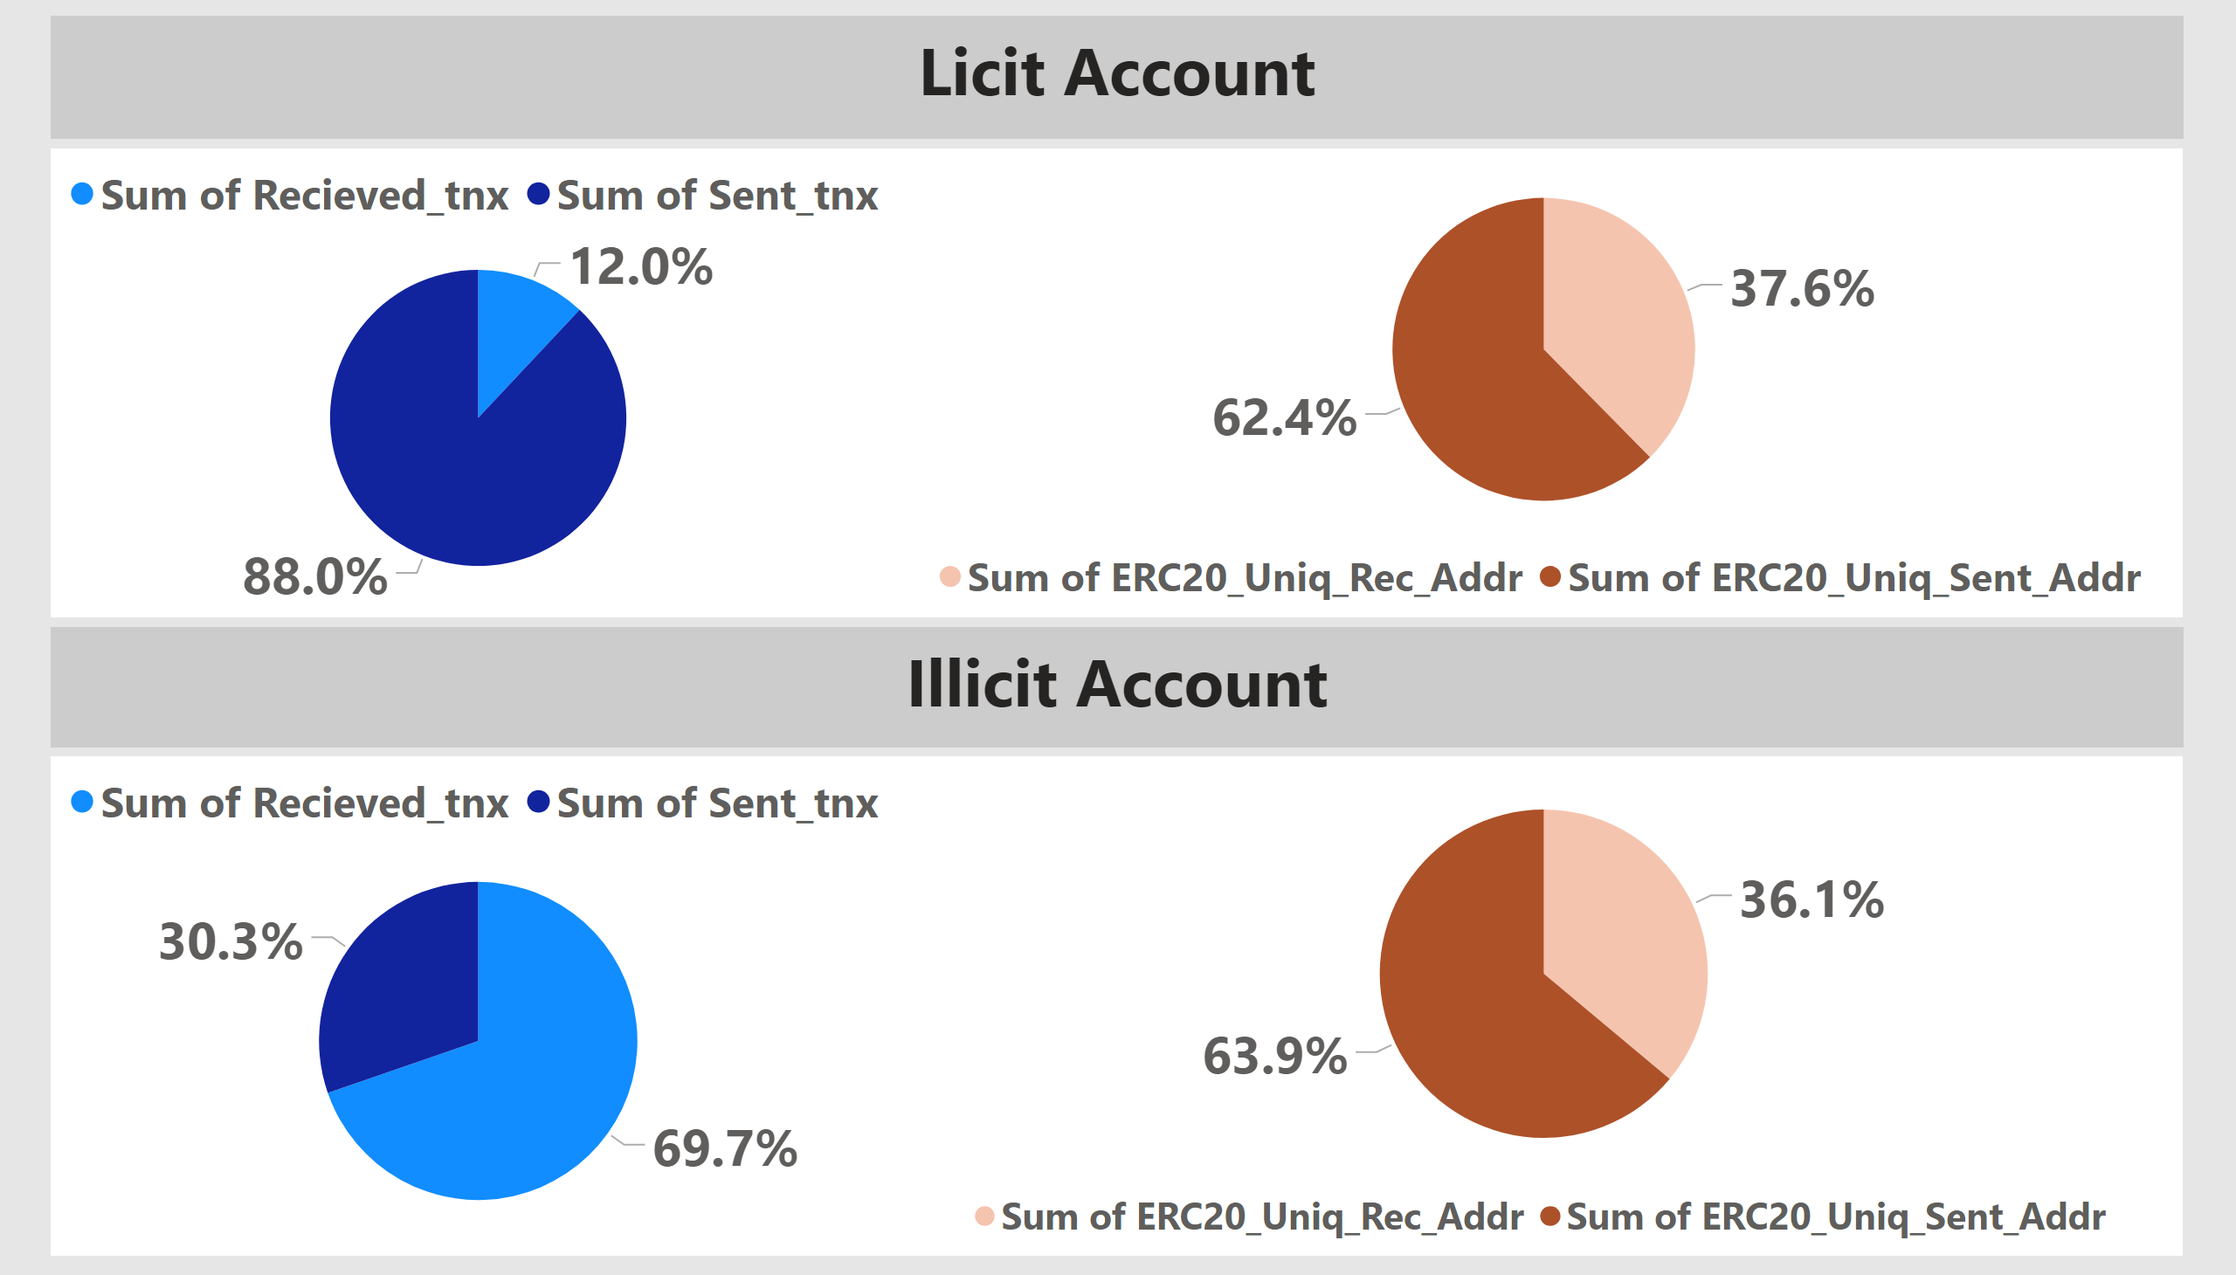
Piecharts
Notes:
textbox
No alt text provided
textbox
No alt text provided
Licit Accounts
No alt text provided
Licit Accounts
No alt text provided
Illicit Accounts
No alt text provided
Illicit Accounts
No alt text provided

Slide 4
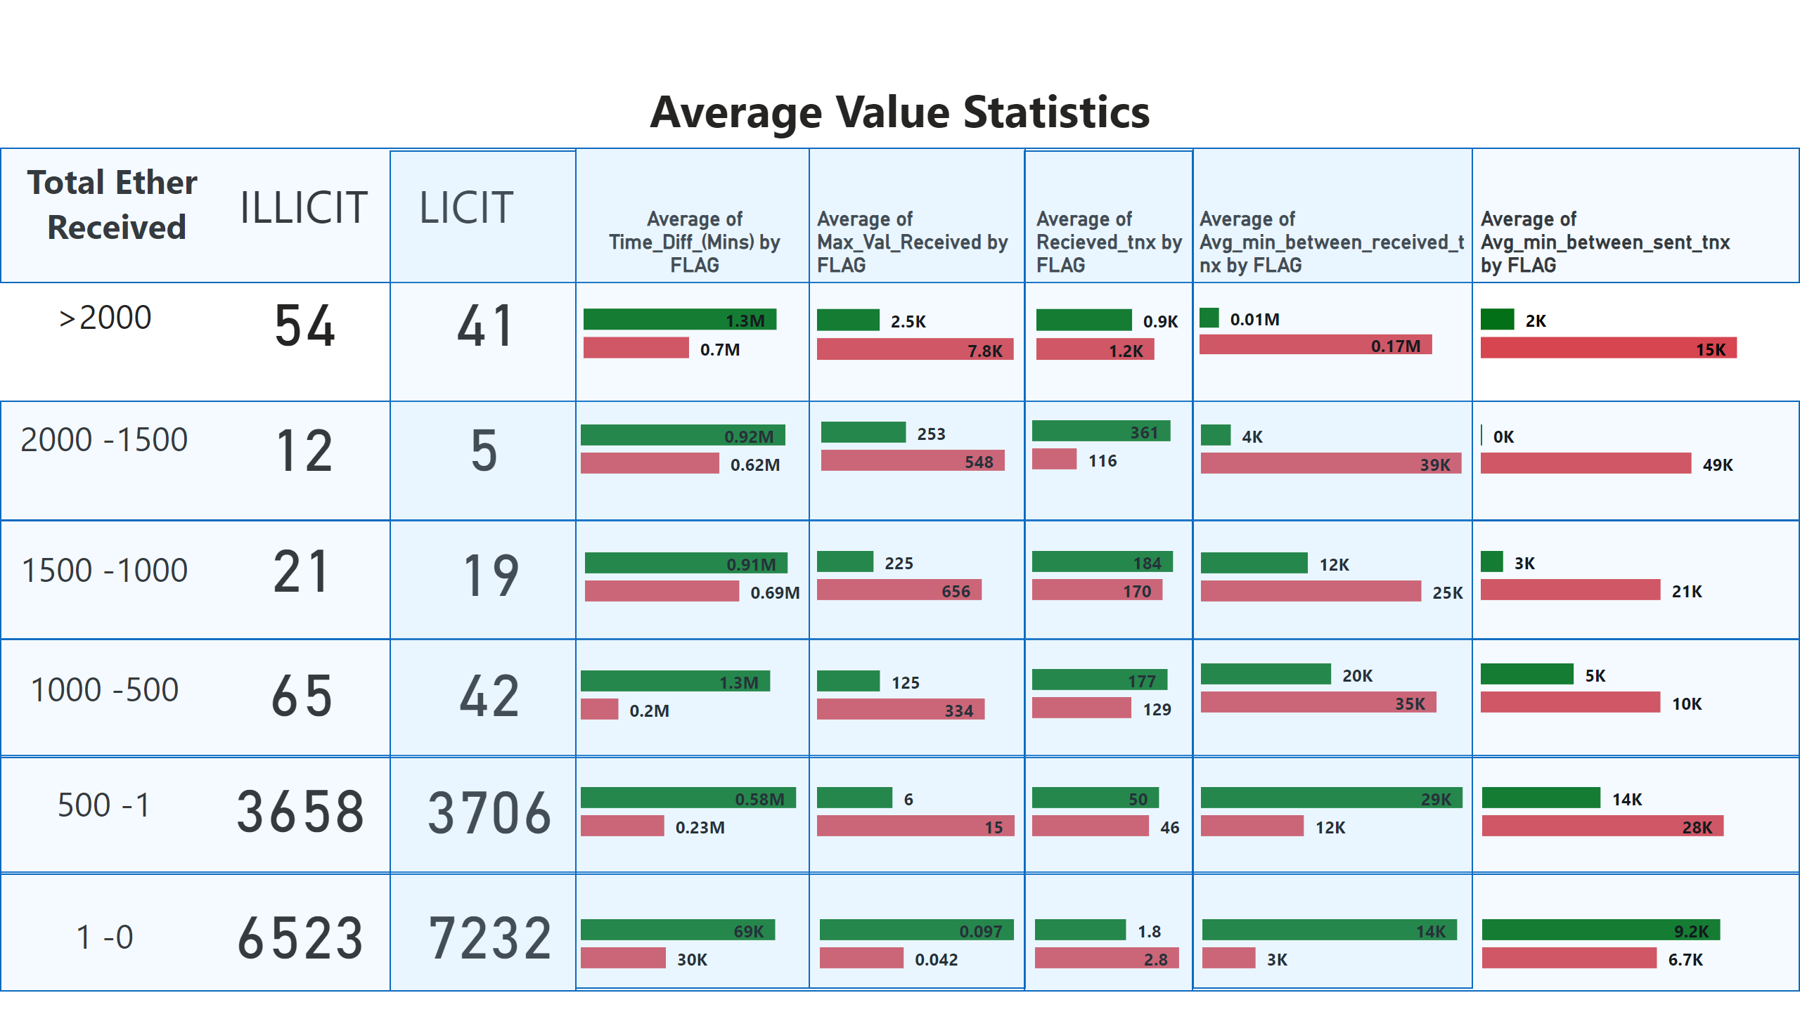
Average Value Statistics
Notes:
shape
No alt text provided
shape
No alt text provided
shape
No alt text provided
shape
No alt text provided
shape
No alt text provided
shape
No alt text provided
shape
No alt text provided
shape
No alt text provided
shape
No alt text provided
shape
No alt text provided
shape
No alt text provided
textbox
No alt text provided
textbox
No alt text provided
textbox
No alt text provided
textbox
No alt text provided
textbox
No alt text provided
textbox
No alt text provided
textbox
No alt text provided
textbox
No alt text provided
textbox
No alt text provided
textbox
No alt text provided
barChart
No alt text provided
barChart
No alt text provided
barChart
No alt text provided
barChart
No alt text provided
barChart
No alt text provided
barChart
No alt text provided
barChart
No alt text provided
barChart
No alt text provided
barChart
No alt text provided
barChart
No alt text provided
barChart
No alt text provided
barChart
No alt text provided
barChart
No alt text provided
barChart
No alt text provided
barChart
No alt text provided
barChart
No alt text provided
barChart
No alt text provided
barChart
No alt text provided
barChart
No alt text provided
barChart
No alt text provided
barChart
No alt text provided
barChart
No alt text provided
barChart
No alt text provided
barChart
No alt text provided
barChart
No alt text provided
card
No alt text provided
card
No alt text provided
card
No alt text provided
card
No alt text provided
card
No alt text provided
card
No alt text provided
card
No alt text provided
card
No alt text provided
card
No alt text provided
card
No alt text provided
card
No alt text provided
card
No alt text provided
barChart
No alt text provided
barChart
No alt text provided
barChart
No alt text provided
barChart
No alt text provided
Average of Time_Diff_(Mins) by FLAG
No alt text provided

Slide 5
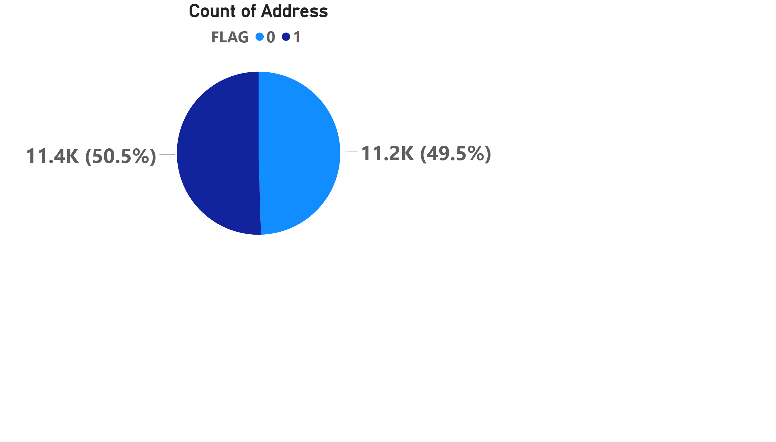
Big pie illicit and licit
Notes:
Count of Address
No alt text provided

Slide 6
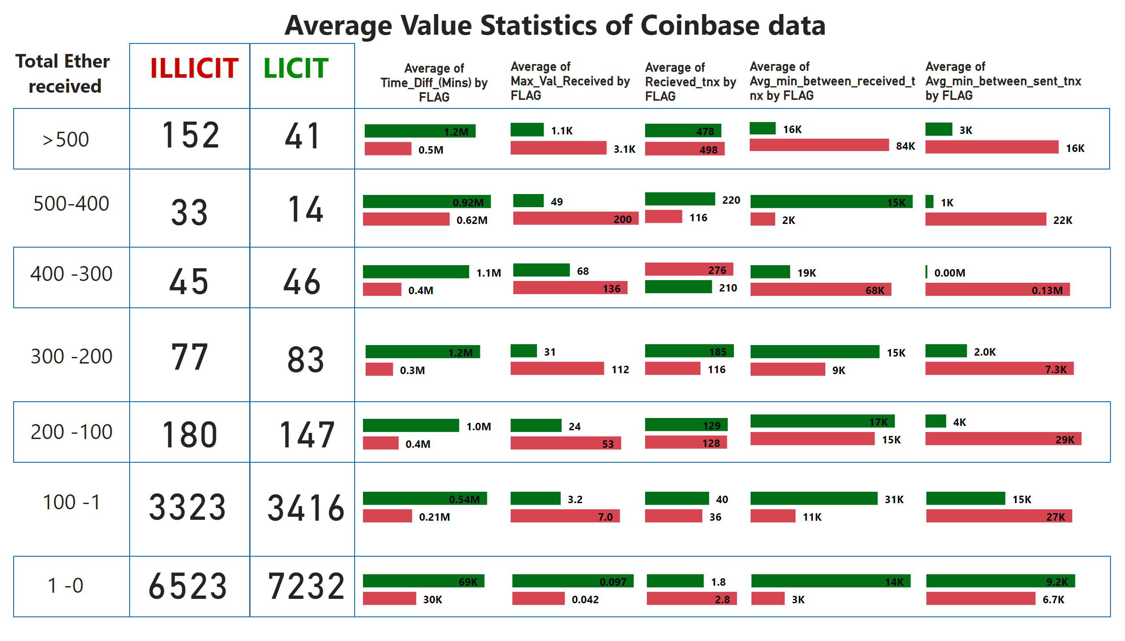
Average Value Statistics less group
Notes:
shape
No alt text provided
shape
No alt text provided
shape
No alt text provided
shape
No alt text provided
shape
No alt text provided
shape
No alt text provided
textbox
No alt text provided
barChart
No alt text provided
barChart
No alt text provided
barChart
No alt text provided
barChart
No alt text provided
barChart
No alt text provided
card
No alt text provided
card
No alt text provided
textbox
No alt text provided
textbox
No alt text provided
textbox
No alt text provided
textbox
No alt text provided
textbox
No alt text provided
textbox
No alt text provided
textbox
No alt text provided
textbox
No alt text provided
textbox
No alt text provided
textbox
No alt text provided
barChart
No alt text provided
barChart
No alt text provided
barChart
No alt text provided
barChart
No alt text provided
barChart
No alt text provided
barChart
No alt text provided
barChart
No alt text provided
barChart
No alt text provided
barChart
No alt text provided
barChart
No alt text provided
barChart
No alt text provided
barChart
No alt text provided
barChart
No alt text provided
barChart
No alt text provided
barChart
No alt text provided
barChart
No alt text provided
barChart
No alt text provided
barChart
No alt text provided
barChart
No alt text provided
barChart
No alt text provided
barChart
No alt text provided
barChart
No alt text provided
barChart
No alt text provided
barChart
No alt text provided
barChart
No alt text provided
card
No alt text provided
card
No alt text provided
card
No alt text provided
card
No alt text provided
card
No alt text provided
card
No alt text provided
card
No alt text provided
card
No alt text provided
card
No alt text provided
card
No alt text provided
card
No alt text provided
card
No alt text provided
barChart
No alt text provided
barChart
No alt text provided
barChart
No alt text provided
barChart
No alt text provided
Average of Time_Diff_(Mins) by FLAG
No alt text provided

Slide 7
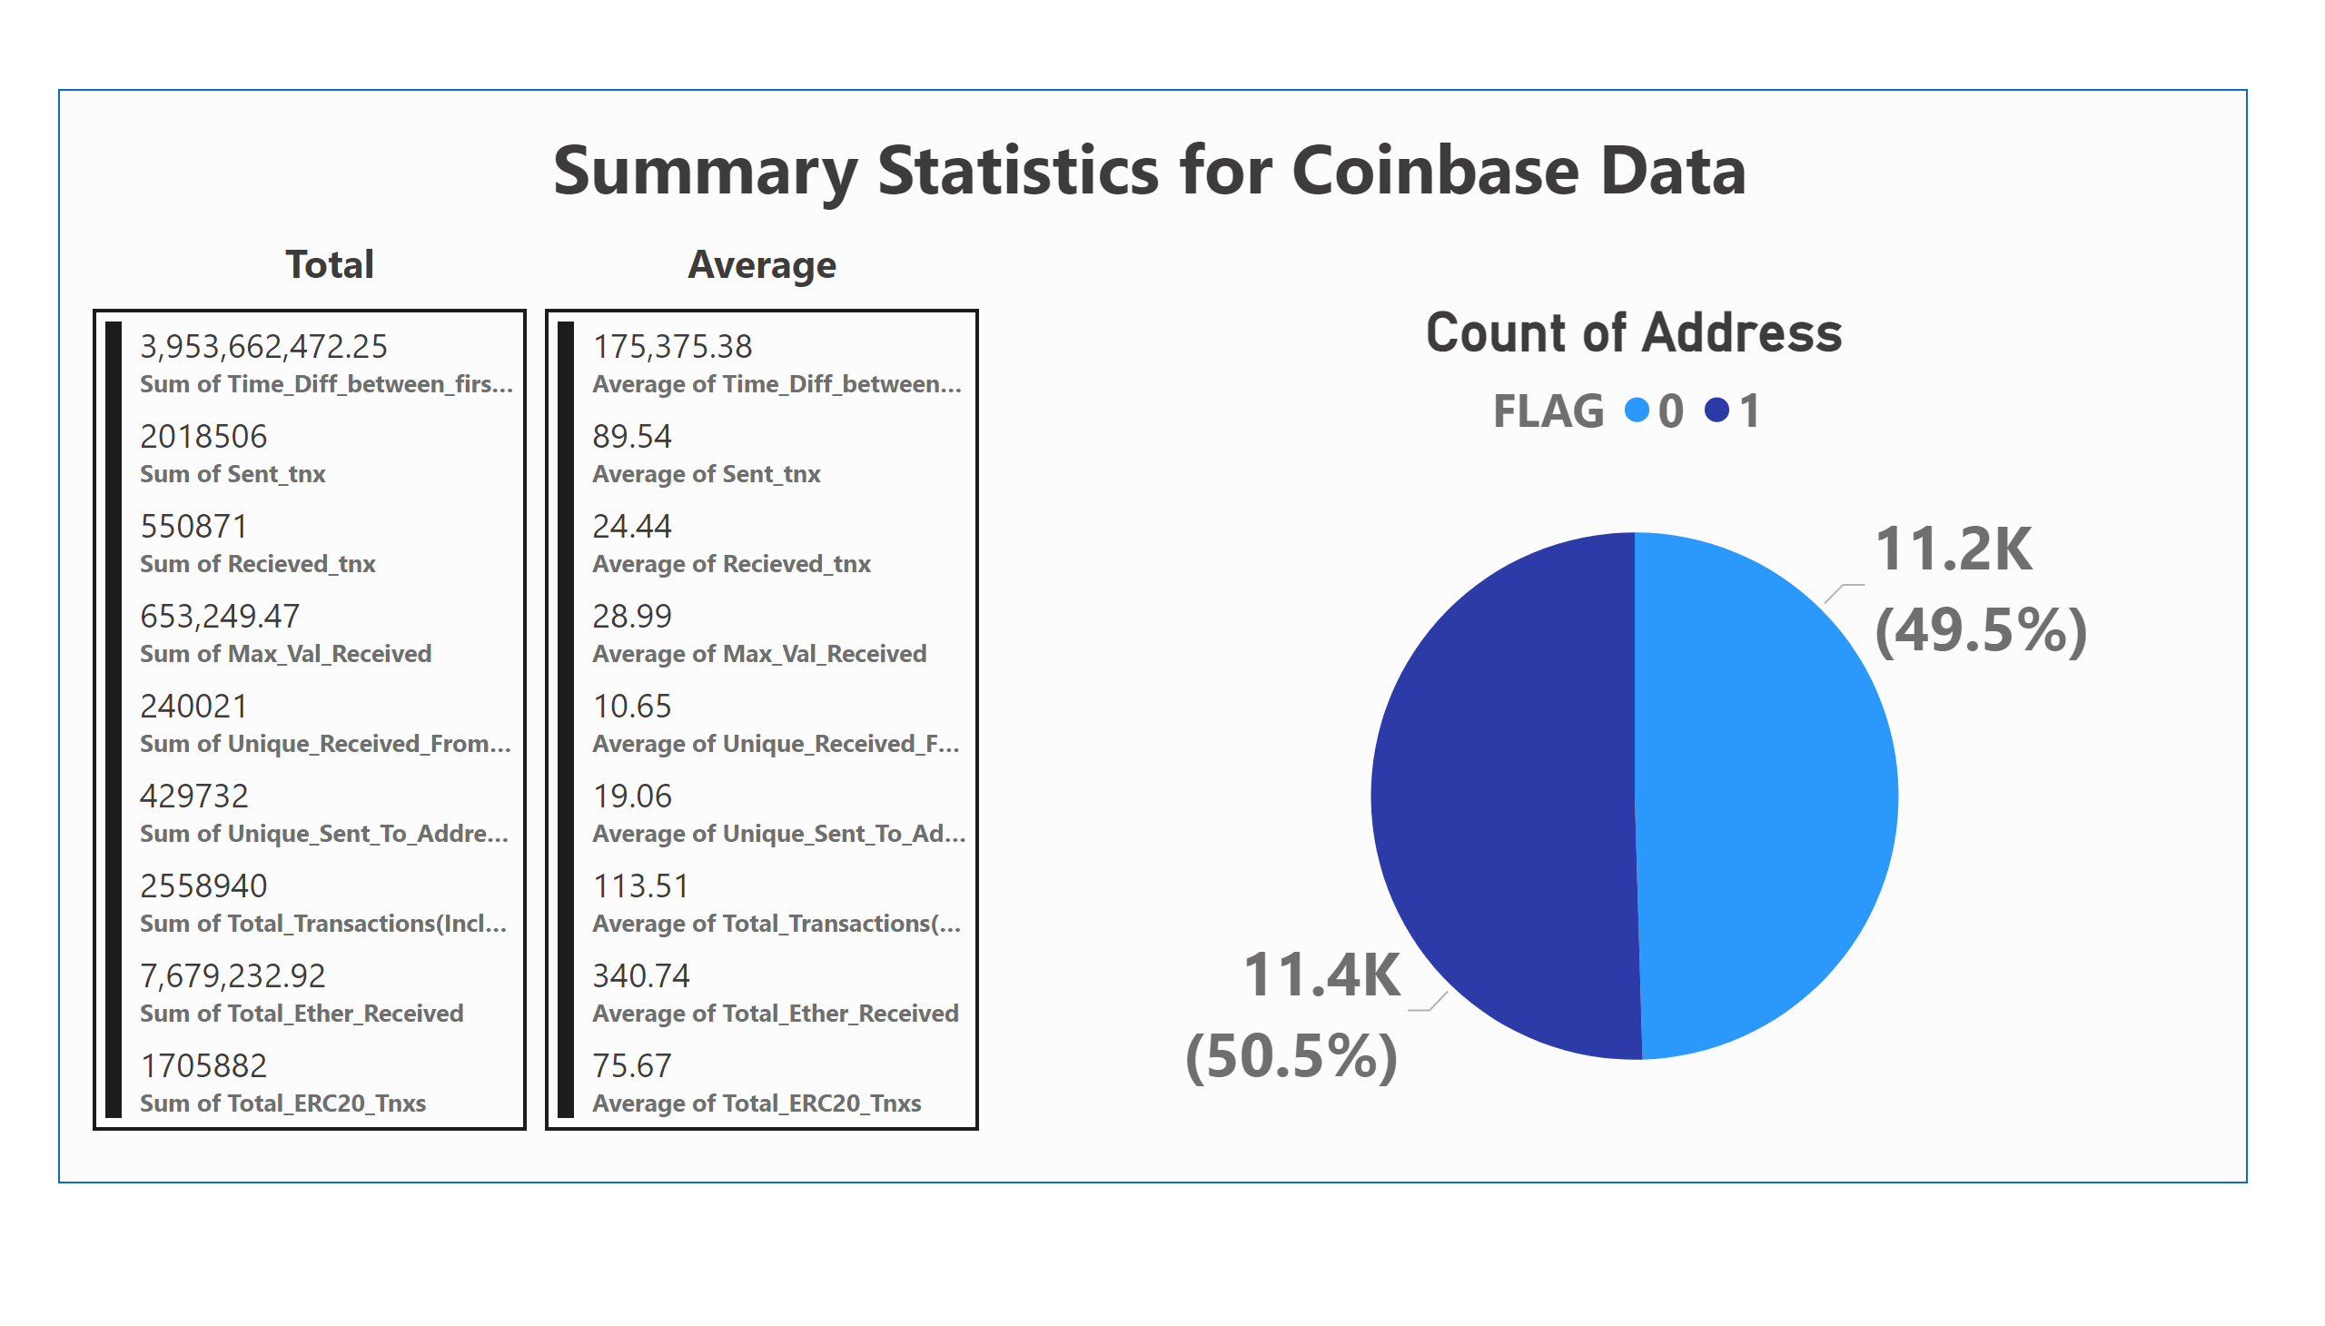
Summary stats coinbase
Notes:
textbox
No alt text provided
textbox
No alt text provided
textbox
No alt text provided
multiRowCard
No alt text provided
multiRowCard
No alt text provided
Count of Address
No alt text provided
shape
No alt text provided

