Slide 1



Common_Accounts_dash
View in Power BI
Last data refresh:
8/24/2023 3:03:33 PM UTC
Downloaded at:
9/21/2023 2:29:57 AM UTC

Slide 2
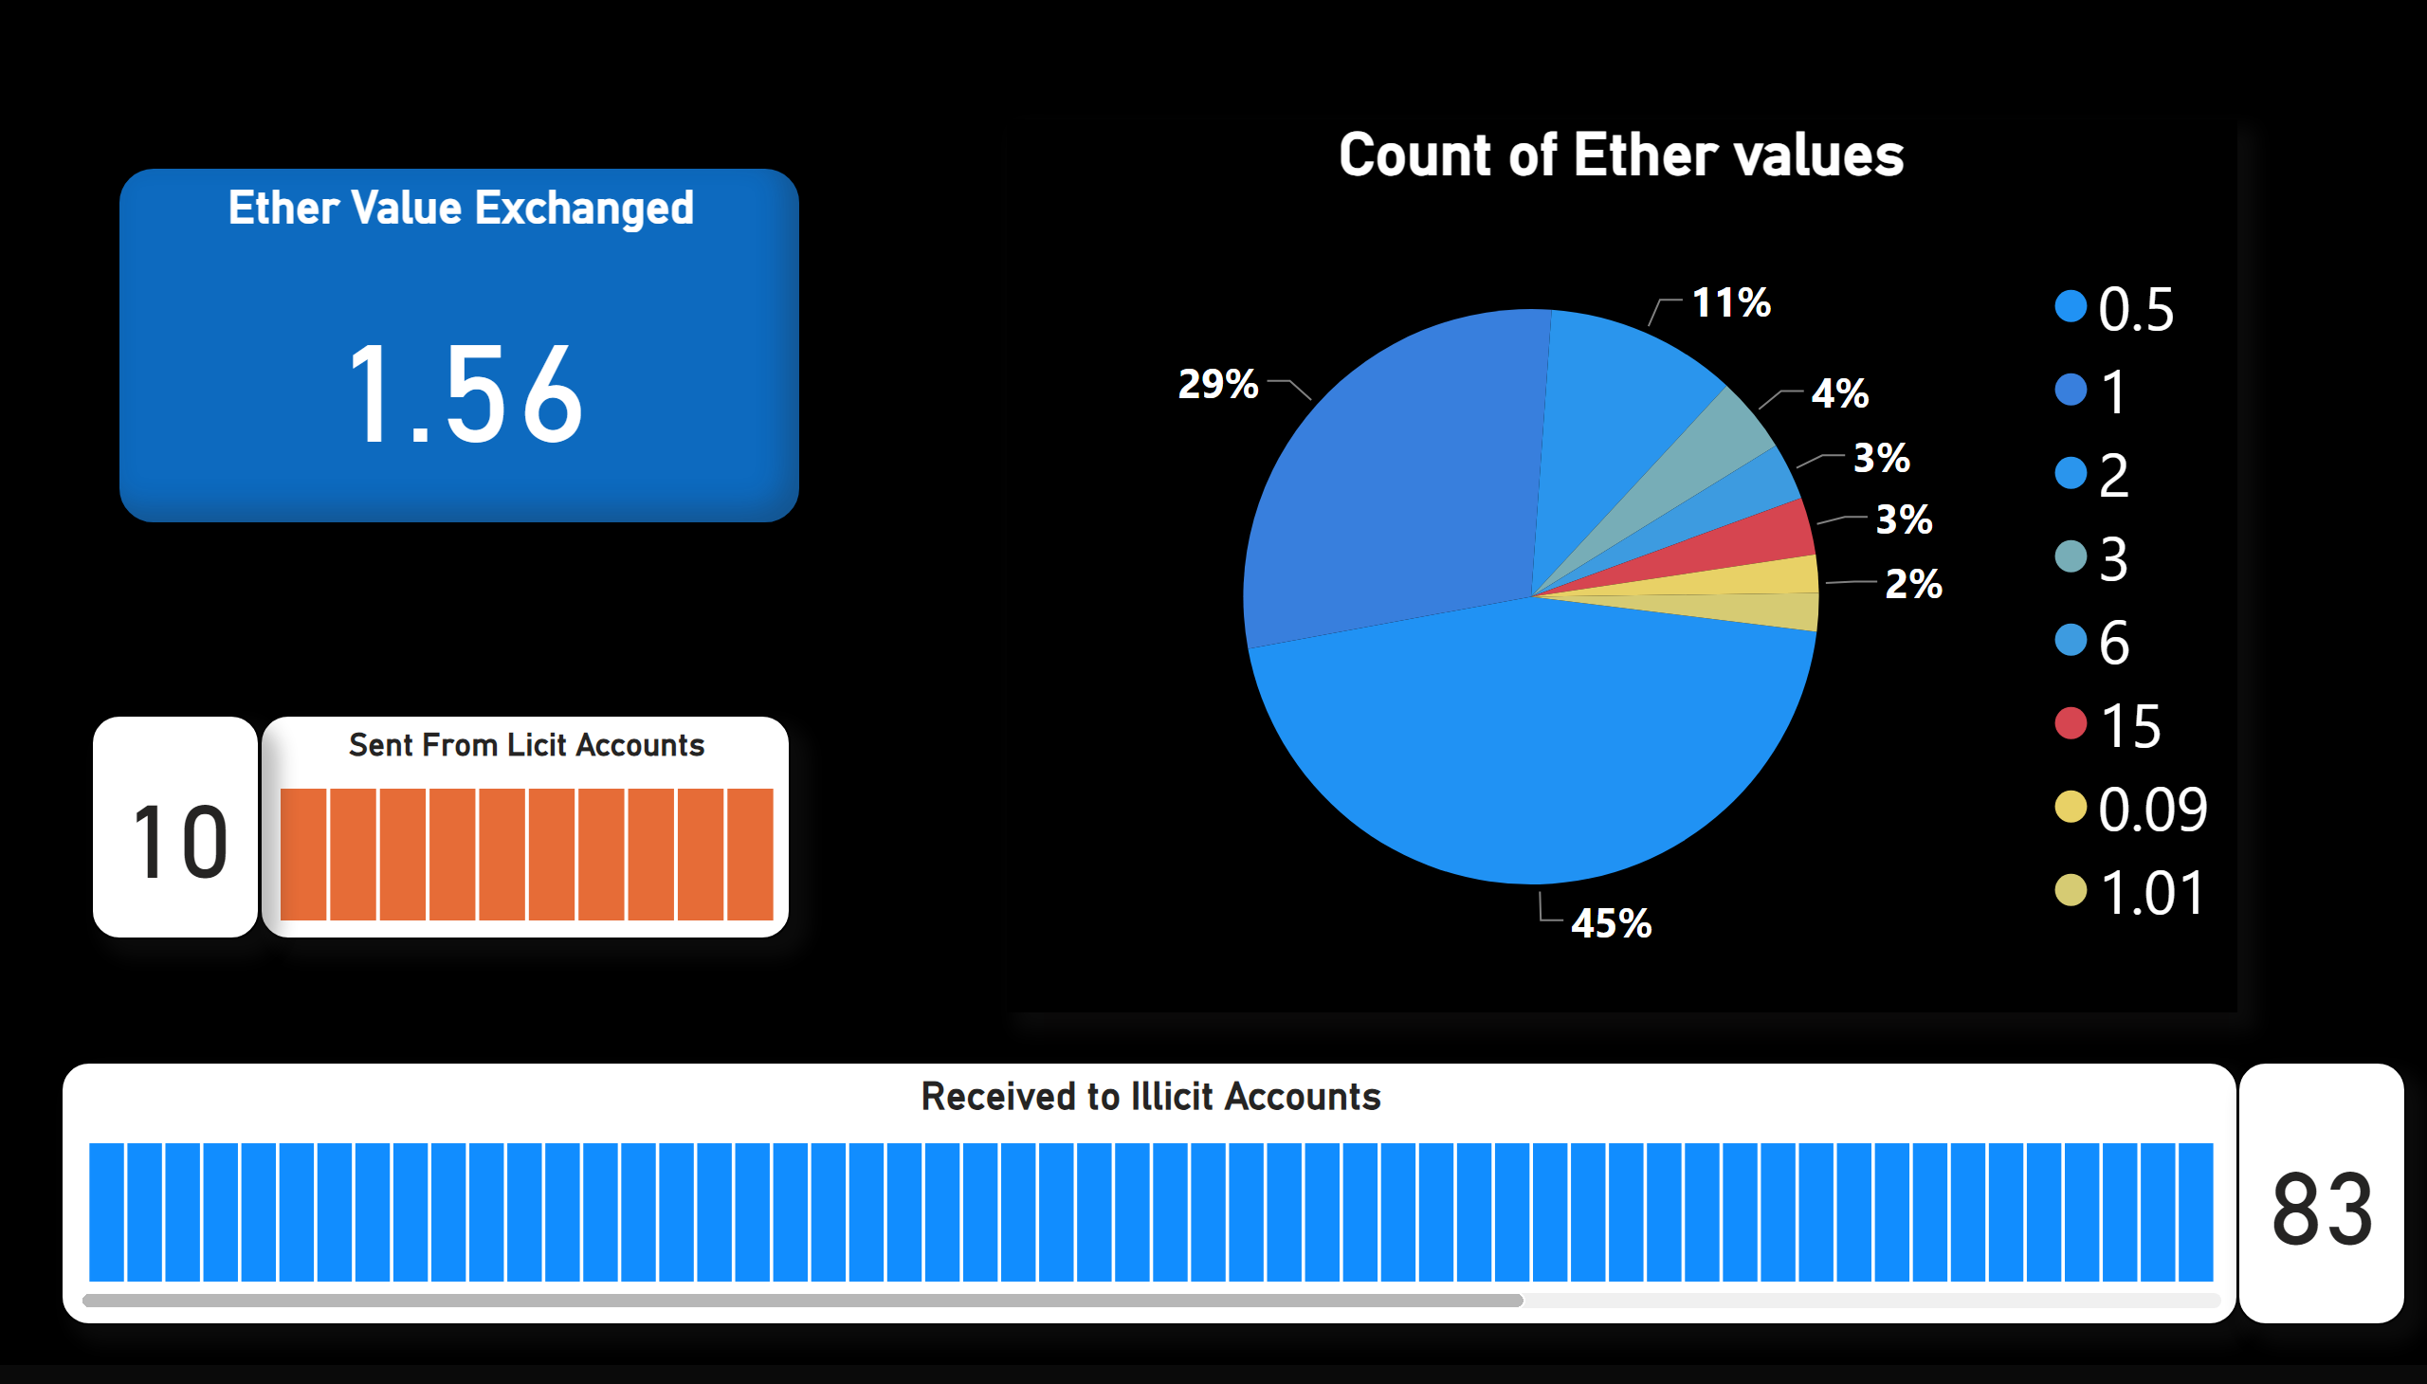
Page 2
Notes:
Count of Ether values
No alt text provided
Received to Illicit Accounts
No alt text provided
Sent From Licit Accounts
No alt text provided
Count ( Sent From Address )
No alt text provided
Count ( Sent From Address )
No alt text provided
Ether Value Exchanged
No alt text provided

