Slide 1



Random_sample_statistics
View in Power BI
Last data refresh:
9/14/2023 7:36:17 PM UTC
Downloaded at:
9/21/2023 2:28:24 AM UTC

Slide 2
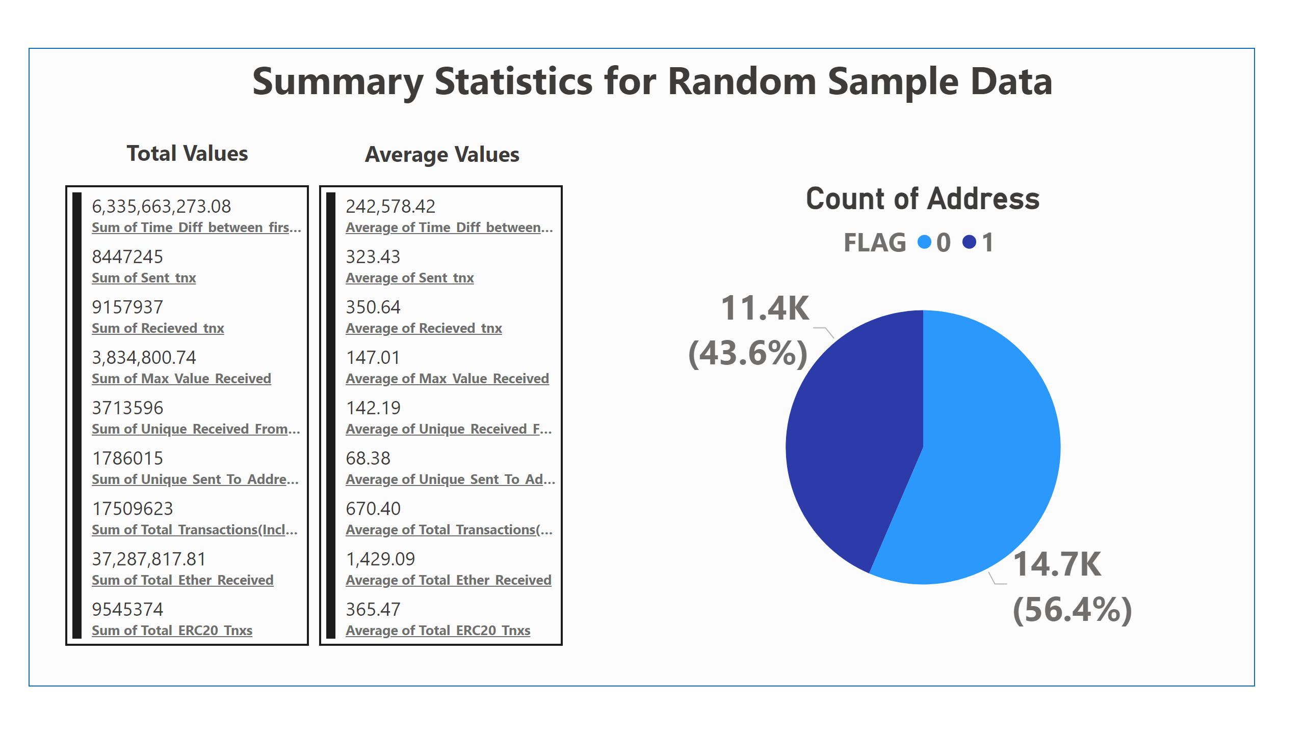
Summary Statitics
Notes:
multiRowCard
No alt text provided
textbox
No alt text provided
multiRowCard
No alt text provided
textbox
No alt text provided
textbox
No alt text provided
shape
No alt text provided
Count of Address
No alt text provided

Slide 3
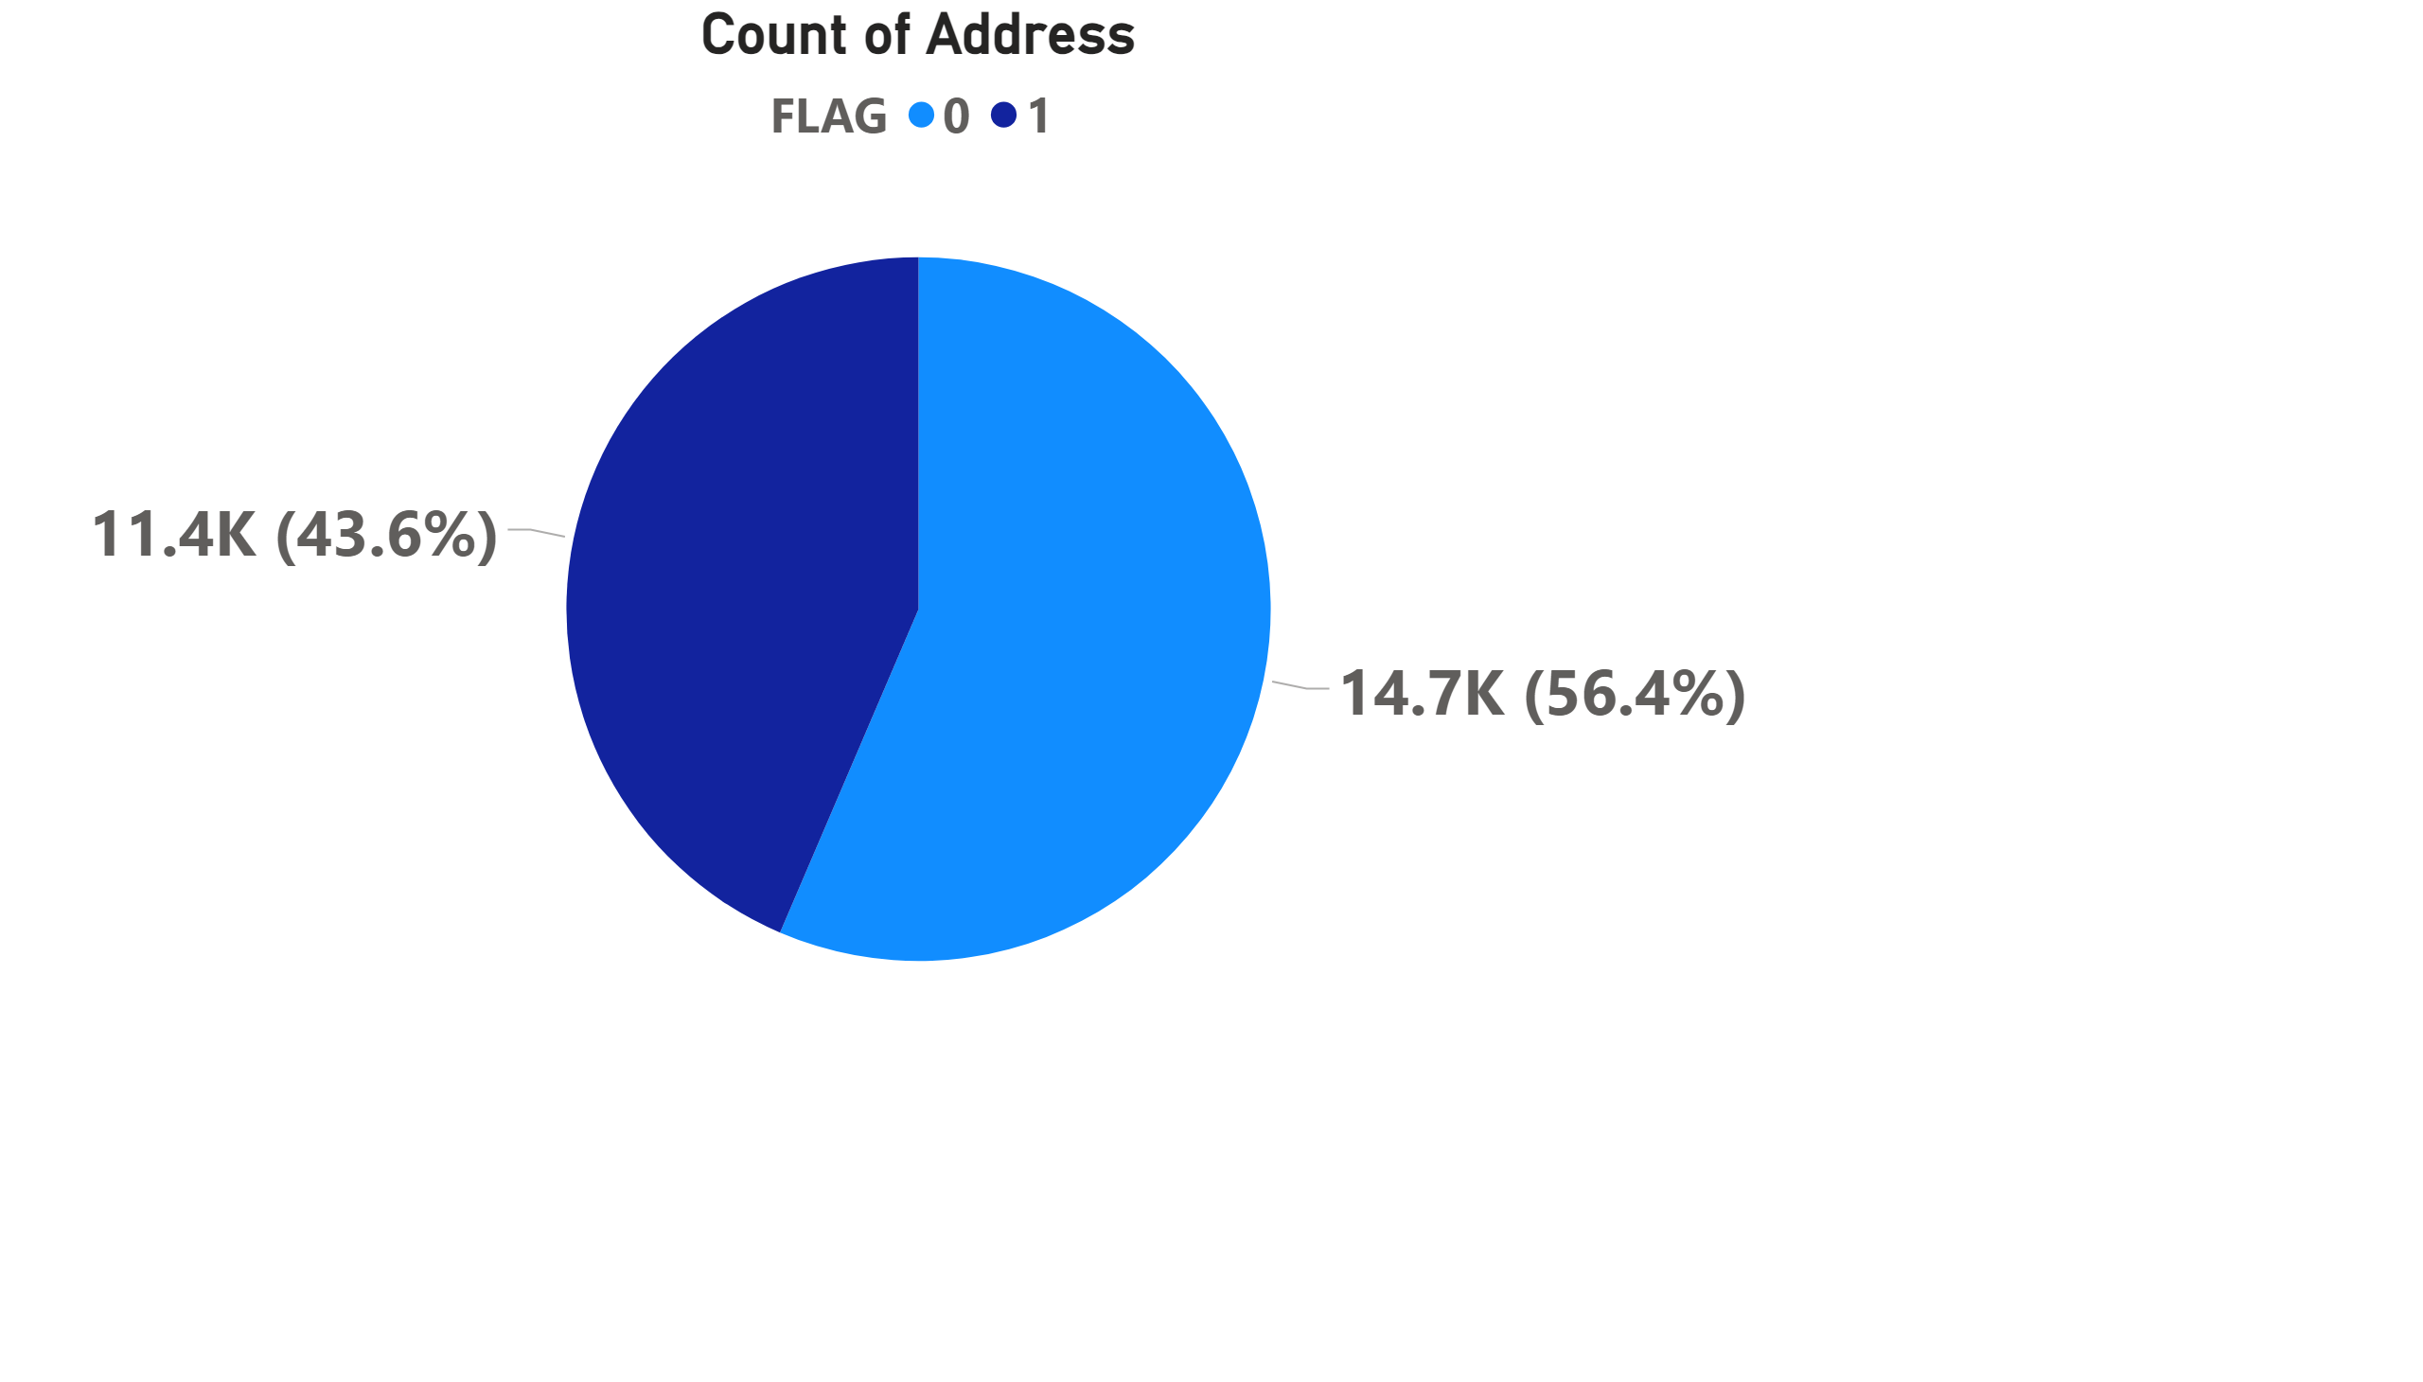
Big Pie illicit and licit
Notes:
Count of Address
No alt text provided

Slide 4
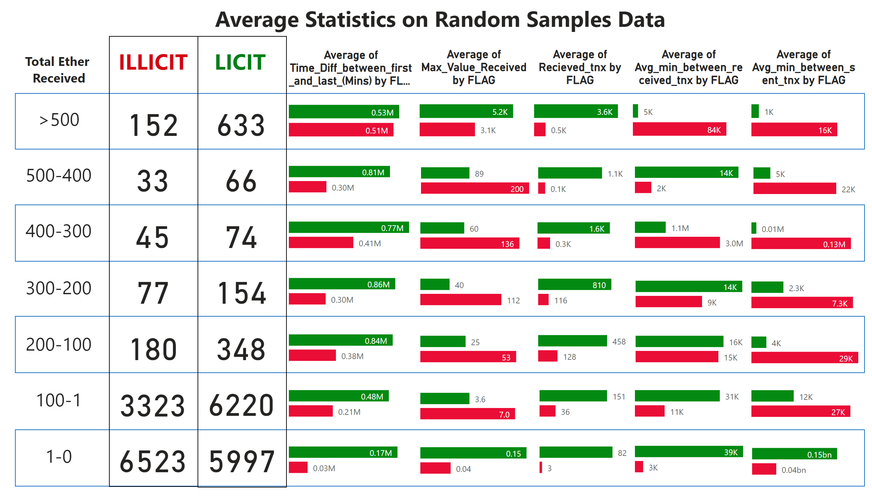
Average stats on random sample
Notes:
card
No alt text provided
card
No alt text provided
card
No alt text provided
card
No alt text provided
card
No alt text provided
card
No alt text provided
card
No alt text provided
card
No alt text provided
card
No alt text provided
card
No alt text provided
card
No alt text provided
card
No alt text provided
textbox
No alt text provided
textbox
No alt text provided
textbox
No alt text provided
textbox
No alt text provided
textbox
No alt text provided
textbox
No alt text provided
textbox
No alt text provided
textbox
No alt text provided
textbox
No alt text provided
textbox
No alt text provided
card
No alt text provided
card
No alt text provided
barChart
No alt text provided
barChart
No alt text provided
barChart
No alt text provided
barChart
No alt text provided
barChart
No alt text provided
barChart
No alt text provided
barChart
No alt text provided
barChart
No alt text provided
barChart
No alt text provided
barChart
No alt text provided
barChart
No alt text provided
barChart
No alt text provided
barChart
No alt text provided
barChart
No alt text provided
barChart
No alt text provided
barChart
No alt text provided
barChart
No alt text provided
barChart
No alt text provided
barChart
No alt text provided
barChart
No alt text provided
barChart
No alt text provided
barChart
No alt text provided
barChart
No alt text provided
barChart
No alt text provided
textbox
No alt text provided
shape
No alt text provided
shape
No alt text provided
shape
No alt text provided
shape
No alt text provided
shape
No alt text provided
shape
No alt text provided
barChart
No alt text provided
barChart
No alt text provided
barChart
No alt text provided
barChart
No alt text provided
barChart
No alt text provided
barChart
No alt text provided
barChart
No alt text provided
barChart
No alt text provided
barChart
No alt text provided
barChart
No alt text provided
barChart
No alt text provided

Slide 5
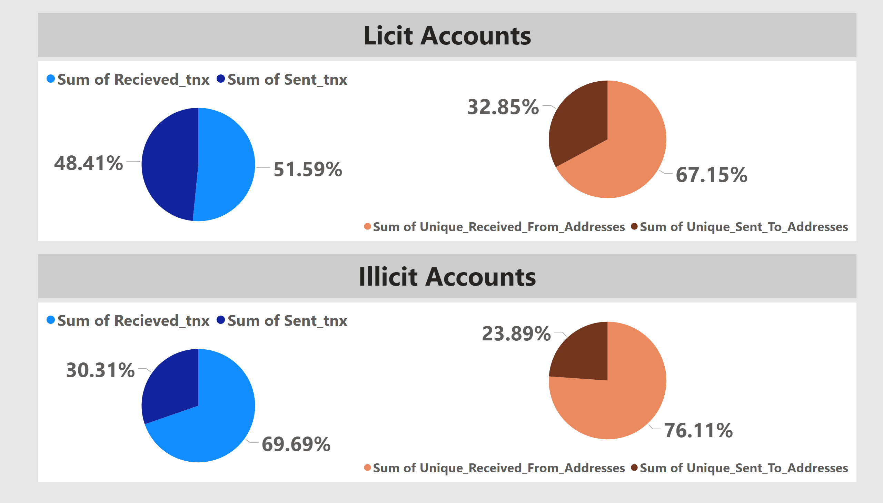
PIe charts on random samples
Notes:
textbox
No alt text provided
textbox
No alt text provided
pieChart
No alt text provided
pieChart
No alt text provided
Unique_Received_From_Addresses and Sum of Unique_Sent_To_Addresses
No alt text provided
pieChart
No alt text provided

