Slide 1



Scam_Types_Analysi
View in Power BI
Last data refresh:
9/2/2023 2:53:17 AM UTC
Downloaded at:
9/21/2023 2:31:02 AM UTC

Slide 2
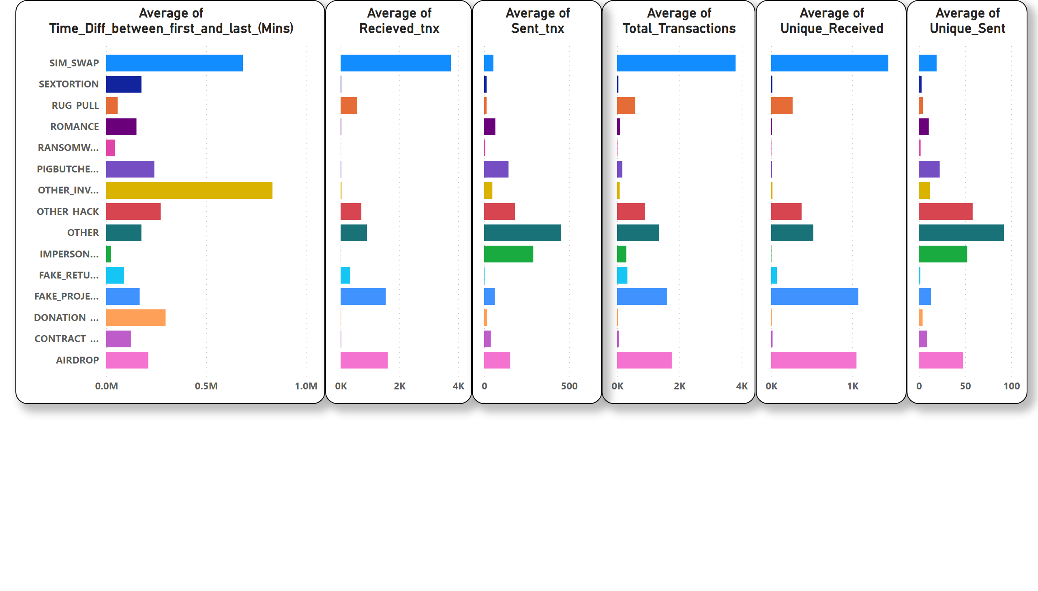
Page 1
Notes:
Average of Time_Diff_between_first_and_last_(Mins)
No alt text provided
Average of Recieved_tnx
No alt text provided
Average of Total_Transactions
No alt text provided
Average of Sent_tnx
No alt text provided
Average of Unique_Received
No alt text provided
Average of Unique_Sent
No alt text provided

