Slide 1
emoji_bot
Tweet me something and I’ll tweet you a related emoji.
By Anamika Sharaf

Slide 2
How do I work you ask 😎
Well! Tweet me a sentence.
I will send you a emoji related to the emotions you show in your tweet.
Do you want to see few demos..Here we go
😃

Slide 3
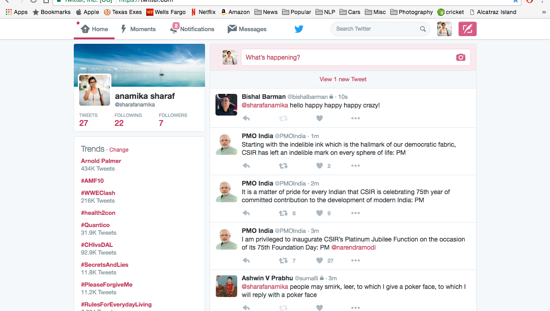
Hey! I got a tweet.

Slide 4
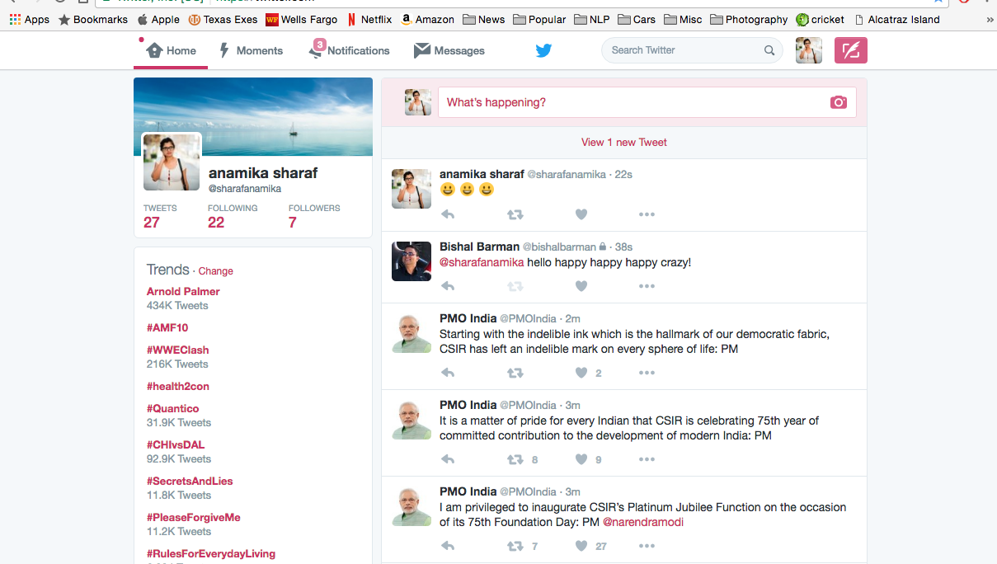
Emoji_bot replies as promised.

Slide 5
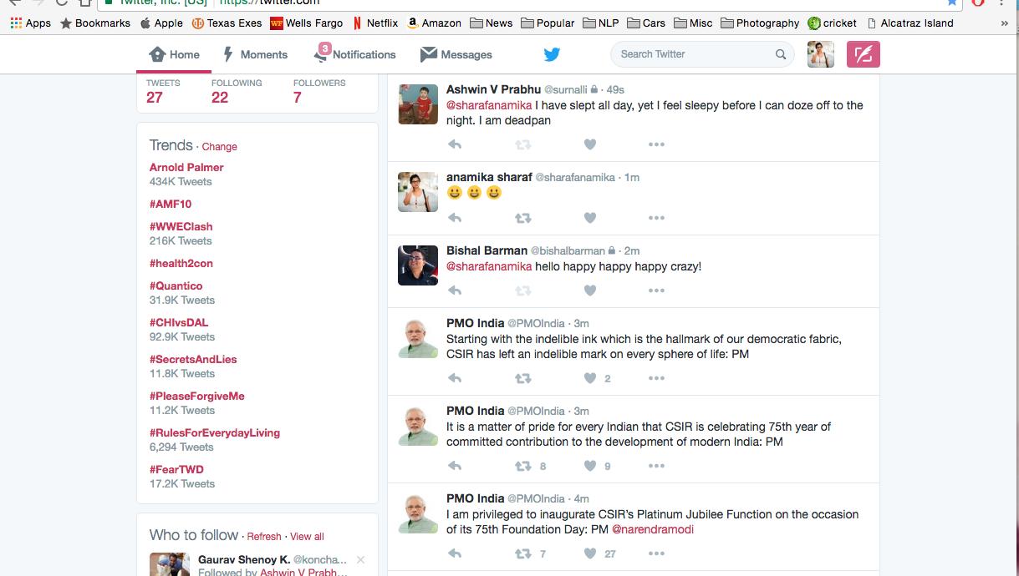
Let’s see some more 😎

Slide 6
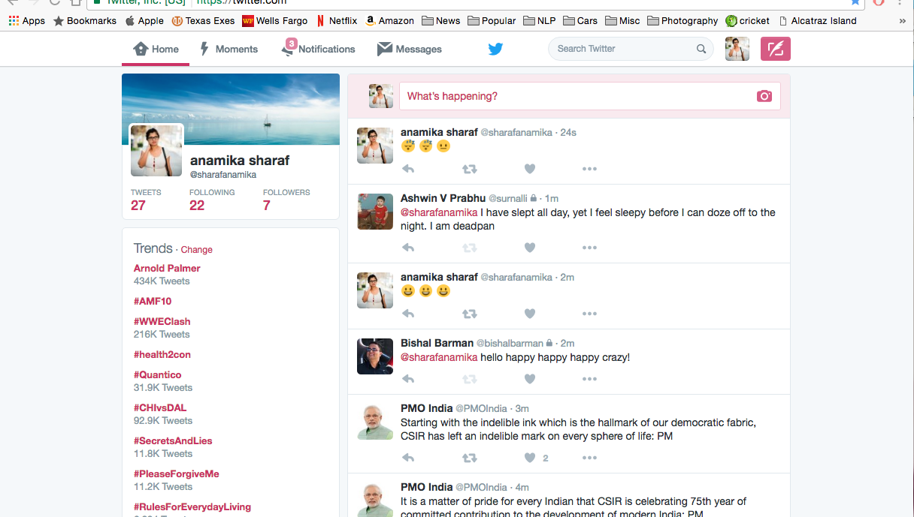
TaaaaDaaaa 😀

Slide 7
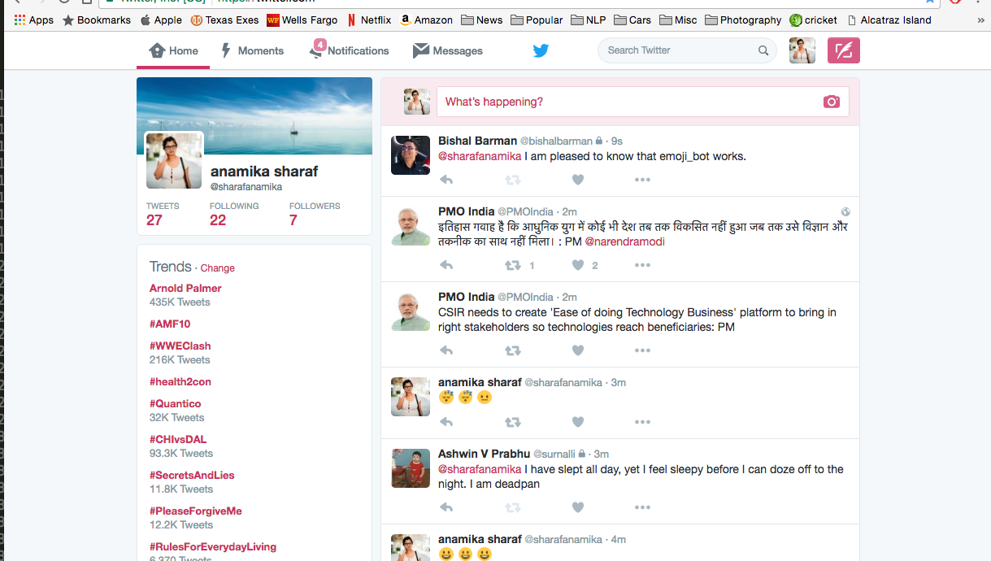
And some more 😜

Slide 8
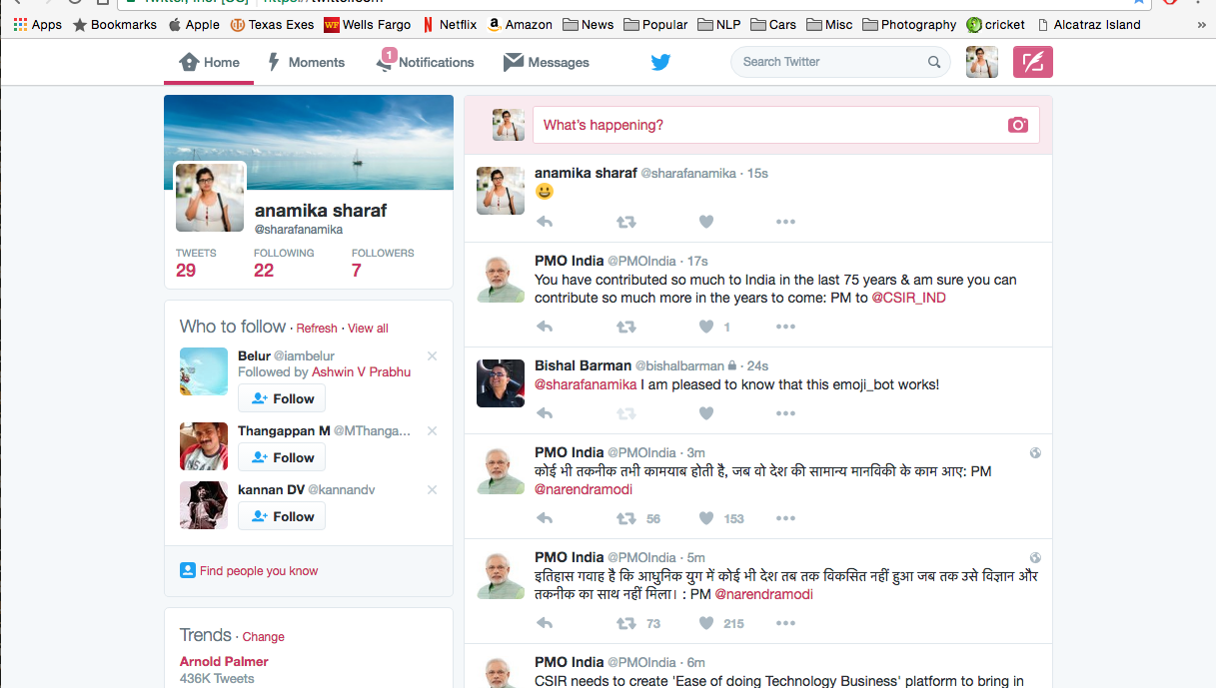
Woo Hoo 😎

Slide 9

Thank You

