Slide 2
AWS & Impetus GenAI Hackathon

Slide 3
Supply Chain Management
Supply Chain OS
Anandhini Rajendran, MS in CS @ UC San Diego
Note: All submissions remain the intellectual property of the individuals or organizations that developed them, and go on to describe a non-exclusive, royalty-free license granted to the sponsor, rather than a full transfer of ownership.

Slide 4
Introduction
Team Member – Anandhini Rajendran, Master’s student in Computer Science, UC San Diego
Passionate about agentic AI, LLMs, and computer vision, Bachelor’s from IIIT Hyderabad
Technical skills: Python, C++, SQL, React, big data systems, Experience in ML, NLP, and CV
Contact Information:
anrajendran@ucsd.edu
+16199538470 | San Diego, CA
https://linkedin.com/in/anandhini-rajendran | github.com/anan-123

Slide 5
Problem ​statement​
Supply Chain Optimization Using Time LLM
In today's fast-paced and demand-driven markets, supply chain inefficiencies cost businesses billions in overstock, stockouts, and delayed deliveries. Traditional demand forecasting models often fail to capture non-linear patterns, real-time market fluctuations, and external disruptions (e.g., seasonality, consumer trends, economic shifts). With the rise of generative AI models, we can leverage these to build more robust and accurate forecasting models and capabilities.
Prior work: Inaccurate forecasting from traditional models, Overstocking & understocking causing cost spikes, Limited use of external signals (market trends, weather, etc.), Lack of AI governance (moderation, RBAC, guardrails).

Slide 6
Solution approach​
The Supply chain OS addresses end-to-end optimization of the supply chain using Temporal LLMs and Generative AI.
Key Features:
Universal data analyzer to process variety of data
time series forecasting using traditional and LLM based models.
Supply chain AI assistant
AI Agent Lab - create and execute agents.
Scope of Scaling: The project can employ horizontal scaling through containerized microservices and distributed data processing for handling large volumes of data. It can leverage vertical scaling by enhancing individual compute resources to support complex AI models and heavy data workloads.

Slide 7
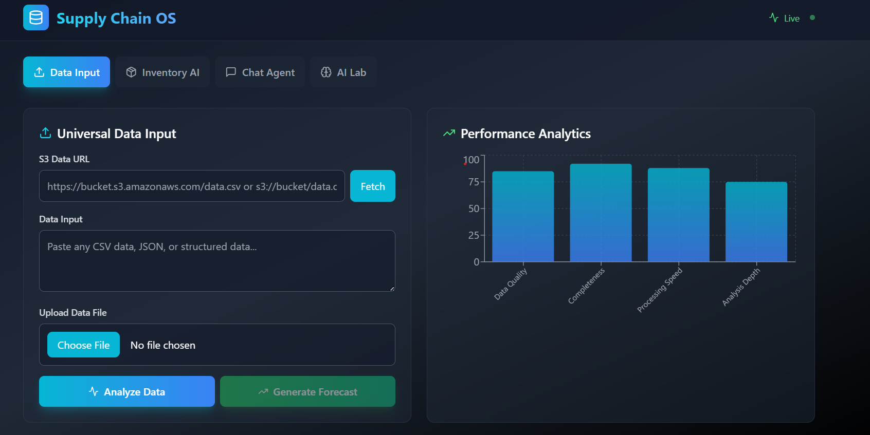
Tech-stack selection​
Backend: FastAPI (Python)
Frontend: React + Tailwind
AI Models: Claude 3, ARIMA, Prophet
Integration: AWS Bedrock + LangChain
Forecasting: Darts, Sklearn
Dataset Input: CSV, S3 URL

Slide 8
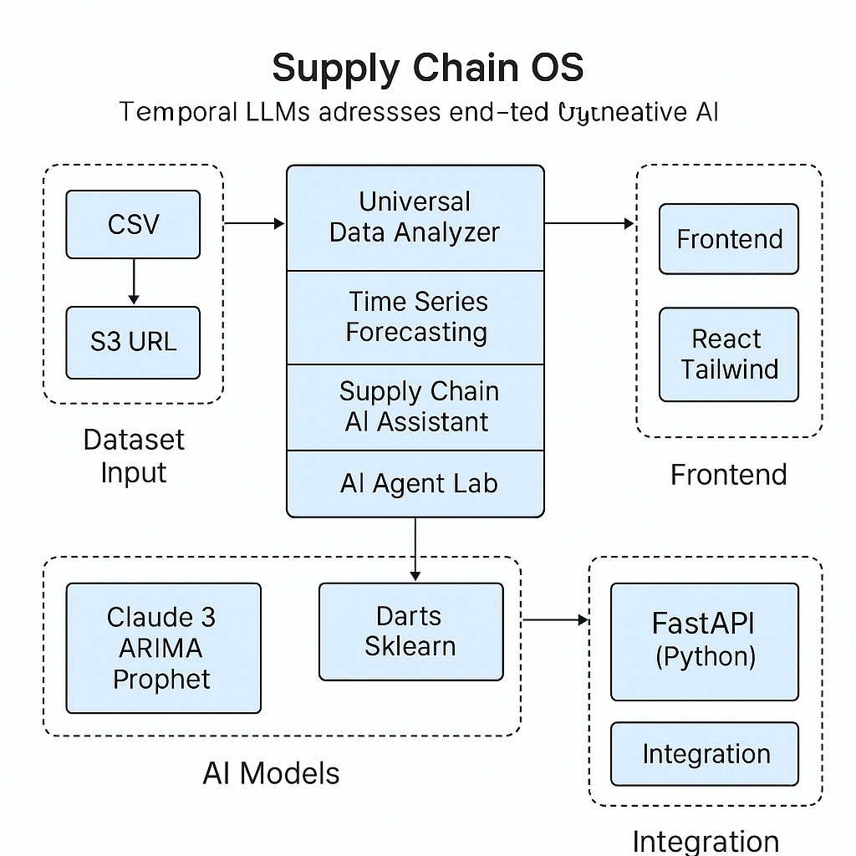
Architecture design/diagram

Slide 9
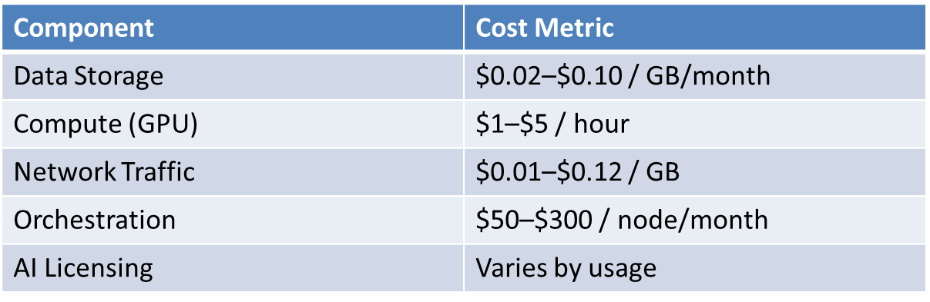
Cost estimates​
Primary Cost Drivers:
Data Infrastructure: Storage, ETL pipelines Compute: High-performance GPUs/TPUs for AI models Licensing: APIs, LLM access (if commercial) DevOps & Maintenance: Orchestration, monitoring, scaling
Current website:

Slide 10
Impact potential & limitations​
Potential Impact:
Transforms supply chain operations through predictive and generative intelligence,
Reduces demand/supply mismatches with real-time optimization
Enhances decision speed and accuracy for planners and managers
Enables autonomous agent-driven execution for routine tasks
Benefits:
Improved forecast accuracy using LLM-augmented models
Unified view across diverse data sources
Scalable and automate process. Enhanced user experience via AI assistant & agent lab
Dependencies: Amazon S3, Bedrock, EC2.
Limitation: Doesn’t work for very large datasets and needs more better scalable code for large organizations.

Slide 11
Ethical & security considerations​
Data Privacy & Consent: Sensitive supply chain data may include customer, vendor, or employee information.
Mitigation: Enforce strict IAM policies for data access
Bias in AI Models: Forecasting or decision-support models could reflect bias in training data (e.g., regional or supplier bias). Mitigation: Use diverse, representative datasets
Over-reliance on AI Recommendations: Users might follow AI decisions without understanding the context or risk.
Mitigation: Include confidence scores and explanations

Slide 12
Project URL, video pitch & demo
Project hosted url: http://34.226.152.181/
Video link: https://youtu.be/I3PRUQcD8Rw?si=b4Dnv0nGlrMfwKxK

