Slide 1
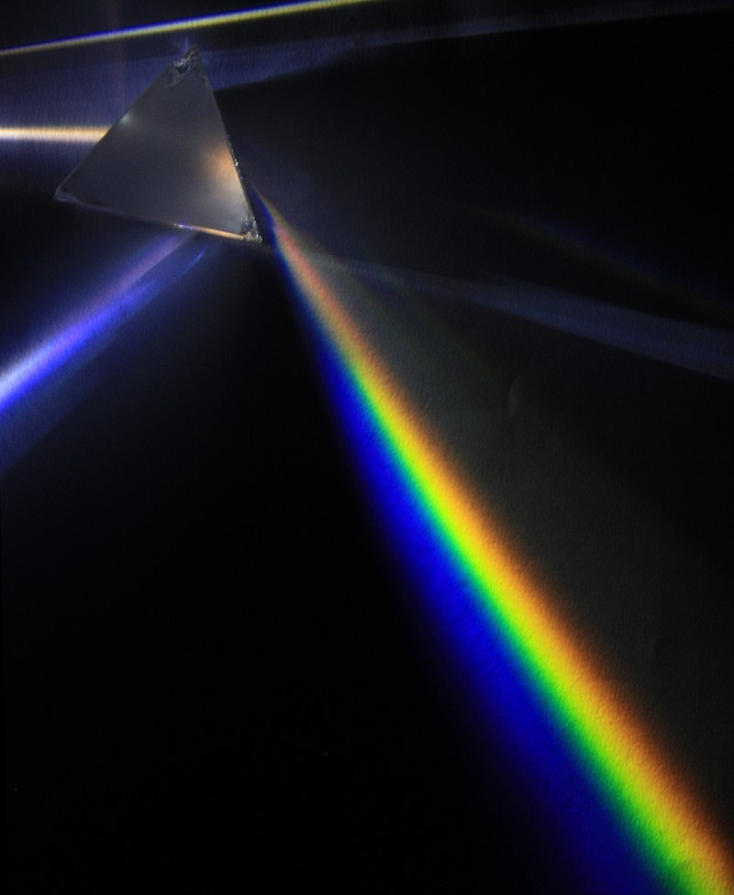
Spectroscopy
decomposition of light in contributions of different wavelength
the beginnings: I. Newton’s optical experiments (1666–1672)

Slide 2
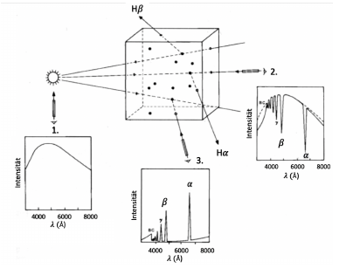
What can we see?
continuous spectra (black-body)
emission spectra
absorption features

Slide 3
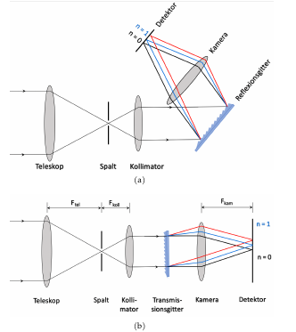
Main Components of a Spectrograph
entrance pupil
  slit in focal plane
  fiber
collimator → parallelizing light
dispersive element
  prism
  grating
  grism
camera + detector
  focusing + imaging + intensity measurement

Slide 4
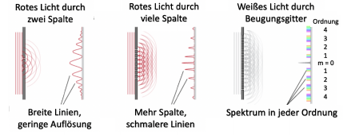
Interference pattern of a diffraction grating
transmissive or reflective periodic structure (with spacing d)
→ light is being diffracted
Resolution R (increasing with order number and smaller spacing):
R = λ/Δλ

Slide 5
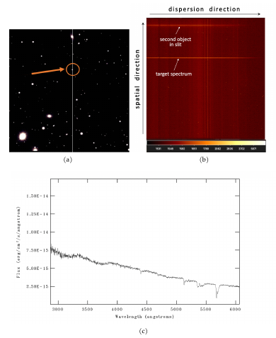
From Raw Data to 1D spectra
bias correction (varying offset over detector)
flat-fielding (pixel-to-pixel variations in eff.)
removal of cosmic rays
tracing the spectrum on image
extraction of the spectrum → 1D (flux vs. pixel)
wavelength calibration → 1D (flux vs. wavelength)
flux calibration (instr. response)

Slide 6
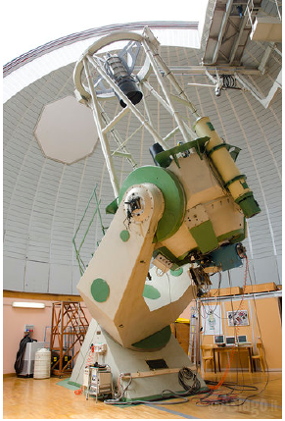
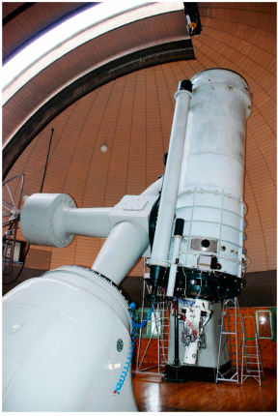
Data Sets – Osservatorio Astrofisico di Asagio
Copernico telescope
1.82 m
Asiago Object Spectrograph and Camera (AFOSC)
Resolution: 311
Grism #4
→ Central wavelength (580 nm)
Galileo telescope
1.22 m
Boller & Chivens Spectrograph
observations in Sep. 2018
Wavelength range around 350-800 nm
Low resolution
Calibration frames + 15 different objects

Slide 7
What You are expected to do
full data reduction of one or several objects with IRAF (Image Reduction and Analysis Facility)
evaluation of the resulting spectra (and identification of object type)
Material:
    raw calibration and object frames
    reference sheet for IRAF
    excerpts from Magister-thesis of V. Pfeiffer (reference for procedures and IRAF)
    IRAF web ressources:
      IRAF.net
      http://joshwalawender.github.io/IRAFtutorial/IRAFintro_01.html

