Slide 1
GLACIER NATIONAL PARK
Three Days,
Three Trails
Tuesday 25 to Thursday 27 August · Avalanche Lake, Logan Pass, Many Glacier
1
DAY 1
2
DAY 2
3
DAY 3
Avalanche Lake
Highline & Hidden Lake
Grinnell Glacier & Grinnell Lake
Notes:
Three hiking days in Glacier. Day 2 splits into two groups and is the only day that depends on the shuttle.

Slide 2
The three days
Distances are round trip unless noted.
1
DAY 1
2
DAY 2
3
DAY 3
Avalanche Lake
Highline & Hidden Lake
Grinnell Glacier
Tuesday 25 · Lake McDonald Valley
Wednesday 26 · Logan Pass
Thursday 27 · Many Glacier
5.9 mi
757 ft
11.8 mi
summit group
11.0 mi
2,181 ft
3–4 hr
out & back
2.7 mi
lakes group
7.6 mi
with boat
Stop at the foot of the lake, or keep going along the shore to the head for another 0.65 mi each way.
The summit group finishes at The Loop rather than back at Logan Pass, so the shuttle has to line up.
Out and back, so anyone can turn around at a viewpoint. Grinnell Lake adds a flat 1.8 mi.
→
Drive there and back.
→
Bus and shuttle, no car.
→
Drive there, drive back.
Notes:
Day 2 is the one to plan around, because it depends on shuttle timing.

Slide 3
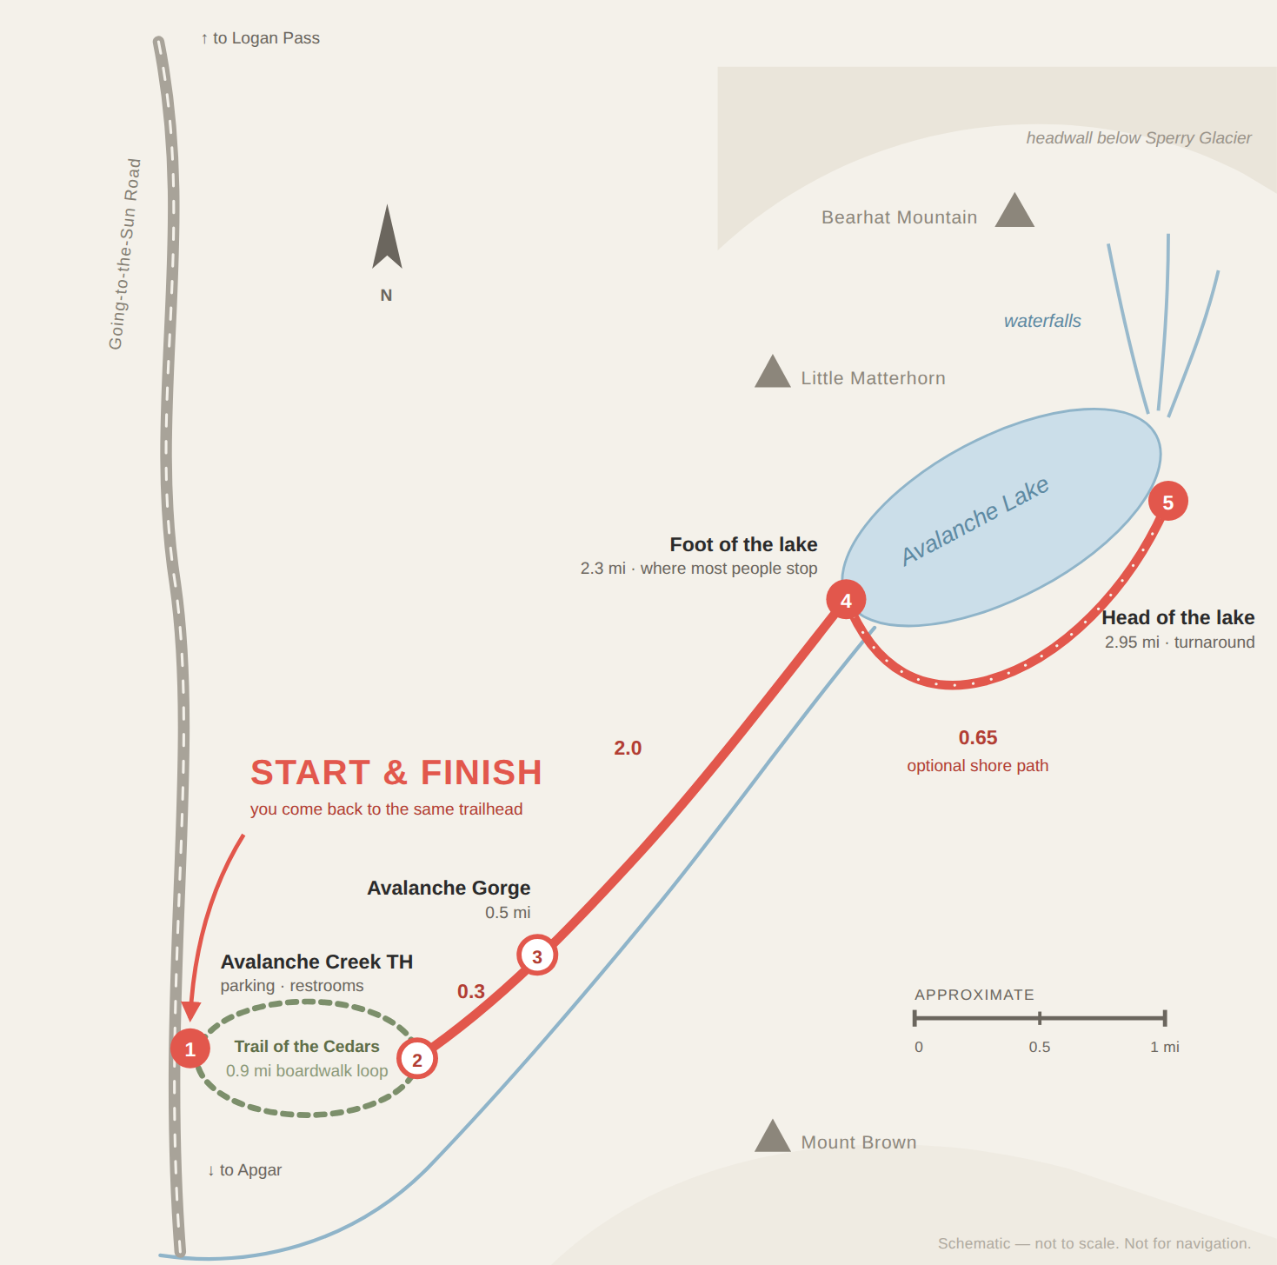
1
DAY 1 · TUE · AUG 25 · LAKE MCDONALD VALLEY
Avalanche Lake
ONE TRAIL · OUT & BACK
5.9 mi
757 ft
3–4 hr
ROUND TRIP
GAIN
MOVING
An easy grade the whole way, up Avalanche Gorge through old cedar to a lake with waterfalls coming off the headwall behind it.
Stopping at the foot of the lake makes it 4.6 mi.
GETTING THERE & BACK
D
Drive to Avalanche Creek on Going-to-the-Sun Road.
H
Hike out and back. The car stays at the trailhead.
D
Drive back the way you came.
Notes:
Avalanche Lake — one trail · out & back.

Slide 4
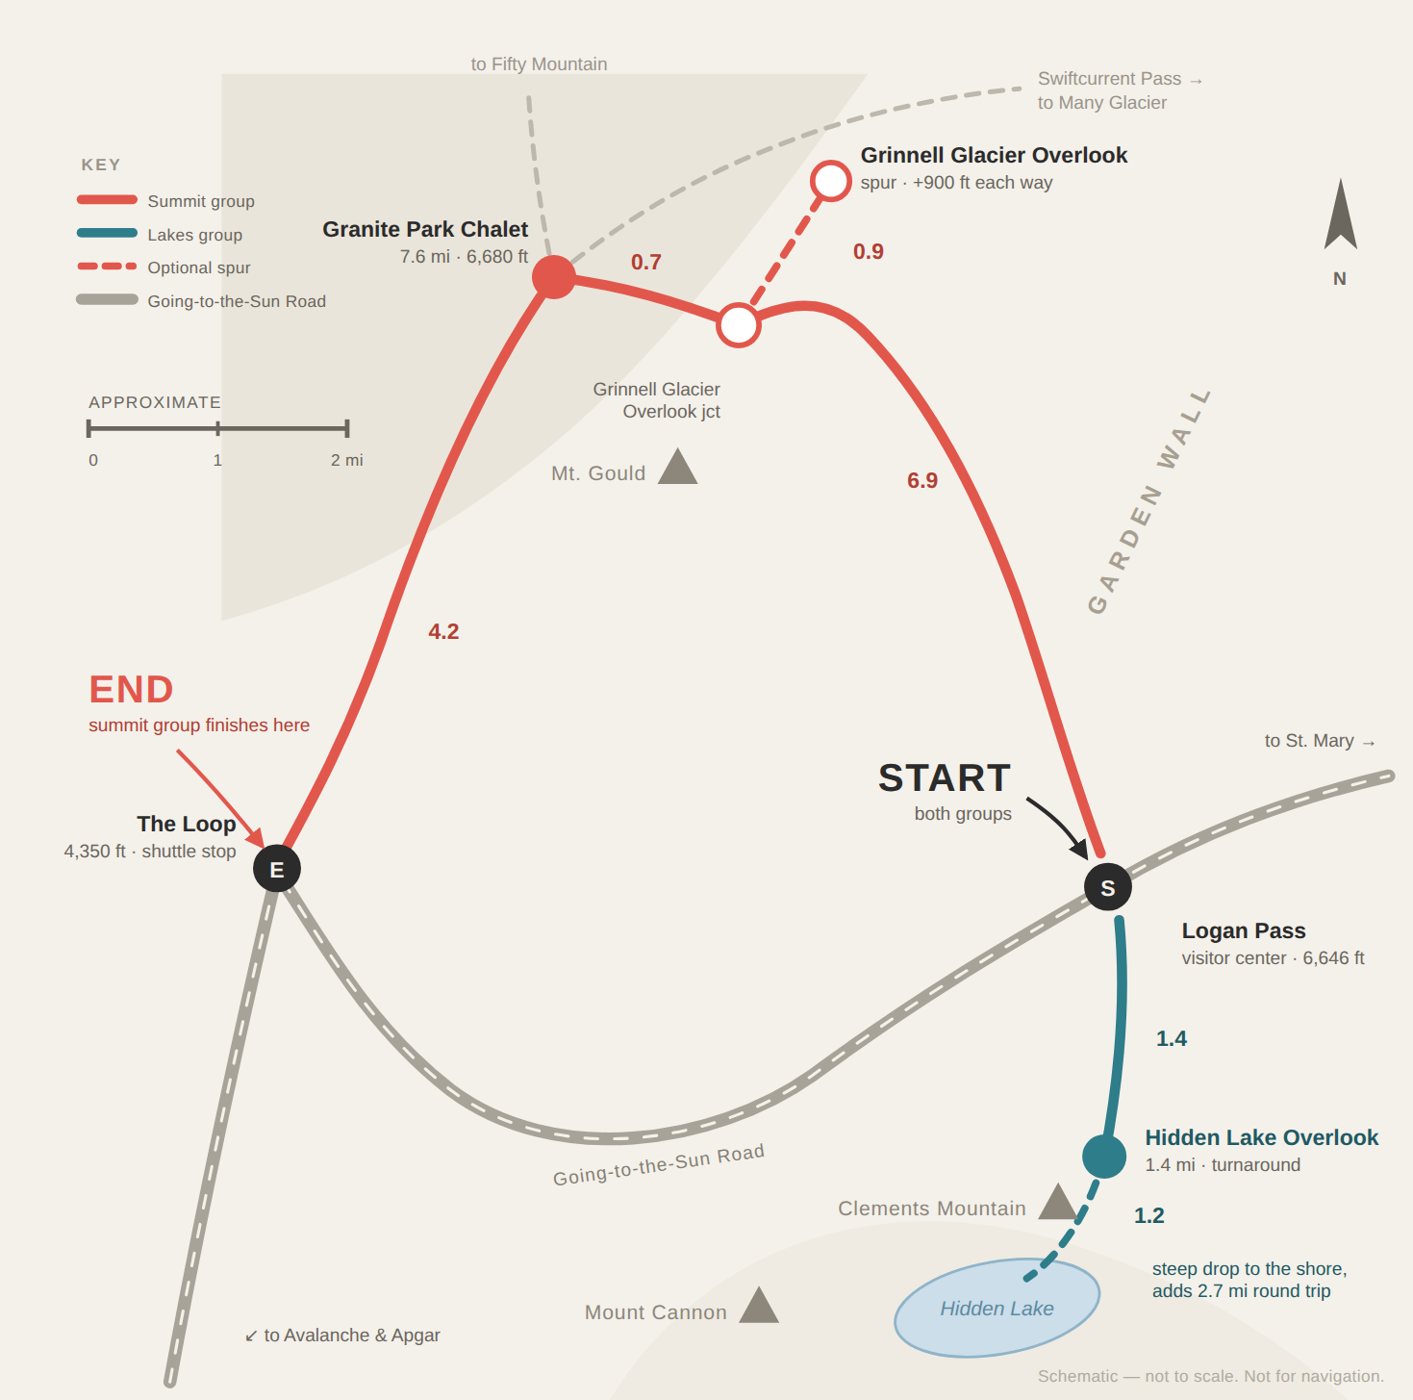
2
DAY 2 · WED · AUG 26 · LOGAN PASS
Highline & Hidden Lake
TWO GROUPS · BOTH START AT LOGAN PASS
SUMMIT GROUP
Highline → The Loop
11.8 mi
2,300 ft
6–8 hr
ONE WAY
DOWN
MOVING
LAKES GROUP
Hidden Lake Overlook
2.7 mi
550 ft
1½–2 hr
ROUND TRIP
GAIN
MOVING
GETTING THERE & BACK
P
Park at Apgar. The car stays there all day.
B
Express shuttle to Logan Pass — direct, no stops on the way up.
B
Both groups get off there and split at the visitor center.
B
Westbound shuttle back — summit at The Loop (last bus 7:30 pm), lakes at Logan Pass.
Notes:
Highline & Hidden Lake — two groups · both start at logan pass.

Slide 5
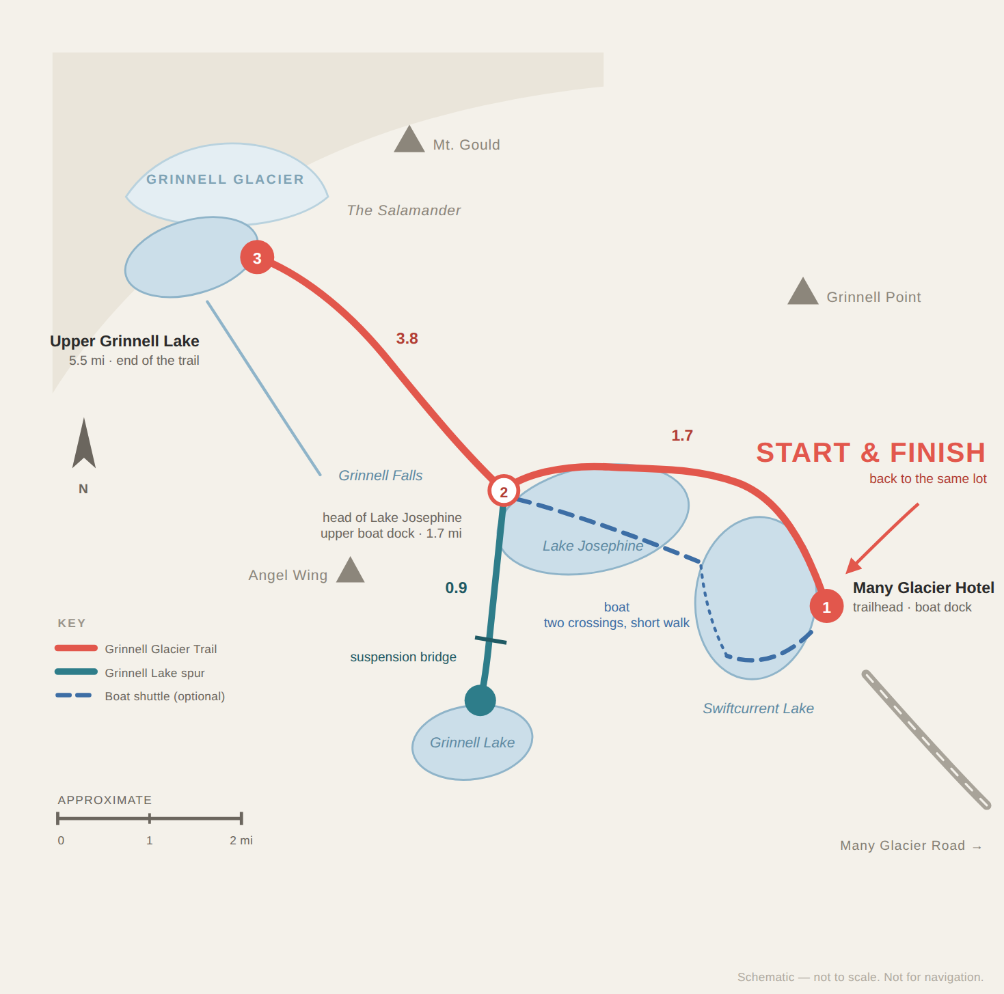
3
DAY 3 · THU · AUG 27 · MANY GLACIER
Grinnell Glacier & Grinnell Lake
OUT & BACK · TURN AROUND ANY TIME
11.0 mi
7.6 mi
2,181 ft
ON FOOT
WITH BOAT
GAIN
Climbs the wall above Lake Josephine and ends at Upper Grinnell Lake, below the glacier. Good views most of the way up, so anyone can stop early and head back.
The Grinnell Lake spur adds 1.8 mi round trip and is flat.
GETTING THERE & BACK
D
Drive to Many Glacier and park by the hotel.
H
Hike out and back as far as the group wants.
~
Boat (optional) saves 1.7 mi each way.
Notes:
Grinnell Glacier & Grinnell Lake — out & back · turn around any time.

Slide 6
How we get to each one
Two driving days and one that runs entirely on the park shuttle.
1
Avalanche Lake
Drive
›
Hike out & back
›
Drive
The car sits at the Avalanche Creek lot all day. Nothing to catch and nothing to book.
2
Highline & Hidden Lake
Park at Apgar
›
Express shuttle to Logan Pass
›
Hike
›
Shuttle back
The Apgar shuttle runs express to Logan Pass, no stops on the way up. We should be long gone by then, but the last bus out of The Loop is 7:30 pm and the summit group has to be down before it goes.
3
Grinnell Glacier
Drive
›
Hike out & back
›
Drive
An optional boat across Swiftcurrent and Josephine saves 1.7 mi each way, in either direction or both.
Notes:
Day 2 is the only day the car is left behind, and it depends on the last westbound shuttle from The Loop.

