Slide 1
Sentiment Analysis of Amazon Product Reviews
Academic Semester Project
Bachelor of Technology in Electronics & Communication Engineering
Semester: 6th | Year: 3rd
Presented by: [Your Name]
College: [Your College Name]

Slide 2
Introduction
What is Sentiment Analysis?
• Natural Language Processing (NLP) task to classify the emotional tone of text.
Why Customer Reviews?
• Vital for e-commerce (Amazon) to gauge customer satisfaction automatically.
Real-world Applications
• Brand monitoring, product feedback, and marketing strategy.

Slide 3
Problem Statement & Objective
Problem Statement
• Difficulty in manually processing massive amounts of unstructured review data.
Project Objectives
• Develop an automated system to classify reviews as Positive or Negative.
• Implement a full ML pipeline: Preprocessing -> Vectorization -> Training -> Evaluation.

Slide 4
Tech Stack & Methodology
Tech Stack: Python, Scikit-learn, Pandas, Matplotlib.
Methodology Workflow:
1. Preprocessing: Cleaning text, removing punctuation, custom stopwords.
2. Feature Extraction: TF-IDF Vectorization (n-grams 1 to 2).
3. Model: Logistic Regression & Linear SVC.

Slide 5
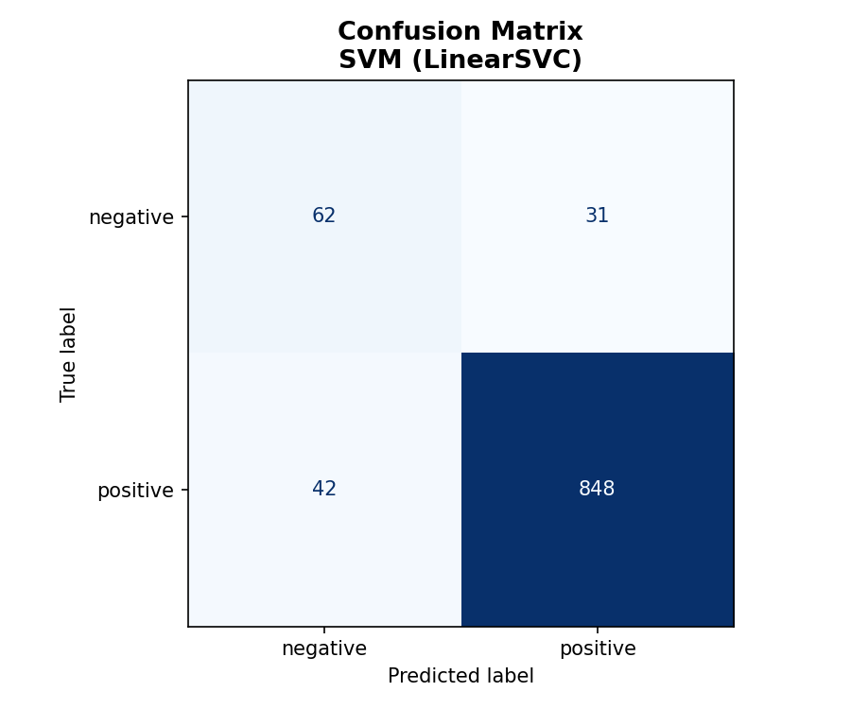
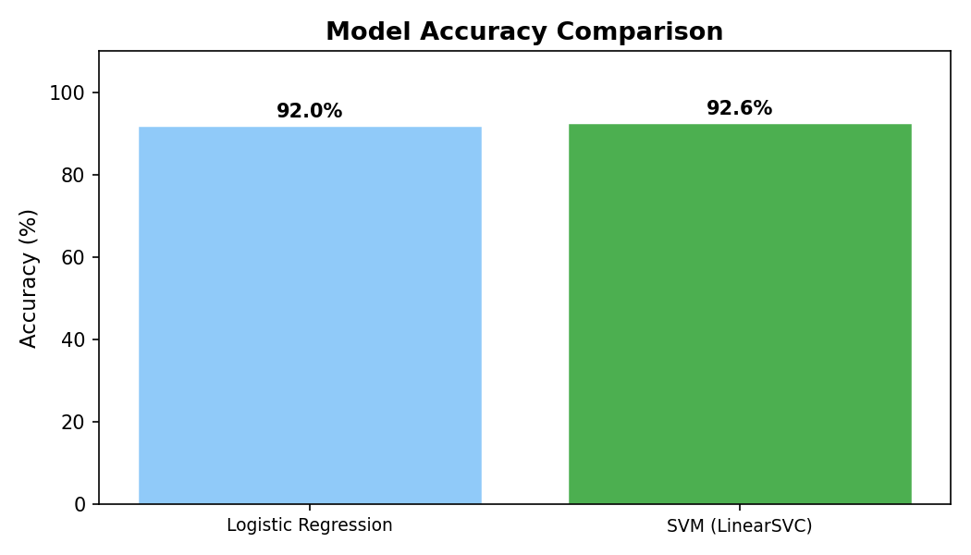
Model Evaluation & Results
The models achieved high accuracy by capturing key sentiment indicators.

Slide 6
Challenges & Solutions
1. Negation Handling: Modified stopword list to retain 'not'.
2. Data Imbalance: Used 'class_weight' parameter in models.
3. Sarcasm: Classical ML sometimes struggles with sarcastic reviews.

Slide 7
Conclusion & Future Scope
Summary
• Successfully built a reliable sentiment classifier for Amazon reviews.
Future Scope
• Implement Deep Learning (LSTMs) or Transformers (BERT).
• Deploy as a web-scale API.

