Slide 1
SOFTWARE CONTEST & MAINTANACE 2nd project
Group : Mammoth

Slide 2
User Acceptance test
22 UAT
UAT02
Purpose of Test | To ensure that: It is possible to add the activity. It is possible to view the activity.
Test Environment | The test environment is as follows: Client Hardware: Lenovo Y5070 laptop Server: Lenovo Y5070 laptop No other applications should be running on the laptop Activity is held in database MSSQL server
Test Script | In the Activity page, the tester should: Left click into the “Add new activity” Tester fill in the information into the given text field Tester choose the activity date Left click “Create” button
Expected Result | On completing the above steps, the history should be displayed. Verify that the application can add the activity and the activity that been added is correct.
Wad Dub Phai Temple Test Script
UAT title | Administrator can add activity of the temple on activity page
UAT ID | UAT-02 | Version | V1.0
Iteration | 02 | Date of Test | 17/05/2015

Slide 3
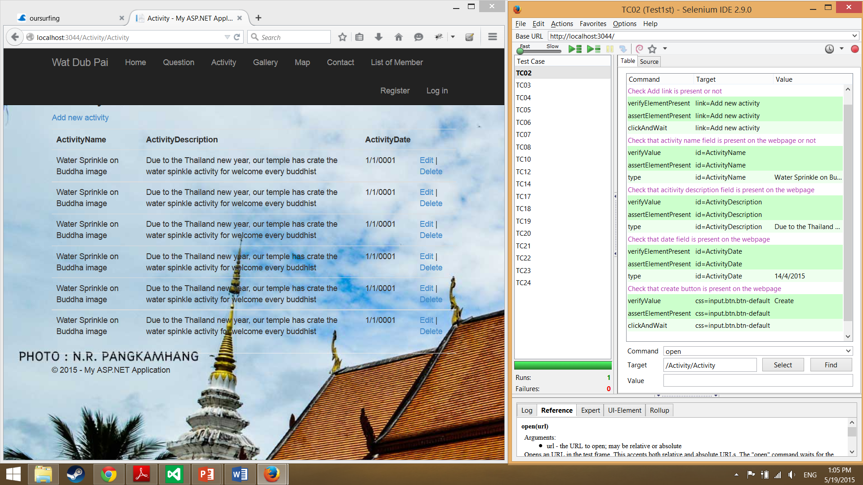

Slide 4
User Acceptance Record
Wad Dub Phai Temple Test Script
UAT title | Administrator can add activity of the temple on activity page
UAT ID | UAT-02 | Version | V1.0
Iteration | 02 | Date of Test | 17/05/2015
Test ID | TD-02 | Time of Test | 21:00-22:00
Observed Test Result | Having – Left click into the “Add new activity” Tester fill in the information into the given text field Tester choose the activity date Left click “Create” button I was able to verify that: The application can add the activity and the activity that been added is correct.
Test Result Category | Pass
Test Error Description | N/A
Tester Name | Chanchai Suksang | Tester Signature |  | CS

Slide 5
Integration Testing
Test ID | IT01
Test item(s) | Activity Page -> Activity Controller
Description | Test the integration by create an input to test the function add activity
Input specification | Create typical activity input
Output specification | Check that the correct function are called in controller

Slide 6
Unit Test Case
Unit Test Case (UTC02): testAddActivity () : Activity
Description
Test testAddActivity method by inputting activity information to the database system
Test Function
public ActionResult AddActivity(Activity a)
Test Data
Test Cases
Unit Test Case (UTC02): testAddActivity () : Activity
Description
Test testAddActivity method by inputting activity information to the database system
Test Function
public ActionResult AddActivity(Activity a)
Test Data
Test Cases
Case | Description | Input | Expected Results
 |  | Type: Activity object | Type: Activity object
1 | Test with all parameters have input the data | a | a
2 | Test with input duplicate data | a | Can’t Add
3 | Test with null | Null | Can’t Add

Slide 7
Bi-directional Matric between User Acceptance Testing and User Requirement Specification
No. | Unit Testing | URS-01 | URS-02 | URS-03 | URS-04 | URS-05 | URS-06 | URS-07 | URS-08 | URS-09 | URS-10 | URS-11 | URS-12 | URS-13 | URS-14 | URS-15 | URS-16 | URS-17 | URS-18
1 | UAT01
2 | UAT02
3 | UAT03
4 | UAT04
5 | UAT05
6 | UAT06
7 | UAT07
8 | UAT08
9 | UAT09
10 | UAT10
11 | UAT11
12 | UAT12
13 | UAT13
14 | UAT14
15 | UAT15
16 | UAT16
17 | UAT17
18 | UAT18

Slide 8
Bi-directional Matric between User Acceptance Testing and User Integration test
N0. | Integration test | ITC -01 | ITC -02 | ITC -03 | ITC -04 | ITC -05 | ITC -06 | ITC -07 | ITC -08 | ITC -09 | ITC -10 | ITC -11 | ITC -12 | ITC -13 | ITC -14 | ITC -15 | ITC -16 | ITC -17 | ITC -18 | ITC -19 | ITC -20 | ITC -21 | ITC -22
1 | UTC-001
2 | UTC-002
3 | UTC-003
4 | UTC-004
5 | UTC-005
6 | UTC-006

