Slide 1
Leveraging OpenCV for Precise Yoga Pose Estimation and Reducing Injury Risks
Anand Jha
x21157251

Slide 2
Introduction
- Yoga gains popularity due to its physical and mental health benefits.
- Proper execution is crucial but not everyone can afford a trainer.
- Our system addresses this by detecting correct poses in real-time.
- It helps users know if they're doing the poses accurately.
- Additionally, it educates users about the benefits of each yoga pose.
- Introducing: The Yoga Pose Detector.
Which will help in reducing the risk of injury

Slide 3
Research Question and Objectives
How can computer vision and machine learning be effectively combined to develop a real-time yoga pose detection system that provides accurate pose classification, guided feedback, and pose benefit analysis to enhance user experience and accessibility for yoga practitioners?”
” How can the identified yoga poses, and their corresponding benefits be integrated into the system to provide comprehensive guidance and enhance user engagement during yoga sessions?

Slide 4
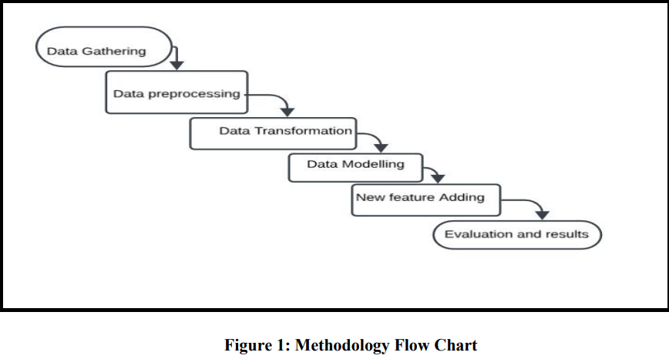
Methodology: CRISP-DM

Slide 5
Implementation
Data Gathering: Kaggle Dataset. https://www.kaggle.com/datasets/swapzzj/yoga-dataset?select=Dataset
Data Transformation:
In this with the help of Mediapipe we have detected the pose and save them in the form of csv File.
Data Splitting: In this all the data in the dataset is shuffled and splitted into Training and testing (70:30)

Slide 6
Data Training models:
Machine learning and deep learning model to be used:
LSTM
CNN
KNN
Decision Tree
Random Forest
Xgboost
Support vector Machine

Slide 7
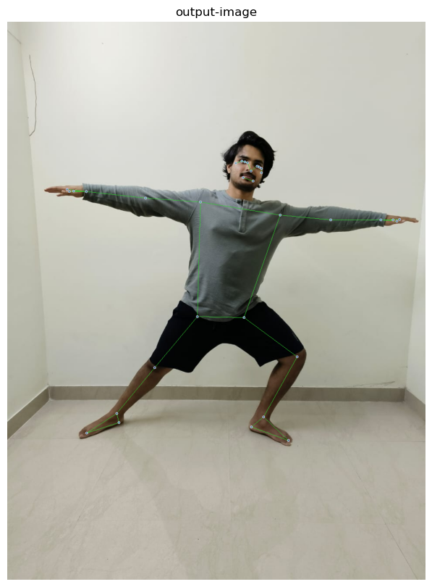
Experiment 1: Key point detection using Mediapipe model
Successfully identify the 33 keypoint using mediapipe.

Slide 8
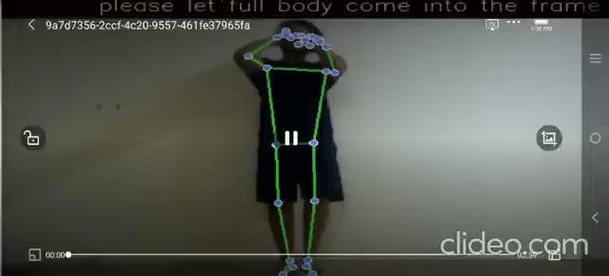
Experiment 2: Keypoint detection of real time video using media pipe and opencv

Slide 9
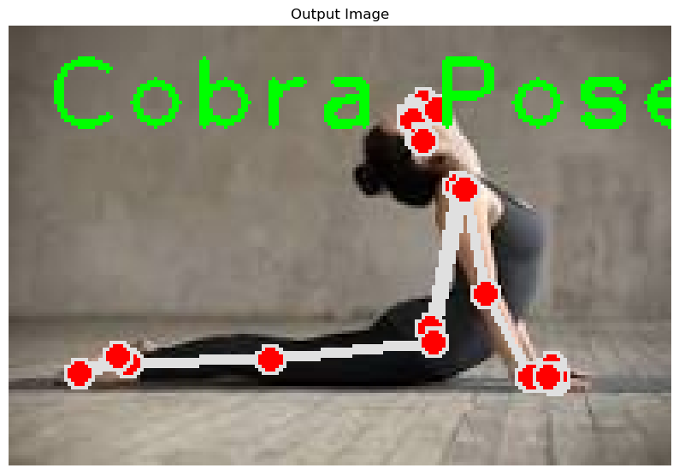
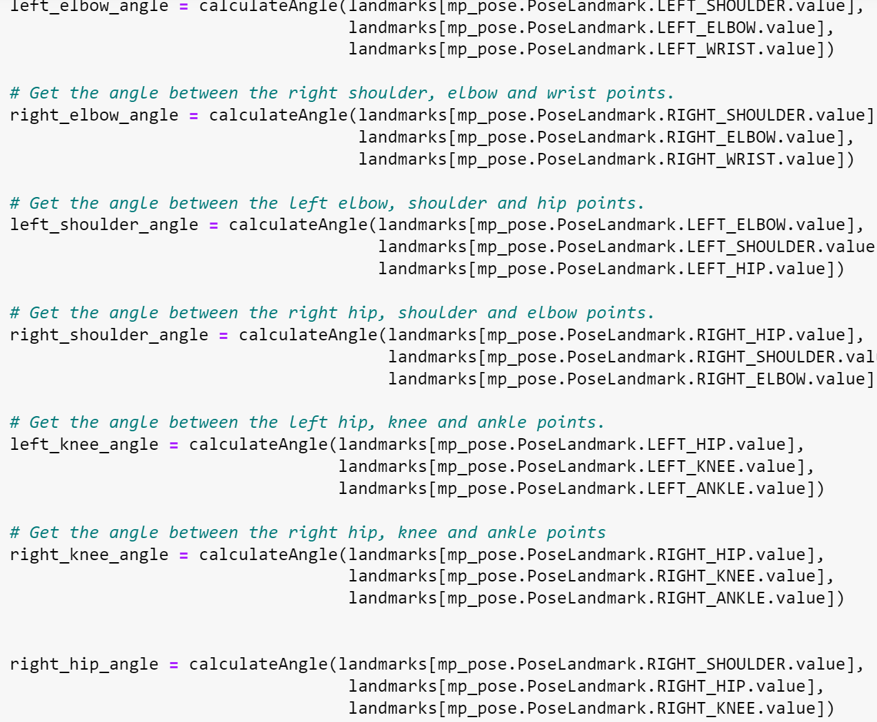
Experiment 3: predicting pose using maths ( angle between the keypoints

Slide 10
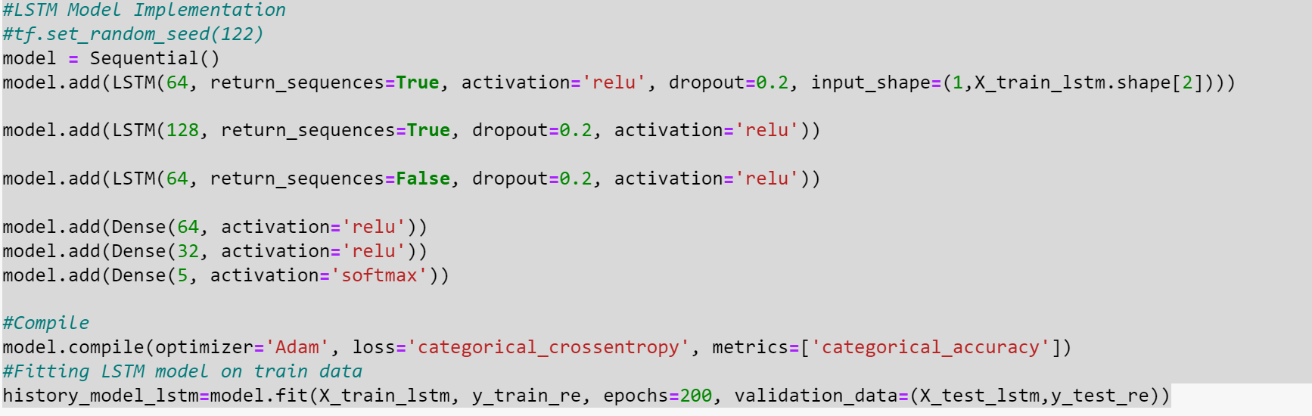
Experiment 4: LSTM

Slide 11
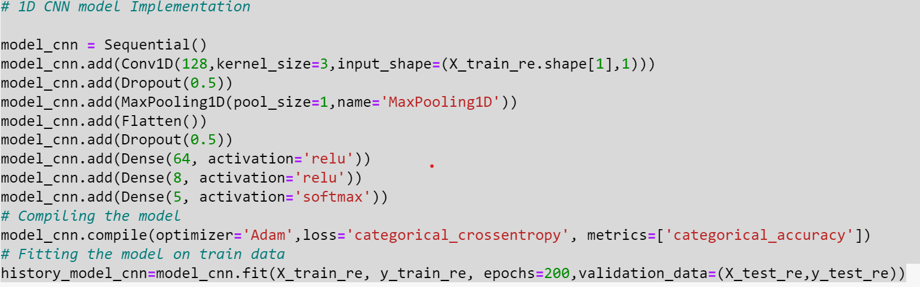
Experiment 5: CNN

Slide 12
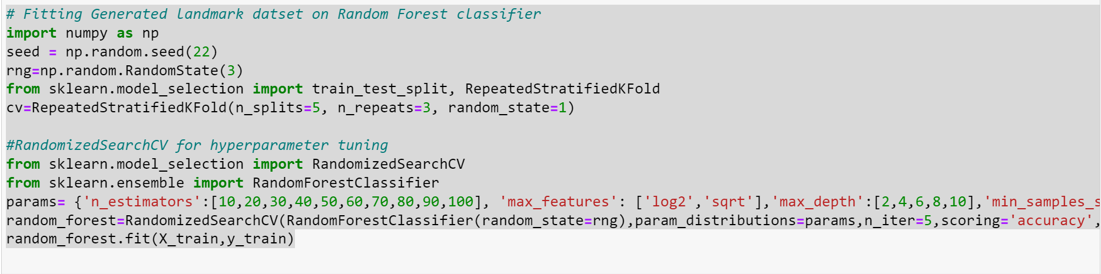
Experiment 6: Random Forest

Slide 13
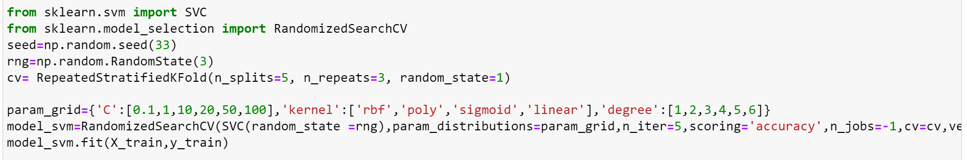
Experiment 7: SVM

Slide 14
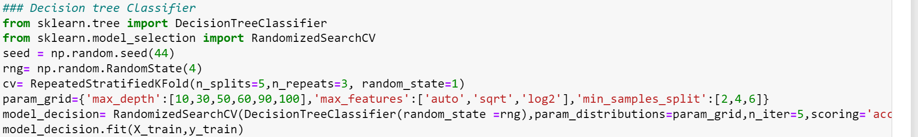
Experiment 8: Decision Tree

Slide 15
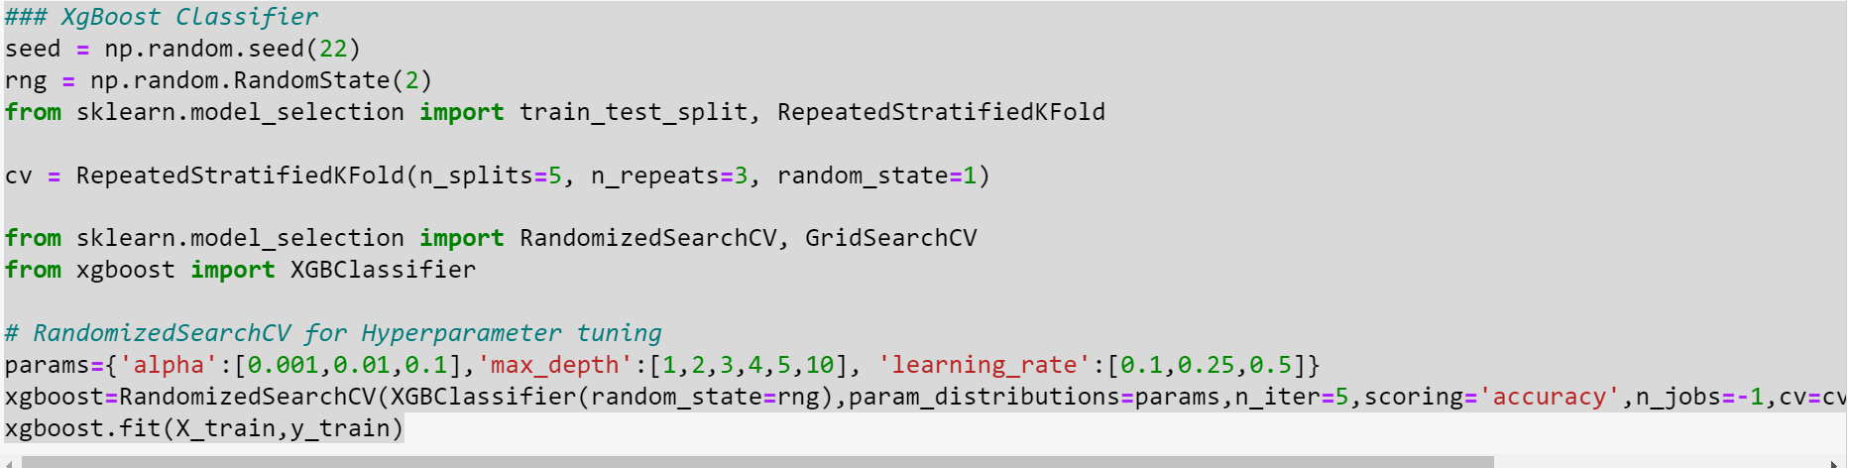
Experiment 9: XGBoost

Slide 16
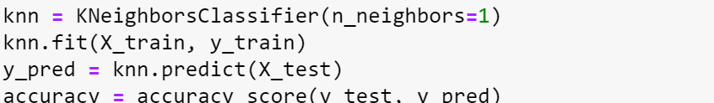
Experiment 10:

Slide 17
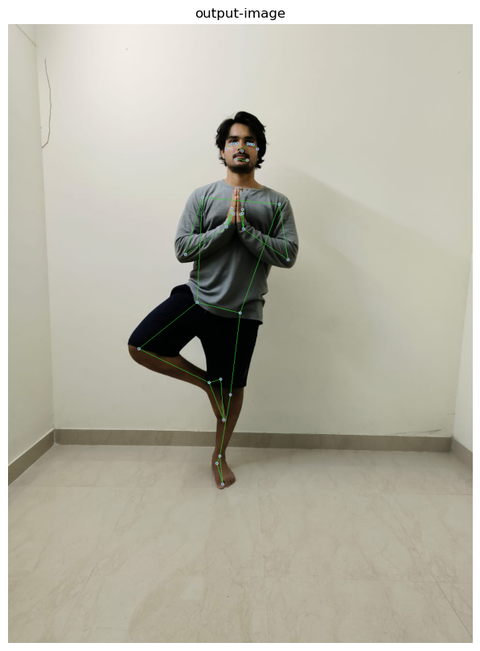
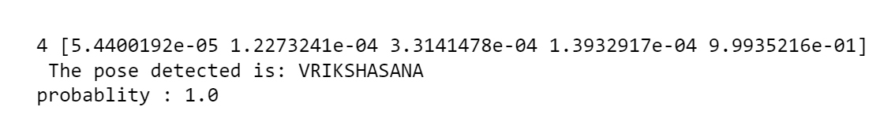
Experiment 11: Predicting Pose using Machine Learning Model

Slide 18
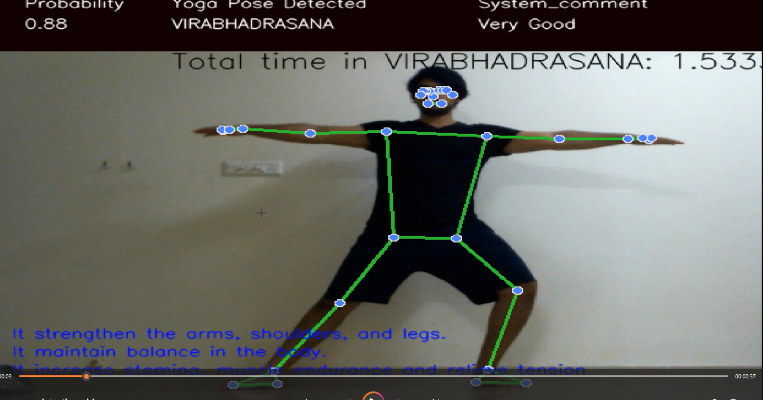
Experiment 12: predicting pose in real time using machine learning

Slide 19
Conclusion And Future Work
Successfully created Yoga Pose detection Method
Yoga Pose Benefit Function Is built
Audio Feedback
Helps to prevent injury.
Expand Dataset: Consider more yoga poses for a robust model.
- Increase Sample Data: Augment images or gather more data for enhanced accuracy.
- Experiment with Models: Test other ML algorithms for improved results.
- - GNN Integration: Explore Graphical Neural Networks for pose detection.
- Expert Involvement: Collaborate with yoga instructors for precise data creation.
- Chatbot Integration: Link system with a chatbot for yoga-related inquiries.
- Breathing Assistance: Include guidance on breathing techniques during poses.

