Slide 1
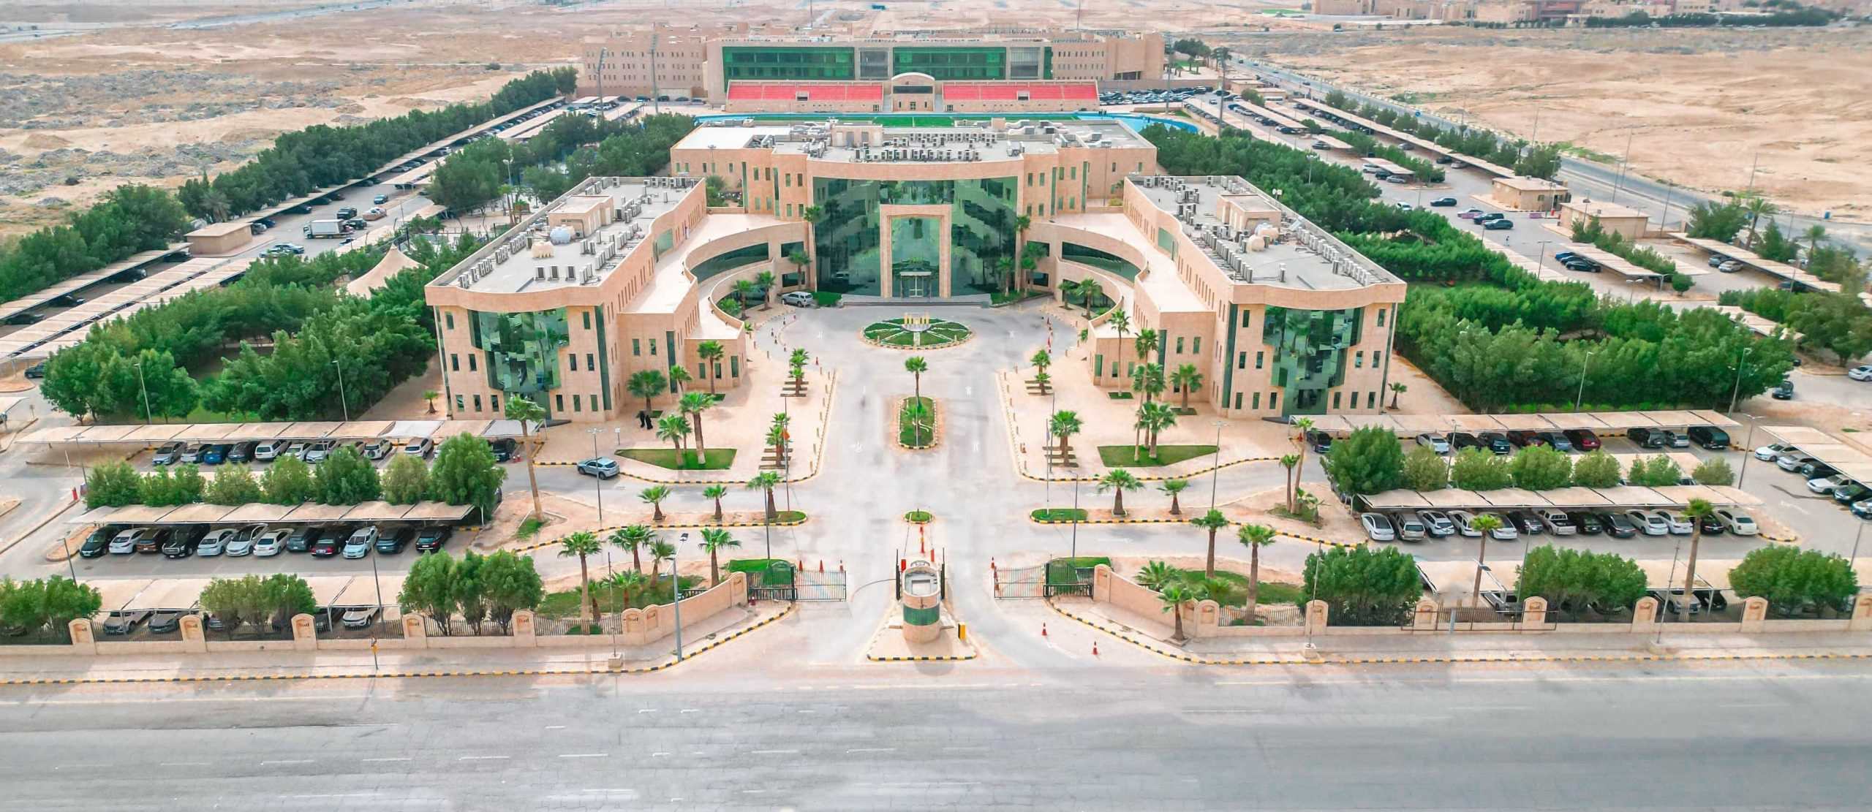
Al Yamamah University -
InsightVerge Applied AI Partnership
AI Skill Weeks, executive academies, applied AI Centre of Excellence and academic pathways for Saudi Arabia
Strategic concept note | August 2026
Core proposition
Build market traction first through Skill Weeks and executive offerings; then stack evidence into certificates, professional credentials, AI-for-X pathways and later advanced academic programs.

Slide 2

InsightVerge
Al Yamamah University Applied AI Initiative
Why this partnership now?
Saudi Arabia needs AI capability that converts learning into deployed systems, responsible adoption and measurable value.
National pull
Data and AI strategy emphasizes workforce transformation, practical capability, responsible use and sectoral adoption.
YU platform
Engineering, cybersecurity and executive education create a credible academic and professional base for applied AI.
Market gap
Many learners know AI concepts; fewer can build, deploy, govern and defend real AI systems.
Need
What is needed is an applied AI capability platform - not a generic training menu.

Slide 3
InsightVerge
Al Yamamah University Applied AI Initiative
The strategic fit
Al Yamamah can serve students, professionals, enterprise teams and faculty through one integrated AI platform.
Academic base
Software, network/security, industrial engineering, architecture and cybersecurity.
Executive channel
Centre for Executive Education (CEE) can convert AI demand into short, customized and leadership programs.
What InsightVerge adds
Applied AI curriculum architecture
Practitioner-led system design and review
Five-day build-week delivery model
Faculty development and QA transfer
Capstones with production-oriented evidence
Enterprise relevance
Corporate and government relationships can become a problem-bank and project engine.
Saudi context
Arabic*/English applications and local governance contexts create differentiation.
* InsightVerge will work with an expert in Arabic for this purpose.
Value promise: Move learners from AI awareness to AI engineering, adoption, governance and measurable outcomes.

Slide 4
InsightVerge
Al Yamamah University Applied AI Initiative
Portfolio architecture
Use the catalog as a ladder: short evidence-producing programs first, then credentials and academic pathways.
1
2
3
4
5
Applied AI
Skill Weeks
Certificate
Pathways
Executive
AI Academy
AI Centre of
Excellence
Academic
Pathways
One week = One capability + one defensible artifact
Evidence-based ladder
Leaders + functions + sectors
Problem bank + artifact QA
Diploma, master’s, research
Immediate launch: Skill Weeks, executive cohorts and CoE / Studio pilots.
Scaling: Certificates, professional credentials and academic pathways, based on artifact quality, learner demand and employer feedback.

Slide 5
InsightVerge
Al Yamamah University Applied AI Initiative
Skill Week portfolio
Each week bundles related catalog units and culminates in a working artifact mapped to roles.
AI Engineering Foundations
Python, data, Git/Linux and statistics foundations; output: reproducible AI workflow.
GenAI Application Engineering
Prompting, embeddings, RAG, guardrails and evaluation; output: enterprise GenAI app.
Agentic AI + Orchestration
Tool use, memory, workflows and human gates; output: controlled agentic workflow.
Sample rhythm
Day 1: Frame + foundations
Day 2: Core build
Day 3: Evaluate + improve
Production AI: LLMOps/AgentOps
APIs, containers, monitoring, token economics and rollback; output: deployed AI service.
Responsible & Secure AI
Red teaming, privacy, security and system cards; output: risk pack and controls.
Applied AI Industry Sprint
Problem discovery through evaluated prototype; output: demo, defense and roadmap.
Day 4: Deploy + govern
Day 5: Defend + roadmap
Evaluation emphasizes artifact quality, engineering judgment, risk awareness, deployment readiness and practical defensibility.

Slide 6
InsightVerge
Al Yamamah University Applied AI Initiative
Stackable pathways
Skill Weeks become a credential ladder that uses completion evidence, not attendance alone.
Skill Week
Foundation Certificate
Advanced Certificate
Professional Credential
Master’s / Research Pathway
5 days
2-3 Skill Weeks
4-5 Skill Weeks + project
Post-Graduate certificate Program (PGP) / Diploma
Later
One capability + artifact
AI foundations, productivity and responsible use
AI engineering, GenAI or secure-AI portfolio
Studio-backed prototype, system card and defense
Advanced systems + applied research evidence
Credentials awarded based on Skill Week completion, assessed artifacts, reviewer feedback and capstone defense. This makes the certificate employer-visible and evidence-based.

Slide 7
InsightVerge
Al Yamamah University Applied AI Initiative
Executive AI Academy
Fastest route to market: leadership, function, manager and sector academies from the catalog.
Demystifying AI + Leading AI Transformation Shared executive language, prioritization, operating model and governance.
Leading AI Transformation / AI Value Realization Diagnose live AI initiatives; create value hypotheses, interventions and 90-day actions.
AI for X + Advanced Tool Development
Function-specific workflows, prototypes, evaluation and engineering handoff.
Governing AI
Accountability, risk taxonomy, privacy, security, auditability and oversight cadence.
Design Thinking for AI
Business and technology teams convert problems into feasible AI solution choices.
Custom Enterprise / Sector AI Academy
Role-based journeys for leaders, managers, engineers and functional teams.
Outputs: use-case portfolio + value hypothesis + governance/risk pack + 90-day action plan + role-wise capability map.

Slide 8
InsightVerge
Al Yamamah University Applied AI Initiative
Applied AI Centre of Excellence
The CoE connects projects, faculty capability, enterprise engagement and measurable AI outcomes.
Problem bank
Curated Saudi enterprise problems for courses, hackathons, capstones and executive clinics.
Prototype factory
Working demos in RAG, agents, cybersecurity AI, productivity automation and governance.
Intelligent Systems Studio outputs (sample)
Review panels
Practitioners assess feasibility, reliability, cost, security, adoption and value.
Faculty capability
Faculty develop through observation, labs, co-review and progressive co-delivery.
AI-assisted cyber incident triage
Operations forecasting prototype
Contract intelligence assistant
AI governance / system-card pack
Bilingual knowledge assistant

Slide 9
InsightVerge
Al Yamamah University Applied AI Initiative
AI Centre of Excellence: mandate
A permanent capability platform linking academic programs, faculty, enterprise problems and applied innovation.
Academic capability
Curriculum refresh, applied labs, assessment standards, faculty enablement and progressive capability transfer.
Industry engagement
Problem bank, practitioner panels, employer feedback and enterprise-sponsored challenges.
Applied innovation
Intelligent Systems Studio for prototypes, capstones, hackathons and demonstrators.
Executive capability
Executive AI Academy, AI-for-X programs, governance clinics and value-realization interventions.
Quality & governance
Steering Committee, Academic Quality Board, Industry Curriculum Council and outcome dashboard.
Outcome orientation
Measure capability, artifact quality, faculty readiness, industry engagement and enterprise relevance.
The CoE is an academic-and-industry capability venture — not a training vendor arrangement.

Slide 10
InsightVerge
Al Yamamah University Applied AI Initiative
CoE governance and roles
Clear ownership preserves academic sovereignty while bringing specialist AI capability and industry relevance.
Al Yamamah University
Own academic governance, approvals, awards and institutional infrastructure.
Nominate faculty and students; activate local enterprise relationships.
Own institutional outcome reporting and learner records.
InsightVerge
Design/refresh curricula, labs, rubrics and technical standards.
Lead initial specialist delivery, faculty enablement, project architecture and QA.
Support dashboards, capstone governance and advanced content refresh.
Industry participants
Validate industry relevance and contribute practitioner judgment.
Provide problem statements, domain context, mentors or non-sensitive datasets where feasible.
Review projects and provide employer feedback.
Steering Committee
Strategy & annual portfolio
Academic Quality Board
Curriculum & assessment quality
Industry Curriculum Council
Relevance & employer feedback

Slide 11
InsightVerge
Al Yamamah University Applied AI Initiative
CoE activity portfolio
The Centre will create visible capability and applied evidence across students, faculty, executives and enterprises.
Student capability
Skill Weeks • certificates • capstones • hackathons
Evidence: Repositories, deployed prototypes, evaluations and defenses
Faculty development
Labs • shadowing • co-review • co-teaching • certification
Evidence: Capability matrix, certified instructors and calibrated rubrics
Industry projects
Problem bank • live challenges • prototypes • technical reviews
Evidence: Proof-of-value systems, review notes and implementation roadmaps
Executive capability
Leadership programs • governance clinics • AI-for-X academies
Evidence: Use-case portfolios, governance packs and 90-day action plans
Applied innovation
Bilingual AI • secure AI • intelligent operations • responsible AI
Evidence: Demonstrators, reusable IP, benchmarks and applied case studies
Ecosystem engagement
Roundtables • demo days • expert panels • innovation challenges
Evidence: Project pipeline, employer feedback and partnership opportunities

Slide 12
InsightVerge
Al Yamamah University Applied AI Initiative
CoE outcomes and performance dashboard
Success is measured by capability and applied value — not by the number of events conducted.
Learner capability
Skill Weeks completed
Certificate progression
Capstone technical-defense pass rate
Faculty capability
Faculty trained
Co-delivering
Independently delivering approved modules
Industry engagement
Active problem statements
Reviewers
Enterprise cohorts
Sponsored challenges
Applied innovation
Prototypes completed
Demonstrators reviewed
Projects advancing toward implementation
Executive impact
Leaders/managers reached
AI roadmaps
Governance interventions
Follow-through
Quality & relevance
Artifact quality
Employer feedback
Periodic curriculum refresh
Learner outcomes
Quarterly dashboard → Annual CoE portfolio review → Curriculum, faculty and project priorities refreshed

Slide 13
InsightVerge
Al Yamamah University Applied AI Initiative
Academic expansion runway
Use market evidence, CoE quality and faculty capability before committing to larger academic programs.
Now
Skill Weeks + Executive Academy
Immediate traction across students and enterprises
Next
Micro-credentials + Certificates
Visible progression and portfolio evidence
Then
PGP / Professional Diploma
Serious applied AI transition credential
Later
Master’s + Executive AI Pathways
Advanced systems + working-professional options
Future
Bachelor-level AI / AI-for-X expansion
Only after demand, approval and faculty maturity
AI-for-X: Software, networks/security, industrial engineering, business, finance, legal, operations and architecture can all receive applied AI pathways without waiting for a new degree.

