Slide 1
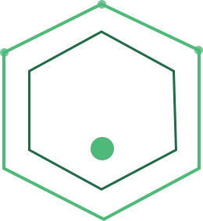


ENTERPRISE AI ARCHITECTURE INTENSIVE • ALBERTSONS
Day 2- The GenAI Rung,
Taken Deliberately
LLM mechanics, grounding, and model right-sizing; how the language rung of the ladder actually works.
Dr. Anand Jayaraman
Chief AI Officer, InsightVerge
3.5-Day Enterprise AI Architecture Intensive | InsightVerge | Day 2 Lecture | Confidential

Slide 2

TODAY'S ROADMAP
Three Moves, One Deliberate Climb
One thread runs through all three: every capability claim is also a cost, latency, and governance claim.
1
2
3
What an LLM Actually Is
Grounding It in the Enterprise
Right-Sizing It
Tokens, attention, the training pipeline; mechanism, not math, each with its architectural consequence.
Structured outputs as the airlock; RAG as the knowledge mechanism; evaluation as the discipline.
Scaling laws to Chinchilla, SLM vs frontier, the decision ladder, the fine-tune-vs-RAG boundary.
Why every downstream design rule today falls out of this.
The theory your afternoon lab executes.
The architect's cost discipline.
InsightVerge

Slide 3
THE QUESTION THAT CHANGES THE DAY
“Can I Run the Same Promotion Next Month?”
None of yesterday's tools can read the question, let alone answer it.
Yesterday's tools solved the numbers: the exception was detected (analytics), demand was forecast (ML), scenarios were compared (simulation). Then the category manager asks: “Can I run the same promotion next month under the new vendor funding policy and the loyalty program terms?”
Unstructured
Private and current
Auditable
The policy is prose, not a feature table.
Last week's policy revision, not the internet.
The answer must cite a paragraph an auditor can check.
None of yesterday's tools can read the question, let alone answer it.
InsightVerge

Slide 4
TRIAGE CHECKPOINT #2
Is GenAI the Right Tool and Which GenAI?
THE CHECKPOINT
AND THE DISCIPLINE
Rules miss the nuance of prose. Classical ML can't read the policy at all. But notice: the demand number the answer leans on still comes from yesterday's ML service.
“You're not going to generate this kind of spend unless you're going to promise to profoundly change the world. So is it hype? Of course.”
Verdict: hybrid. The LLM structures, interprets, and cites. The forecast stays a forecast.
- Ken Griffin, Citadel, on $500B+ of US data center spend.
Today's question is no longer ‘AI or not.’ It is: which model, which knowledge mechanism, which deployment envelope, and why not the cheaper rung?
InsightVerge

Slide 5
SEGMENT 1 • WHAT AN LLM ACTUALLY IS
How Do We Understand Language?
The naive approach works, until language stops holding still.
THE NAIVE APPROACH
WHY IT BREAKS
• Build a reference list of positive/negative words: “excellent” = +ve, “devastated” = –ve.
• Reduce each word to its root form: devastated, devastating, and devastation collapse into one entry.
• Cheap, explainable, and workable for a narrow domain.
• “The cost exceeded the budget” (bad) vs. “exceeded my expectations” (good). Same verb.
• “The virus killed thousands” (tragedy) vs. “the comedian killed it” (high praise).
• “His services were cheap” (maybe a compliment) vs. “the build quality is cheap” (not).
A word list has no way to represent this. We need a representation where meaning depends on context: tokens and vectors, next.
InsightVerge
Notes:
PRESENTER NOTES: Two beats on one slide — the naive baseline (word list + root-form reduction), then let the room feel it fail on three pairs: exceeded, killed, cheap. Don't rush the right-hand card; the failure is the hook for everything that follows.
NARRATION: The oldest trick in NLP: build a reference list of positive and negative words, reduce each word to its root so 'devastated,' 'devastating,' and 'devastation' collapse into one entry, and count. Cheap, explainable, works for a narrow domain. Except: 'the cost exceeded the budget' is bad news, 'the product exceeded my expectations' is great news — same verb. 'The virus killed thousands' is a tragedy; 'the comedian killed it' is high praise. 'His services were cheap' could be a compliment; 'the build quality is cheap' is not. A word list cannot represent this. We need a representation where meaning depends on more than the word itself — on where it sits, what surrounds it.

Slide 6
MECHANICS • TOKENIZATION
Tokenization
Since the number of variants of a word can be varied, we first break up words into tokens.
This helps us keep the size of the vocabulary for which rules needs to be built to be small.
Subword Tokenization
  Breaks words into smaller, meaningful parts
  Handles unknown or rare words effectively
  Used in models like BERT, GPT
  Example: "unhappiness" → ["un", "##happiness"]
A token budget is a cost budget: context windows, API bills, and rate limits are all denominated in tokens, not words.
InsightVerge
Notes:
PRESENTER NOTES: 'unhappiness' -> ['un', '##happiness'] is the one example to slow down on -- it's the clearest illustration of why subword tokenization exists (handles rare/unknown words without an infinite vocabulary). Land the cost line hard; it recurs all day.
NARRATION: Words have too many variants to build rules for each one, so the first real step is to break words into tokens -- pieces small enough that a fixed, manageable vocabulary can cover almost anything. Subword tokenization is the dominant scheme: BERT and GPT both use it, both handle a word they've never seen by breaking it into pieces they have seen. 'Unhappiness' becomes 'un' plus 'happiness' as a continuation piece. And here is the architectural consequence that follows you for the rest of the day: every context window, every API bill, every rate limit is denominated in tokens, not words.

Slide 7
MECHANICS • WORD2VEC
Numbers for Words: From Hand-Picked to Learned
 | Noun/Adj/Verb | Sentiment? | Future? | Male?
Blue | 2 | -0.5 | 0 | 0.8
Pink | 2 | 0.8 | 0 | -0.8
cried | 3 | -1 | -1 | 0
Word2Vec learns vectors like these automatically, from how words are actually used together. It's the same geometry Product2Vec used on Day 1 to place basket items near each other.
InsightVerge
Notes:
PRESENTER NOTES: The left table is hand-picked (we chose 4 dimensions); the right image is learned (Word2Vec found hundreds of dimensions on its own, just from context). That contrast is the whole point of this slide. Land the Day-1 Product2Vec callback in the footer -- it's the most important bridge line in this segment.
NARRATION: Suppose we score every word on a few dimensions by hand: noun or verb, positive or negative, future tense, gendered association. Now 'blue,' 'pink,' and 'cried' are each a row of numbers. That's the idea behind embeddings — but we picked these dimensions ourselves. Word2Vec does the same thing without the hand-picking: it looks at millions of sentences and learns a vector for every word, purely from which words tend to appear near which other words. Words used in similar contexts end up with similar vectors — that's why, in this plot, related words cluster together. And this geometry should feel familiar: on Day 1, Product2Vec placed basket items that customers buy together near each other in exactly this kind of space. Same mechanism, different input.

Slide 8
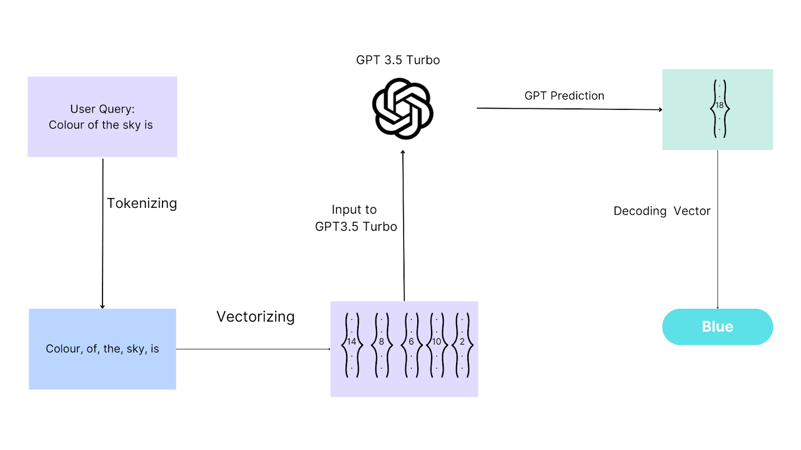
MECHANICS • WHAT AN LLM ACTUALLY DOES
What Do LLMs Do?
Tokenize, vectorize, predict the next token, decode back to text. Every answer an LLM ever gives you is this loop, run one token at a time.
InsightVerge
Notes:
PRESENTER NOTES: This diagram is the whole mechanism end to end -- tokenize, vectorize, run through the model, decode. Everything else today is zooming into one box in this picture.
NARRATION: Put the whole pipeline together and here's what an LLM actually does: your text is tokenized, the tokens are turned into vectors, the model processes those vectors and predicts the single most likely next token, and that token is decoded back into text. Then the loop repeats, one token at a time, until the model decides to stop. Everything we cover for the rest of this segment is a closer look at one box in this picture.

Slide 9
MECHANICS • WHERE EMBEDDINGS BREAK DOWN
Embeddings: Limitation
Word2vec was a good starting point. Converted words to rich numerical vectors
However key limitation: Based on the context, meaning may change
  I took my cell phone into the prison cell to meet the cell mates and collect their cell DNAs
Word2Vec gives every word ONE fixed vector, no matter the context. That's the gap attention is built to close.
InsightVerge
Notes:
PRESENTER NOTES: 'Cell phone... prison cell... cell mates... cell DNA' — four senses of 'cell' in one sentence, one fixed Word2Vec vector for all four. This is the exact motivation for attention on the next slide -- don't let it pass as a throwaway joke.
NARRATION: Word2Vec was a real breakthrough -- it converted words into rich numerical vectors. But it has one hard limitation: each word gets exactly one vector, fixed, no matter the context. 'I took my cell phone into the prison cell to meet the cell mates and collect their cell DNA' -- four completely different senses of 'cell' in one sentence, and Word2Vec would represent all four identically. We need a mechanism that lets a word's representation shift based on what's actually around it. That mechanism is attention.

Slide 10
MECHANICS • ATTENTION
Attention: the Context Finder
1
‘Cell’ four ways; Phone, prison room, inmate, biology. One word, one static vector: the embedding can't tell them apart.
2
Reweighted by neighbors; ‘Apple’ near ‘orange’ pulls toward fruit. ‘Apple’ near ‘phone’ pulls toward tech. A learned, weighted average, computed across the whole sequence at once.
3
Multi-head attention; Parallel specialist departments; one head tracks timeline, another liability, another identity; reviewing the same contract simultaneously.
Architectural consequence: whatever is in the window changes behavior. Prompt construction is context engineering, an architecture concern, not prompting trivia.
InsightVerge

Slide 11
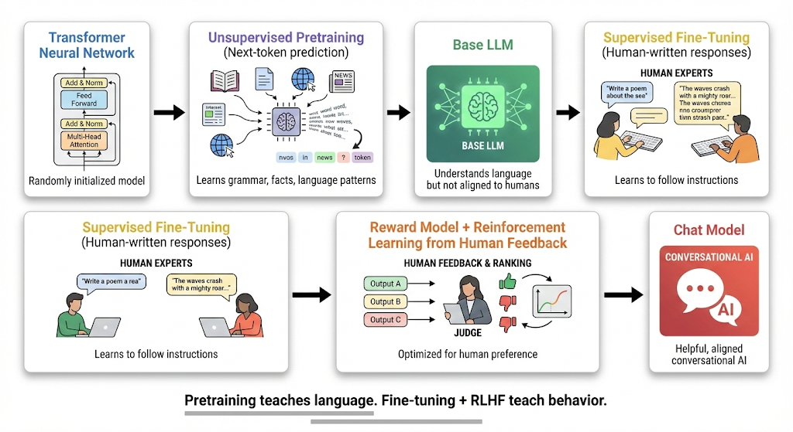
MECHANICS • FROM PREDICTOR TO ASSISTANT
How a Transformer Becomes ChatGPT
A Transformer is many attention blocks like the last slide's, stacked layer on layer. Train that stack at scale on raw text, and this is the six-stage path from there to a helpful assistant.
InsightVerge
Notes:
PRESENTER NOTES: Six panels, pretraining through RLHF. The subtitle carries the one-line definition of a Transformer (a stack of attention blocks) so the term isn't used undefined -- pause on it for a beat before moving into the pipeline. Emphasize the split: pretraining teaches language and world knowledge from raw text (next-token prediction, no labels); SFT and RLHF teach BEHAVIOR -- how to follow instructions, how to be safe and helpful. That distinction resolves a lot of 'why did it say that' questions later.
NARRATION: A Transformer, in one line, is many copies of the attention mechanism we just walked through, stacked layer on layer, each layer refining the representation a little further. Train that stack at scale on huge amounts of raw text, and here's the path from there to ChatGPT. Pretraining on huge amounts of raw text teaches the model language and a great deal of world knowledge, purely by predicting the next token, over and over, with no human labels. That alone gives you a model that completes text -- not one that follows instructions or stays on topic. Supervised fine-tuning and reinforcement learning from human feedback are what teach behavior: how to follow an instruction, how to refuse unsafe requests, how to be a helpful assistant rather than a text-completion engine. Same base model, two very different jobs.

Slide 12
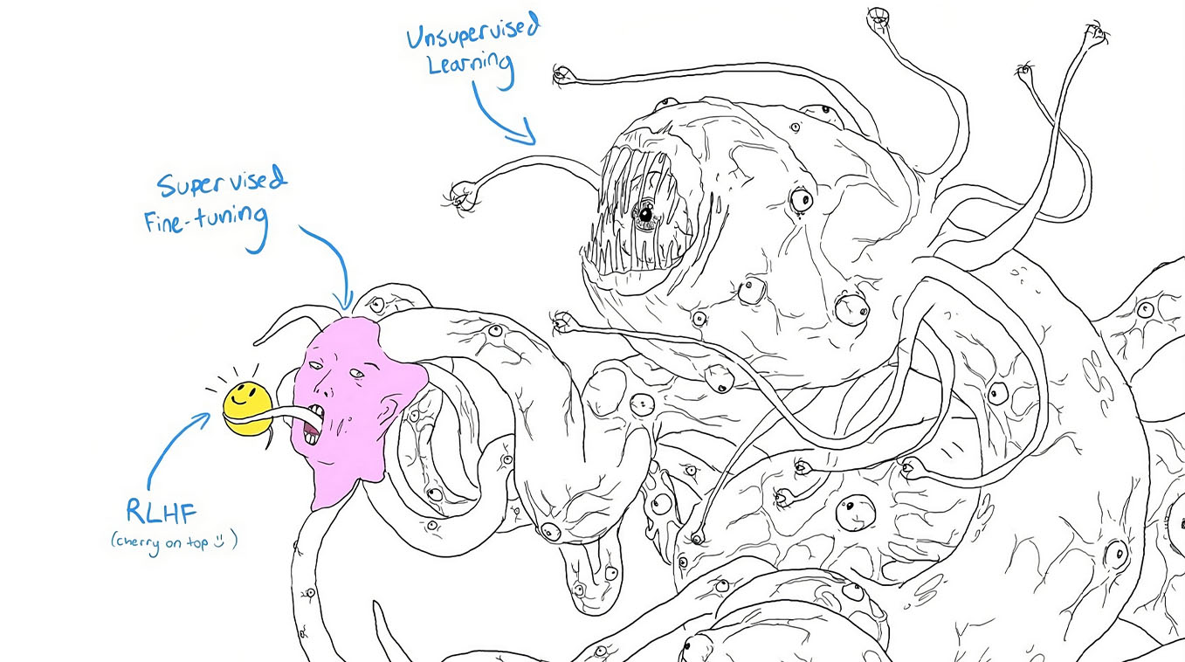
MECHANICS • THE PICTURE THAT EXPLAINS EVERYTHING
Never a database: it will fabricate a plausible policy clause with full confidence.
Never a calculator: arithmetic is a behavior it imitates, not a mechanism it has.
Never a policy engine: the rules it states are patterns of language, not enforced rules.
InsightVerge
Notes:
PRESENTER NOTES: The segment's landing slide — let the image do the work, as Day 1's Ferrari and AI-Crush images did. Deliver the three ‘never’ rules slowly; they are the theoretical justification for everything in segments 3 and 4: structured outputs (free text cannot cross a boundary), grounding (there is no truth inside), human gates (politeness is not correctness). Rhetorical question to the room: ‘What does the creature do when the smiley face doesn't know?’ — it confidently completes. That is hallucination, and it is structural.
NARRATION: I want to leave the mechanics with a picture the ML community drew of itself, because it makes a serious point. The base model — the thing that actually holds all the capability — is this vast, alien pattern-matcher that learned the statistical shape of the internet. It is not trying to be helpful. It is not trying to be truthful. It is completing text. Supervised fine-tuning and RLHF are a comparatively thin layer on top that shapes the mouth into something that behaves politely and follows instructions. The smiley face is real — the politeness is genuine engineering. But it is a layer, not the creature. So three operating rules fall out of this picture, and they justify everything else today. Never treat it as a database — it has no lookup, only completion, so it will fabricate a plausible policy clause with total confidence. Never treat it as a calculator — arithmetic is a behavior it imitates, not a mechanism it owns. Never treat it as a policy engine — the rules it states are patterns of policy language it has seen, not rules that are enforced anywhere. The polite interface is a veneer over a probabilistic completion engine. That single sentence is why we need structured outputs, why we need grounding, and why we need a human gate at the moment of commitment. Mechanics done. Now let's put this thing to work.

Slide 13
RETRIEVAL • WHY RAG
The Model Doesn't Know Two Things
Its training ended on a fixed date, and it has never seen your company's data. Retrieval is how you close both gaps.
IT'S FROZEN IN TIME
IT HAS NEVER SEEN YOUR DATA
Training data has a cutoff date. Ask about a policy that changed last month, a product that launched last week, or this quarter's numbers, and there is nothing there.
It will still answer. It just makes something up that sounds right.
Your contracts, your inventory, your internal policies, your customer history were never in its training data. No public model has trained on them.
It knows language and reasoning well. It does not know your business at all.
Retrieval hands the model what it's missing: current, company-specific facts, at the moment it answers. That's everything from here on.
InsightVerge
Notes:
PRESENTER NOTES: Two gaps, not one -- frozen training cutoff and zero exposure to private data. This is the direct consequence of the Shoggoth picture on the last slide (no lookup, only completion) and it's the sole bridge into RAG in this version of the deck; don't rush past it into the RAG diagram on the next slide.
NARRATION: A language model doesn't know two things. It's frozen in time: its training data has a cutoff date, so ask about a policy that changed last month, a product that launched last week, or this quarter's numbers, and there is nothing there. It will still answer -- it just makes something up that sounds right. And it has never seen your data: your contracts, your inventory, your internal policies, your customer history were never in its training data, no public model has trained on them. It knows language and reasoning well. It does not know your business at all. Retrieval is how you close both gaps -- hand the model current, company-specific facts, at the moment it answers. That's everything from here on.

Slide 14
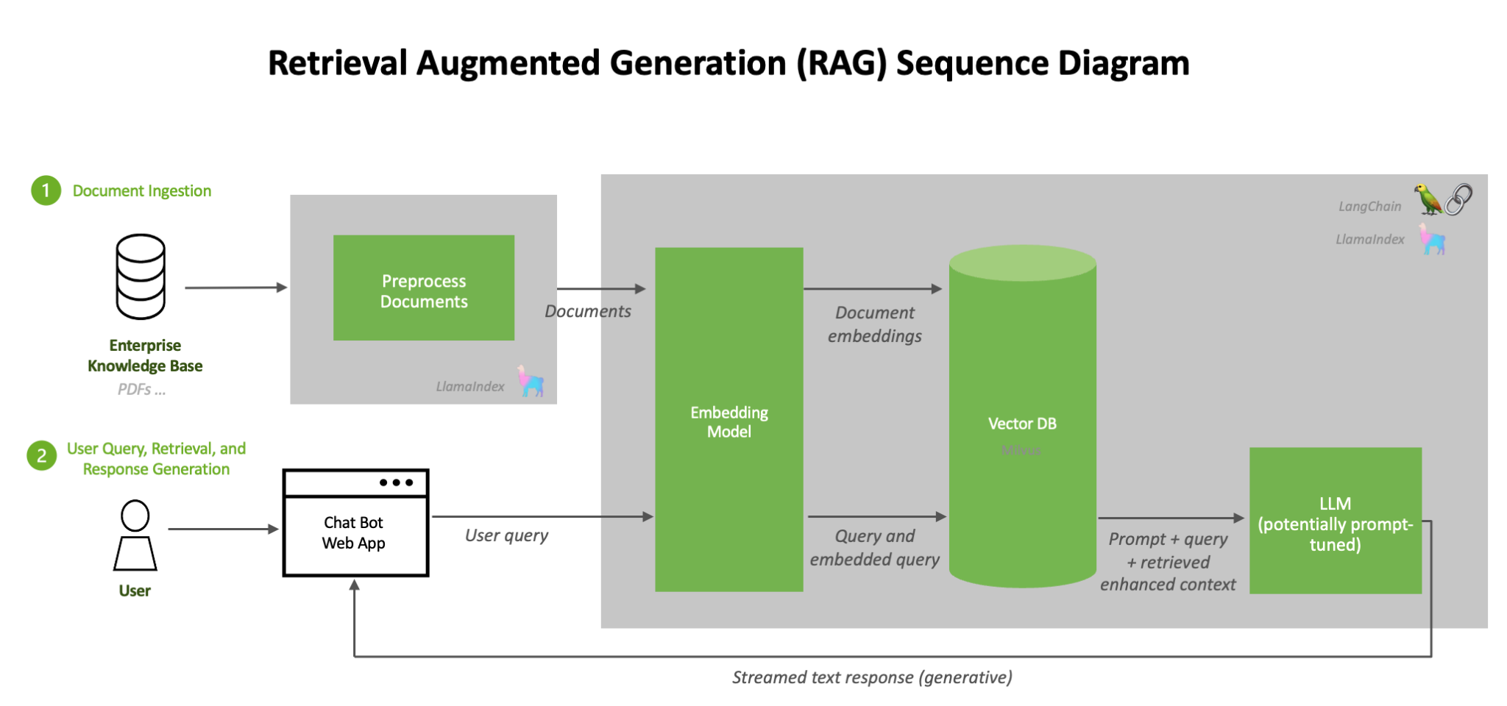
SEGMENT 3 • ENTERPRISE RAG
Memory on Demand
InsightVerge

Slide 15
RAG • HOW IT'S BUILT
Chunking: The First Decision in RAG
Before a single document can be retrieved, it has to be cut into pieces. How you cut it decides how well it can ever be found again.
THE SIZE TRADE-OFF
• Larger chunks: more context per retrieval, but slower and quick to drag in irrelevant material alongside the relevant line.
• Smaller chunks: precise and fast, but meaning leaks out across the cut. Sweet spot most teams land on: ~300–500 tokens, never split mid-sentence.
1
Fixed-size; cut every N tokens; cheapest, crudest, ignores meaning.
2
Sliding-window / recursive; overlap chunks and split on structure (headings, paragraphs) so context survives the cut.
3
Semantic / structure-aware; cut where meaning actually changes; the ladder's top rung, used when the accuracy bar is high.
A vendor-funding policy split mid-clause retrieves half a sentence, and the answer cites half a rule. Chunk boundaries are policy boundaries. Get this right first: everything downstream, including the production controls on the next slide, assumes clean chunks.
InsightVerge
Notes:
PRESENTER NOTES: This is the basic mechanic of how RAG is actually built -- keep it separate from the production/security material on the next slide. The escalation ladder (fixed-size to semantic) is the one thing worth them remembering.
NARRATION: Before anything can be retrieved, a document has to be cut into pieces, and that decision quietly controls everything downstream. Chunks too large drag in irrelevant context and slow retrieval down; chunks too small and meaning leaks out across the cut. Three hundred to five hundred tokens, never split mid-sentence, is where most teams land. The technique itself climbs a ladder: fixed-size cuts are cheapest and crudest; sliding-window and recursive splitting respect document structure; semantic and structure-aware chunking, at the top, cut where the meaning itself changes. Get chunking wrong and no amount of clever retrieval downstream can fix it.

Slide 16
RAG • PRODUCTIONIZING AT SCALE
Filter Before You Search
Same chunks, a harder problem: at a million documents, access control has to happen before similarity scoring, not after.
10M → 80K
WHY FILTER FIRST
• Access-aware filtering is a security mechanism, not a relevance feature. Tenant, document type, date, and permission decide what's even eligible.
• Filtering after the vector search means a permission check on results the model has already seen; filtering before means it never sees them.
chunks filtered by metadata before a single similarity score runs
THE HNSW TRAP
• Naive pre-filtering breaks HNSW's navigability: pruning the graph before traversal can strand the search in a disconnected pocket and miss real matches.
• Production engines (Qdrant, Weaviate, Milvus) build filtering into the ANN traversal itself, so the graph and the access rules are applied together.
This is the same index from the last slide, just at real scale. Clean chunking earns nothing if the filtering layer breaks the search that sits on top of it.
InsightVerge
Notes:
PRESENTER NOTES: This is the production/security escalation of the basic chunking mechanic on the previous slide -- same index, but now at a scale and a permission model where naive filtering actively breaks the search engine.
NARRATION: Once that index has real documents behind real access controls, a new problem shows up. Filtering isn't about relevance, it's a security boundary: tenant, document type, date, permission. Filter by metadata first and ten million chunks becomes eighty thousand before a single similarity score gets computed. Do it naively, after the vector search instead of before, and you can actually break the search index's own navigability — pruning HNSW's graph after the fact can strand the search in a disconnected pocket and miss matches that were sitting right there. Production vector databases build filtering into the graph traversal itself for exactly this reason.

Slide 17
RAG • MODES AND THE EXIT CRITERION
Retrieval: Choose the Mode, Enforce the Exit
Retrieval quality is the biggest lever on answer quality, bigger than prompt polish.
Keyword
(BM25-style)
Vector
(meaning)
Hybrid + Rerank
(production default)
Keyword is blind to synonyms; vector is blind to exact tokens (a misread SKU becomes a confident wrong answer); hybrid fuses both, then reranks before the window.
1
Cite; every claim carries a pointer to the chunk it came from; the audit trail an auditor can open.
2
Verify; claims are validated against retrieved evidence before release: source exists, quote matches.
3
STOP; when evidence is insufficient or conflicting, the workflow halts and escalates.
Where vector search fails, on deterministic lookups and database questions wearing search costumes, route to SQL/API, not a bigger top-K.
InsightVerge
Notes:
PRESENTER NOTES: Two ideas, one slide. Top: three retrieval modes and their failure profile (memorize the hybrid+rerank line — that's the production default for a reason). Bottom: groundedness isn't a model property, it's a pipeline property — cite, verify, and know when to stop.
NARRATION: Keyword search is exact but blind to synonyms. Vector search understands meaning but is blind to exact tokens — a misread SKU becomes a confidently wrong answer. Production systems fuse both signals and rerank before the context window — recall against latency against token spend. And retrieval quality alone doesn't make an answer trustworthy: groundedness lives in the workflow. Every claim needs a citation back to its source chunk. Every claim gets verified against retrieved evidence before release. And when the evidence is insufficient or conflicting, the system has to know how to stop and escalate rather than guess. Knowing when not to answer is the most valuable feature you can build.

Slide 18
RAG • MEASURING QUALITY
RAGAS: Measuring RAG Quality
The retrieval mode and the exit criterion on the last slide are only as good as your ability to prove they're working. That's a measurement problem.
WHAT RAGAS DOES
• Open-source framework (Hugging Face) that scores a RAG pipeline automatically, without a human reading every output.
• Compares the answer against both the question and the retrieved context using semantic similarity models, not string matching.
4 Metrics
RUN IT CONTINUOUSLY
• Plugged into LangChain, LlamaIndex, or TruLens as a regression test, not a one-time report.
• Judge the judge: an LLM scoring outputs agrees with humans about as often as two humans agree with each other. Good enough to catch drift, not a substitute for spot-checks.
faithfulness · context precision · context recall · relevance
This turns evaluation from a one-time gut check into a continuous regression test, the same discipline the exit criterion on the last slide was asking for, now automated.
InsightVerge
Notes:
PRESENTER NOTES: Pure measurement slide. The point isn't the tool name, it's the shift from a one-time vibe check to a continuous regression test — and the honest caveat that an LLM judge is a useful proxy, not ground truth.
NARRATION: Citations and an exit criterion tell you the workflow is disciplined. They don't tell you whether the pipeline is actually retrieving the right things week over week. That's what RAGAS is for: an open-source framework that scores your pipeline automatically, comparing the answer against both the question and the retrieved context, using semantic similarity models rather than exact matching. Four metrics: faithfulness, context precision, context recall, relevance — plugged into LangChain or LlamaIndex so it runs continuously instead of once. And a fair caveat: you're using an LLM to judge an LLM, and that judge agrees with a human grader about as often as two humans agree with each other. Good enough to catch regressions, not a replacement for periodically reading the actual outputs.

Slide 19
RAG • OPERATING IT
Running RAG in Production: Stale Data and Cost
A pipeline can score well on RAGAS on Monday and still misbehave in production by Friday. These are the two ways that happens.
STALE
EXPENSIVE
• HR updates a policy Monday; Tuesday the bot is still quoting the old one. The index didn't know anything changed.
• Fix: upsert by parent document ID so a re-ingested document replaces the old chunks instead of sitting alongside them, and weight retrieval by recency.
• 30–40% of enterprise queries are repetitive: the same handful of questions, asked by different people, hitting the full pipeline every time.
• Fix: semantic caching recognizes a previously-answered question and serves it at near-zero cost and near-zero latency, no embedding or generation call needed.
Neither failure shows up in a RAGAS score taken in isolation. Both only surface when you watch the pipeline over time, which is the whole argument for running that measurement continuously.
InsightVerge
Notes:
PRESENTER NOTES: This is operations, not measurement -- the two things that go wrong once RAG is live regardless of how well it scored in testing. Pairs naturally with RAGAS on the previous slide: measurement tells you something's wrong, this slide is two of the most common reasons why.
NARRATION: Two things go wrong once RAG is actually live. It goes stale — HR updates a policy Monday, the bot is still quoting the old one Tuesday, because nothing told the index anything changed. Fix: upsert by parent document ID so updates replace old chunks instead of piling up next to them, and weight retrieval by recency. And it gets expensive — thirty to forty percent of enterprise queries repeat, the same handful of questions from different people, and every one of them is hitting the full retrieval and generation pipeline. Semantic caching recognizes a previously-answered question and serves it back near-instantly and near-free. Neither of these shows up in a single accuracy score — they only show up when you're watching the system over time, which is exactly why the continuous measurement on the last slide matters.

Slide 20
RAG • THE EMPTY PANTRY RETURNS
Your Data Is Not Ready; and RAG Inherits That
Scattered
Stale
Tacit
The policy lives across SharePoint, email, local drives, three document systems; no single source of truth.
The documents exist, but nobody trusts them; they haven't been updated in years, so people route around them.
The worst one: the real rule lives in one person's head or one local file. The process step is literally ‘ask so-and-so.’
“The reason your AI agent keeps getting it wrong isn't the model. It's the data. Your data strategy and your AI strategy aren't two separate conversations.”
– Eniko Rozsa, IBM
Day 1's Empty Pantry, one rung up: AI amplifies whatever data system it sits on; including a weak one.
InsightVerge

Slide 21
RIGHT-SIZING • SLM VS FRONTIER
Two Deployment Worlds; and the History That Rhymes
The honest version: both worlds keep growing. Most enterprise workloads never needed the frontier.
Dimension | Frontier (cloud) | SLM (local)
Capability breadth | Deep, general | Narrow, task-focused
Latency | Network round-trip | Local, ultra-low
Cost | Per-token, recurring | Hardware, then near-zero marginal
Privacy & compliance | Data leaves the envelope | Data never leaves
Control | Provider updates silently | You pin the version, fully auditable
“Supercomputers with time-sliced access were supposed to be the future. Then commodity hardware won. Cloud LLMs are the HPC of this era; local SLMs are the commodity hardware.”; after Justin Gottschlich
InsightVerge

Slide 22
RIGHT-SIZING • THE FIRST DECISION
Prompting vs RAG vs Fine-Tuning
Everything from here to the end of this segment expands one row of this table, starting with the one most teams reach for too early: fine-tuning.
Criteria | Prompting | RAG | Fine-Tuning / PEFT
Effort to Implement | 🟢 Very low | 🟡 Medium | 🔴 High
Needs Labeled Data? | ❌ No | ❌ No | ✅ Yes (input-output pairs)
Needs External Storage? | ❌ No | ✅ Yes (vector DB, documents) | ❌ No
Personalization | 🟡 Prompt-hacked | 🟢 Strong (via content) | 🟢 Strong (via weight updates)
Grounded Knowledge | ❌ Can hallucinate | ✅ Pulls real documents | ❌ May still hallucinate
Latency | 🟢 Low | 🟡 Medium (due to retrieval step) | 🟢 Low
Best When | You just need format/style control | You want domain-aware + up-to-date output | You want custom behavior embedded in model
Escalate only when the rung below fails. Every step up this table adds cost, complexity, and governance surface.
InsightVerge
Notes:
PRESENTER NOTES: This table is the decision the rest of Move 3 unpacks one row at a time. Anchor the room here before going deep on fine-tuning mechanics -- most enterprise asks resolve in column 1 or 2, not column 3.
NARRATION: Three options, one decision. Prompting: near-zero effort, no data, no storage, but it can't add facts the model wasn't trained on and it's easy to hallucinate past. RAG: needs a vector store and a retrieval step, but it pulls real, current documents and is strongly grounded. Fine-tuning: needs labeled examples and real compute, but it's the only lever that changes the model's actual behavior rather than what it's shown at inference time. Escalate only when the rung below fails -- every step to the right adds cost, complexity, and governance surface.

Slide 23
FINE-TUNING • THE DECISION AND THE LOOP
Why Fine-Tune, and What the Loop Looks Like
The last column of the table on the last slide, opened up: when it's actually the right call, and what happens mechanically when you do it.
THE DECISION
Pre-trained
LLM
+ Task-Specific
Examples
Fine-Tuned
LLM
• Prompting = surface-level control; fine-tuning = embed knowledge or style into the model itself.
• Start with prompting.
• Use RAG if the model needs external knowledge.
• Use fine-tuning when the model itself needs to change how it behaves.
Pretraining already taught the model language and reasoning. Fine-tuning only needs to redirect it, typically a few thousand examples, not millions.
Prompting is a temporary fix; fine-tuning is permanent learning. Most problems that feel like they need fine-tuning are actually RAG problems.
InsightVerge
Notes:
PRESENTER NOTES: The heuristic in three lines (start with prompting; RAG for knowledge; fine-tune for behavior), paired with the simplest possible picture of the mechanics. The one number worth landing: a few thousand examples, not millions -- pretraining already did the expensive part.
NARRATION: Prompting gives you surface-level control that disappears the moment the prompt changes. Fine-tuning embeds knowledge or style directly into the weights -- permanent, but expensive to change your mind about. So: start with prompting; reach for RAG if the model needs external knowledge; reach for fine-tuning only when the model itself needs to behave differently. Mechanically, the loop is simple -- take a pre-trained LLM, show it task-specific examples, and nudge the weights toward producing that response. Because pretraining already taught it language and reasoning, fine-tuning only needs to redirect it. A few thousand examples, typically. Not millions.

Slide 24
FINE-TUNING • THE COST PROBLEM, AND THE FIX
The Cost Problem, and PEFT's Fix
You've decided fine-tuning is the right call. Here's why doing it the naive way is unaffordable, and the technique that makes it practical.
FULL FINE-TUNING: THE COST
PEFT: THE FIX
• GPU memory needed is equivalent to training the LLM from scratch: optimizer states, gradients, activations, on top of the weights.
• A 7B model needs 80–120 GB of GPU memory to fine-tune; a 70B model, 600+ GB.
• And that's one fine-tuned copy, for one task.
• Train only a small set of additional parameters; most layers of the LLM stay frozen.
• Less prone to catastrophic forgetting. The original weights never change.
• Dramatically less storage, compute, and budget required.
PEFT trains a small set of new parameters and freezes the rest, the same idea as adding an adapter, not rebuilding the engine.
InsightVerge
Notes:
PRESENTER NOTES (kept from source): A 7B model at 32-bit is ~28GB just to load; training needs optimizer states, gradients, and activations on top, so 80-120GB in practice -- a single A100 (80GB) isn't enough on its own. A 70B model needs 600+GB. PEFT's four advantages all trace back to freezing the base model.
NARRATION: Full fine-tuning means updating every parameter, and the memory bill is brutal -- a 7B model needs 80 to 120GB of GPU memory to fine-tune fully, a 70B model needs 600-plus GB, spread across multiple high-end GPUs, and that's one fine-tuned copy for one task. PEFT answers this directly: freeze the entire pre-trained model, train a small set of new parameters alongside it. Most of the network never sees a gradient, so memory drops sharply; because the original weights are untouched, you're far less exposed to catastrophic forgetting; and storage, compute, and budget all fall with it -- which is exactly what the next slide puts numbers on.

Slide 25
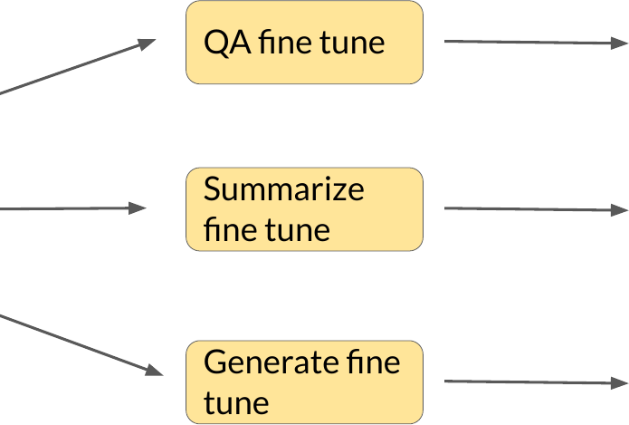
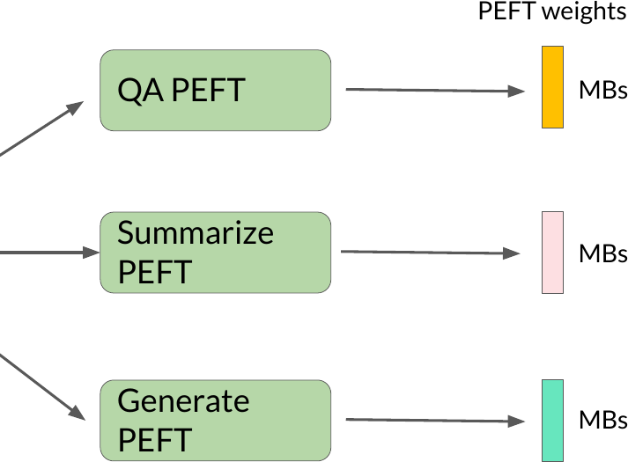
FINE-TUNING • STORAGE, BEFORE AND AFTER
Storage: Full Copies vs. PEFT Adapters
PEFT solved the training-cost problem on the last slide. It solves a second one at the same time: what it costs to keep ten fine-tuned variants around.
Full fine-tuning: one complete copy per task (~14 GB each).
PEFT: one shared base + tiny adapters (10–50 MB each).
Ten task variants: 140 GB versus under 500 MB, three orders of magnitude, and adapters retrain and roll back independently of the frozen base.
InsightVerge
Notes:
PRESENTER NOTES (kept from source): full fine-tuning: every task gets its own complete model, not a diff. 14GB base x 4 tasks = 56GB before versioning. PEFT: a full fine-tuned LLaMA-7B copy is ~14GB/task, a LoRA adapter for the same model is 10-50MB -- three orders of magnitude smaller.
NARRATION: With standard fine-tuning, every task you support needs its own complete copy of the model -- four tasks on a 14GB base is 56GB stored, before you even think about versioning or rollback. PEFT looks completely different: one shared base model, and a tiny adapter per task, 10 to 50 megabytes instead of 14 gigabytes. Ten task variants: 140GB versus under half a gigabyte. The base model becomes shared infrastructure; adapters become small, independently versioned, instantly rollback-able artifacts on top of it.

Slide 26
RIGHT-SIZING • A REAL CASE
Thomson Reuters Shows Why Companies Fine-Tune
Rent the base, own the data, and right-size the envelope. That's the trade behind every fine-tuning decision.
THOMSON REUTERS STOPPED RENTING
• ~$40M over two years to build their own model; the final training run: ~$450K. Started from an open-source base, fine-tuned on proprietary Westlaw, Practical Law, and Reuters content.
• READ THIS AS: the base model is a commodity; the proprietary data is the moat.
• DON'T READ THIS AS: "everyone should train a model." $40M is a rounding error for a $60B firm whose product IS the corpus, and a non-starter for almost everyone else.
The takeaway for us: the base model is a commodity race. The proprietary data is what wins it.
InsightVerge
Notes:
PRESENTER NOTES: Two closing beats. Left: the one real build-vs-buy case, and the two readings to give it (moat is data, not parameters; this is not a template for most of us). Right: the acid test recap, landed on your own category-manager example one last time.
NARRATION: Thomson Reuters is the one case worth taking seriously on 'should we build our own model.' Reported cost: about $40 million over two years, with a final training run of roughly $450,000, starting from an open-source base and fine-tuning on their own proprietary Westlaw, Practical Law, and Reuters content. Read this as: the base model is a commodity, the proprietary data is the moat -- their model beats frontier models on their own content because of the corpus, not the parameter count. Don't read this as a template: $40 million is two years of salaries and R&D for a $60 billion firm whose product IS the corpus; for almost everyone else it's a non-starter. Which brings us back to the boundary you actually have to defend: does the correct answer change when the documents change? That's RAG. Is the correct answer the same, just said differently? That's fine-tuning. Our category manager's policy validation question is squarely, unambiguously RAG.

Slide 27
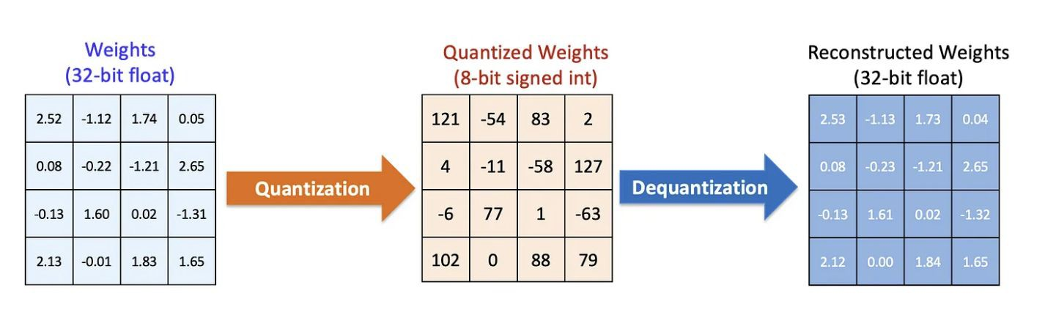
RIGHT-SIZING • QUANTIZATION
Quantization: Why Shrink It, and the Math
A different lever from PEFT. This one shrinks the model itself, fine-tuned or not, and the two are usually combined rather than chosen between.
WHY SHRINK THE MODEL?
• Most LLMs have billions of parameters, slow and memory-hungry at inference.
• Inference cost is high in the cloud; a hard blocker on the edge (memory limits, latency budgets).
• The fix: compress the model you already have, without sacrificing much performance.
Store numbers in 8-bit or 4-bit format instead of 32-bit floats. A 7B model at FP32 (~28 GB) becomes ~3.5–4 GB in INT4, a small accuracy hit, usually acceptable.
This is what makes running a serious model on a laptop or a single consumer GPU possible at all.
InsightVerge
Notes:
PRESENTER NOTES: Motivation, then math, on one slide. The headline number: 7B parameters at FP32 is ~28GB; INT4 brings that to ~3.5-4GB. That's the whole pitch for quantization in one sentence.
NARRATION: Most LLMs carry billions of parameters, which makes them slow and memory-hungry at inference -- expensive in the cloud, often a hard blocker on the edge. The fix isn't training a smaller model from scratch; it's compressing the one you have. Quantization stores each number in 8-bit or 4-bit format instead of 32-bit floating point: a 7B-parameter model at FP32 needs about 28GB, the same model in INT4 needs roughly 3.5 to 4GB -- a seven-fold reduction, for a small and usually acceptable accuracy hit. This is what makes running a serious model on a laptop possible at all.

Slide 28
RIGHT-SIZING • THE DECISION RULE
When Fine-Tuning Earns Its Cost
The conditions that make fine-tuning worth the cost, and the ones that don't.
WHEN FINE-TUNING EARNS ITS COST
JUSTIFIED WHEN:
• A stable, well-defined behavior target
• Volume high enough that per-call costs dominate
• Prompting and RAG genuinely tried and documented as insufficient
REJECTED WHEN:
• The real need is fresh or changing facts. That's what RAG solves.
• The "target behavior" is actually a moving target
• It "sounds more serious" than prompt engineering
Steering-committee line: “We fine-tune when a stable behavior, at volume, survives documentation of what prompting and RAG already achieved. Everything else rents.”
InsightVerge
Notes:
PRESENTER NOTES: This is the hard test that closes the fine-tuning thread -- three justified conditions, three common rationalizations to reject. The steering-committee line is the one sentence worth the room writing down; land it slowly, then close on the category-manager question one last time.
NARRATION: Fine-tuning is justified when three things are all true: the target behavior is stable and well-defined, the volume is high enough that per-call costs actually dominate, and prompting and RAG have genuinely been tried and documented as insufficient. It's rejected when the real need is actually fresh or changing facts -- that's what RAG solves -- when the "target behavior" is itself a moving target, or when fine-tuning just sounds more serious than prompt engineering. The line for the steering committee: we fine-tune when a stable behavior, at volume, survives documentation of what prompting and RAG already achieved. Everything else rents. Which brings us back to the boundary you actually have to defend: does the correct answer change when the documents change? That's RAG. Is the correct answer the same, just said differently? That's fine-tuning. Our category manager's policy validation question is squarely, unambiguously RAG.

Slide 29
What You're Actually Guarding Against
Enabling success takes careful usage and the right architecture, not more model, not more scale.
1
PERFORMING; “AI wishing” and “AI washing.” 75% of executives admit their AI strategy is “more for show.” 95% of GenAI pilots deliver zero P&amp;L impact. Still true.
2
SKIPPING THE BOUNDARY TEST; Fine-tuning gets reached for before the acid test does. RAG solves fresher-facts problems for a fraction of the cost and complexity.
3
NO RIGHT-SIZING DISCIPLINE; A quantized, LoRA-tuned 7B does the job a 70B model was reached for. The expensive path becomes the default when nobody checks the cheaper rung first.
4
UNDOCUMENTED REJECTS; Decisions made without recording what was tried and rejected. Teams re-litigate the same tradeoffs project after project instead of compounding what they've learned.
5
NO OWNER ON THE OUTPUT; Nobody signed off on what the model is allowed to say before it shipped. The accountability follows the company either way.
InsightVerge

