Slide 1
Components of a Linux Distro

Slide 2
Introduction
Not all components are developed by a single vendor
Linux developed by Linus torvolds and the Kernel community.
GNU tools are developed by the GNU Project developers and Free software foundation.
KDE desktop environment is developed by KDE Project, Firefox browser is developed by Mozilla, X display server is developed by the X Foundation.. And so on

Slide 3
Introduction
What Linux distributions do is that they get the source code for all those applications and build them, converting them into packages that can be installed on users computers and put them in a repository containing all those packages,
Linux distributions are actually just the shipment of those software in a specific way and format to end users, and they differ from each other by the default set of components and the software and features they offer.

Slide 4
Different components of a Linux distro
1. Linux kernel
2. GNU tools
3. Display Server or Window system
4. Display manager
5. Package manager
6. Desktop Enviroment
7. User applications

Slide 5
Different components of a Linux distro
Each component is programmed by a different programming language, you can’t say that Ubuntu for example is developed by C language, because it contains a lot of applications that are developed by other programming languages like Python, Ruby, C++, Perl.. etc.

Slide 6
1 Linux kernel
The heart of any operating system; the kernel.
Linux Kernel is the responsible part about linking the software to the hardware and distributing resources among software applications, it also runs the I/O processes and executes them by passing them to the CPU,
It is also responsible for turning on hardware parts like GPU, sound cards, internet cards, RAM, hard disks.. etc.

Slide 7
1 Linux kernel
The kernel is the heart of every single operating
system and it can’t work without it. Today, there are 19 million lines of code in the Linux kernel right now.

Slide 8
2 GNU tools
GNU is a project started in the 1980s by Richard Stallman who is also the founder of the FSF foundation.
GNU aim was to create a completely free operating system that can be an alternative to UNIX. GNU developers created all the tools and programs that surrounds the operating system, like the boot loader and the bash shell and the GCC compiler, but they didn’t get to write the operating system kernel.

Slide 9
2 GNU tools
In 1991 is that Linus Torvalds created the Linux kernel and then used the GNU software and tools to create a functional operating system.
GNU projects includes a lot of things actually, like the Bash shell, GNU C Compiler, GRUB boot loader, GTK+, Gzip, Nano and a lot of other software. Many of them his its own position right now at your Linux distribution.

Slide 10
3 Display Server
A display server is the responsible software about drawing the graphical user interface on the screen, from icons to windows and menus, every graphical thing you see on the screen is done by a display server (known also as windows system).
Without a display server, you will end up using the black command line interface for the whole screen.

Slide 11
3 Display Server
There are many display servers out there, for for Unix Like systems and Linux distributions the most famous one is the X display server, it was released in 1987, even before the Linux kernel and is used until today.
Because X server is more than 30 years old, buggy and full of security problems, some developers backed by companies like Redhat and Intel started to work on a new display server called “Wayland“, it’s still under heavy development and is available for testing right now.

Slide 12
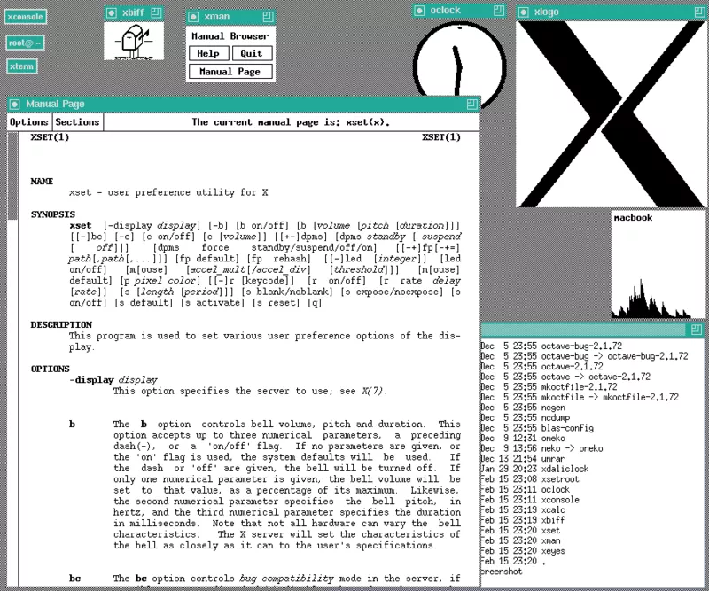
3 Display Server

Slide 13
4 Display Manager
DMs are used to show the welcome screen after the boot loader and start desktop sessions as a connection with the X display server.
Display managers are the welcome screen that asks you for your username and password before letting you login to your Desktop environment.
If you are using a GNOME environment then the default display manger should be GDM, if you are using KDE environment then the default display manager should be KDM.

Slide 14
4 Display Manager
You can use any display manager you want even if you run a different desktop environment from its default.
For those, you need to search the configurations and customization for each display manger of them, because they are different from each other. You can’t run more than one at a time because X server doesn’t allow multiple graphical sessions to be run together.

Slide 15
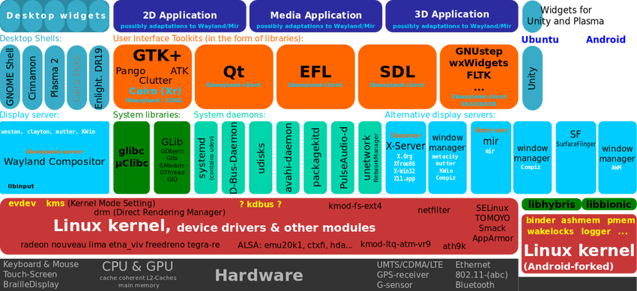
4 Daemons

Slide 16
4 Daemons
Daemons are programs that run in the background of the operating system instead of being normal applications with windows on the user interface.
They run some specific jobs and processes that are needed by the operating system, like the network-manager daemon which allows you to connect to the network automatically when you login to your system.

Slide 17
4 Daemons
The most famous daemon is called “systemd”.
It is the first process that is executed after loading the Linux kernel
It’s job is simply to control other daemons and run them when needed at boot time or at any time you want, it controls all the services available on the operating system and it can turn it on or off or modify it when needed.

Slide 18
5 Package Manager
On Linux, software are treated as “packages”, if you want to install an application, a library, a game or whatever on the Linux system and make it recognized, you should use packages and package manager to do that.

Slide 19
5 Package Manager
Open your package manger / software center to find and install the applications you need, you can search for their names and install them in one click, if you don’t know what you are looking for, you may search the packages descriptions online on websites like Ubuntu Packages and Fedora Packages to get the package name and install it later.

Slide 20
5 Package Manager
The main thing here is the packaging system, the Redhat family and many other families of Linux distributions use the “rpm” packaging system, in this system, packages come in .rpm format.
In the Debian family of Linux distributions, the system uses the “dpkg” packaging system which ships its packages as a .deb formats, you can’t install .deb files on an rpm-powered Linux distribution
You should grab the packages from your system’s official repositories as well

Slide 21
5 Package Manager
The packaging system is the core system for managing software on Linux, you may use it to create packages / install them locally and many other things, but usually we don’t deal with it on daily bases, we use a “package manager” which is like the interface for managing software on Linux.
There are many different package managers on the Linux desktop, and they differ from a distribution to another, for example, Ubuntu uses the “apt” package manager while Fedora uses “dnf”, openSUSE uses “zypper” while Arch uses “pacman”.

Slide 22
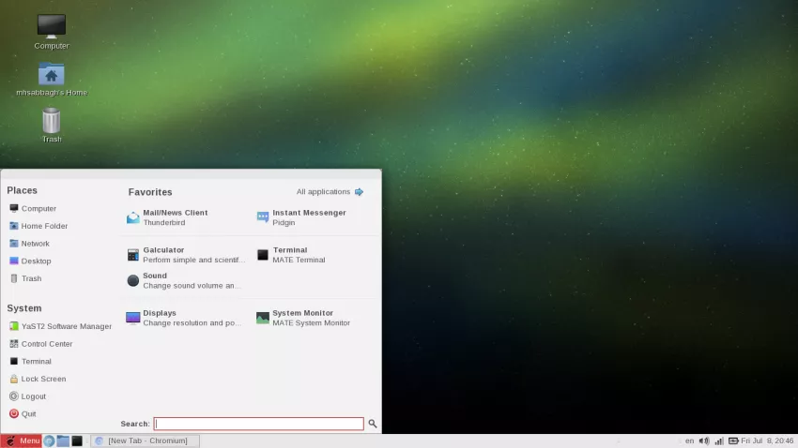
6 Desktop Environment

Slide 23
6 Desktop Environment
A desktop environment is a group of applications and libraries that are combined together to provide graphical applications to the user.
They provide a lot of core libraries, services, programs for end-users and a lot more. The most famous desktop environments on the Linux desktop are GNOME and KDE.

Slide 24
6 Desktop Environment
GNOME for example uses the GTK+ library to draw the GUI (Graphical user interface) widgets of its applications while KDE uses Qt library.
GNOME comes with a desktop interface called “GNOME Shell” while KDE comes with “KDE Plasma”.
Desktop environments also provide other applications like a display manager, file manager, session manager, archiver application, web browser, ui toolkit, settings manager.. and a lot more.

Slide 25
7 User application
The normal applications that you use every day; Firefox, LibreOffice, Terminal Emulator, VLC Media Player, Pidgin.. etc, those applications are all in the user space and can completely be different from a distribution to another.
Those applications (and all other packages) and downloaded from the distribution repositories; repositories are like a place to store the files of packages and its metadata and distribute them to the users, so that they can install them at any time they want.

