Slide 1
CAN Protocol

Slide 2
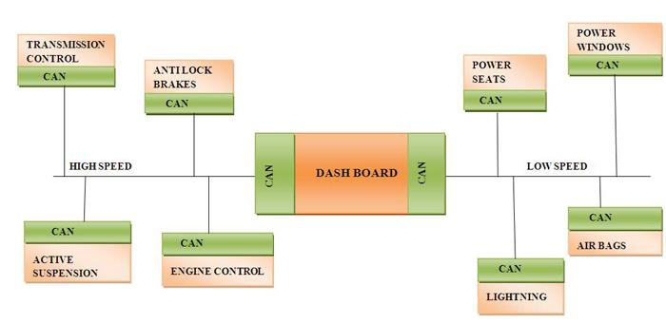
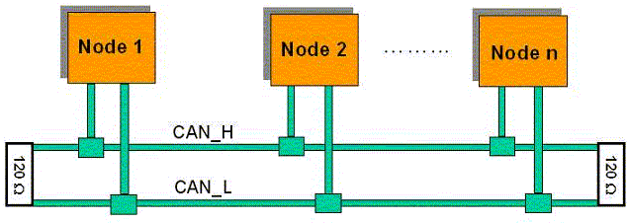
Introduction to CAN
Introduction to CAN

Slide 3

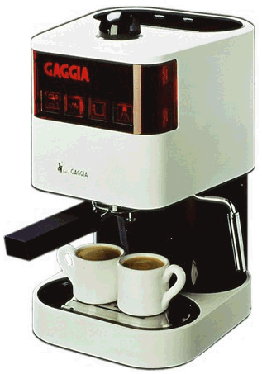


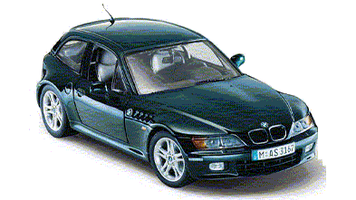

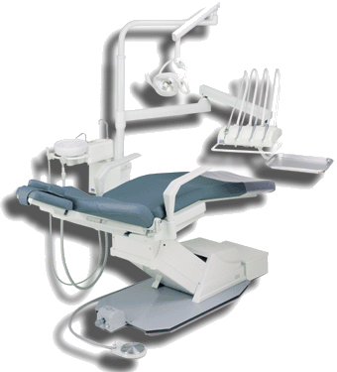

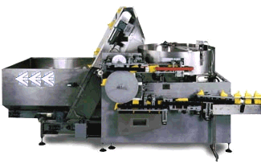
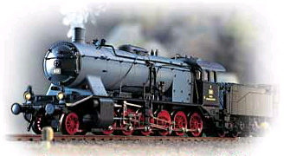
Introduction to CAN
Domestic Appliances
Construction Equipment
The many uses of
Ships & Boats
Medical Equipment
Building Automation
Trains
Industry Automation

Slide 4
Introduction to CAN
The Necessity
Usage of more and more electronics in Modern Motor Vehicles
Usage of dedicated “Electronic Control Units” for each individual functionality
The need for information exchange between various ECUs and also to share some sensors in common

Slide 5
Introduction to CAN
The communication between ECUs
By point to point interconnection
ENGINE
CO NTROL
ANTI-LOCK
BREAKING
ACTIVE
SUSPENSION
AIR
BAGS
DISADVANTAGES
Unreliable
More material cost
More production time

Slide 6
Characteristics of ‘CAN’
Multi master based, but only one master at a time
Message based protocol
Nodes can be easily added
Multicast and broadcast message transmission support
Automatic retransmission of corrupted messages
Distinction between temporary errors and permanent failures of nodes and autonomous switching off of defect nodes
Arbitration on message priority(CSMA-CD)
NRZ-5 Encoding , bit stuffing
MSB first
Error States in CAN
Differential Voltages on Bus

Slide 7
Characteristics of ‘CAN’
Serial data communications bus Inexpensive and simple, but slower than parallel bus.
Linear bus structure No star structure, no ring structure, no tree structure !
Sensor / actor bus Example: rain sensor = sensor, windscreen wipers = actor, both connected via the same bus.

Slide 8
CAN Basics
CAN Bus Characteristics
There are two logic states on the bus called “Dominant” and “Recessive”
The Dominant bit (logic level ‘0’) overwrites the Recessive bit (logic level ‘1’)
5v
TRUTH TABLE
CAN BUS
C B A BUS
D D D D
D D R D
D R D D
D R R D
R D D D
R D R D
R R D D
R R R R
R T
R T
R T
NODE A
NODE B
NODE C

Slide 9
Protocol Overview
The ISO/OSI seven-layer model and CAN
Data frames
Media access/Arbitration
Bit Stuffing
Error Handling in CAN and Types of Errors
Remote frames/Overload frames

Slide 10

The ISO/OSI 7-layer Model
The ISO/OSI seven-layer model
7
Electronic Control Unit
Applications, operating system Conversion of data formats Task synchronization, buffers, connection setup and monitoring, access rights control Address conversion, routing, segmentation Setup of logical connection, transport protocol Transmission security, frame setup, error management Electrical / mechanical characteristics: Transmission medium, wiring, connectors, encoding, signals
Application Layer
6
Presentation Layer
5
Session Layer
4
Transport Layer
3
Network Layer
2
Data Link Layer
1
Physical Layer

Slide 11
CAN within the ISO/OSI 7-layer Model
CAN within the ISO/OSI seven-layer model
7
Electronic Control Unit
not specified by the CAN Specification, implemented in Software
Acceptance filtering, error management, de-/encryption, (de-)stuffing, arbitration, frame setup, acknowledgement Encoding / decoding, bit timing, synchronization, wiring, connectors, bus, transceiver characteristics
Application Layer
6
Presentation Layer
5
Session Layer
4
Transport Layer
3
Network Layer
Implemented in Hardware
2
Data Link Layer
1
Physical Layer

Slide 12
CAN ISO specifications cover the ISO/OSI layers 1 and 2
CAN ISO specifications cover the ISO/OSI layers 1 and 2
Data Link Layer
LLC (Logical Link Control)
MAC (Medium Access Control)
CAN Driver Software
LLC: BusOff-Recovery
Acceptance filtering, Overload Notification
MAC: Data De-/Encryption, Frame Setup, (De-)Stuffing, Collision Detection, Arbitration, Error Management, Acknowledgement
PLS: Bit Encoding / Decoding Bit Timing, Synchronization
PMA: Transceiver Characteristics
MDT: Wiring, Connectors, Bus
2
CAN Controller
Physical Layer
PLS (Physical Signalling)
PMA (Physical Medium Attachment)
MDT (Medium Dependent Hardware)
1
CAN Transceiver
CAN Bus

Slide 13
CAN transmission principles
Controller Area Network Transmission Principles
Multicast / broadcast philosophy:
CAN messages do not include references to sender or receivers, but to information contents.
Bus access principle: CSMA/CA
Carrier Sense Multiple Access with Collision Avoidance
Carrier Sense: Every node monitors the bus level, all the time => monitoring of foreign and own CAN frames!
Multiple Access: Every node can start a transmission any timewhen the bus is free.
Collision Avoidance: When several nodes start transmission at the same time, all but one withdraw from sending.

Slide 14
CAN Signal Coding
Controller Area Network Signal Coding
NRZ (non-return-to-zero) coding Example: Voltage levels: 0V (dominant), 5V (recessive) Characteristics of NRZ coding: Voltage level stays the same for consecutive bits of same polarity. Note: Different voltage levels are defined for different purposes.
5V
recessive
0V
1
0
1
0
0
0
1
1
0
1
0
0
1
dominant

Slide 15
CAN Message types
There are four different message types (or “frames”) on a CAN bus:
Data Frame,
Remote Frame,
Error Frame, and
Overload Frame.

Slide 16
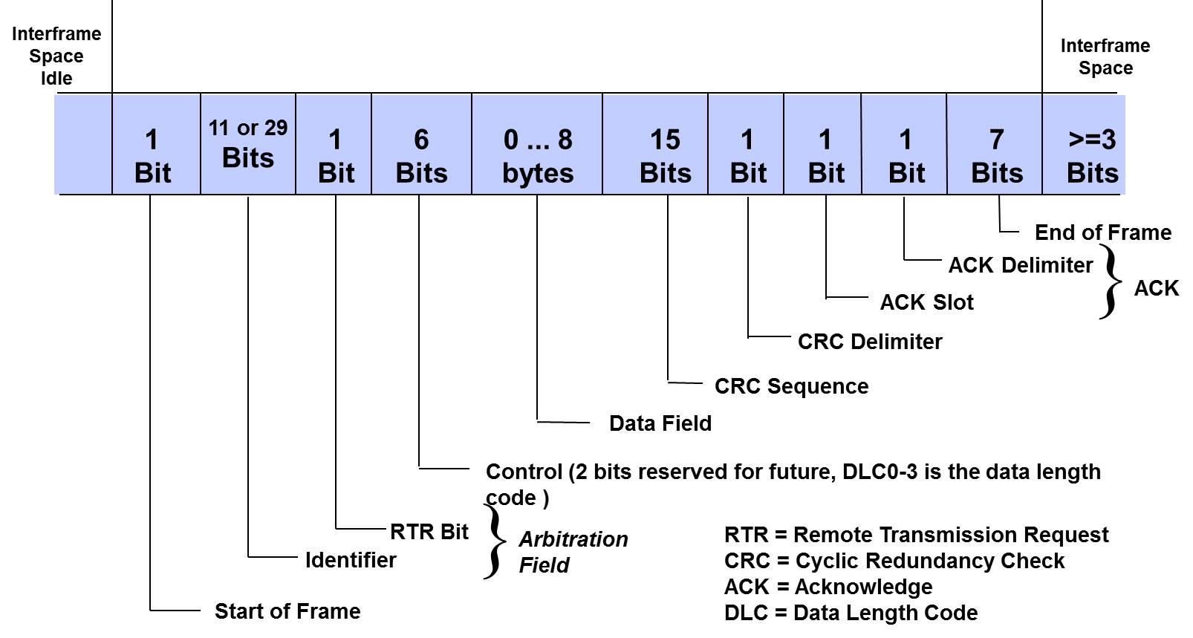
CAN Message Frame Format

Slide 17
Data Frame: Formats
Standard Format (CAN 2.0A): 11-bit Identifier 2¹¹ = 2048 (in reality only 2032) identifiers possible
Bus Idle
Arbitration Field
Control Field
Data Field
CRC Field
Ack Field
End of Frame Field
Inter- frame Space
Bus Idle
recessive
S
R
I
r
D
A
D
Bus Idle
O
11-bit Identifier
T
D
0
DLC
0..64 Bit Data
15-bit CRC
E
C
E
7-bit EOF
IFS
Bus Idle
dominant
F
R
E
L
K
L
Extended Format (CAN 2.0B): 29-bit Identifier 2²⁹ = 536.870.912 identifiers possible
Bus Idle
Arbitration field
Control Field
Data Field
CRC Field
Ack Field
End of Frame Field
Inter- frame Space
Bus Idle
recessive
S
S
I
R
r
r
D
A
D
Bus Idle
O
11-bit Base Id
R
D
18-bit Ext. Id
T
1
0
DLC
0..64 Bit Data
15-bit CRC
E
C
E
7-bit EOF
IFS
Bus Idle
dominant
F
R
E
R
L
K
L

Slide 18
CAN Message Frame Format
The Start of Frame (SOF) is a dominant 0 to tell all the other ECUs that a message is on the way.
Identifier field (ID). This is usually a functional address (e.g. Engine parameters, Wheel speeds, etc.). The value of the Identifier determines the message priority. The lower the value, the higher the priority.
The Remote Transfer Request (RTR) bit allows an ECU to request
an ID from another ECU that has not been transferred within a specified time period. When an RTR message is sent, this bit is set to Recessive (Data 1). During normal messages, the RTR bit is always set to Dominant (Data 0).

Slide 19
CAN Message Frame Format
The Control Field contains the Data Length Code (DLC). The DLC simply informs of the length of the data field. This can be a value between 0 and 8 Bytes. It is always in Bytes. Even if the node wants to send just one bit, a Byte must be assigned. There can be 0 Byte frames. The RTR message is a 0 Byte message. In some protocols, a 0 Byte message can be used as health/heartbeat message.
The Data Field contains the information to be relayed to other ECUs, e.g. the Engine Parameters message may contain info such as Engine speed, Water & Oil Temp, etc. The format of the data and how it is interpreted is covered in a later section.
The Cyclic Redundancy Check (CRC) is a 15 bit sequence used for checking the integrity of the data.

Slide 20
CAN Message Frame Format
CAN data frames and remote frames contain a safeguard based on a CRC polynomial: The transmitter calculates a check sum from the transmitted bits and provides the result within the frame in the CRC field.
The receivers use the same polynomial to calculate the check sum from the bits as seen on the bus-lines. The self-calculated check sum is compared with the received on. If it matches, the frame is regarded as correctly received and the receiving node transmits a dominant state in the ACK slot bit, overwriting the recessive state of the transmitter. In case of a mismatch, the receiving node sends an Error Frame after the ACK delimiter.
In Classical CAN, a 15-bit CRC polynomial is used (x¹⁵ + x¹⁴ + x¹⁰ + x⁸ + x⁷ +x⁴ +x³ + x⁰).

Slide 21
CAN Message Frame Format
The Acknowledge (ACK) slot is a single bit generated by all receiving CAN node to indicate that their CRC processes are OK. The transmitter node leaves this bit recessive (Data 1), and the receiver nodes all insert a dominant bit (Data 0) in this slot. This indicates that all receivers are OK with the integrity of the CAN frame data.
Delimiters. CRC and the ACK fields have a one bit Delimiters.
End-of-Frame (EOF). EOF is a seven bit recessive sequence at the end of the CAN frame. This, along with the minimum of 3 bits of Interframe Space, give enough time delay to allow for the next access of CAN messages.

Slide 22
CAN Message Frame Format
Maximum frame size (for 8 Data Bytes)
without stuff bits
with stuff bits
Standard Frame CAN 2.0A (11-bit identifier)
111 bits
130 bits
Extended Frame CAN 2.0B (29-bit identifier)
131 bits
154 bits

Slide 23
Arbitration
Arbitration
Arbitration = the allocation of bus access rights
Arbitration occurs when several nodes start transmission on the bus at the same time
Arbitration procedure: 1. All controllers monitor the bus while transmitting simultaneously
2. A dominant bit (“0”) pulls the bus voltage level to zero
3. When a controller transmits “1”, but observes “0” on the bus, it has lost arbitration
4. Controllers who lost arbitration retreat immediately and retry later
5. Arbitration is won by frame with lowest identifier = highest priority

Slide 24
Arbitration : Example
Arbitration: Example
Start
withdraws
Bus Idle
SOF
Unit 1
ID: 13Dh
recessive
1
0
0
0
1
0
0
1
1
1
1
0
1
loses arbitration
dominant
Start
Bus Idle
SOF
Unit 2
ID: 069h
recessive
1
0
0
0
0
0
1
1
0
1
0
0
1
wins arbitration
dominant
Start
withdraws
Bus Idle
SOF
Unit 3
ID: 079h
recessive
1
0
0
0
0
0
1
1
1
1
0
0
1
loses arbitration
dominant
Bus level
recessive
1
0
0
0
0
0
1
1
0
1
0
0
1
dominant

Slide 25
Bit Stuffing: Motivation
Bit stuffing: Motivation
Problems when using NRZ coding
recessive
1
0
1
0
0
0
1
1
0
1
0
0
1
dominant
long sequences of bits of the same polarity
no changes in voltage level for a longer time
no falling edges for synchronization
synchronization between sender and receiver may be lost

Slide 26
Bit Stuffing: Approach
Bit stuffing: Approach
Solution: Bit stuffing
After five consecutive bits of same polarity, insert one bit of reverse polarity
CRC code is calculated before bit stuffing is done
bit stuffing is done by the sender directly before transmission
de-stuffing is done by the receiver directly after reception
CRC code check is done after de-stuffing the frame
bit stuffing is applied to part of the frame from SOF to CRC field

Slide 27
Bit Stuffing: Example
Bit stuffing: Examples
Example 1
original sequence
recessive
1
0
0
0
0
0
0
1
0
1
0
0
1
dominant
recessive
stuffed sequence
1
0
0
0
0
0
1
0
1
0
1
0
0
1
dominant
stuff bit
Example 2
original sequence
recessive
1
0
0
0
0
0
1
1
0
1
0
0
1
dominant
stuffed sequence
recessive
1
0
0
0
0
0
1
1
1
0
1
0
0
1
dominant
stuff bit
Example 3
original sequence
recessive
1
0
0
0
0
0
1
1
1
1
0
0
1
dominant
stuffed sequence
recessive
1
0
0
0
0
0
1
1
1
1
1
0
0
0
1
dominant
stuff bit
stuff bit

Slide 28
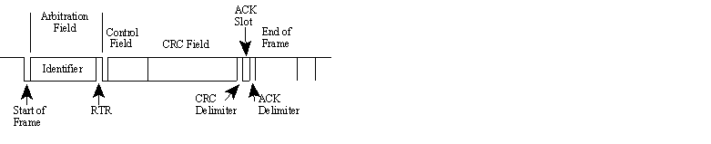
The Remote Frame
The Remote Frame is just like the Data Frame, with two important differences:
It is explicitly marked as a Remote Frame (the RTR bit in the Arbitration Field is recessive), and
there is no Data Field.
The intended purpose of the Remote Frame is to solicit the transmission of the corresponding Data Frame
Most CAN controllers can be programmed either to automatically respond to a Remote Frame, or to notify the local CPU instead.

Slide 29
The Remote Frame
Node A transmits a Remote Frame with the Arbitration Field set to 234, then node B, if properly initialized, might respond with a Data Frame with the Arbitration Field also set to 234.
There’s one catch with the Remote Frame: the Data Length Code must be set to the length of the expected response message. Otherwise the arbitration will not work.

Slide 30
CAN Errors/CAN Error Detection
How CAN Handles Errors?
Error handling is built into in the CAN protocol and is of great importance for the performance of a CAN system. The error handling aims at detecting errors in messages appearing on the CAN bus, so that the transmitter can retransmit an erroneous message
Error Detection Mechanisms
The CAN protocol defines no less than five different ways of detecting errors. Two of these works at the bit level, and the other three at the message level.
Bit Monitoring.
Bit Stuffing.
Frame Check.
Acknowledgement Check.
Cyclic Redundancy Check.

Slide 31
CAN errors – Applicable fields

Slide 32
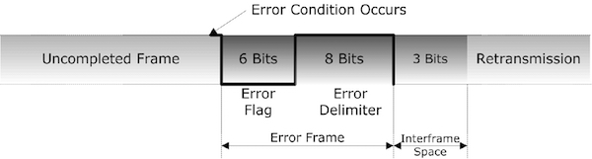
The Error Frame
It is transmitted when a node detects a fault and will cause all other nodes to detect a fault – so they will send Error Frames, too. The transmitter will then automatically try to retransmit the message.
The Error Frame consists of an Error Flag, which is 6 bits of the same value (thus violating the bit-stuffing rule) and an Error Delimiter, which is 8 recessive bits. The Error Delimiter provides some space in which the other nodes on the bus can send their Error Flags when they detect the first Error Flag. This occurs immediately with the next bit interval, unless the detected error is a CRC error
In case of a CRC error the sending of the error flag will be delayed by two bit times in order not to conflict with the Acknowledge function.

Slide 33
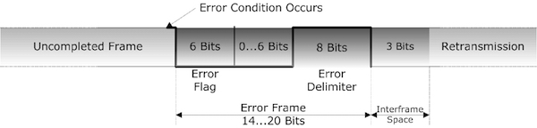
The Error Frame
An error frame, posted by any number of nodes, will be recognized as an error condition by all other nodes in the network. In turn they, too, will send an error frame to the bus.
The actual posting of the error frames may occur at different times from node to node. As a result, the actual error flag, as it occurs on the bus, may be constructed by a superposition of several error frames.
The actual error flag length will be between 6 and 12 bit times. The total error frame length will be between 14 and 20 bit times. Using these numbers plus the Interframe Space length of 3 bits it is possible to determine the total error recovery time in a CAN network.

Slide 34
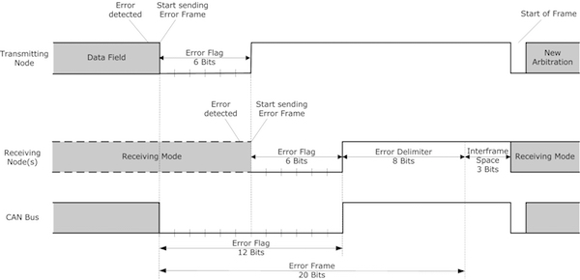
Example: Transmitting Error

Slide 35
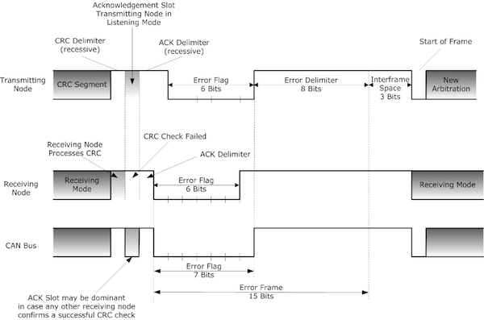
Example: Receiving Error

Slide 36
Example: Receiving Error
The transmitting node, after sending the CRC sequence plus the recessive CRC Delimiter, will switch into listening (receiving) mode and wait for one bit time to monitor the response from other nodes in the network.
In this example a receiving node determined a CRC error during the CRC Delimiter and reports the error by posting a recessive level during the Acknowledgement Slot. The posting of the recessive level may not have any effect on the bus level in case other nodes in the network do not detect a CRC error. In this case the bus level will remain dominant.
The error-reporting node will delay the posting of an error frame for two bit times, i.e. the Acknowledgement slot and the ACK Delimiter, in order not to conflict with the Acknowledge function. The error frame will be sent to the bus right after the completion of the ACK Delimiter.

Slide 37
Example: Receiving Error
At the same time, i.e. right after the completed ACK Delimiter, the transmitting node will detect a bit error, because it was attempting to send the first of 7 recessive bits of the End of Frame field.
The transmitting node in turn will post its own error frame. As shown the resulting error flag length on the bus will be 7 bit times.
Both examples, transmitting and receiving error, describe scenarios of overlapping error flags posted by different nodes in the network. The CAN standard considers the monitoring and timing of error frames to determine which node(s) reported the error first. In addition the determination of local and global errors allows the detection of single defective nodes

Slide 38
CAN
Error Handling in CAN
TEC<=255
REC > 127
OR
ERROR
PASSIVE
TEC > 255
Reset
TEC > 127
ERROR
ACTIVE
BUS
OFF
REC <= 127
AND
TEC <= 127
REC <= 127
OR
TEC <= 127
Re-
Initialization
only
After 128 occurrences of 11 consecutive recessive bits

Slide 39
CAN
Error Handling in CAN
Each node maintains two error counters:
Transmit Error Counter and the Receive Error Counter.
A transmitter detecting a fault increments its Transmit Error Counter faster than the listening nodes will increment their Receive Error Counter.
Transmit errors give 8 error points, and receive errors give 1 error point. Correctly transmitted and/or received messages causes the counter(s) to decrease.
When the Transmit Error Counter raises above 127 (i.e. after 16 attempts), node A goes Error Passive. The difference is that it will now transmit Passive Error Flags on the bus.
A Passive Error Flag comprises 6 recessive bits, and will not destroy other bus traffic – so the other nodes will not hear A complaining about bus errors. However, A continues to increase its Transmit Error Counter. When it raises above 255, node A finally gives in and goes Bus Off.

Slide 40
CAN
What is Bus Off?

Slide 41
The Overload Frame
Very similar to the Error Frame with regard to the format and it is transmitted by a node that becomes too busy.
The Overload Frame is not used very often, as today’s CAN controllers are clever enough not to use it. In fact, the only controller that will generate Overload Frames is the now obsolete 82526.

Slide 42
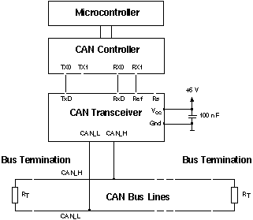
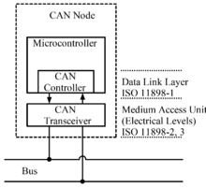
CAN Physical Layer - The CAN Bus lines
The CAN bus uses Non-Return To Zero (NRZ) with bit-stuffing. There are two different signaling states: dominant (logically 0) and recessive (logically 1).
These correspond to certain electrical levels which depend on the physical layer used (there are several.)
The modules are connected to the bus in a wired-AND fashion: If just one node is driving the bus to the dominant state, then the whole bus is in that state regardless of the number of nodes transmitting a recessive state.

Slide 43
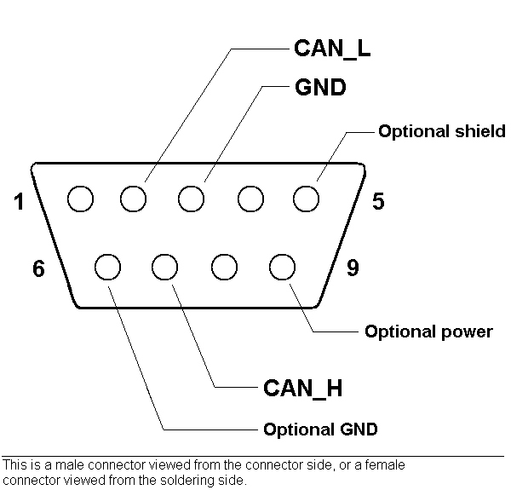
CAN
CAN Physical Layer - CAN Connectors
There is no standard at all for CAN bus connectors! Usually, each Higher Layer Protocol(!) defines one or a few preferred connector types.
Common types include,
9-pin DB, proposed by CiA.
5-pin Mini-C and/or Micro-C, used by DeviceNet and SDS.
6-pin Deutch connector, proposed by CANHUG for mobile hydraulics.
Go to Page 7 to view a few different connector layouts.

Slide 44
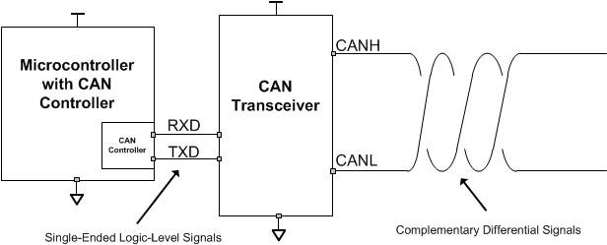
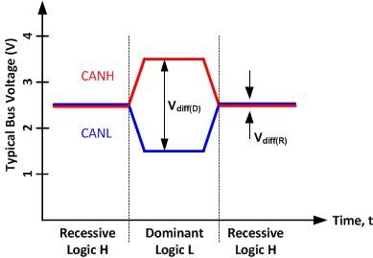
CAN Physical Layer - CAN Bus Levels
The CAN bus has two logical states: dominant and recessive.
The dominant state occurs when a logic low level is applied to the transmit input pin (usually called TXD) of the transceiver.
The recessive state corresponds to a logic high level on the transmit input pin of the transceiver.

Slide 45
CAN Physical Layer - CAN Bus Levels
Both CANH and CANL bus pins are biased to the same level: ~2.5V.
During the dominant state, the CANH bus pin is biased to a higher voltage potential (~3.5V) and the CANL bus pin is biased to a lower voltage potential (~1.5V).
By subtracting the voltage potential of the two bus pins, you can determine the logical state of the bus

Slide 46
CAN bit timing/Baud rate calculation
The Nominal Bit Rate of the network is uniform throughout the network and is given by:
where tNBT is the Nominal Bit Time.
A bit is divided into four separate non-overlapping time segments -
SYNC_SEG
PROP_SEG
PHASE_SEG1
PHASE_SEG2.

Slide 47
CAN bit timing/Baud rate calculation
The period of the Nominal Bit Time (NBT) is the sum of the segment durations:
Each of these segments is an integer multiple of a unit of time called a Time Quantum, tQ.
The duration of a Time Quantum is equal to the period of the CAN system clock, which is derived from the microcontroller (MCU) system clock or oscillator by way of a programmable prescaler, called the Baud Rate Prescaler.

Slide 48
Relationship Between CAN system Clock and CAN bit period

Slide 49
CAN bit timing segment values

Slide 50
Synchronization Segment
For each CAN node, the nominal start of each bit is the beginning of the SYNC_SEG segment. For nodes that are transmitting, the new bit value is transmitted from the beginning of the SYNC_SEG segment.
For receiving nodes, the start of the received bit is expected to occur during the SYNC_SEG segment. Due to the propagation delay of the transmitted signal through the physical interface to the bus and along the bus itself, the SYNC_SEG segment of receiving nodes will be delayed with respect to the SYNC_SEG segment of the transmitting node(s).
The actual delay will vary depending on the distance between the transmitting and receiving nodes being considered.

Slide 51
Propagation delay between nodes

Slide 52
Bit Synchronization
Synchronization is required due to phase errors between nodes which may arise due to nodes having slightly different oscillator frequencies, or due to changes in propagation delay when a different node starts transmitting.
Two types of synchronization are defined, hard synchronization and re-synchronization.
Hard synchronization is performed only at the beginning of a message frame, when every CAN node aligns the SYNC_SEG of its current bit time to the recessive to dominant edge of the transmitted Start-Of-Frame bit.
Re-synchronization is subsequently performed during the remainder of the message frame, whenever a change of bit value from recessive to dominant occurs outside of the expected SYNC_SEG segment.
Bit value is transmitted from SYNC_SEG until the end of the PHASE_SEG2 segment

Slide 53
Bit Synchronization
All nodes which are active receive the data on the bus (including transmitting nodes) and any changes in bit value are expected to occur during the SYNC_SEG segment.
If a recessive to dominant bit value transition is detected outside of a receiving nodes SYNC_SEG segment, then that node will re-synchronize to the edge.
If a recessive to dominant bit value transition is detected after the SYNC_SEG segment, but before the sample point, then this is interpreted as a late edge.
The node will attempt to re-synchronize to the bit stream by increasing the duration of its PHASE_SEG1 segment of the current bit by the number of Time Quanta by which the edge was late, up to the re-synchronization jump width limit(RJW)

Slide 54
Bit Synchronization
If a recessive to dominant bit value transition is detected after the sample point but before the SYNC_SEG segment of the next bit, then this is interpreted as an early bit.
The node will now attempt to re-synchronize to the bit stream by decreasing the duration of its PHASE_SEG2 segment of the current bit by the number of Time Quanta by which the edge was early, by up to the resynchronization jump width limit
The number of Time Quanta by which a bit period may be extended or shortened due to re-synchronization is limited by a programmable value
called the re-synchronization jump width (RJW or SJW).

Slide 55
RJW rules
The re-synchronization jump width cannot exceed 4 Time Quanta.
It also must not exceed the number of Time Quanta in the PHASE_SEG1 segment.
The minimum value for the re-synchronization jump width is 1 Time Quantum.
Note:
In order to minimize the maximum time between recessive to dominant
edges, and hence maximize the number of opportunities for
resynchronization, the CAN protocol uses bit stuffing.

Slide 56
Bit Synchronization
No separate clock signal on the CAN bus to synchronize the node
To a effectively achieve this CAN frames have NRZ-5 coding
Hard synchronization of the clocks:
When the transmitting node sends a CAN frame all the clocks of the receiving nodes are synchronized to the transmitter clock at the falling edge of the “Start of Frame” (SOF) bit.
Subsequent falling edges of the CAN frame are used for soft synchronization of the nodes.

Slide 57
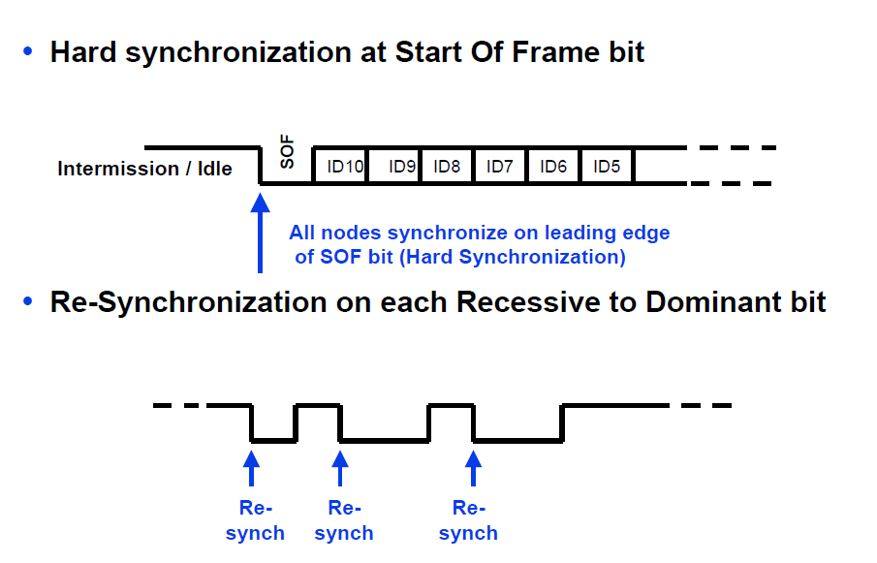
Bit Synchronization

Slide 58
Bit Sampling and Soft Synchronization
There are many causes of timing errors which lead to the incorrect sampling of data. The most important is the error in the main clock from which the CAN clock is derived and delays in the cable.
The CAN frame can be as long as 149 bits. To sample such a long frame correctly the restrictions on clock error and cable length are not practical to achieve.
CAN specifications allow solving this problem by the use of soft synchronization of the CAN clock.
The receiving nodes synchronize the CAN clock at all recessive to dominant edges of the CAN frames

Slide 59
Bit Sampling and Soft Synchronization
Soft synchronization takes care of both positive and negative phase errors in the received CAN frame.
A phase error is positive, if the arriving edge is delayed from the expected time; and negative, if it is ahead of the expected time
If there is a positive phase error then the sampling point is delayed by increasing the phase segment 1 delay by positive phase error but not more than the maximum synchronization jump width.
Similarly, if there is a negative phase error the sampling point is moved ahead by the amount of the phase error by decreasing the phase error by 2, again limited by the maximum synchronization jump width.

Slide 60
Vector CAN Interfaces

Slide 61
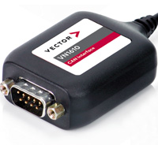
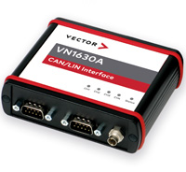
CAN network Interfaces
VN161x, VN7610
Cost-efficient network interface with USB interface for CAN and CAN FD.
Channels: 2 x CAN (FD) (fixed)
VN1630
Flexible, cost-efficient network Interface with USB interface for CAN, CAN FD, LIN, K-Line, J1708 and IO. Channels: 2 x CAN (FD) (fixed), 2 x CAN (FD)/LIN/K-Line/J1708 (variable)
VN1640A
Flexible, cost-efficient network interfaces with USB interface for CAN, LIN, K-Line, J1708 and IO. Channels (all variable): 0..4 x CAN (FD), 0..4 x LIN, 0..2 x K-Line, 0..4 x J1708

Slide 62
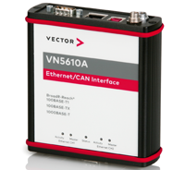
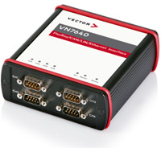
CAN network Interfaces
VN5610A
Network Interface with USB Interface for Ethernet and CAN
VN7640
Flexible Interface for the CAN FD, LIN, FlexRay and Ethernet Connection via USB
VN5640
Powerful Network Interface with USB Interface for Ethernet and CAN FD

Slide 63
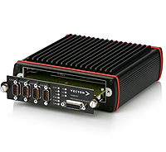
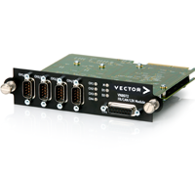
CAN network Interfaces – PC cards
VN8900/VN8970/VN8972
FlexRay/CAN/LIN/J1708 Network Interface with up to 8 Channels including Integrated Real-time PC for CANoe/CANalyzer/CANape

