Slide 1
CANoe Basic Training and CAPL -Anand K

Slide 2
Prerequisites for Using CAPL
To use CAPL effectively you need the following:
A CANoe tool – the programmable version is required
An understanding of the CAPL Browser – where you write your CAPL program
A database tool – CANdb++ – to create your shared network data variables
CAPL programming knowledge
A small amount of CAN communication knowledge
C programming language because CAPL syntactically same as C

Slide 3
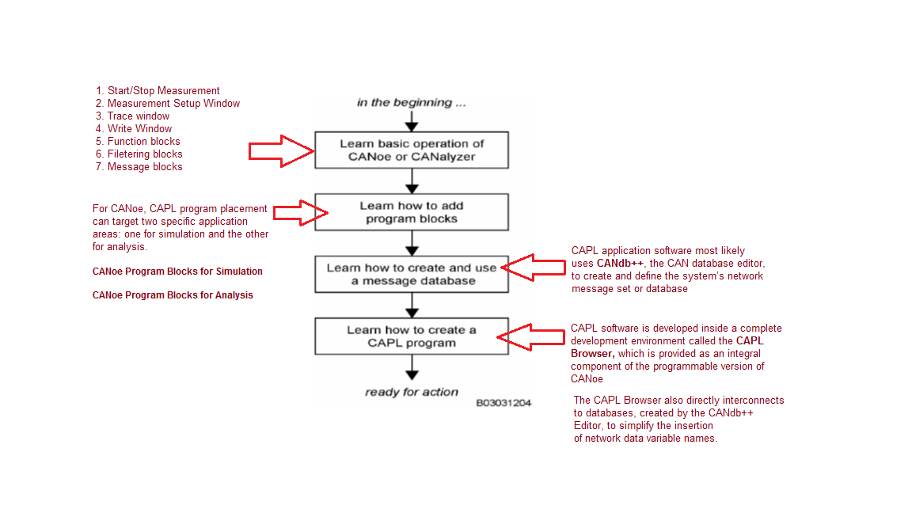
Learning Steps

Slide 4
CAPL Programming
The CAN Access Programming Language CAPL is a C-like programming language, which allows you to program CANoe for individual applications.

Slide 5
Introduction to CAPL
CAPL, the CAN Access Programming Language, allows you to quickly develop code that makes CANalyzer or CANoe simulations more powerful.
CAPL is a procedural language whereby the execution of program blocks is controlled by events. These program blocks are known as event procedures.
The program code that you define in event procedures is executed when the event occurs.
For example,
You can send a message on the bus in response to a key press (on key), track the occurrence of messages on the bus(on message), or execute certain actions cyclically (on timer).

Slide 6
Introduction to CAPL

Slide 7
Introduction to CAPL
CAPL software can be created to respond to the following:
Time events (software timers)
I/O events (keyboard, serial port, parallel port)
CAN communication events (messages, errors)
CAPL is an event-driven language, CAPL will only executes one event procedure at a time. If there are no events, you can say that the CAPL program is “idle”.

Slide 8
Introduction to CAPL
CAPL provides many predefined functions that support working with the CANoe and CANalyzer development, testing and simulation tools.
The goal of CAPL has always been to solve specific tasks as simply as possible. Typical tasks are reacting to received messages, checking and setting signal values and sending messages.
CAPL programs use specific databases for the concepts of the system under analysis. Messages and signals get their names there and these names can be used directly in the CAPL program code.

Slide 9
Introduction to CAPL
CAPL programs do not give the user any pointer types to use. Right from the outset this excludes numerous potential programming errors and causes of program crashes, such as those that frequently happen in C programming. Nonetheless, since pointers – aside from their susceptibility to errors − also represent a very powerful concept.
CAPL provides a substitute for some things, e.g. associative arrays as a substitute for dynamic memory.
One important property that CAPL shares with C should be mentioned: CAPL is always compiled, i.e. it is converted to efficiently executable and flexible machine code.

Slide 10
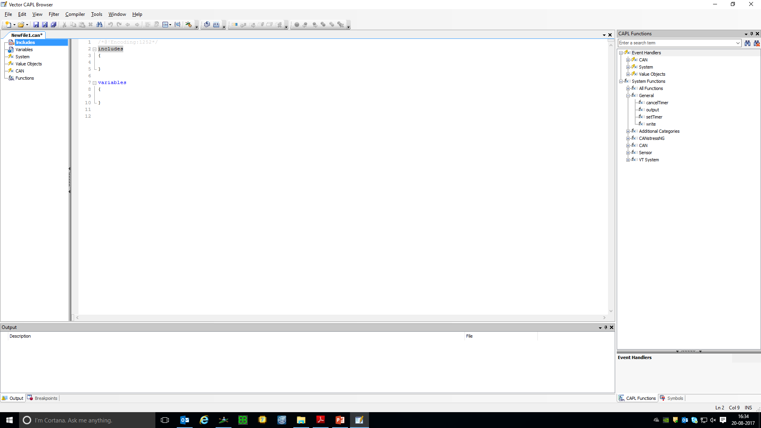
CAPL browser(Tools->CAPL Browser)

Slide 11
CAPL browser
CAPL software is developed inside a complete development environment called the CAPL Browser, which is provided as an integral component of the programmable version of CANalyzer or CANoe.
The CAPL Browser essentially combines a text editor and a compiler with an easy-to-use graphical user interface.
The CAPL Browser also directly interconnects to databases, created by the CANdb++ Editor, to simplify the insertion of network data variable names.

Slide 12
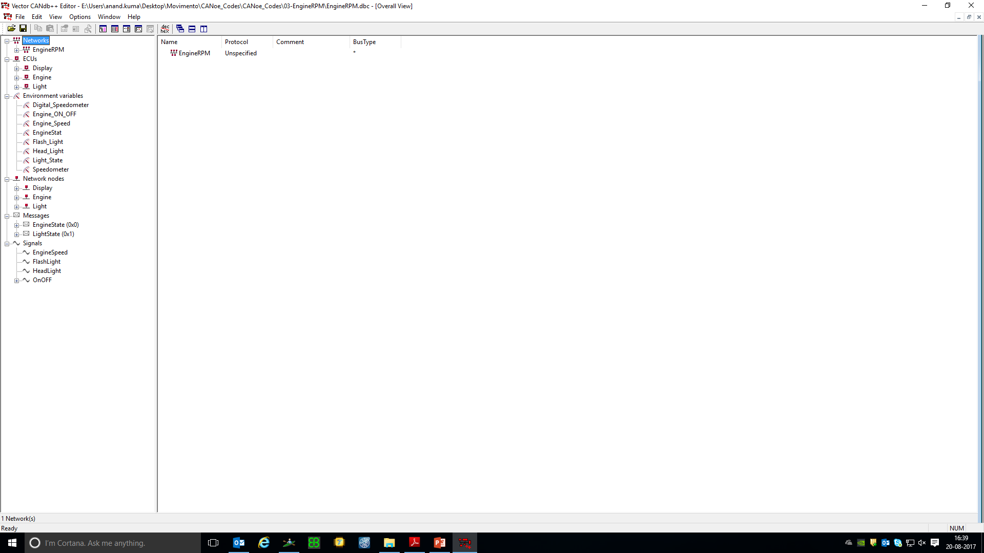
CANdb++ Editor(Tools->CANdb++ Editor)

Slide 13
CANdb++
CAPL application software most likely uses CANdb++, the CAN database editor, to create and define the system’s network message set or database.
With CANdb++, you can perform all of the following tasks:
Define network nodes
Define messages and its properties
Define and position data items or signals within a CAN message
Define the physical units of a signal, if appropriate
Define symbolic values for a signal, if appropriate
Define common variables (known as attributes), if appropriate

Slide 14
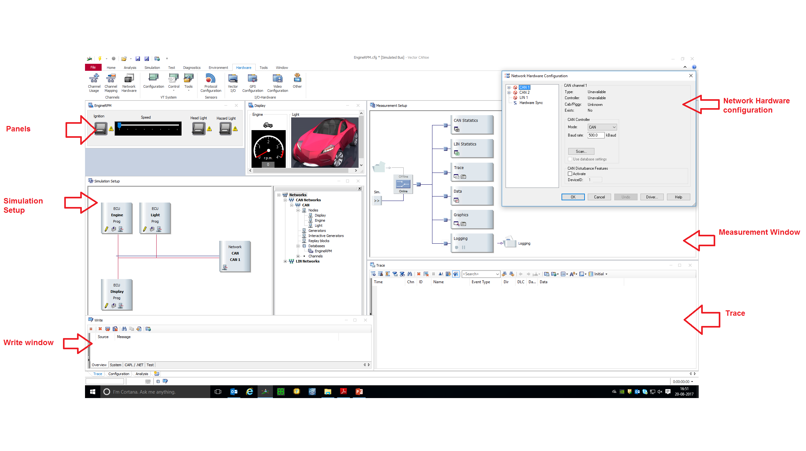
CANoe

Slide 15
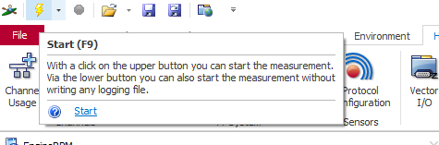
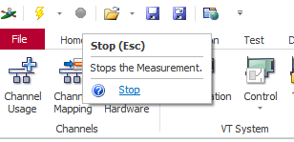
CANoe – Start/Stop Measurement
To run CANoe, look at the upper toolbar and find a pair of grouped buttons – the “lightning bolt” (in yellow) and the “stop sign” (deactivated at the moment). Follow the steps below:
Click on the “lightning bolt” to start CANoe.
2. Click on the “stop sign” to stop CANoe.

Slide 16
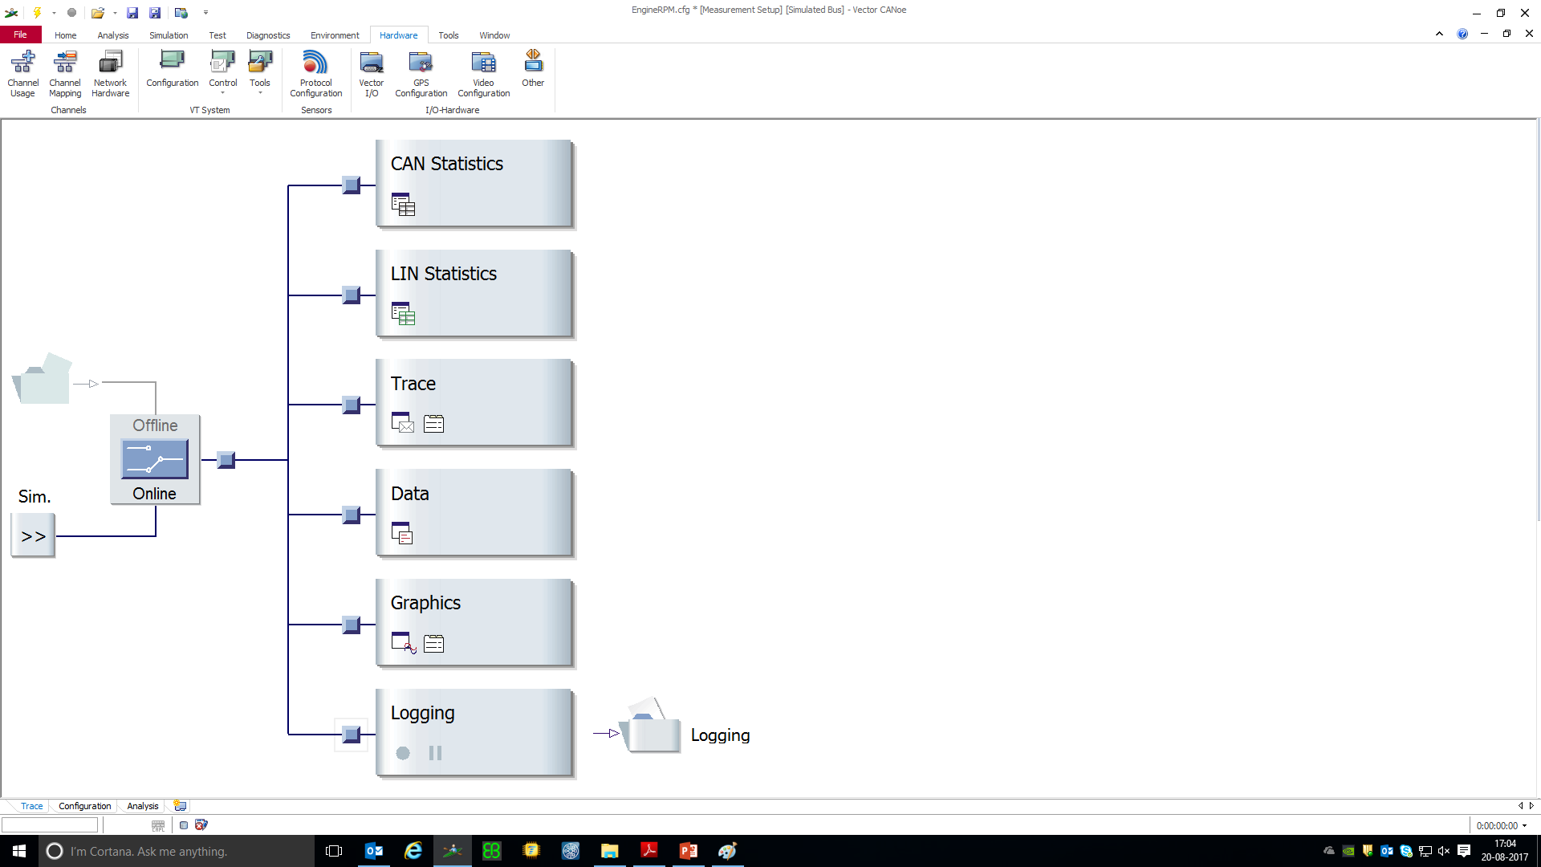
CANoe – Measurement Setup Window
Measurement Setup window shows the structural process and information flow of the CANoe configuration.
You can create, modify, read, and save any CANalyzer configuration. Configurations are saved as .cfg files.

Slide 17
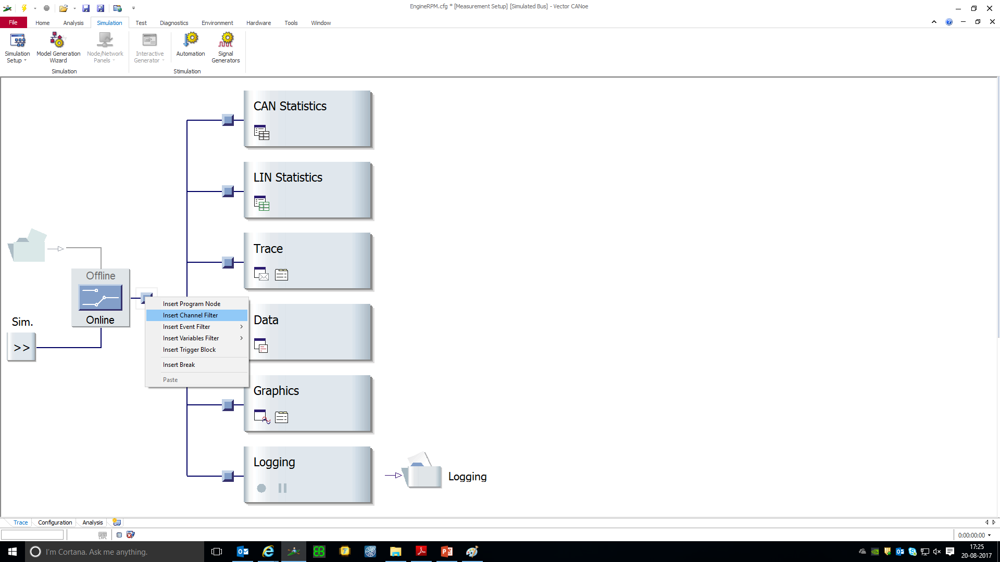
CANoe – Function Blocks

Slide 18
CANoe – Function Blocks
The Measurement Setup window not only displays the direction of data flow, but it also allows users to insert a variety of function blocks so as to provide more analysis and simulation options to the user.
Filtering Blocks
Channel Filter
There are many levels of filtering possible along the data flow plan of the Measurement Setup window. The highest level is filtering on specific CAN channels.
Variable filter
If the channel filtering approach is too broad, and filtering has to be done at the message level, you have need of the Filter block. The Filter block is used to filter messages for transmission and reception, depending on where the block is inserted. But, before you start inserting messages into the block, you need to separate the messages into two groups: messages to be blocked and messages to be passed.

Slide 19
CANoe – Function Blocks
Filtering Blocks
Variable filter
The Filtertype option is selected via radio buttons at the bottom left of the Filter configuration dialog (double click on the block to open). With a Pass Filter (PF the user can specify the list of messages to transmit or receive, while the Stop Filter (SF) stops the message list from transmitting or receiving. Both blocks are used to reduce data traffic volume as well as unwanted messages.
Trigger Block
If you have a Trace window monitoring heavy bus traffic, and you are unable to observe a particular signal value because of the complexity of message traffic. This scenario is very common, and the best solution is to use a Trigger block (T) . The Trigger block allows filtering based on signal values. The best aspect of using the Trigger block is you do not have to manually pause or stop the Trace window from updating once the desire condition has occurred.

Slide 20
CANoe – Trace, Write Window
The Trace window shows the data content of the messages detected on the bus and other information about them. Each message is time-stamped, and the identifier, message type, data length, and any associated data bytes are shown.
The Write window is a text output window and is used to indicate major CANalyzer operational modes, such as measurement start/end times and detected hardware warning conditions. This window also allows a CAPL program to output text information during program execution.
The CAPL write() function is used to output text to this window. Clearing the window and copying its contents to the clipboard are also possible.

Slide 21
CANoe – Message Blocks
CANoe contains four function blocks that are capable of transmitting messages:
Interactive Generator block
Replay block
CAPL Program block
IG block:

Slide 22
CAPL Program Parts
A CAPL program consists of two parts:
1. Declare and define global variables
2. Declare and define user-defined functions and event procedures

Slide 23
CAPL Variables
Data types available for variables include integers (dword, long, word, int, byte, char), floating point numbers (float and double)
CAN messages (message) and timers (timer or msTimer). Except for the timers, all other variables can be initial-ized in their declarations.
variables {
int msgCount; // Is set to 0 at measurement start
message 34 sendMsg = { // Declare message with Id 34
dlc = 1, // Set Data Length Code = 1
byte(0) = 1 // Set 1st data byte = 1
};
}

Slide 24
CAPL Variables
Variables can be initialized when they are declared, whereby you can use either simple notation or brackets {}. With the exception of timers, the compiler initializes all variables with default values (unless otherwise defined: 0).
CAPL permits the declaration of arrays (arrays, vectors, matrices), analogous to their declaration in the C programming language.
variables {
int vector[5] = {1,2,3,4,5};
int matrix[2][2] = {{11,12},{21,22}};
char progname[10] = “CANoe“;
}

Slide 25
CAPL Variables
Variables of the type timer (based on seconds) or msTimer (based on milliseconds) serve to generate time events. Timer variables are not automatically initialized at the program start, rather they must be "set" explicitly with the function setTimer().
variables {
timer delayTimer; // Declaration of a second timer ...
msTimer cycTimer; // ... and a millisecond timer
}
...
setTimer(delayTimer,3); // Set timer to 3 sec
setTimer(cycTimer,100); // Set timer to 100 msec
...

Slide 26
Declaration of Messages
Messages to be output from the CAPL program are declared with the key word message. The complete declaration includes the message identifier or when working with symbolic databases - the message name. For example, you might write the following to output messages on the bus that have identifier A (hex) or 100 (dec) or the message EngineData defined in the database.
message 0xA m1; // Message declaration (hex)
message 100 m2; // Message declaration (dec)
message EngineData m3; // Symbolic declaration
message * wcrd; // Declaration without Id
...
output(m1); // Transmit message m1
output(m2); // Transmit message m2
output(m3); // Transmit message m3
wcrd.id = 0x1A0; // Define Id...
output(wcrd);

Slide 27
Declaration of Messages
It is possible to access control information for the CAN message objects using the following component selectors:
ID Message identifier
CAN Chip number
DLC Data Length Code
DIR Direction of transmission, possible values: RX, TX, TXREQUEST.
RTR Remote Transmission Request; possible values: 0 (No RTR), 1 (RTR)
TYPE Combination of DIR and RTR for efficient evaluation.
(TYPE = (RTR << 8) | DIR )
TIME Time point, units: 10 microseconds

Slide 28
Event Procedures
You can react to the following events in CAPL using event procedures:
Event Event procedure
Receipt of a CAN message on message{}
Press of a key on key{}
Initialization of measurement on preStart{}
Measurement start on start{}
End of measurement on stopMeasurement{}
CAN controller goes to ErrorActive on errorActive{}
CAN controller goes to ErrorPassive on errorPassive{}
CAN controller reaches the warning limit on warningLimit{}
CAN controller goes to Bus Off on busOff{}
Elapse of a timer on timer{}
Occurrence of an error frame on errorFrame{}
Environment variable change on envVar{}

Slide 29
React to Messages
The event procedure type on message is provided to react to the receipt of CAN messages in the CAPL nodes.
on message 123 React to message 123 (dec)
on message 0x123 React to message 123 (hex)
on message EngineData React to message EngineData
on message CAN1.123 React to message 123, if it is received by chip CAN1
on message * React to all messages
on message CAN2.* React to all messages that are received by chip CAN2
on message 100-200 React to all messages with identifiers between 100 and 200

Slide 30
Example for React to Messages
on message CAN1.34 {
message CAN2.34 sendMsg; // Local message variable with
// name sendMsg, identifier 34,
// target controller CAN 2
sendMsg = this; // Copy all data and attributes
// of received message (this)
// to message to be transmitted
sendMsg.byte(4) = 0; // Change byte 4,
// always enter 0
output(sendMsg); // Transmit message
}

Slide 31
React to Keyboard Events
With on key procedures you can execute certain actions by key press.
on key 'a' React to press of .a. key
on key ' ‘ React to press of spacebar
on key 0x20 React to press of spacebar
on key F1 React to press of F1 key
on key ctrlF12 React to press of Ctrl-F12
on key PageUp React to press of Page Up
on key Home React to press of Home
on key * React to any key press
The code for a key press can either be input as a character, number or a predefined name for a function key.

Slide 32
Example of React to Keyboard Events
variables {
int counter = 0;
}
on key 'a' {
write("A total of %d messages 0x1A1 counted",counter);
}
on message 0x1A1 {
counter++;
output(this); // Only in the evaluation branch
}
on message * {
output(this); // Only in the evaluation branch !!!
}

Slide 33
React to Changes in Values of Environment Variables
The “on envVar” event is caused by the value of an environmental variable changing. (Note:Remember that environmental variables are only enabled in CANoe.) The “this” keyword is used in conjunction with the getValue() function to access the value of the environmental variable. For
example:
on envVar Switch {
int val;
val = getValue(this);
// Read value of Switch into val
}

Slide 34
React to Time Events
CAPL allows you to create timers for seconds (Timer) or milliseconds (msTimer). After thesetimers have been set and expire, the corresponding “on timer” event procedure is executed.
This facility can be used to create a cyclic event if you reset the timer at the end of the timer event procedure. Timers can also be used to respond to an event after a delay.
The setTimer() function takes two parameters, the name of the timer and the length of time to setthe timer. The length of time parameter has different units depending on what kind of timer youare using. For a Timer, the units are seconds; for an msTimer, the units are milliseconds.
The maximum values are 1799 seconds and 65,535 milliseconds, respectively. The cancelTimer()function can be called on a timer before it has expired to prevent the timer event from triggering.Calling the cancelTimer() function has no effect if the timer is not set or has already expired.

Slide 35
Example for Time Events
msTimer myTimer; // Define millisecond timer
message 100 msg; // Define message to be transmitted
...
on key 'a' { // React to key press of 'a'...
setTimer(myTimer,20); // ... Set timer to 20 ms
}
...
on timer myTimer { // Send message after timer...
output(msg); // ... has elapsed
}

Slide 36
React to System Events
The preStart, start, and stopMeasurement events are used to perform actions before, at the start of, and after CANoe measurements. If they are defined, each is called once per measurement. When the “Go” button is pressed in CANoe.
The preStart event procedure is executed (if one exists). You use this procedure to read data from files, initialize variables, or write to the Write window. Other actions, such as outputting a message onto the bus, are not available in the preStart event. Generally, actions that are invalid in the preStart event procedure can be moved to the start event procedure.
After the preStart event procedure has completed executing, the start event procedure is executed (if one exists). The start event procedure can be used to initialize environmental variables, set timers, and output messages onto the bus. The measurement is also started at this time.

Slide 37
React to System Events
When you press the Stop button in CANalyzer or CANoe, the stopMeasurement event procedure is executed (if one exists). You can use this procedure to print statistics in the Write window, output messages onto the bus, or write to a log file. After this event has finished executing, the measurement is stopped.

Slide 38
React to CAN Controller Events
The event procedures on errorActive, on errrorPassive, on warningLimit and on busOff are called during a state transition or in response to a change in the CAN controller's error counter. Use these procedures to monitor the error counter (e.g. output a warning), to terminate the measurement if necessary, or to execute a reset after a transition to the Bus-Off state.
The CAN controller's error counters can be accessed within the CAN controller's event procedures using the key word this:

Slide 39
React to CAN Controller Events
on errorPassive {
...
write("CAN Controller ist in errorPassive")
write(" errorCountTX = %d", this.errorCountTX);
write(" errorCountRX = %d", this.errorCountRX);
};

Slide 40
Expressions in CAPL
CAPL syntax is based on the C programming language. The following expressions are permitted as they are in C:
Instruction blocks: { ... }
if { ... } and if {...} else { ... }
switch, case, default
for.., while.., do..while loops
continue and break
return
?: expression

Slide 41
The Key Word ‘this’
The key word this is used to refer to the the data structure of an object within an event procedure for receiving a CAN object or environment variable. For example, the following accesses the first data byte of message 100 which is just being received:
on message 100 {
byte byte_0;
byte_0 = this.byte(0);
...
}

Slide 42
Event Message Transmission
When information only needs to be transferred on an event basis, the event message is used.
This sample program uses the pressing of the ‘b’ key on the PC keyboard to initiate a single CAN message transmission.
variables
{
message 0x555 msg1 = {dlc=1};
}
on key ‘b’
{
msg1.byte(0)=0xAA;
output(msg1);
}

Slide 43
Periodic Message Transmission
When information requires transferring on a repetitive basis, the periodic message is used.
variables
{
message 0x555 msg1 = {dlc=1};
mstimer timer1; // define timer1
}
on start
{
setTimer(timer1,100); // initialize timer to 100 msec
}
on timer timer1
{
setTimer(timer1,100); // reset timer
msg1.byte(0)=msg1.byte(0)+1; // change the data
output(msg1); // output message
}

Slide 44
Conditionally Periodic Message Transmission
When information requires transferring on a repetitive basis only when a certain set of conditions is true, the conditionally periodic message is used.
on timer timerA
{
if(conditionA == 1) // if condition is still
true
{
setTimer(timerA,200); // then continue timer
}
msgA.byte(0)=msgA.byte(0)-1; // change the data
output(msgA); // output message
}

Slide 45
Handling of Run-Time Errors
A number of run-time errors are monitored in CAPL:
Division by zero
Exceeding upper or lower array limits
Exceeding upper or lower offsets in the data fields of messages
Stack overflow when CAPL subroutines are called
If a run-time error is detected, the intrinsic function runError() is called. This outputs a message to the Write window containing the name of the CAPL program, the error type and an error index. The location of the particular CAPL source text which caused the error is found with the help of the error index. The measurement is terminated after output of the message.
The function runError() can also be called directly by the user to generate assertions.

Slide 46
Application Uses for CAPL
Create a black box to simulate the rest of the network.
Create a module simulator.
Simulate event messages, periodic messages, or conditionally repetitive messages

Slide 47
Application Uses for CAPL
Simulate human events like button presses using the PC keyboard
Simulate timed node or network events
Create a functional gateway between to different CAN networks.

