Slide 1
UDS Services

Slide 2
Contents
Why Diagnostic is needed ?
Introduction to UDS
Protocol Format
UDS Services

Slide 3
Why Diagnostic Is Needed ?
To know the system failures and take corrective action
To know and modify the key parameters related to SW and HW.
Final level of IO testing could be performed using diagnostic.
Flashing and Re-flashing the application SW

Slide 4
Why Diagnostic Is Needed ?
Tester request for ECU data or commands an action to ECU
ECU responds to tester request
Tester analyzes the data and concludes or take next action as per the request
TESTER
Request
ECU
Response

Slide 5
Introduction to UDS
UDS is an abbreviation for Unified Diagnostic Services
UDS Define common requirements for diagnostic systems
UDS is defined by ISO (International Organization for standardization)
UDS occupies the 7th layer in ISO – OSI Model ,which is application Layer
UDS is independent of the physical link between client and server.
UDS frame data length has no limit but we know data length allowed at the CAN BUS is up to 8 byte. So data length greater then the allowed frame length must be segmented into multi-Frame as per CAN transport layer protocol(15765-2)before sending it at CAN-Bus.

Slide 6
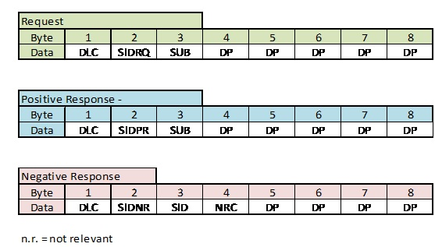
Protocol Format – Request & Response

Slide 7
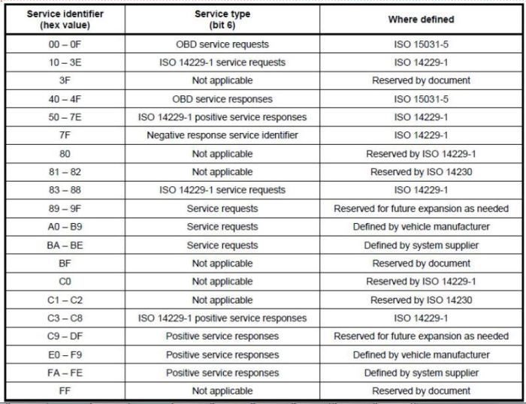
Service Identifiers Range

Slide 8
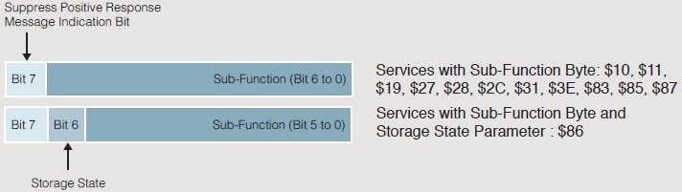
The Sub-Function Byte of UDS
Services without Sub-Function-Byte:
14, 23, 24, 2A, 2E, 2F, 34, 35, 36, 37, 3D, 84.
Services with Sub-Function Byte:
10, 11, 19, 27, 28, 2C, 31, 3E, 83, 85, 87
Services with Sub-Function Byte and Storage State Parameter :
86

Slide 9
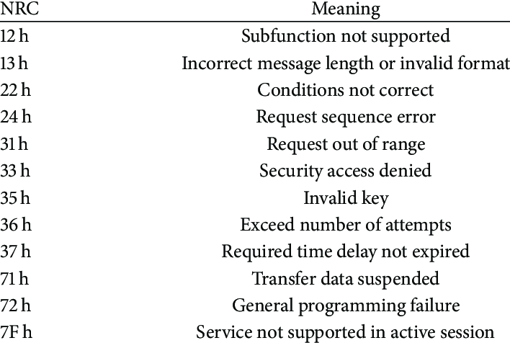
Some Commonly used NRCs

Slide 10
UDS Services
Diagnostic and Communication Management functional unit
Data Transmission functional unit
Stored Data Transmission functional unit
Input/output Control functional unit
Routine functional unit
Upload Download functional unit

Slide 11
Diagnostic and Communication Management functional unit
DiagnosticSessionControl (0x10) service
ECU Reset (0x11) service
Security Access (0x27) service
Communication Control (0x28) service
TesterPresent (0x3E) service
Control DTCSetting (0x85) service

Slide 12
Data Transmission functional unit
ReadDataByIdentifier (0x22) service
WriteDataByIdentifier (0x2E) service
ReadMemoryByAddress (0x23) service
WriteDataByIdentifier (0x2E) service
ReadDataByPeriodicIdentifier (0x2A) service
DynamicallyDefineDataIdentifier (0x2C) service

Slide 13
Stored Data Transmission functional unit
ClearDiagnosticInformation (0x14) Service
ReadDTCInformation (0x19) Service

Slide 14
Routine functional unit
RoutineControl (0x31) service

Slide 15
Input/output Control functional unit
InputOutputControlByIdentifier (0x2F) service

Slide 16
Upload Download functional unit
Request Download (0x34) service
Request Upload (0x35) service
Transfer Data (0x36) service
Request Transfer Exit (0x37) service
Request File Transfer (0x38) service

Slide 17
Diagnostic Session Control (0x10) service
The Diagnostic session control service is used to enable the different diagnostic session in the service.
A diagnostic session enables a specific set of diagnostic service and /or functionality in the service.
At a time only one diagnostic session active in a server. Default session shall be run as long as the server is powered up.

Slide 18
DiagnosticSessionControl (0x10) service
Default session (01)
Programming session (02)
Extended session (03)

Slide 19
What does a Diagnostic session describe?
Applicable services
Amount of functionality
Timing parameter values

Slide 20
Different Sessions
Default session
No tester present required to keep the session active
Does not support any diagnostic application timeout provision
Does not require security capability
Programming session
All diagnostic services required to support memory programming of ECU

Slide 21
Different Sessions
Extended session
Enables all diagnostic services supported by individual ECU. Timer controlled environment for ECU in which all of the supported diagnostic services can be executed. All diagnostic services are supported in extended diagnostic session (some are with security features and must be unlocked before use)

Slide 22
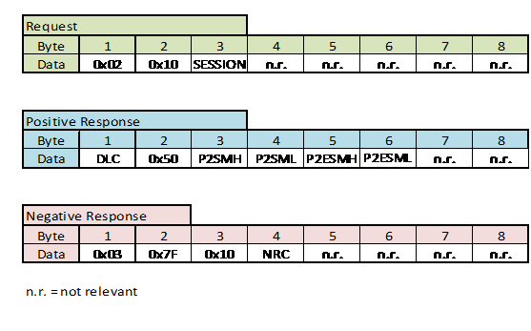
DiagnosticSessionControl (0x10) service

Slide 23
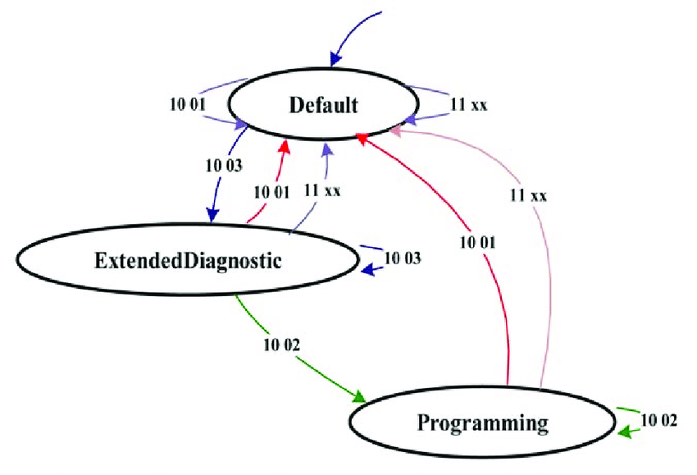
Diagnostic Session Control (0x10) service - subfunctions

Slide 24
DiagnosticSessionControl (0x10) service
P2 Server : Default P2Server_max timing supported by the server for the activated diagnostic session.
P2*Server_max : Enhanced (NRC 0x78) P2Server_max supported by the server for the activated diagnostic session.
S3 Server Time out : session time out

Slide 25
Diagnostic Session Control (0x10) service
All requests sent by the Tester will expect a positive response or a RCRRP (Request Received Response Pending) with in 50ms as mentioned in the table below. The timings which ever are greater than 50ms have to support RCRRP Message

Slide 26
DiagnosticSessionControl (0x10) service – Function Execution Time
Service ID | Name | 0x01(ms) | 0x02(ms) | 0x03(ms)
0x10 | Diagnostic Session Control | 50 | 25 | 50
0x11 | ECU Reset | 200 | 200 | 200
0x14 | Clear Diagnostic Information | 1000 |  | 1000
0x18 | Read DTC Information | 50 |  | 50
0x22 | Read Data by Identifier | 50 | 25 | 50
0x27 | Security Access | 50 | 25 | 50
0x2E | Write Data by Identifier | 5000 | 5000 | 5000
0x31 | Routine Control | 200 | 60000 | 200
0x2F | Input Output Control by Identifier | 50 |  | 50
0x34 | Request Download |  | 1000
0x36 | Transfer Data |  | 5000
0x37 | Transfer Exit |  | 5000
0x3E | Tester Present | 50 | 25 | 50
0x85 | Control DTC Setting | 200 |  | 200

Slide 27
Diagnostic Session Control (0x10) service
The following NRC’s are supported
0x12 - sub function Not Supported
0x13 - incorrect Message Length Or Invalid Format
0x22 - conditions Not Correct

Slide 28
ECU Reset (0x11) service
The ECU Reset is used by the client to request a server reset.
This service request the server to effectively perform a server reset based on the content of the reset type parameter values embedded in the ECU Reset request messages
Different Reset Types :
HARD Reset ,Soft Reset ..etc.

Slide 29
ECUReset (0x11) service
Hard Reset:
Server Power shut down(battery removed) followed by the power-up sequence is known as “Hard Reset”.
There is no standard action performed during hard-reset command it is completely application Specific.
A hard reset might end with the re-initialization of volatile and non-volatile memory.
Key Off-On Reset:
As the name suggests, this command is like off the ignition and then again on.
Like other resets there is nothing to do standard for this value, all is implementation specific.
Volatile memory re-initialized but Non-volatile data will remain protected.

Slide 30
ECU Reset (0x11) service
Soft Reset:
A server will not completely shut down when soft reset will receive. It will just restart the application.
Like the Hard reset, No standard action performed in Soft reset. It is implementation specific.
Soft reset might end with the volatile data clear but Non -Volatile data will be preserved

Slide 31
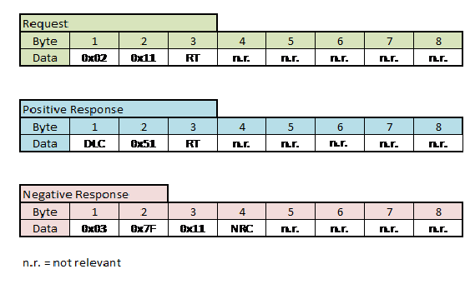
ECU Reset (0x11) service

Slide 32
ECU Reset (0x11) service
The following NRC’s are supported
0x12 - sub function Not Supported
0x13 - incorrect Message Length Or Invalid Format
0x22 - conditions Not Correct
0x33 – security Access Denied

Slide 33
Security Access (0x27) service
The Security access is used to provide access to data and/or services that have restricted access.
Security Access requires the transmission of two requests:
1. Request the Seed
2. Send the Key.

Slide 34
Security Access (0x27) service

Slide 35
Security Access (0x27) service
Flow of the Security Access(27h) service is as follows :
Client requests the “seed”;
Server sends the “seed”;
Client sends the “key” (appropriate for the Seed received);
Server responds that the “key” was valid and that it will unlock itself.

Slide 36
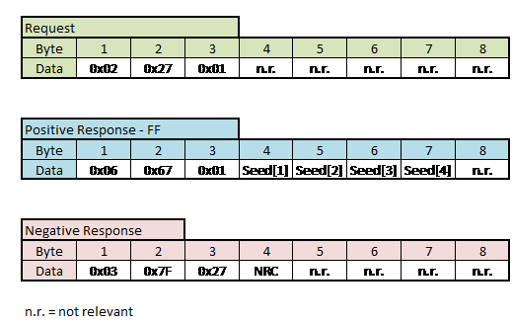
Security Access (0x27) service

Slide 37
Security Access (0x27) service
The following NRC’s are supported
0x12 - sub-function Not Supported
0x13 - incorrect Message Length Or Invalid Format
0x22 - conditions Not Correct
0x31 – request out of Range
0x33 – security Access Denied
0x35 - invalid Key

Slide 38
Security Access (0x27) service
0x36 - Exceeded Number Of Attempts
0x37 - Required Time Delay Not Expired

Slide 39
Communication Control (0x28) service
This service shall be used to switch on/off the transmission and/or reception of CAN messages
To run this service the server shall be in extended diagnostic session only.
Different Sub function
00h – enable Rx and Tx
01h – enable Rx and Disable Tx

Slide 40
Communication Control (0x28) service
02h – Disable Rx and Enable Tx
03h – Disable Rx and Tx

Slide 41
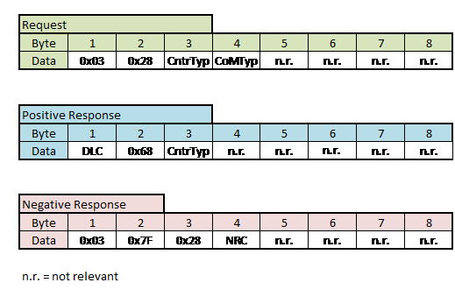
Communication Control (0x28) service

Slide 42
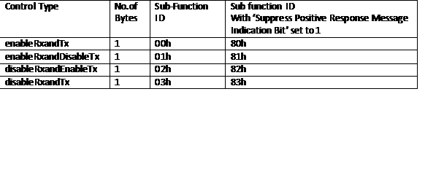
Communication Control (0x28) service

Slide 43
Communication Control (0x28) service
The following NRC’s are supported
0x12 - sub function Not Supported
0x13 - incorrect Message Length Or Invalid Format
0x22 - conditions Not Correct
0x31 – Request out of range

Slide 44
Control DTC Setting (0x85) service
The ControlDTCSetting service shall be used to disable/ re-enable the setting of diagnostic trouble codes in ECU
Sub function :
- On (01) – Allow DTC Setting
- Off (02) – Stop DTC Setting

Slide 45
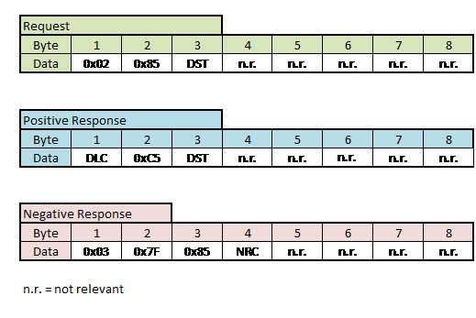
Control DTC Setting (0x85) service

Slide 46
Control DTC Setting (0x85) service
The following NRC’s are supported
0x12 - sub function Not Supported
0x13 - incorrect Message Length Or Invalid Format
0x22 - conditions Not Correct
0x31 – Request out of range

Slide 47
Tester Present (0x3E) service
This service shall be used to keep the ECU in a diagnostic session other than the default Session. It may also be used to inform the ECU that the “Off Board Tool” is still connected and certain diagnostic services and/or communication remain active
This request is sent by client periodically.

Slide 48
Tester Present (0x3E) service
Sub Function :
- zero sub function
- suppress positive response

Slide 49
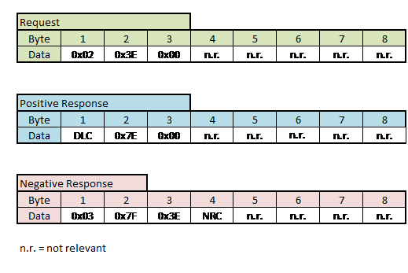
Tester Present (0x3E) service

Slide 50
Tester Present (0x3E) service
The following NRC’s are supported
0x12 - sub function Not Supported
0x13 - incorrect Message Length Or Invalid Format

Slide 51
Read Data By Identifier (0x22) service
This service allows the tool to request data record values from the ECU via the predefined data Identifiers.
This service is generally used to get logistic data like part numbers, configuration parameters and also vehicle parameters.

Slide 52
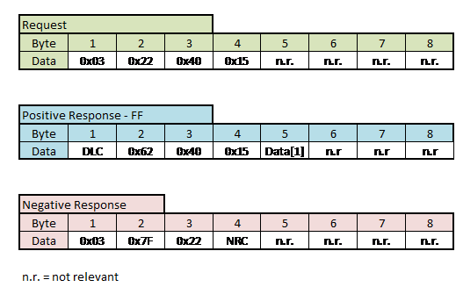
Read Data By Identifier (0x22) service

Slide 53
Read Data By Identifier (0x22) service
The following NRC’s are supported
0x12 - sub function Not Supported
0x13 - incorrect Message Length Or Invalid Format
0x22 - conditions Not Correct
0x31 – Request out of range
0x33 - security Access Denied

Slide 54

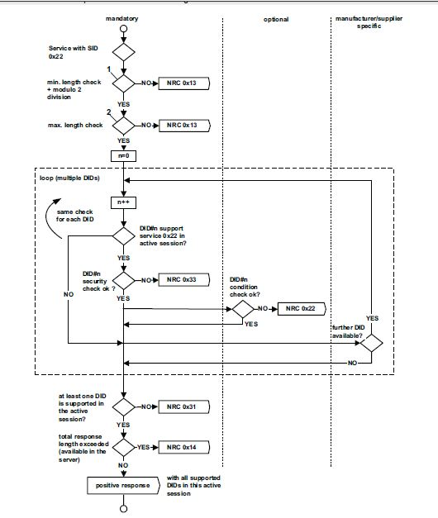
Read Data By Identifier (0x22) service

Slide 55
Write Data By Identifier (0x2E) service
The Write Data By Identifier service allows the client to write information into the server at an internal location specified by the provided data identifier.
The Write Data By Identifier service is used by the client to write a data Record to a server. The data is identified by a data Identifier, and may or may not be secured

Slide 56
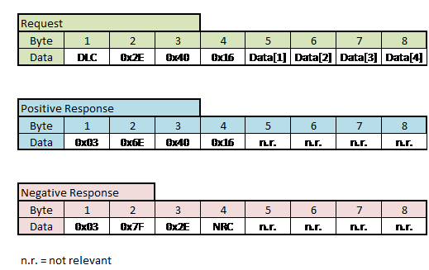
Write Data By Identifier (0x2E) service

Slide 57
Write Data By Identifier (0x2E) service
The following NRC’s are supported
0x12 - Sub function Not Supported
0x13 - Incorrect Message Length Or Invalid Format
0x22 - Conditions Not Correct
0x31 - Request out of range
0x33 - Security Access Denied
0x72 - General Programming Failure

Slide 58
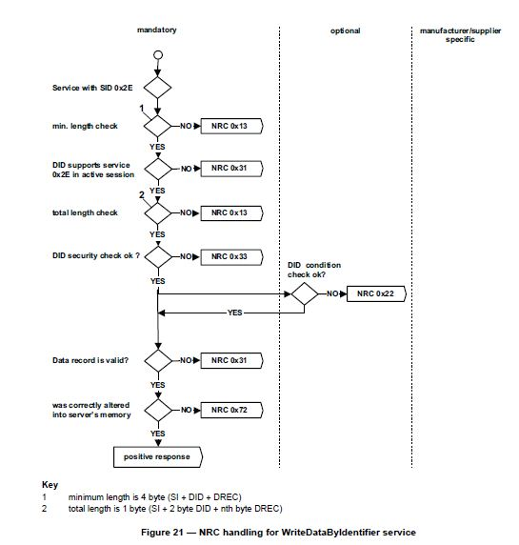
Write Data By Identifier (0x2E) service

Slide 59
Need for Service 0x31 – Routine Control
The Routine Control service is used by the client to execute a defined sequence of steps and obtain any relevant results.
Common usages are erasing memory, resetting or learning adaptive data, running a self-test, overriding the normal server control strategy, and controlling a server value to change over time including predefined sequences etc.

Slide 60
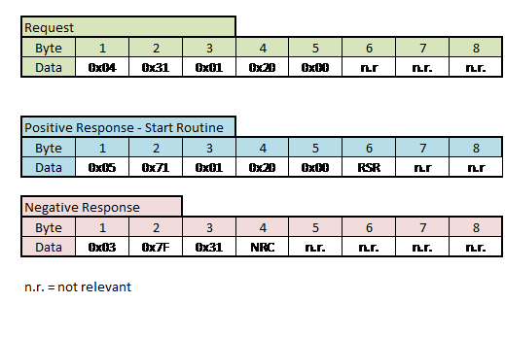
Routine Control (0x31) service

Slide 61
Routine Control (0x31) service – Routine control types
Routine Control Types
Start Routine (01 hex)
Stop Routine (02 hex)
Request Results (03 hex)

Slide 62
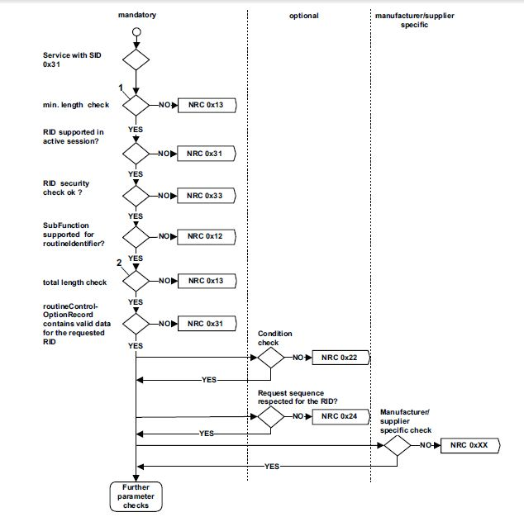
Routine Control (0x31) service

Slide 63
Routine Control (0x31) service
The following NRC’s are supported
0x12 - sub function Not Supported
0x13 - incorrect Message Length Or Invalid Format
0x22 - conditions Not Correct
0x24 – Request Sequence Error

Slide 64
Routine Control (0x31) service
0x31 – Request out of range
0x33 - security Access Denied
0x72 - general Programming Failure

Slide 65
Input/output Control functional unit – Service 2F
The InputOutputControlByIdentifier service is used by the client to substitute a value for an input signal, internal server function and/or force control to a value for an output (actuator) of an electronic system.
In general, this service is used for relatively simple (e.g., static) input substitution / output control whereas routine Control is used if more complex input substitution / output control is necessary.

Slide 66
Input/output Control functional unit – Service 2F
ECU shall re-assume control over the outputs previously under control of the external test tool if one of the following conditions are met:
A request to Return control to the ECU
A session transition occurs
A ECU reset occurs
Internal disable conditions

Slide 67
Service 2F NRCs
0x13 – Incorrect Message length or Invalid format
0x22 – Conditions not correct
0x31 - Request Out of range
0x33 – Security Access denied

Slide 68
Service 2F

