Slide 1
Unified Diagnostics Services(UDS)
Introduction, definitions and Standards

Slide 2
Introduction
Diagnostics is used to configure, maintain, support, control and extend an ECU before or after it is installed in a system, e.g. a vehicle.
Diagnostics is usually performed in a request – response scheme: a tester (client) sends a request to an ECU (or even more than one ECU) and the ECU (server) responds by sending a “positive response message” containing the requested information, or a “negative response” indicating the reason for the negative response.

Slide 3
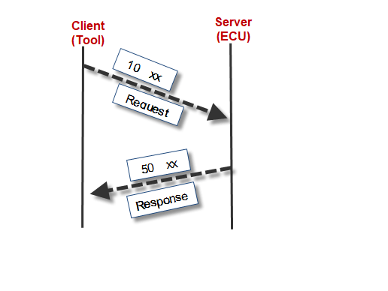
Introduction

Slide 4
Why Diagnostics?
Robust on-board diagnostics combined with off-board diagnostics procedures for proper identification, isolation, and correction of failed components and systems. Satisfying their objectives contribute to reduction of product life cycle costs and improvements of overall customer satisfaction.
Reprogramming done by diagnostics application layer and so considered a diagnostic function.

Slide 5
Why Diagnostics?
Via diagnostics we can do,
ECU configuration data
System operation
Performance
ECU calibration
ECU configuration immediately becomes active, no reset required.

Slide 6
Basic Diagnostics
Using Basic Diagnostics, you can exchange diagnostic information with an ECU also without a Diagnostic Description (CDD/ODX/MDX).
You can describe simple diagnostic services (UDS & KWP) with the Basic Diagnostics Editor and afterwards send/receive the defined requests/responses on CAN, LIN, FlexRay, K-Line and via DoIP using the Diagnostics Console, CAPL and in CAPL test modules/ test case libraries.

Slide 7
Diagnostics Operations required in an ECU
Report ECU info
Report Vehicle Information
Report IO device information
Report IO actuation status
Report or Modify information
Set/Clear/Age diagnostics fault information aka DTCs
Secure access to protected information
Initiate test functions and on board processes
Set vehicle configuration parameters
Run calibration tests

Slide 8
Diagnostics Operations required in an ECU
Proper applications of these requirements shall improve:
Reduce overall warranty costs
Reduce overall diagnostics costs
Improve “Fixed First visit” occurrences
Improve “No Trouble Found” occurrences

Slide 9
Important documents for Diagnostics implementation
1 | Generic Global Diagnostic Specification(GGDS) Part 1 – Diagnostic Implementation Requirements | OEM
2 | Subsystem Specific Diagnostic Specification (Part 2)- Includes CDD/MDX files for development | Supplier
3 | Road vehicles — Unified diagnostic services (UDS) — Part 1: Specification and requirements 14229-1 | ISO
4 | Road vehicles — Unified diagnostic services (UDS) — Part-2 Session layer services 14229-2 | ISO
5 | Road vehicles — Unified diagnostic services (UDS) — UDS on CAN 14229-3 | ISO
6 | Diagnostics on controller area network (CAN) ISO 15765-3 | ISO
7 | AUTOSAR_SWS_DiagnosticCommunicationManager | AUTOSAR.org
8 | AUTOSAR_SWS_DiagnosticEventManager | AUTOSAR.org
9 | AUTOSAR_SRS_Diagnostic | AUTOSAR.org

Slide 10
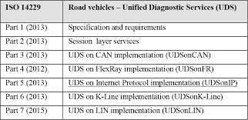
Important documents for Diagnostics implementation

Slide 11
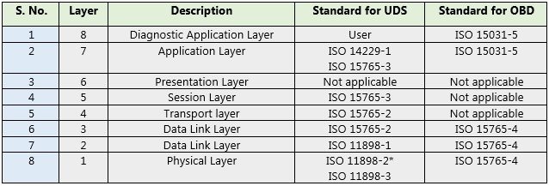
ISO/OSI layers Vs UDS standard

Slide 12
What it contains?
1 | 14229-1 | Application layer services (diagnostic services). Application layer protocol Service description conventions DCM Functional Unit Services Data Transfer Functional Unit Services IO Control Functional Unit services Routine Functional Unit Services Upload Download Functional Unit services
2 | 14229-2
4 | AUTOSAR_SWS_ Diagnostic Communication Manager
5 | AUTOSAR_SWS_ Diagnostic Event Manager
6 | Part1 – Diagnostic Implementation Requirements
7 | Subsystem Specific Diagnostic Specification (Part 2)

Slide 13
Important definitions
Unified Diagnostic Services(UDS) | Unified Diagnostic Services is an industry standard diagnostic communication framework.
Tester | A system that controls functions such as test, inspection, monitoring, or diagnosis of an on-vehicle electronic control unit and may be dedicated to a specific type of operators (e.g. a scan tool dedicated to garage mechanics or a test tool dedicated to assembly plant agents). The tester is also referenced as the client.
Functional/ Physical Addressing | A device is considered to be physically addressed if the Destination address is the address of the device. It is considered to be functionally addressed if the destination address is the broadcast address. The diagnostic requests for it will be sent using the transport protocol parameters for functional requests so that all ECUs which react on this functional request will send responses. The responses received from the ECUs will be processed individually in the tester, and the interpretation will be based on the concrete Diagnostic Description for each ECU
Aging | A process whereby certain servers evaluate past results of each internal diagnostic to determine if a confirmed DTC can be cleared from long-term memory, e.g. in the event of a calibrated number of failure free cycles

Slide 14
Important definitions
Monitor Cycle | If ignition changes from OFF to RUN state it will be taken as a new monitor
CDD | CANdela Diagnostic description. CANdela Diagnostic Descriptions (CDD) files are databases for diagnostic data, comparable to the .dbc-file used for CAN messages and signals. The CDD files are created in the Vector tool CANdelaStudio and can be used in CANoe and CANalyzer for symbolic access and interpretation of diagnostic services and parameters.
ODX | Open Diagnostic Data Exchange. ODX files (Open Diagnostic Data Exchange) also carry diagnostic data. This data can be divided into several ODX files and stored in PDX files (ODX archives). The usage of ODX files is similar to the usage of CDD files.
MDX | MDX files (Multiplex Diagnostic Exchange) is an OEM-specific format carrying diagnostic data as well. The usage of MDX files is similar to the usage of ODX archive files.
ISOTP Support | CANoe includes the ISO TP Observer, which interprets messages sent over the CAN bus according to the ISO Transport Protocol ISO/TF2 and displays the results in the Trace window in clear text. It also includes an implementation of the transport protocol that enables easy sending and receiving of diagnostic objects. This implementation is realized by a node layer DLL that comes with every CANoe standard installation and takes care of transport protocol specific functions such as segmentation, flow control etc. To enable transport layer interpretation, it is needed to activate the ISO TP Observer. Please refer to the online help in CANoe on how to activate the observer.
Seed & Key | To access the ECU using an ECU specific DLL. This DLL calculates the Key in dependence of the Seed sent by the ECU. Alternatively for testing purpose on CANoe without DiVa, the DLL can be replaced by a CAPL code.

Slide 15
Important definitions
Monitor interval | Way a component/system is tested for failure. Continuously monitored: Periodically polled for active failure. Condition for both fault maturation and de-maturation process. Non-continuously monitored: On demand, event driven, one-time instance for active failure condition for fault maturation process ECU shall provide a mechanism called routine to check non-continuous failures. (ODST, Peripheral test etc.)
Mature criteria | Mature criteria defined as failure threshold, monitor internal, declaration rate and time required to set an active DTC Monitor interval = Min time required to set active DTC Threshold = boundary once exceeded, failures may be matured. Matured indicates test failed and ‘Test failed’ sets to 1.
Failure time | Indicates time interval required to mature an active DTC condition.

Slide 16
Diagnostic components
The diagnostic software in AUTOSAR consists of the three basic software modules - DCM, DEM and TCR.
AUTOSAR diagnostics is limited to the UDS and OBDII protocols
The diagnostic sub system component Diagnostic Event Manager (DEM) is responsible for processing and storing diagnostic events (errors) and associated data. Further, the DEM provides fault information to the DCM (e.g. read all stored DTCs from the event memory). The DEM offers interfaces to the application layer and other sub systems.
Event memory defined shall be as per ford GGDS part 1 specification. DTCs shall be defined as per part2 diagnostics specification for product variant.

Slide 17
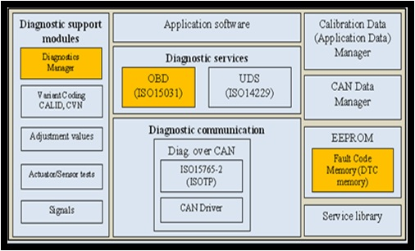
Diagnostic components

Slide 18
Diagnostic components
Diagnostics Communication Manager(DCM) | Generally the DCM module provides a common API and functions for diagnostic services. The functionality of the DCM module is used by external diagnostic tools during the development, manufacturing or service. Responsibilities of DCM specific to diagnostics sub systems are Communication with tester with the help of network sub system excluding transport layer and network management features. Identification of Service Ids and sub function Ids Identification of diagnostics sessions, Security states and protocol sequence and validity Coordinating diagnostics service requests and its execution. Sending positive and negative response for diagnostics requests
Diagnostics Event Manager(DEM) | The diagnostic sub system component Diagnostic Event Manager (DEM) is responsible for processing and storing diagnostic events (errors) and associated data. Specific responsibilities of DEM with respect to diagnostics sub system are Writing DTCs to event memory Reading and Clearing DTCs based on diagnostics requests based on UDS Updating error status and environment and snapshot data for DTCs APIs for all above functionalities which would be used by other sub systems or DCM Maintaining diagnostics event memory based on characteristics of event memory defined, error reports received and diagnostics commands.

Slide 19
Diagnostic components
Test and Calibration Routines(TCR) | Functions for each calibration and test routines which would coordinate and call APIs with other sub systems. Support Read Data by Identifier, Write Data by Identifier, Routine Control and Input Output Control by Identifier diagnostics requests based on routine identifier and PID.

