Slide 1
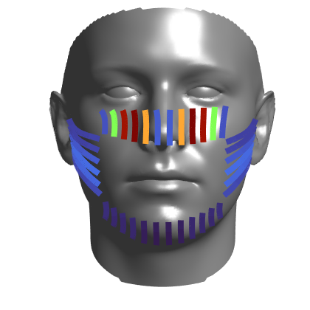
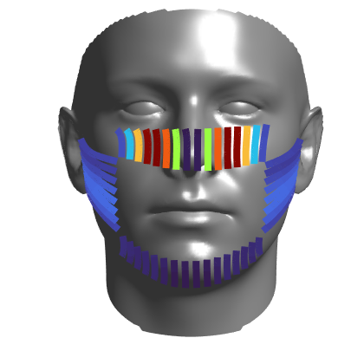
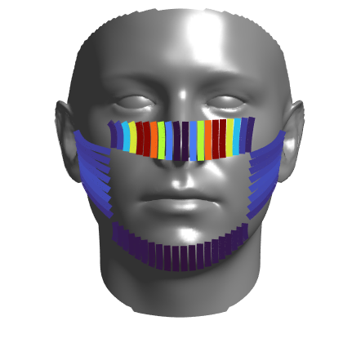
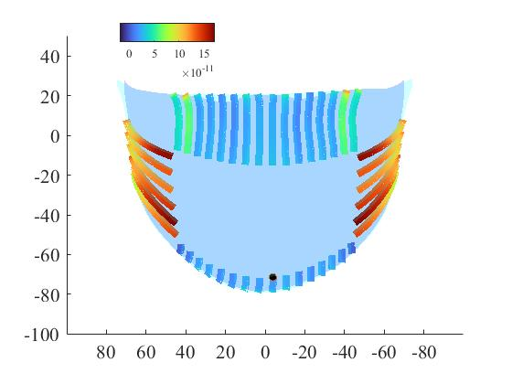





$$5×{10}^{−4}$$
$$m2/s$$
$q_{g}$
$( )$
# of channel: 36
# of channel: 48
# of channel: 56
$$2×{10}^{−4}$$
more channels

