Slide 1
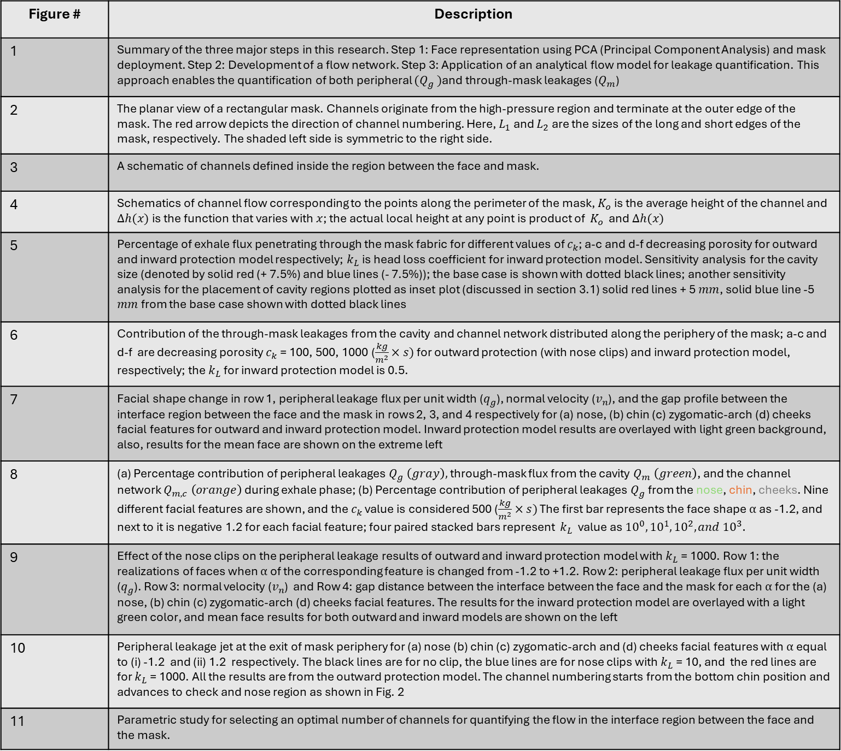
Figure # | Description
1 | Summary of the three major steps in this research. Step 1: Face representation using PCA (Principal Component Analysis) and mask deployment. Step 2: Development of a flow network. Step 3: Application of an analytical flow model for leakage quantification. This approach enables the quantification of both peripheral ${(Q}_{g} )$and through-mask leakages ($Q_{m}$)
2 | The planar view of a rectangular mask. Channels originate from the high-pressure region and terminate at the outer edge of the mask. The red arrow depicts the direction of channel numbering. Here, $L_{1}$and $L_{2}$ are the sizes of the long and short edges of the mask, respectively. The shaded left side is symmetric to the right side.
3 | A schematic of channels defined inside the region between the face and mask.
4 | Schematics of channel flow corresponding to the points along the perimeter of the mask, $K_{o}$ is the average height of the channel and $Δh(x)$is the function that varies with $x$; the actual local height at any point is product of $K_{o}$ and $Δh(x)$
5 | Percentage of exhale flux penetrating through the mask fabric for different values of $c_{k}$; a-c and d-f decreasing porosity for outward and inward protection model respectively; $k_{L}$is head loss coefficient for inward protection model. Sensitivity analysis for the cavity size (denoted by solid red (+ 7.5%) and blue lines (- 7.5%)); the base case is shown with dotted black lines; another sensitivity analysis for the placement of cavity regions plotted as inset plot (discussed in section 3.1) solid red lines + 5 $mm$, solid blue line -5 $mm$ from the base case shown with dotted black lines
6 | Contribution of the through-mask leakages from the cavity and channel network distributed along the periphery of the mask; a-c and d-f are decreasing porosity $c_{k}$= 100, 500, 1000 ($\frac{kg}{m^{2}}×s)$ for outward protection (with nose clips) and inward protection model, respectively; the $k_{L}$for inward protection model is 0.5.
7 | Facial shape change in row 1, peripheral leakage flux per unit width ($q_{g}$), normal velocity ($v_{n}$), and the gap profile between the interface region between the face and the mask in rows 2, 3, and 4 respectively for (a) nose, (b) chin (c) zygomatic-arch (d) cheeks facial features for outward and inward protection model. Inward protection model results are overlayed with light green background, also, results for the mean face are shown on the extreme left
8 | (a) Percentage contribution of peripheral leakages $Q_{g} \left(gray\right),$through-mask flux from the cavity $Q_{m} \left(green\right)$, and the channel network $Q_{m,c} \left(orange\right)$ during exhale phase; (b) Percentage contribution of peripheral leakages $Q_{g}$from the nose, chin, cheeks. Nine different facial features are shown, and the $c_{k}$ value is considered 500 ($\frac{kg}{m^{2}}×s)$ The first bar represents the face shape $α$as -1.2, and next to it is negative 1.2 for each facial feature; four paired stacked bars represent $k_{L}$ value as ${10}^{0}, {10}^{1}, {10}^{2}, and {10}^{3}.$
9 | Effect of the nose clips on the peripheral leakage results of outward and inward protection model with $k_{L}$= 1000. Row 1: the realizations of faces when $α$of the corresponding feature is changed from -1.2 to +1.2. Row 2: peripheral leakage flux per unit width ($q_{g}$). Row 3: normal velocity ($v_{n}$) and Row 4: gap distance between the interface between the face and the mask for each $α$for the (a) nose, (b) chin (c) zygomatic-arch (d) cheeks facial features. The results for the inward protection model are overlayed with a light green color, and mean face results for both outward and inward models are shown on the left
10 | Peripheral leakage jet at the exit of mask periphery for (a) nose (b) chin (c) zygomatic-arch and (d) cheeks facial features with $α$equal to (i) -1.2 and (ii) 1.2 respectively. The black lines are for no clip, the blue lines are for nose clips with $k_{L}$= 10, and the red lines are for $k_{L}$= 1000. All the results are from the outward protection model. The channel numbering starts from the bottom chin position and advances to check and nose region as shown in Fig. 2
11 | Parametric study for selecting an optimal number of channels for quantifying the flow in the interface region between the face and the mask.

