Slide 1
Data Structures and Algorithms( CS/IS F211)
Tutorial-1
Sanjeev Kumar Singh

Slide 2
Problem-1
Given 2 arrays a1, a2 of size m and n. Find the intersection of a1 & a2
Ex: a1 :
a2 :
(Assume : Array1 and Array2 have distinct elements)
5 | 8 | 2 | 6 | 9
10 | 2 | 14 | 7 | 8 | 1 | 5 | 20

Slide 3
Problem 2
A sorted array a with duplicate element x is given. Find out the lowest index of x in a
Ex :
i/p : array is 1 3 6 6 6 8 9 and x is 6
o/p : 2
fn decl : int findLowestIndex(int a[], int n, int x);

Slide 4
Problem 3
An array of size n with each number repeated even number of times except one element. Find that element
Ex :
i/p : 1 5 2 2 2 6 2 6 8 8 5 5
o/p : 5

Slide 5
Problem 4
Square 2D array is given. Each row is sorted and each column is sorted and an element x is given. Determine whether x is available or not ?
Ex : x = 9
YES
fn decl : int isPresent(int n, int a[][n], int x);
1 | 2 | 3 | 5
4 | 6 | 8 | 11
5 | 10 | 12 | 15
9 | 15 | 18 | 20

Slide 6
Problem 5
You are given an array of n positive integers. All the numbers are in the range of 1 to n-1. Find any 1 duplicate number in the array.
Ex :
i/p : n=5
o/p : 2
2 | 1 | 3 | 4 | 2

Slide 7
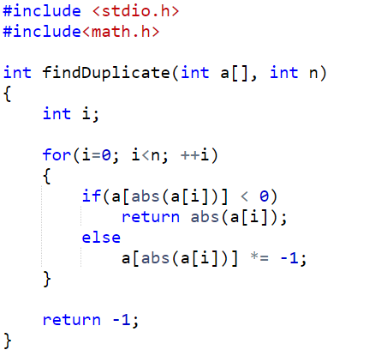

Slide 8
Thank You!

