Slide 1
Data Structures and Algorithms( CS/IS F211)
Tutorial-10
Sanjeev Kumar Singh

Slide 2
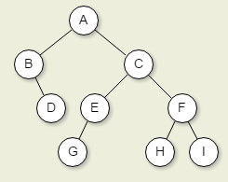
Problem
Write the answer of following traversal:
In-order
Pre-order
Post-order
Level-order

Slide 3
Problem
Construct Binary Tree given
inorder : DBEACF
preorder : ABDECF
What if pre and post order are given ?
What if tree is BST ?

Slide 4
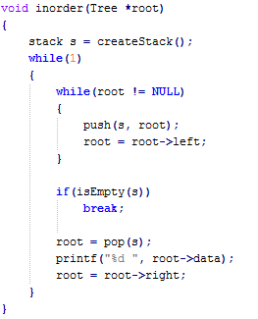
Problem
Inorder traversal without recursion

Slide 5
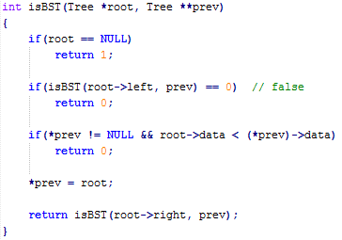
Problem
Given a Binary Tree, check if it’s a BST or not ?

Slide 6
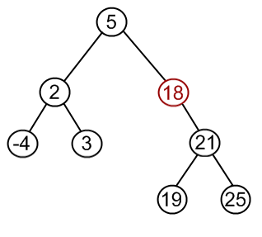
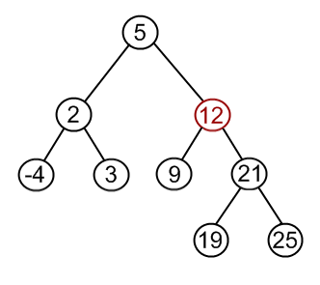
Problem
Delete following nodes on the following binary tree.
Fig. 1 Fig. 2

Slide 7
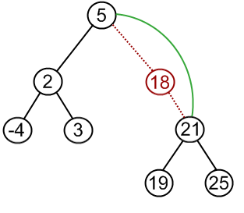
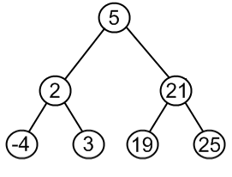
Fig. 1

Slide 8
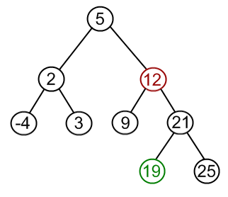
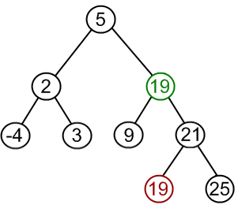
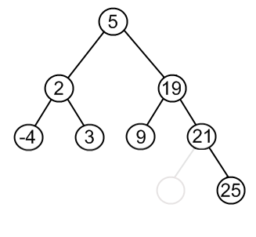
Fig. 1

Slide 9
Problem
Can the min-heap property be used to print out the keys of an n-node tree in sorted order in O(n) time? Show how or explain why not.
Ans : NO
Lower bound for TC for comparison based is c.nlogn (You all seen proof for it)
So you can’t have sorted order in O(n) otherwise you can create a heap in O(n) time and print the sorted order in O(n) making O(n) overall complexity

Slide 10
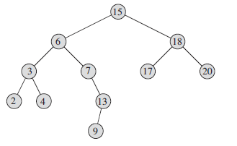
Problem
Write the algorithms for finding out
TREE-MINIMUM
TREE-MAXIMUM
TREE-SUCCESSOR
TREE-PREDECESSOR

Slide 11
Problem
Suppose that we have numbers between 1 and 1000 in a binary search tree, and we want to search for the number 363. Which of the following sequences could not be the sequence of nodes examined?
i.) 2, 252, 401, 398, 330, 344, 397, 363
ii.) 924, 220, 911, 244, 898, 258, 362, 363
iii.) 925, 202, 911, 240, 912, 245, 363
iv.) 2, 399, 387, 219, 266, 382, 381, 278, 363
v.) 935, 278, 347, 621, 299, 392, 358, 363

Slide 12
Problem
Check if Tree is height balanced or not ?
Height balanced if for every node :
| Ht(left) – Ht(right) | ≤ 1

Slide 13
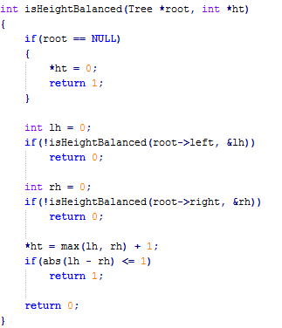

Slide 14
Thank You!

