Slide 1
Data Structures and Algorithms( CS/IS F211)
Tutorial-11
Sanjeev Kumar Singh

Slide 2
Problem
How many BST are there that contain n different elements ?
Ans : Catalan Number

Slide 3
Problem
Let us define a relaxed red-black tree as a binary search tree that satisfies red-black properties 1, 3, 4, and 5. In other words, the root may be either red or black.
Consider a relaxed red-black tree T whose root is red. If we color the root of T black but make no other changes to T , is the resulting tree a red-black tree ?
Ans : Yes it remains a red-black tree.

Slide 4
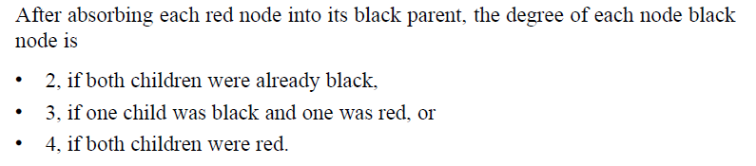
Problem
Suppose that we “absorb” every red node in a red-black tree into its black parent, so that the children of the red node become children of the black parent. (Ignore what happens to the keys.)
What are the possible degrees of a black node after all its red children are absorbed?

Slide 5
Problem
Show the red-black trees that result after successively inserting the keys : 41, 38, 31, 12, 19, 8 into an initially empty red-black tree
Keys in order : 41, 38, 31, 12, 19, 8

Slide 6
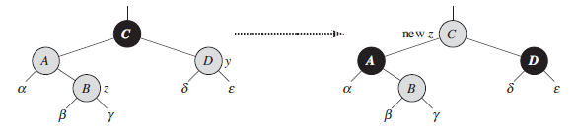
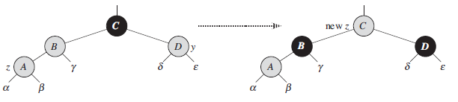
Cases 1 : Uncle is Red

Slide 7

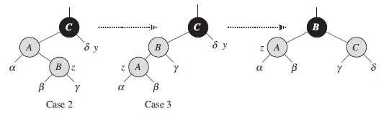
Case 2 & 3

Slide 8
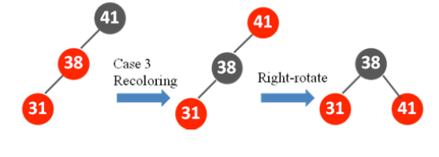
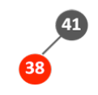


Slide 9
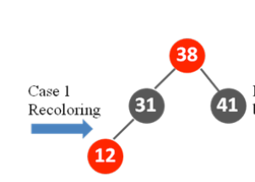
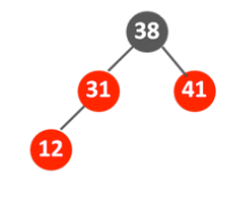
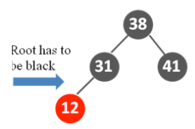
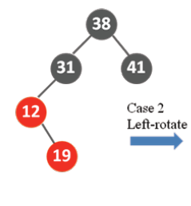
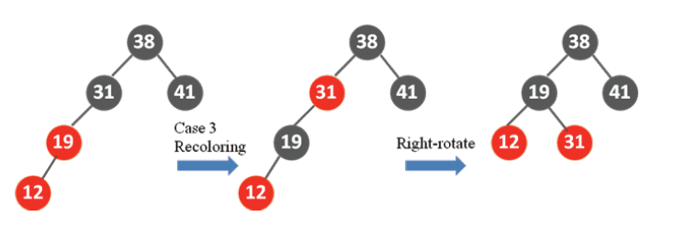

Slide 10
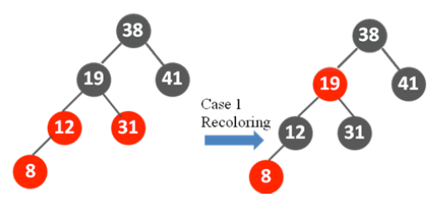

Slide 11
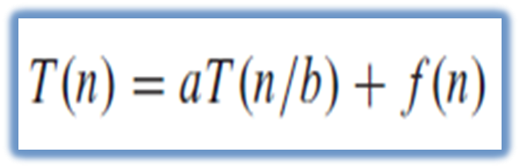
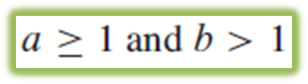
Master Theorem
a = # of sub-problem.
n/b = size of each sub-problem.
f(n) = total cost of dividing the problem and combing the sub-problem

Slide 12
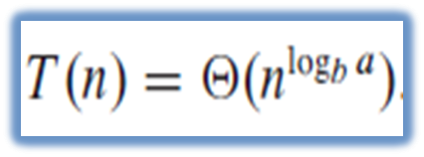
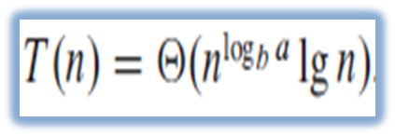

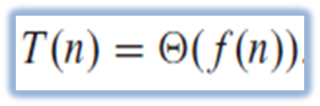
3 cases to handle
1.
2.
3.
and for

Slide 13




Example :
1.
2.
3.
4.

Slide 14
Problem
T(n) = 3T(n/2) + n²
T(n) = 4T(n/2) + n²
T(n) = 16T(n/4) + n
T(n) = 3T(n/3) + n/2
T(n) = 2^{n}T(n/2) + n^{n}
^{T(n) = T(n/2) + n(2-cosn)}

Slide 15
Thank You!

