Slide 1
Data Structures and Algorithms( CS/IS F211)
Tutorial-12
Sanjeev Kumar Singh

Slide 2
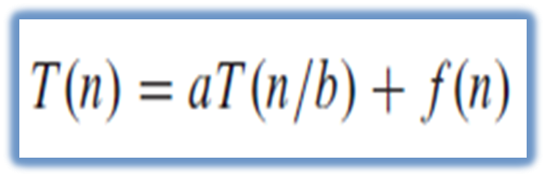
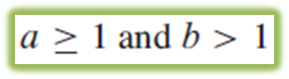
Master Theorem
a = # of sub-problem.
n/b = size of each sub-problem.
f(n) = total cost of dividing the problem and combing the sub-problem

Slide 3
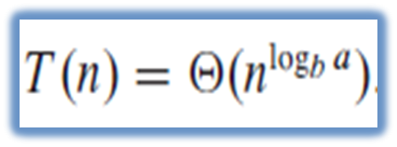
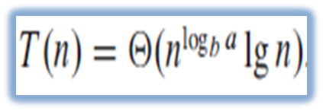

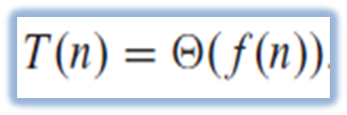
3 cases to handle
1.
2.
3.
and for

Slide 4
Problem
How would you modify Strassen’s algorithm to multiply n x n matrices in which n is not an exact power of 2 ?
Show that the resulting algorithm runs in time Ɵ(n^{lg7})

Slide 5
Problem
What is the largest k such that if you can multiply 3 x 3 matrices using k multiplications then you can multiply n x n matrices in time o(n^{lg7}) ? What would the running time of this algorithm be ?
Ans : T(n) = kT(n/3) + Ɵ(n²)
case 1 : log₃k > 2 T(n) = Ɵ(nlog3k) , k = 21
similarly for other cases

Slide 6
Problem
How quickly can you multiply a kn×n matrix by an n×kn matrix, using Strassen’s algorithms as a subroutine? Answer the same question with the order of input matrices reversed.
Ans : Ɵ(k²n^{lg7})
Reversed : Ɵ(kn^{lg7} + (k-1)n²) = Ɵ(kn^{lg7})

Slide 7
Problem
For matrix multiplication we divide each matrix into sub-matrix of size n/4 X n/4. Now divide and combine steps together will take Ɵ(n²) time. You have to determine how many sub-problems should the algorithm has to create in order to beat Strassen’s algorithm.
If the algorithm creates a sub-problems, then the recurrence for the running time T(n) = aT(n/4) + Ɵ(n²)
What is the largest integer value of a ?
Ans : a = 48

Slide 8
Problem
Can the master method be applied to the recurrence
Why or why not?
Ans : No since f(n) = n²lgn is not polynomially greater than n²(a = 4 and b = 2 so log_{b}a = 2)

Slide 9
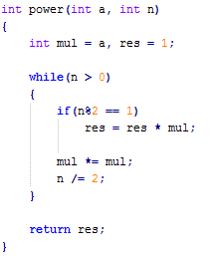
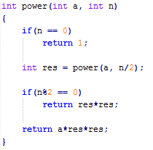
Problem
Solve the problem of finding out
power(a, n) in O(lgn) time where n is positive integer
a. With Recursion
b. Without Recursion

Slide 10
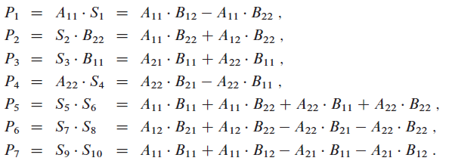
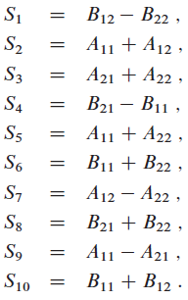



Slide 11
Thank You!

