Slide 1
Data Structures and Algorithms( CS/IS F211)
Tutorial-13
Sanjeev Kumar Singh

Slide 2
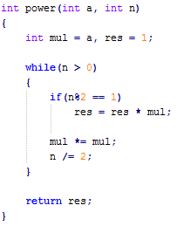
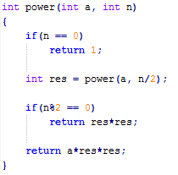
Problem
Solve the problem of finding out
power(a, n) in O(lgn) time where n is positive integer
a. With Recursion
b. Without Recursion

Slide 3
When chances of DP ???
Optimization problems : maximum, minimum, min. no. of ways, etc…
Constructing the recurrence and finding out overlapping sub-problems

Slide 4
Ways of Implementing DP
Top-Down (Recursion + Memoization)
Bottom-Up (Solving sub-problems of smaller size first )

Slide 5
Problem
f(i, j) = f(i-1, j-1) + f(i-1, j) i, j ≠ 0
j i = 0
i i ≠ 0 , j = 0
Compute f(n, n)

Slide 6
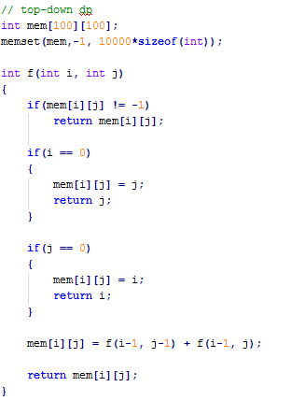
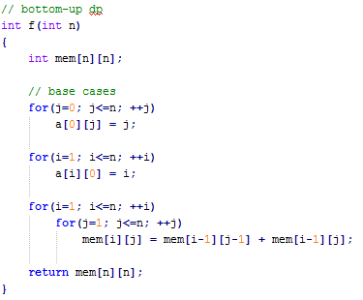

Slide 7

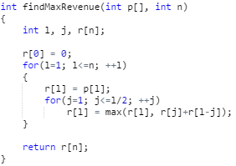
Problem
Given rod of length n(=10) and given price-list. You can cut rod in such a way to maximize the revenue.
Recurrence :
r(j) = max(r(j), r(i)+r(j-i))
1 ≤ i ≤ j/2

Slide 8
Problem
Given an array of n positive integer. Find the largest sum that does not contain any 2 consecutive number
Ex : 2 , 1 , 5 , 10 , 3
largest sum = 10 + 2 = 12
Recurrence : Storing number from index 1 in a-array
S(j) = max ( S(j-2) + a[j], S(j-1)), j > 1
0 , j == 0
a[1] , j == 1

Slide 9
Problem
You are given some items with weight w_{i} and price_{i} of it. You have a bag of W. You can take item completely or not at all. Find the maximum price which you can make.
Solution : w and price storing with index 1
p(i, j) = max { p(i-1, j- w_{i}) + price_{i} , p(i-1, j) } if j >= w_{i}
0, j = 0
0, i = 0
p(i-1, j) w_{i} > j

Slide 10
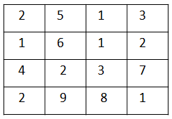
Problem
Given number of coins in each cells. You have to start from top-left and come to bottom-right. You can move right and down. Find the maximum number of coins collected.
Solution:
c(i, j) = max { c(i-1, j) , c(i, j-1) } + coins[i][j] , i , j > 0
0, , i = 0 or j = 0

Slide 11
Thank You!

