Slide 1
Data Structures and Algorithms( CS/IS F211)
Tutorial-3
Sanjeev Kumar Singh

Slide 2
Problem 1
Complexity of the value k returned by the function
int f(int n)
{
int i, j, k = 0;
for (i = n/2; i <= n; i++)
for (j = 2; j <= n; j = j * 2)
k = k + n/2;
return k;
}
k = O(n²logn)

Slide 3
Problem 2
Find time complexity of the function
function mystery()
r=0
for i=1 to n-1 do
for j=i+1 to n do
for k=1 to j do
r=r+1
T(n) = 1/3 n(n-1)(n+1) = O(n³)

Slide 4
Problem 3
Given an array a of N distinct integers in ascending order.
Devise an algorithm to find an index i such that a[i] = i if such an index exists.

Slide 5
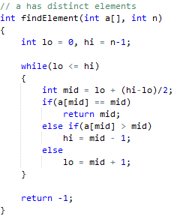

Slide 6
Problem 4
Consider the polynomial f(x) = ax² + bx + c
Find out the least non-negative integer x_{o} such that ax_{o}² + bx_{o} + c >= k
Assume :
1 ≤ a, b, c ≤ 10⁵
1 ≤ k ≤ 10¹⁰

Slide 7
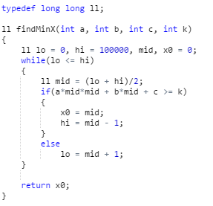
TC : O(logn)

Slide 8
Problem 5
Given a sorted array A and a number X, check for pair in A with sum as X
Ex :
A : 3 6 7 10 15 18 20
X : 25

Slide 9
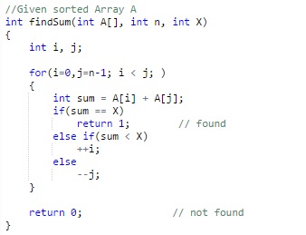
T.C. : O(n)

Slide 10
Problem 6
Given an unsorted array A having distinct elements and a number X, find number of pairs of elements in the array whose difference is X.
Ex :
A : 10 6 9 7 13 4
X : 3
# of pairs = 4
{ (4, 7), (6, 9) , (7, 10), (10, 13) }

Slide 11
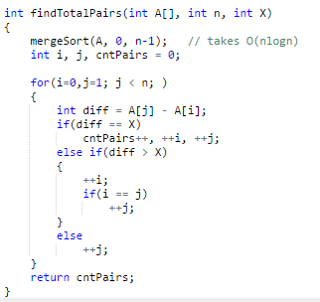
Time Complexity : O(nlogn)

Slide 12
Problem 7
Let A be an array of n distinct numbers.
If i < j and A[i] > A[j] , then the pair (i, j) is called an inversion of A.
List the five inversions of the array {2, 3, 8, 6, 1}
What array with elements from the set {1,2,3, … n} has most inversion ? How many does it have ?
Give an algorithm to find the number of inversion in any array ?

Slide 13

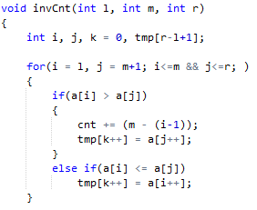
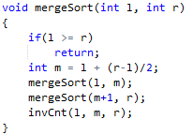
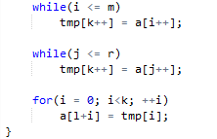

Slide 14
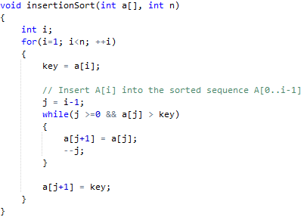
Problem 8
linear search to scan (backward) through the sorted subarray a[0..i-1]. Can we use a binary search instead to improve the overall worst-case running time of insertion sort to O(nlogn)?

Slide 15
Problem 9
Given an array of n elements. An element is a majority if it appears more than n/2 times. Devise an algorithm to identify the majority if it exists.

Slide 16
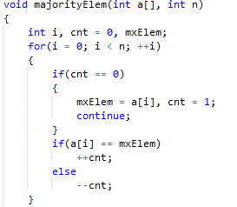
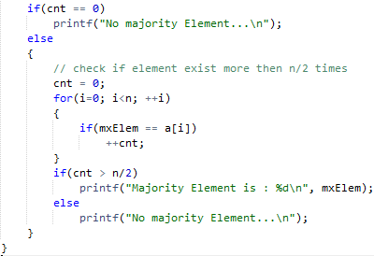

Slide 17
Problem 10
Can we apply Counting Sort on the array containing negative numbers ?

Slide 18
Thank You!

