Slide 1
Data Structures and Algorithms( CS/IS F211)
Tutorial-4
Sanjeev Kumar Singh

Slide 2
Problem 1
Given an unsorted array A having distinct elements and a number X, find number of pairs of elements in the array whose difference is X.
Ex :
A : 10 6 9 7 13 4
X : 3
# of pairs = 4
{ (4, 7), (6, 9) , (7, 10), (10, 13) }

Slide 3
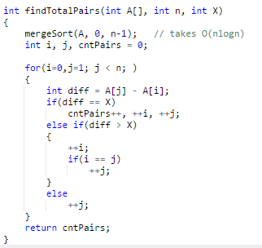
Time Complexity : O(nlogn)

Slide 4
Problem 2
You are given an array of n positive integers. All the numbers are in the range of 1 to n-1. Find any 1 duplicate number in the array.
Ex :
i/p : n=5
o/p : 2
2 | 1 | 3 | 4 | 2

Slide 5
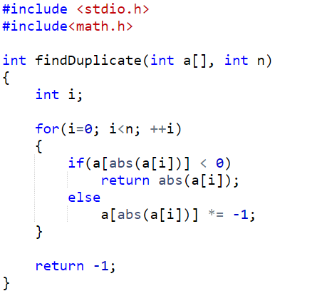

Slide 6
Problem 3
Let A be an array of n distinct numbers.
If i < j and A[i] > A[j] , then the pair (i, j) is called an inversion of A.
List the five inversions of the array {2, 3, 8, 6, 1}
What array with elements from the set {1,2,3, … n} has most inversion ? How many does it have ?
Give an algorithm to find the number of inversion in any array ?

Slide 7

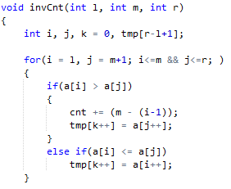
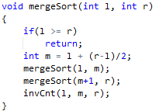
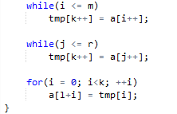

Slide 8
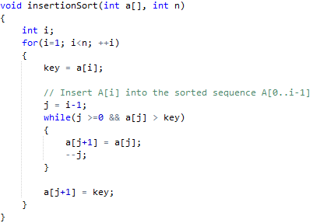
Problem 4
linear search to scan (backward) through the sorted subarray a[0..i-1]. Can we use a binary search instead to improve the overall worst-case running time of insertion sort to O(nlogn)?

Slide 9
Problem 5
Given an array of n elements. An element is a majority if it appears more than n/2 times. Devise an algorithm to identify the majority if it exists.

Slide 10
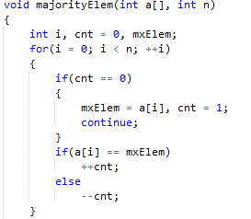
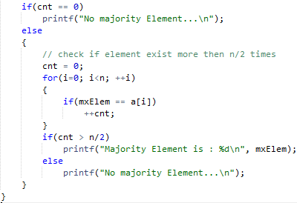

Slide 11
Problem 6
Can we apply Counting Sort on the array containing negative numbers ?

Slide 12
Problem 7
Find a triplet that sum to a given value
Given an array and a value, find if there is a triplet in array whose sum is equal to the given value. If there is such a triplet present in array, then print the triplet and return true. Else return false. For example, if the given array is {12, 3, 4, 1, 6, 9} and given sum is 24, then there is a triplet (12, 3 and 9) present in array whose sum is 24.

Slide 13
Thank You!

