Slide 1
Data Structures and Algorithms( CS/IS F211)
Tutorial-5
Sanjeev Kumar Singh

Slide 2
Problem 1
Given an array of n elements. An element is a majority if it appears more than n/2 times. Devise an algorithm to identify the majority if it exists.

Slide 3
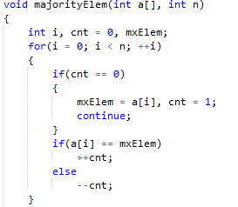
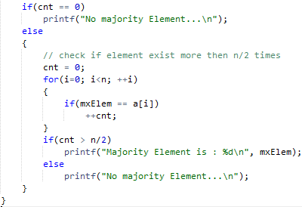

Slide 4
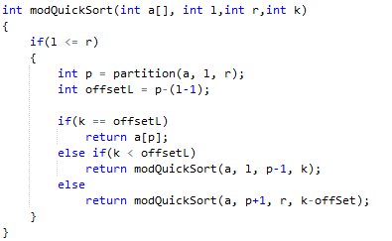
Problem 2
Find kth smallest element using quick-sort partition method.

Slide 5

Problem 3
Shuffle an array randomly or generate a random permutation of array elements

Slide 6
Linked List
If we can dynamically allocate arrays then why Linked-List is required ???
Basic Operation:
1. Print the entire list
2. Search an element X in the list
3. Insert an element X in the list
4. Delete and element X in the list.

Slide 7
Structure Definition of Node of SLL
struct nodeType typedef struct nodeType
{ {
int data; int data;
struct nodeType *next; struct nodeType *next;
}; }node;
typedef struct nodeType node;

Slide 8
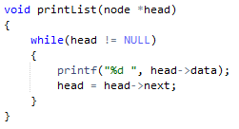

Print the List

Slide 9
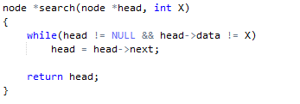
Seach an element X

Slide 10
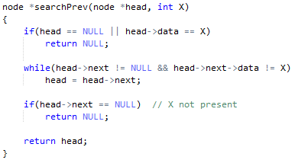
Search the previous node to X

Slide 11
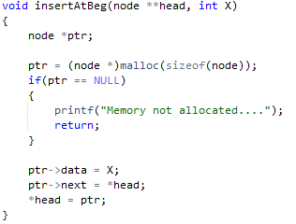
Insert an element X at Beg

Slide 12
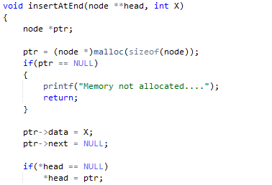
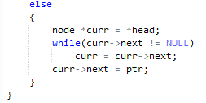
Insert an element X at End

Slide 13
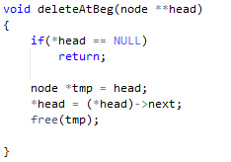
Delete a node At Beg

Slide 14
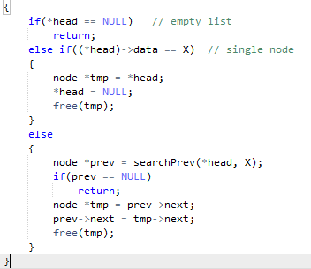
Delete an element X

Slide 15
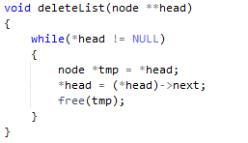
Delete Entire List

Slide 16
Thank You!

