Slide 1
Data Structures and Algorithms( CS/IS F211)
Tutorial-6
Sanjeev Kumar Singh

Slide 2
Problem 1
A polynomial of type 4x3 + 6x2 + 10x + 6 can be represented using linked list. You will be given 2 linked list representing 2 polynomials and your task is to add 2 polynomial.
typedef struct nodeType
{
int coeff;
int power;
struct nodeType *next;
} node;

Slide 3
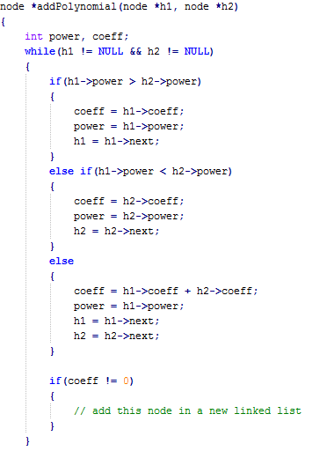
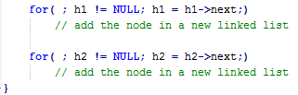

Slide 4
Problem 2
Find out the middle of a Linked-List.

Slide 5
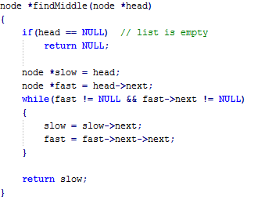

Slide 6
Problem 3
Find kth node from the end of the Linked-List.

Slide 7
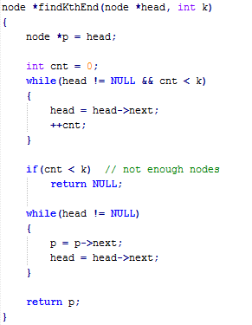

Slide 8
Problem 4
Given 2 Linked-List and they are intersecting at some node. Find the intersecting node.
ex :
L1
L2

Slide 9
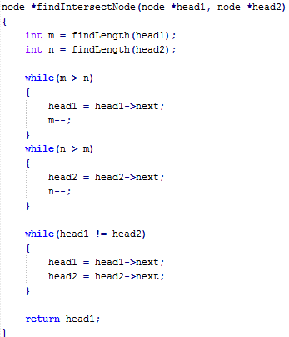

Slide 10
Problem 5
Given a Linked-List check if there is loop and find the intersecting node.
Take it as assignment

Slide 11
Stack Applications
System Stack : Enable function calls
Back Buttons : In browser or windows.

Slide 12
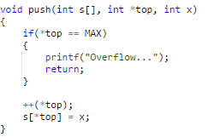

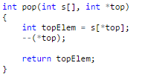
Stack Array Implementation

Slide 13
Problem 6
Parenthesis Checker to check for balancing of symbols
(, ), {, }, [, ]
Ex1 :
input : (({[]}){})
output : YES balanced
Ex2 :
input : {()[}]
output : NO not balanced

Slide 14
Problem 7
You have to implement a stack S where you have to do the following 3 kinds of Operation all in O(1) time
Push into stack S
Pop from stack S
Find Minimum in the stack S

Slide 15
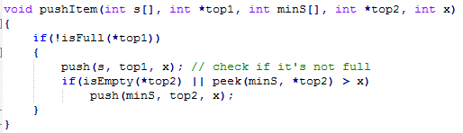
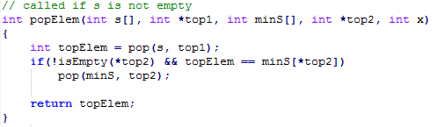

Slide 16
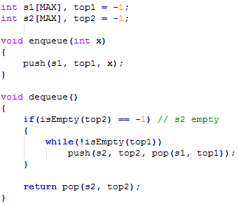
Problem 8
Implement queue using 2 stacks.

Slide 17
Thank You!

