Slide 1
Data Structures and Algorithms( CS/IS F211)
Tutorial-7
Sanjeev Kumar Singh

Slide 2
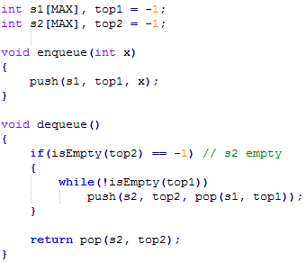
Problem
Implement queue using 2 stacks.

Slide 3
Problem
Prices of stock of a company are given for some consecutive days. You have to find the next greatest price of stock for each day.
Ex :
stock price : 2 3 5 1 3 4 1 9
next Greatest: 3 5 9 3 4 9 9 -1

Slide 4
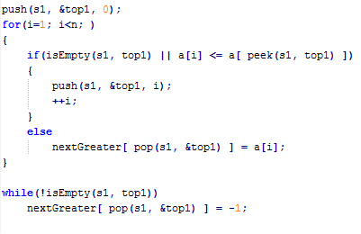

Slide 5
Problem
Design an algorithm such that enqueue, dequeue and findMax All 3 occurs in O(1) time.

Slide 6
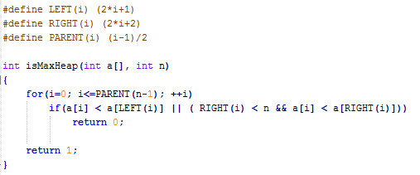
Problem
Given an array representing a Heap. Check whether it is a max Heap or not ?

Slide 7
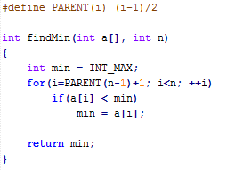
Problem
Given a max Heap. Find the minimum element

Slide 8
Thank You!

