Slide 1
Data Structures and Algorithms( CS/IS F211)
Tutorial-9
Sanjeev Kumar Singh

Slide 2
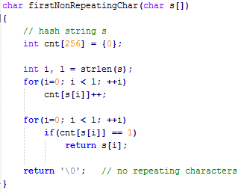
Problem
Find first non-repeating character in string.
Ex : ababcdcae
d is the first non-repeating character.

Slide 3
Problem
Given 2 string s1 and s2. Delete all character of s1 which are present in s2
s1 : abacxdxyz
s2 : axba
s1 - s2 : cdyz

Slide 4
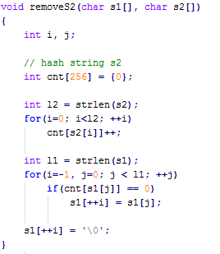

Slide 5
Problem
You are given a fair coin. What is the expected number of heads in N coin tosses.
Ans : N / 2

Slide 6
Problem
Suppose we use a hash function h to hash n distinct keys into an array A of length m. Assuming simple uniform hashing, what is the expected number of collisions ?
Ans : n(n-1)/2m

Slide 7
Problem
Suppose we keep each list in sorted order in the Hash Table where we apply chaining to resolve collisions
How does this modification affect the expected running time for successful searches, unsuccessful searches, insertions and deletions ?

Slide 8
Problem
Suppose that we are storing a set of n keys into a hash table of size m.
Show that if the keys are drawn from a universe U with |U| > (n-1)m , then U has a subset of size n consisting of keys that all hash to the same slot, so that the worst-case searching time for hashing with chaining is O(n).

Slide 9
Problem
Consider inserting the keys
10, 22, 31, 4, 15, 28, 17, 88, 59
into a hash table of size m = 11 using Open addressing with the hash function h’(k) = k % m
Illustrate the result of inserting these keys using
i. linear probing
ii. Quadratic probing with c₁ = 1 and c₂ = 3
iii. Double hashing with h₁(k) = k and
h₂(k) = 1 + k%(m-1)

Slide 10
Linear Probing : h(k, i) = (h’(k) + i) % m
Quadratic Probing : h(k, i) = (h’(k) + i + 3i²) % m
Double Hashing : h(k, i) = (h₁(k) + ih₂(k)) % m

Slide 11
Problem
Suppose in deletion of Open addressing we make it equal to special value DELETED.
Write pseudocode for HASH-DELETE and modify HASHINSERT to handle the special value DELETED

Slide 12
Thank You!

