Slide 1
Data Structures and Algorithms( CS/IS F211)
Tutorial-8
Sanjeev Kumar Singh

Slide 2
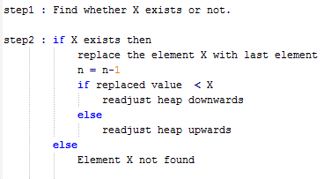
Problem
Given a max Heap of size n. Give an algorithm to delete an element X

Slide 3
Problem
Given a max Heap of size n. Find the kth largest element in O(klogk)
heap : 50 30 40 10 25 20 5 8 7

Slide 4
Problem
Given n Points (x,y). Find the k closest point to origin O(0,0)
Solution :
a. Find distance of each points from (0, 0) → O(n)
b. Creating heap will take O(n)
c. Using heap to find k smallest element in O(klogk)
T(n) = O(n + klogk)

Slide 5
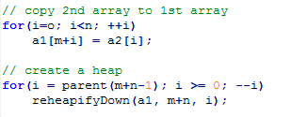
Problem
Given 2 max Heap of size m and n . Merge 2 heaps to create a max Heap in O(m+n) time.
Assume: 1st Array has enough space to hold the elements for both.
Sol : Copy 2nd array in 1st array and then create a heap which takes O(m+n)

Slide 6
Problem
Write an algorithm to :
Merge k sorted array of size n into single sorted array
Ans : O(k) + O(kn times logk) = O(nklogk)

Slide 7
Problem
A d-ary heap is like binary heap but non-leaf nodes have d-children instead of 2
How do you represent a d-ary heap in an array.
What is the height of a d-ary heap of n elements.
Give an efficient implementation : ExtractMaximum
Give an efficient implementation : Insert

Slide 8
a) #define kCHILD(i, k) (d*i+k)
#define PARENT(i) (i-1)/d
b.) ht = O(log_{d}n)

Slide 9
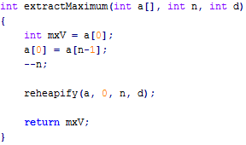
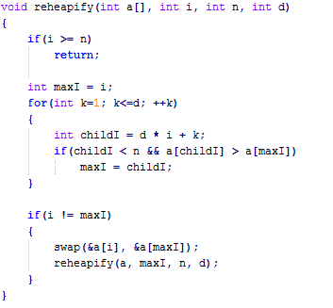

Slide 10
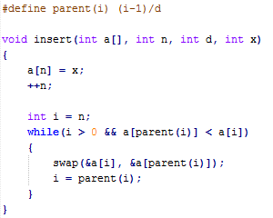

Slide 11
Thank You!

