Slide 1
INVESTMENT CASE STUDY SUBMISSION
Group Name:
Aditya Devarajan (APFE1680336)
Ashank Srinivasan (APFE1680071)
Anand Sonawane (APFE1680856)

Slide 2
Abstract of Spark Funds Investment Case
Introduction
Spark Funds, an Asset Management Company, wants to invest in few companies.
To do so, they have to understand the global trend to take decisions effectively.
The data available with Spark Funds, is
List of Companies, with their description, location, categories etc
List of Investments, that have taken place in such companies, with investment amount and investor details
Goals
Find a Best Companies for Spark Funds to Invest.
Analyze Best Geographies, Best Sector and a suitable Investment Type
Constraints
Spark Funds, are willing to invest between 5-15 million USD only per investment round
Spark Funds will Invest only in English Speaking Countries, as this will ease the communication
Spark Funds want to choose one of the four investment types : “Venture”, “Seed”, “Angel”, “Private Equity”

Slide 3
Problem Solving Methodology

Slide 4
Analysis – Part 1 - Data Cleaning
File Import
Import the 2 Files, “companies.txt” (company details) and “rounds2.csv” (investment details).
Check the granularity of the data sets.
Check if there are any duplicate records present in companies dataset, that can be eliminated
Eliminate these records if it is permitted.
Short list the investment details file for the four funding type where Spark Funds are willing to invest
Data Merging
Merge the 2 datasets based on a unique key (de-normalize the data)
Merging is done so that the analysis can be efficiently.
Treating Missing Values
After Merging data, we can see missing values in Fact variables (total investment raised)
Stratify the data based on Funding Type
Find the % of missing values for individual funding type (ignore if <10%, treat >10%)
For >10% missing values, treat the values by substituting Median value (of the particular funding type) with missing values.
Finalize Funding Type suitable for Spark Funds
Compute mean of the investment raised based on the funding type.
Check the mean with constraint 1 (i.e. Spark Funds will invest between 5-15 million USD)

Slide 5
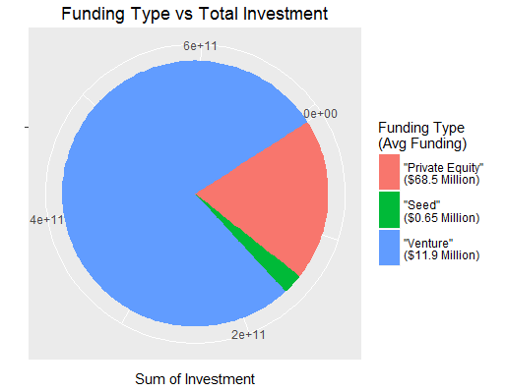
Result - Analysis – Part 1
Findings
Maximum Total investment has occurred in Venture Funding Type
Avg Funding amount of Venture type is 11.9 Million USD
This proves that the best Funding Type for Spark Funds is “Venture”

Slide 6
Analysis – Part 2 – Country/ Sector Analysis
Create Master Frame containing only “Venture” Funding Type
In this dataset, roll up the total investments on a country level
Select top 3 best countries based on the constraints of Spark Funds (English Speaking)
Top 3 countries are USA, GBR, IND
Main Sector details based on Primary Sector
Short list the records that have investment amount between 5-15 Million USD
Identify primary sector of each company by considering the 1st sector in category list as a business rule.
Map the primary sector to 8 main sector categories
Dice the data frame for 3 countries and roll up the aggregate sum of investments for each of the 8 sectors.
This will give us “Others”, “Social, Finance, Analytics, Advertising”, “Cleantech / Semiconductors” and “News, Search and Messaging” as the top sectors of interest.
Shortlist Companies for investment
Aggregate sum of investments sector-wise and company-wise to shortlist the list of probable companies where Spark Funds can invest.

Slide 7
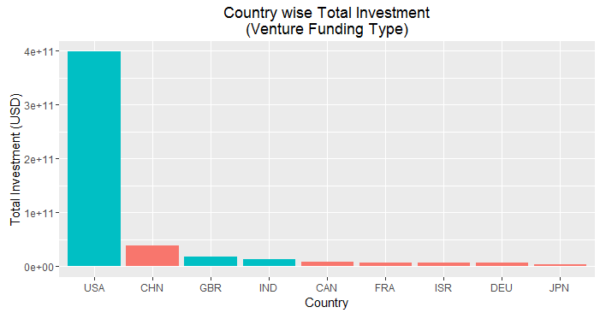
Result - Analysis – Part 2
Findings
Highest funding have been done in USA
Followed by CHN, GBR, IND
China being Non-English Speaking, remove it from the list of probable countries where Spark Funds want to invest.
We can shortlist: USA, GBR and IND as best countries to invest in.

Slide 8
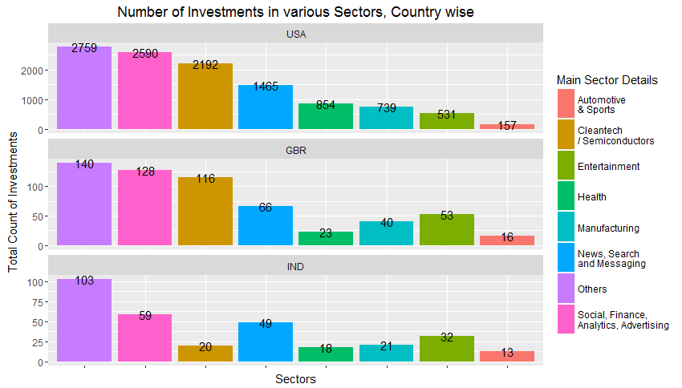
Result - Analysis – Part 2
Findings
The best sectors in USA & GBR are
Others
Social, Finance, Analytics, Advertising
Cleantech / Semiconductors.
The best sectors in IND are
Others,
Social, Finance, Analytics, Advertising
News, Search and Messaging.

Slide 9
Conclusions
S.No | Analysis | Results
1 | Best funding type for Spark Funds (considering constraint of 5-15 Mil USD) | Venture Type
2 | Shortlisted countries for Investments (English Speaking) | USA, GBR, IND
3 | Top Sectors for Investment (based on Number of Investments) | Others Social, Finance, Analytics, Advertising Cleantech / Semiconductors News, Search and Messaging
4 | Top 2 companies in USA (based on Total Investment) | Virtustream SST Inc. (Formerly ShotSpotter)
5 | Top 2 companies in GBR (based on Total Investment) | Electric Cloud Celltick Technologies
6 | Top 2 companies in IND (based on Total Investment) | FirstCry.com Manthan Systems
Spark Funds can invest in the companies identified in points 4, 5 and 6, as these are the most sought after companies based on investment patterns of other investors.

