Slide 1
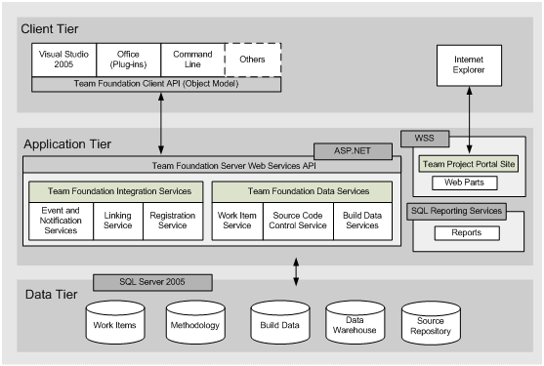
DB – Standalone/Cloud- Columns
VSIX Extension(For VS)
Query program to fetch work items
Group Baselined items
Saved baselined items
Query baselines
Fetch a Baseline with its item
Diff between two baselines
Report Generator
VSIX Baseline Extension
Baseline Manager
Report Manager
Creator
Fetcher
Baseline/ WorkItem Diff
Query TFS
DB Wrapper
SQL Express
Or
Data Tier
Baselines
Baselines
SQL Azure
Baseline Id | Baseline Name | Baseline Date | Baseline CreatedBy
WorkItem Id | WorkItem Revision Id | WorkItem BaselineId

