Slide 1
WeatherAPI.com
Fully managed free weather and geolocation API

Slide 2
Endpoints
Realtime Weather API
Forecast Weather API
IP Lookup API
Time Zone API
Astronomy API
History Weather API
Search/Autocomplete API
Sports API
Future Weather API

Slide 3
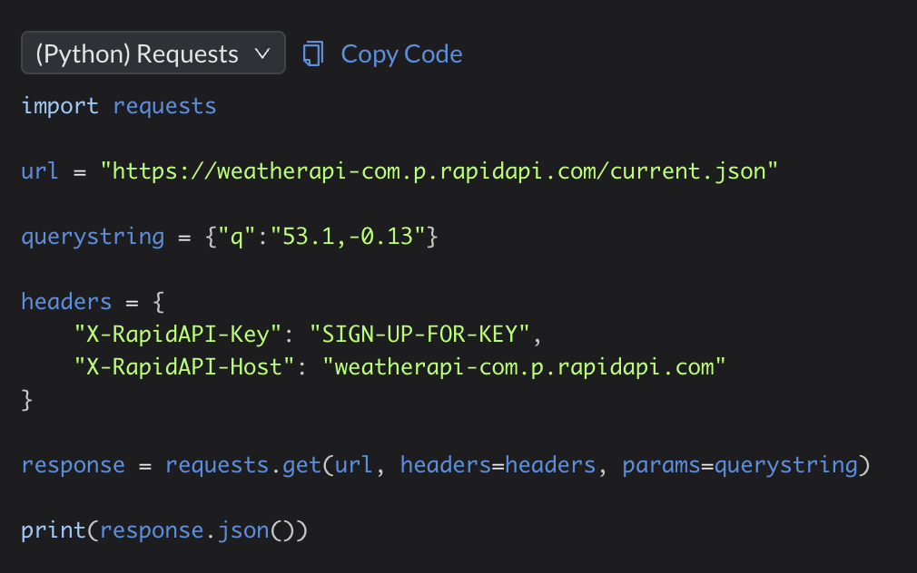
Use Case: Realtime Weather API

Slide 4
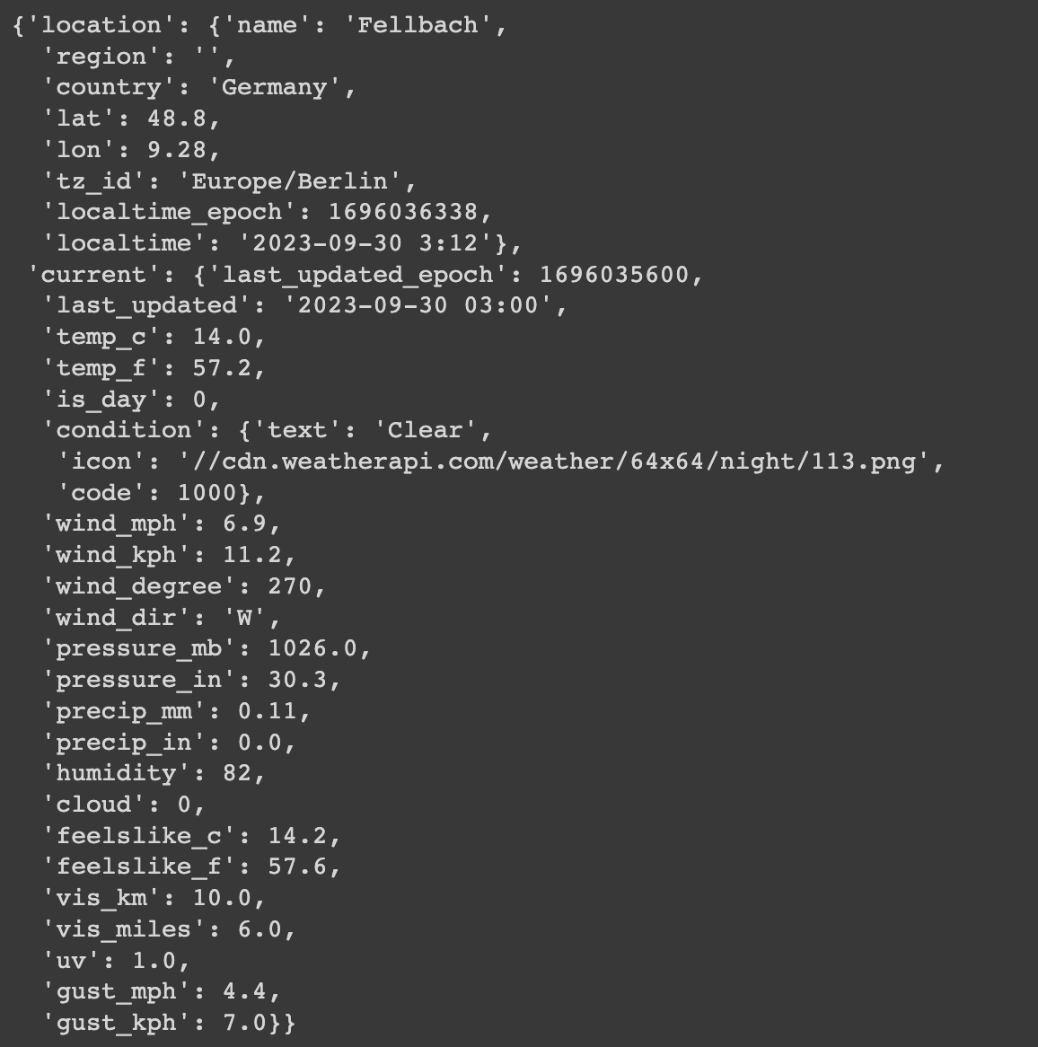
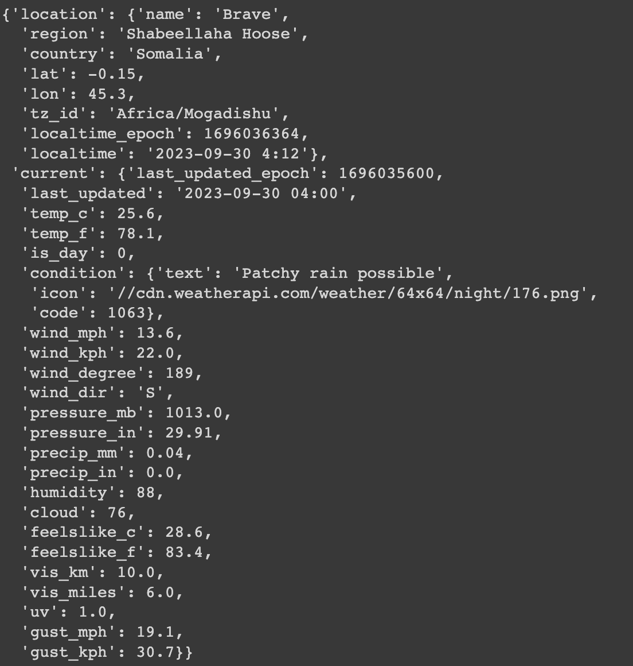
Sample RAW JSON Output

Slide 5
Visualizations

Slide 6
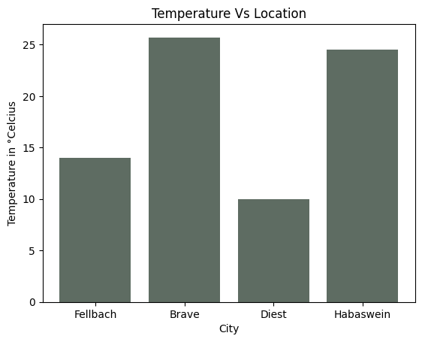
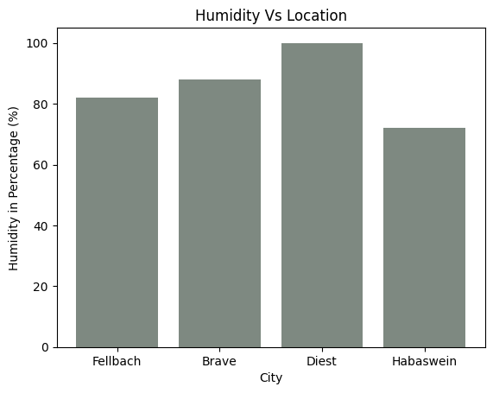
Exhibit A: Temperature and Humidity

Slide 7
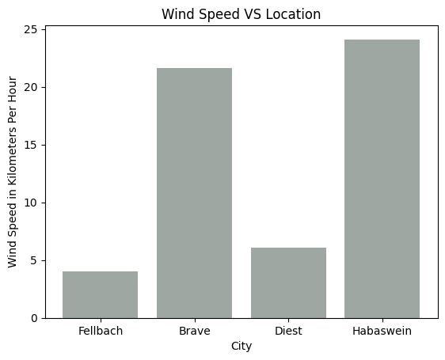
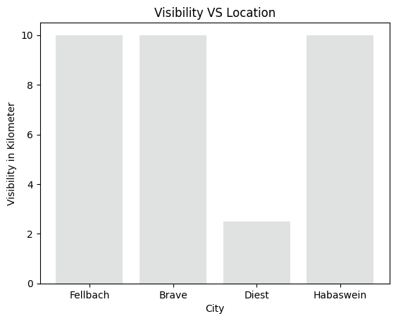
Exhibit B: Wind Speed and Visibility

Slide 8
Possibilities
Integrate WeatherAPI data and yFinanceAPI data to find correlation between Stock Prices (eg. XOM) and Climate
Integrate WeatherAPI data and Retail Sales data to correlate and forecast sales data.
Use endpoints like IP Lookup to identify geolocation of our softwares shipped.
Use Search/Autocomplete API in text-based recommendation algorithm.

Slide 9
Thank You
Anand Shah

