Slide 1
Top 5 Games
SlotCatalog ᐈ What to Play? Where to Play?

Slide 2
Leaderboard
Game King Video Poker
Heads Up Hold' em
Premium Blackjack Single Hand
Quantum Roulette
101 Roulette

Slide 3
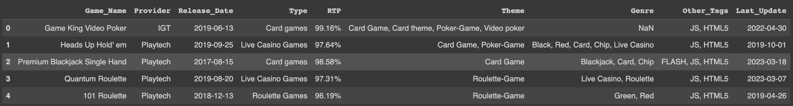
Meaningful Attributes

Slide 4
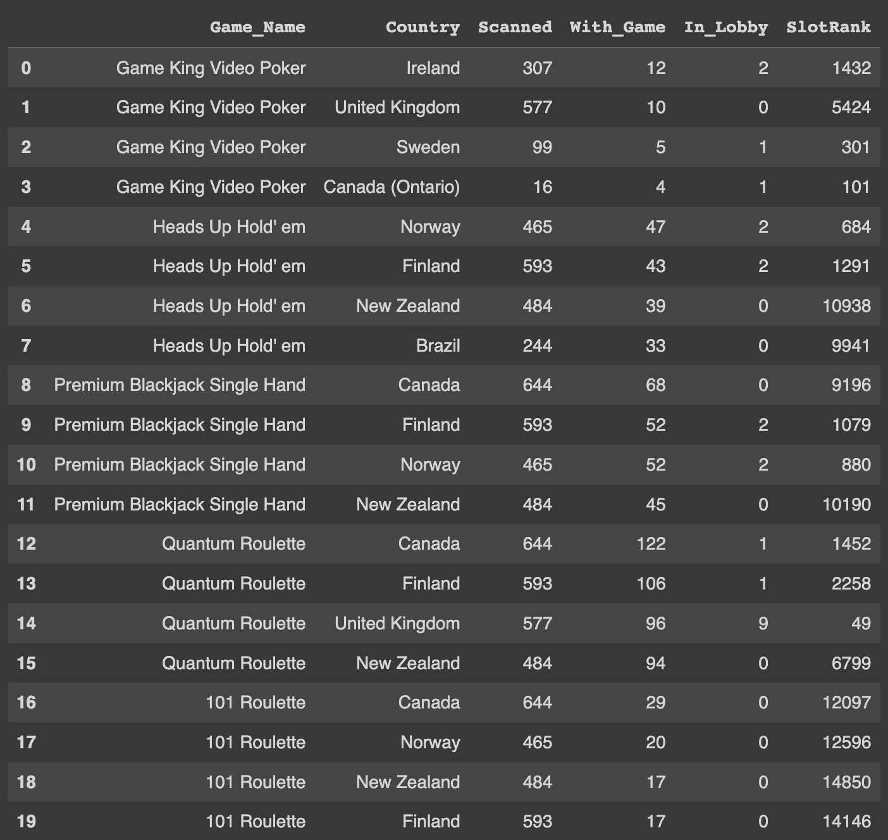
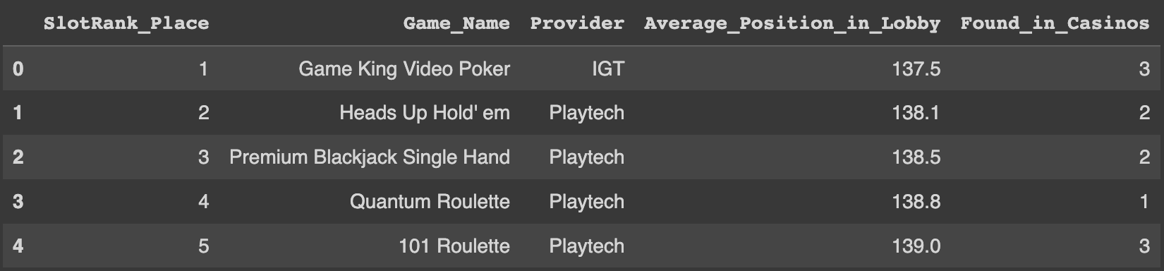
Additional Variables for Analysis

Slide 5
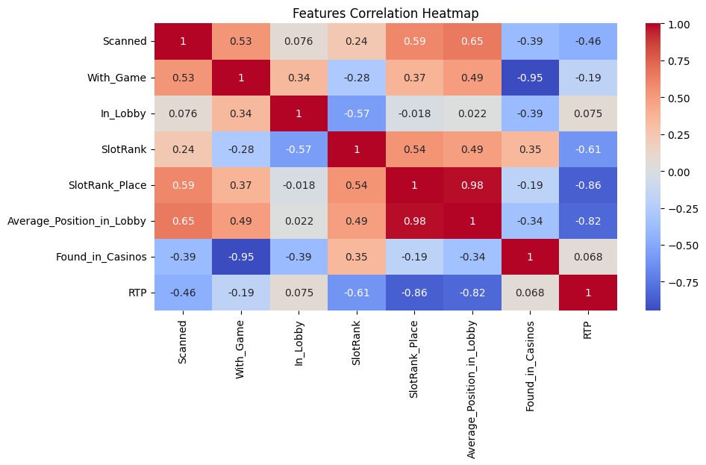
Viz 0. Features Correlation Matrix

Slide 6
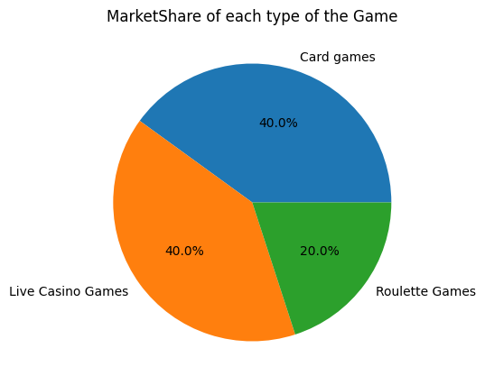
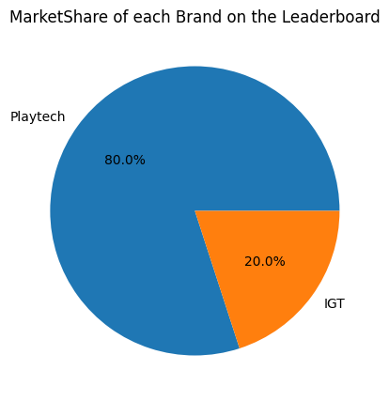
Viz 1. Market Shares

Slide 7
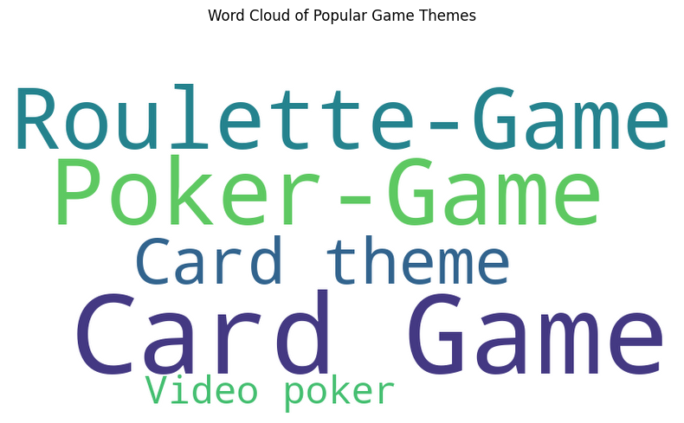
Viz 2. Word Cloud of Popular Game Themes

Slide 8
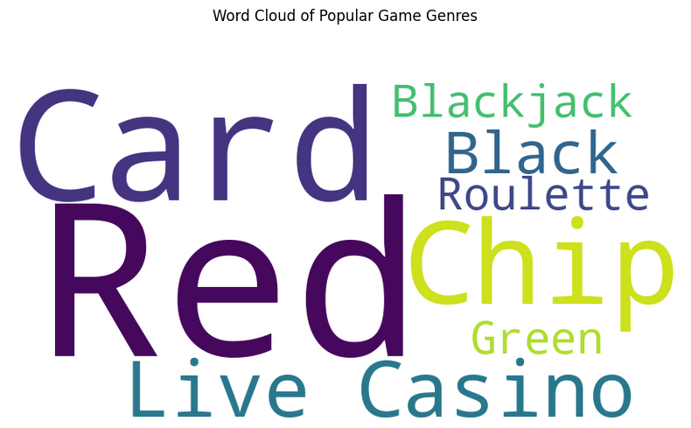
Viz 3. Word Cloud of Popular Genres

Slide 9
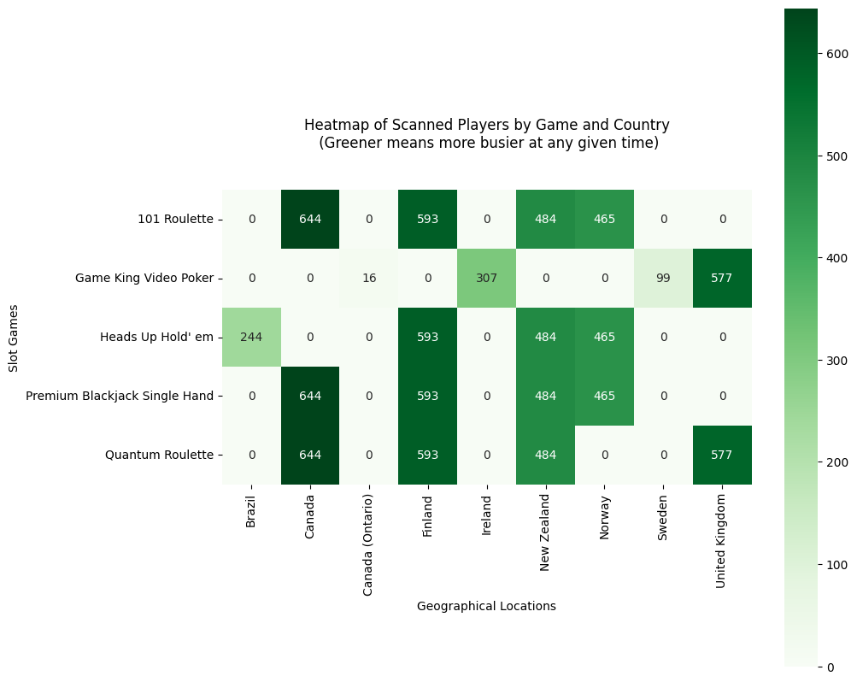
Viz 4. Heatmap of Players Online

Slide 10
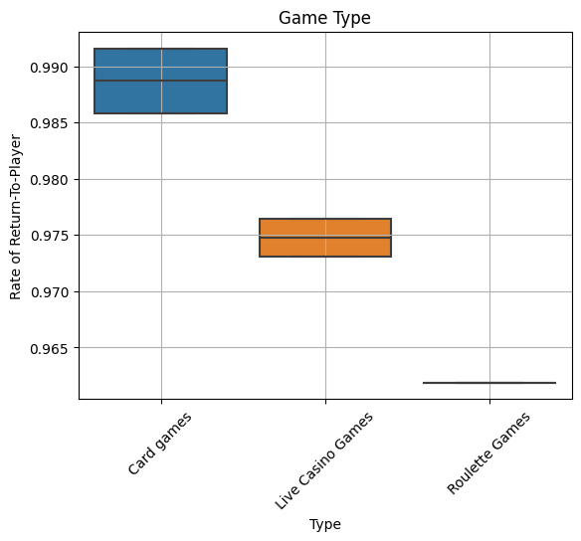
Viz 5. Return-To-Player by GameType

Slide 11
Thank You
Anand Shah

