Slide 1


TERM DEPOSIT SUBSCRIPTION PREDICTION AND ANALYSIS
ANAND S P

Slide 2
CONTENTS
LOADING HACKATON DATASET INTO PYTHON AND IT'S FINDINGS
2. NUMERICAL FEATURES EDA OBSERVATIONS
3. CATEGORICAL FEATURES EDA OBSERVATIONS
4. PREPROCESSING
5. MODEL SELECTION
6. CROSS VALIDATION
7. HYPERPARAMETER TUNING
8. FINAL OUTCOME & CONCLUSION

Slide 3
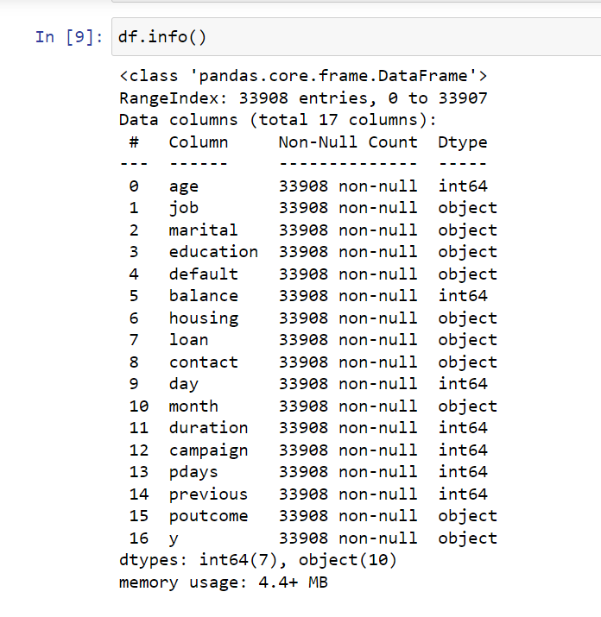
LOADING HACKATON DATASET INTO PYTHON AND IT'S FINDINGS
There are two csv files one for training and one for testing.
The dataset is made up of 33908 rows and 17 columns.
There are no missing values.
There are total 7 numerical columns and 10 categorical columns.
The target variable is binary classification with imbalanced data.

Slide 4
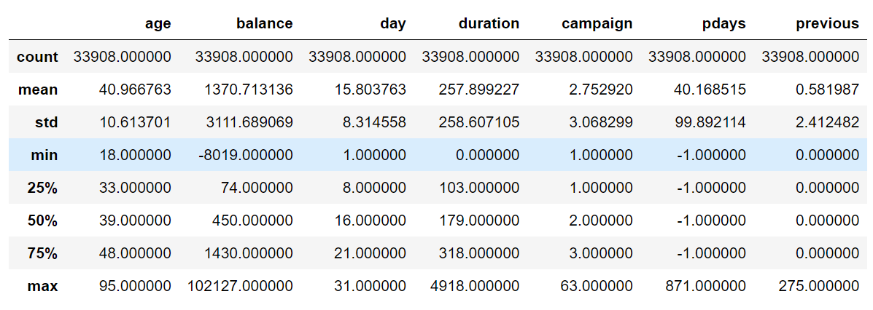
NUMERICAL FEATURES - EDA OBSERVATIONS
Client of age group between 30 to 40 is the highest.
Though 75 percentile of clients are contacted only 3 times, in extreme cases.
Zero and negative balanced client seem to be significantly high.
75 percentile of contacted client during this campaign are new.
75 percentile of clients are not contacted during campaign.

Slide 5
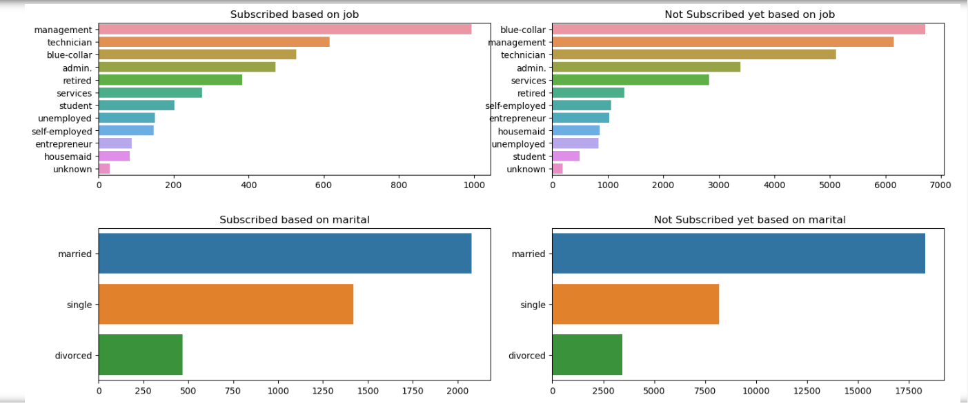
CATEGORICAL FEATURES - EDA OBSERVATIONS 1
From the above visualization ,It can be noted that blue collar job clients who comes in top 3 of subscribed client list comes top in unsubscribed client list with significant number than subscribed.
So it is recommended to target this customers for better successful subscription.

Slide 6
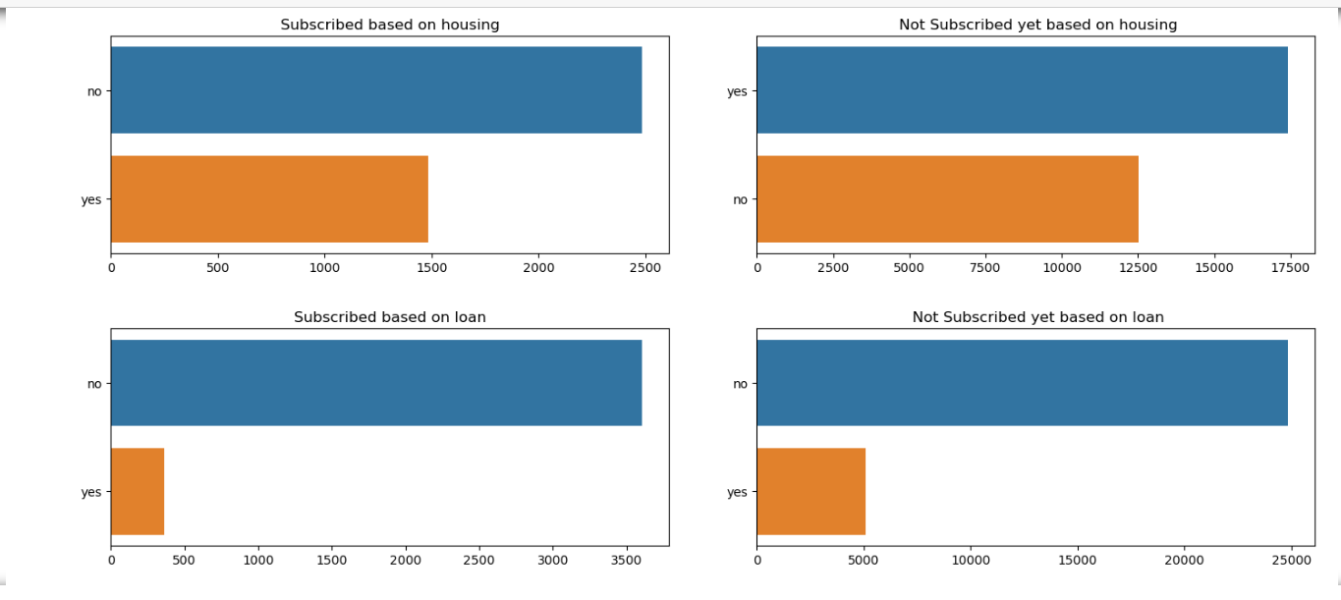
CATEGORICAL FEATURES - EDA OBSERVATIONS 2
People with housing loan have not subscribed for term deposit which is understandable and not encouraged to avoid NPA.
It can be seen that the clients who don't have personal loan have still not opted for term deposit, these clients can be focused for subscription.

Slide 7
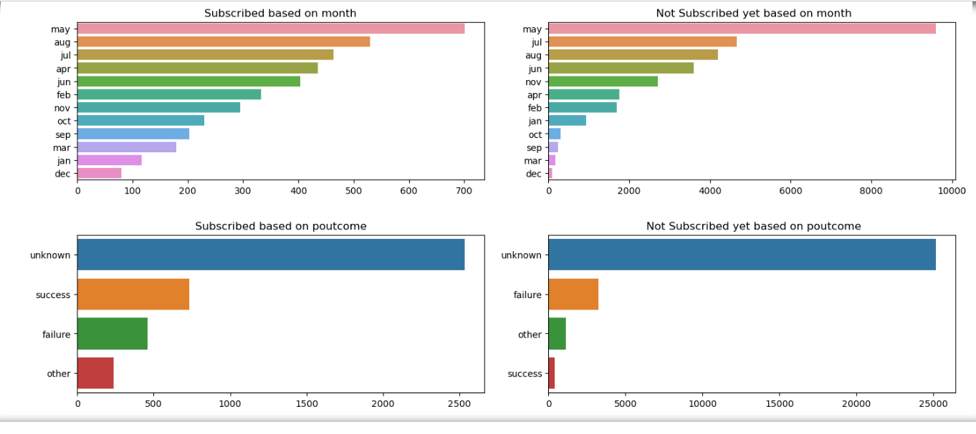
CATEGORICAL FEATURES - EDA OBSERVATIONS 3
December, March, September months campaign count is minimum.
It can be seen that the first month of the year January though the marketing campaign is high, the subscription result is No rather than yes.
Previous marketing failure seems to be continuing as same can be seen in present campaign result from these clients.

Slide 8
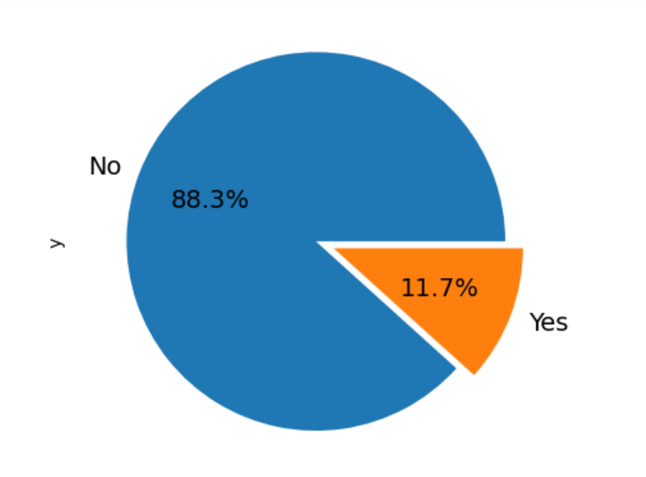
HANDLING IMBALANCE DATASET USING SMOTE
The dataset is imbalanced as we can see from the pie chart.
To avoid bias towards the majority class , SMOTE imbalances correction technique has been used.
SMOTE is an over sampling data augmentation technique better than traditional sampling technique.
SMOTE imbalanced technique is used because instead of duplicating data, it creates new data using KNN algorithm.
SMOTE is given into imblearn pipeline instead of sklearn pipeline to avoid implementing it during validating and testing.

Slide 9
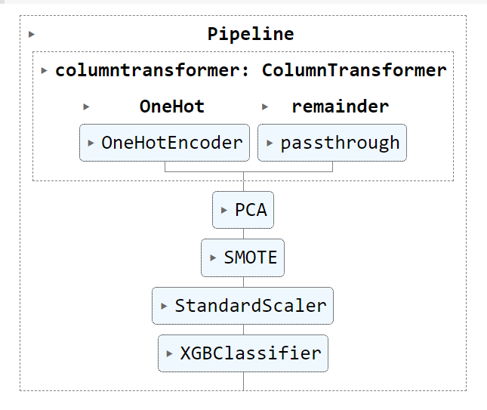
PREPROCESSING
First the dataset is ONEHOT encoded on categorical data and drop the first newly generated dummy column.
Remainder is set to pass through to keep numerical data as it is.
PCA is dimension reduction technique used to reduce the dimension without information loss.
STANDARDSCALER is a scaling technique used to scale all the data of same magnitude by scaling.
These four preprocessing is done internally inside pipeline and the output of the preprocessing is given as an input to the model building.

Slide 10
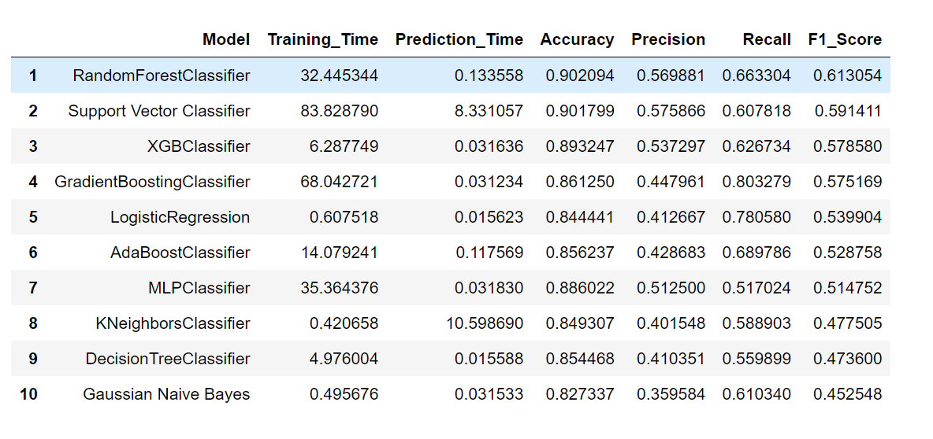
MODEL SELECTION
Among all 10 Models, RandomForest performed best in F1 Score and Extreme gradiant boosting also performed well with less prediction time.
We will cross validate & hypertune these 2 model and select the best performer for Final Model building.
SVM is not considered for this as the prediction time is very high and it's sensitive to outliers which is the case for banking dataset.

Slide 11
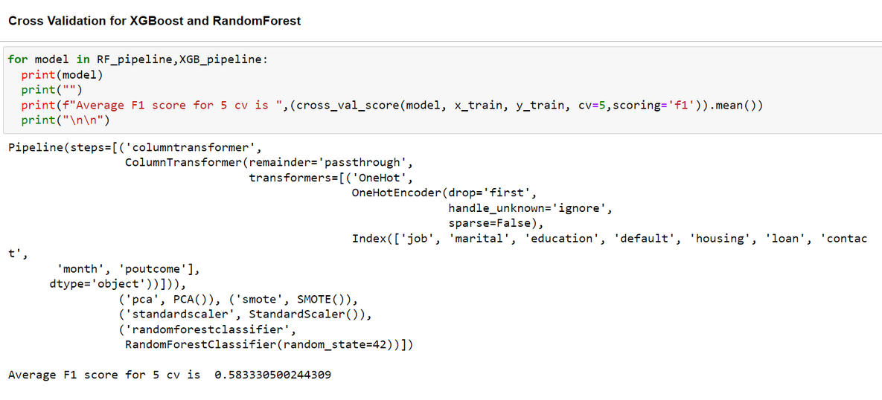
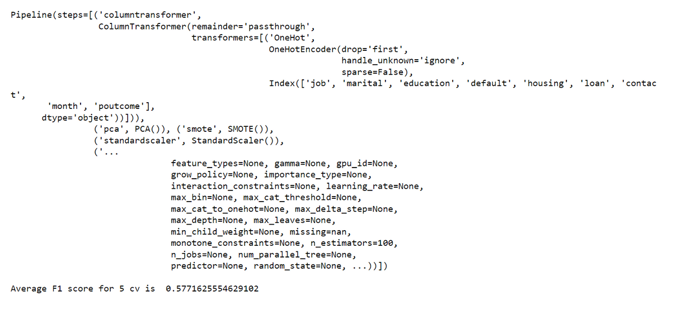
CROSS VALIDATION
Cross validation is done on both XGBoost and RandomForest to ensure that the model is generalizing over the whole dataset.
The average f1 score of RandomForest is 0.588
The average f1 score of XGBoost is 0.577
Both are generalizing well.

Slide 12
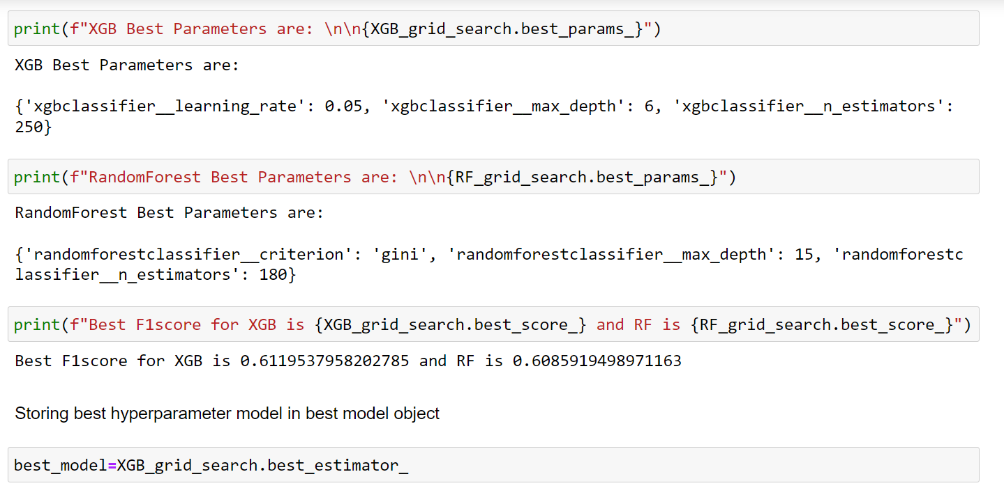
HYPERPARAMETER TUNING
Hyperparameter tuning is done using GridsearchCV multiple times to find the best hyperparameters of both XGBoost and RandomForest.
The final f1 score of RandomForest is 0.608 and XGBoost is 0.6119. so XGBoost is selected as final model and the best parameter is saved for model building.

Slide 13
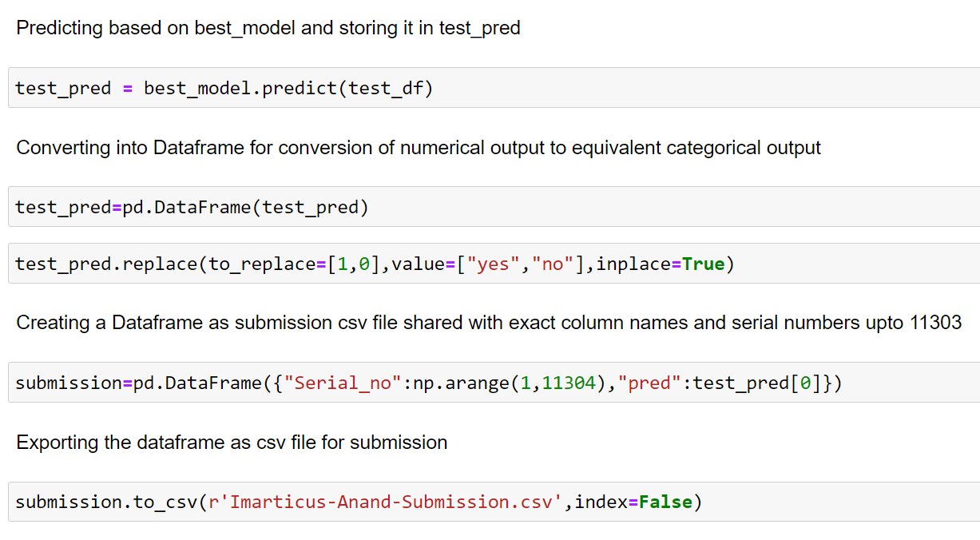
FINAL OUTCOME
Test dataset is loaded and prediction is done using final model.
The output is converted into categorical and exported as csv file.

Slide 14
THANK YOU
Email
anand9009sp@gmail.com
Linkledin
https://www.linkedin.com/in
/anand1994sp/
Phone
+91 7639495037

