Slide 1
WorkDone
Team: ParleG

Slide 2
An app that connects the unorganized sector of people working as Household Workers, Gardeners, Tutors, Manual Labour to the users living in cities according to their needs.
Provide a Skill Check of the Workers and make them Professional in their works so that they earn their livelihood by working in an organized sector with incentives of that of an employee.
Company Earns by charging Commissions in the service provided.

Slide 3
TYPES OF SERVICES PROVIDED
Daily Services consisting of Household Chores like, Baby Sitting, Gardening, Painting , Tutor or the Manual Labour.
As well as the company will provide bulk workers to oraganizations like hotels, hospitals, industries.
Mode of Services:
Monthly/quarterly long term subscriptions.
Ex: Cloth Washing for a month
Package of Services
Ex: Brooming+Gardening+DishWashing
One time service
Ex: House Painting for Diwali, etc
Special Section For Highly Professional Workers.
Research....

Slide 4
Social Impact
Providing Employment and Job Security To a Large Number of People especially the economically lower section.
On long term basis, we see it as a product that will be serving large number of people.
Women Empowerment

Slide 5
AVOIDING SYSTEM BYPASS

Slide 6
Reward based Marketing System for Users.
Coupon System with expiry date
Ex. Myntra
Offers on availing long term services
Ex. Avail a service for 6 months by paying just for 5 months.
3) Festive Season Offers to Customers
Ex. Complete the cake as in GPay
Offers if package of services is availed instead of single service.
Ex. Avail a package of 3 services and get 10% off.
Increasing Involvement
Ex. KFC

Slide 7
Worker Side
Point based Progress Bar
Workers can claim for rewards if have reached certain points which will be predefined on Worker Portal.
Ex. Shimla tour for 1200 points
Top Performers….
Reward to top performer in a particular duration say Half Yearly…. (It leads to competitive environment among workers )

Slide 8
Safety Feature
SOS directly linked to the Company Representatives providing Immediate Help.
Training Provided By us lowers the risks and makes Sure that these workers know who to tackle situations leading to harassments.
We will complete info of user in case any mishap happens

Slide 9
User END

Slide 10
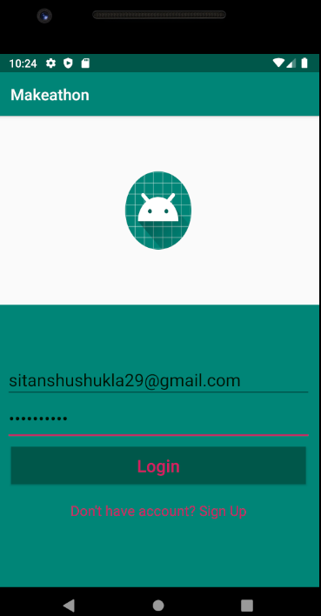

Slide 11
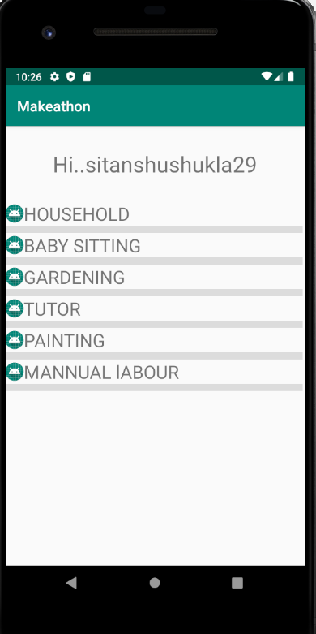

Slide 12
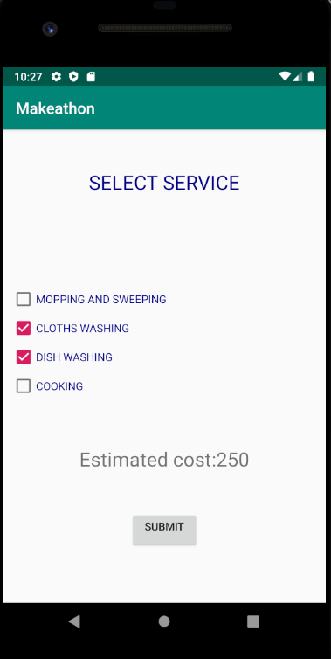

Slide 13
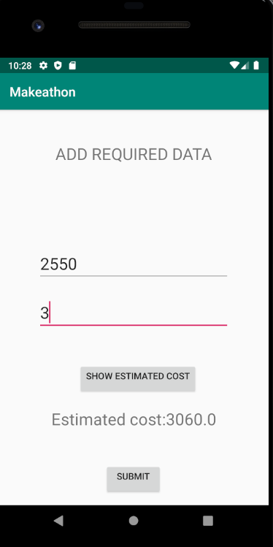

Slide 14
Worker End

Slide 15
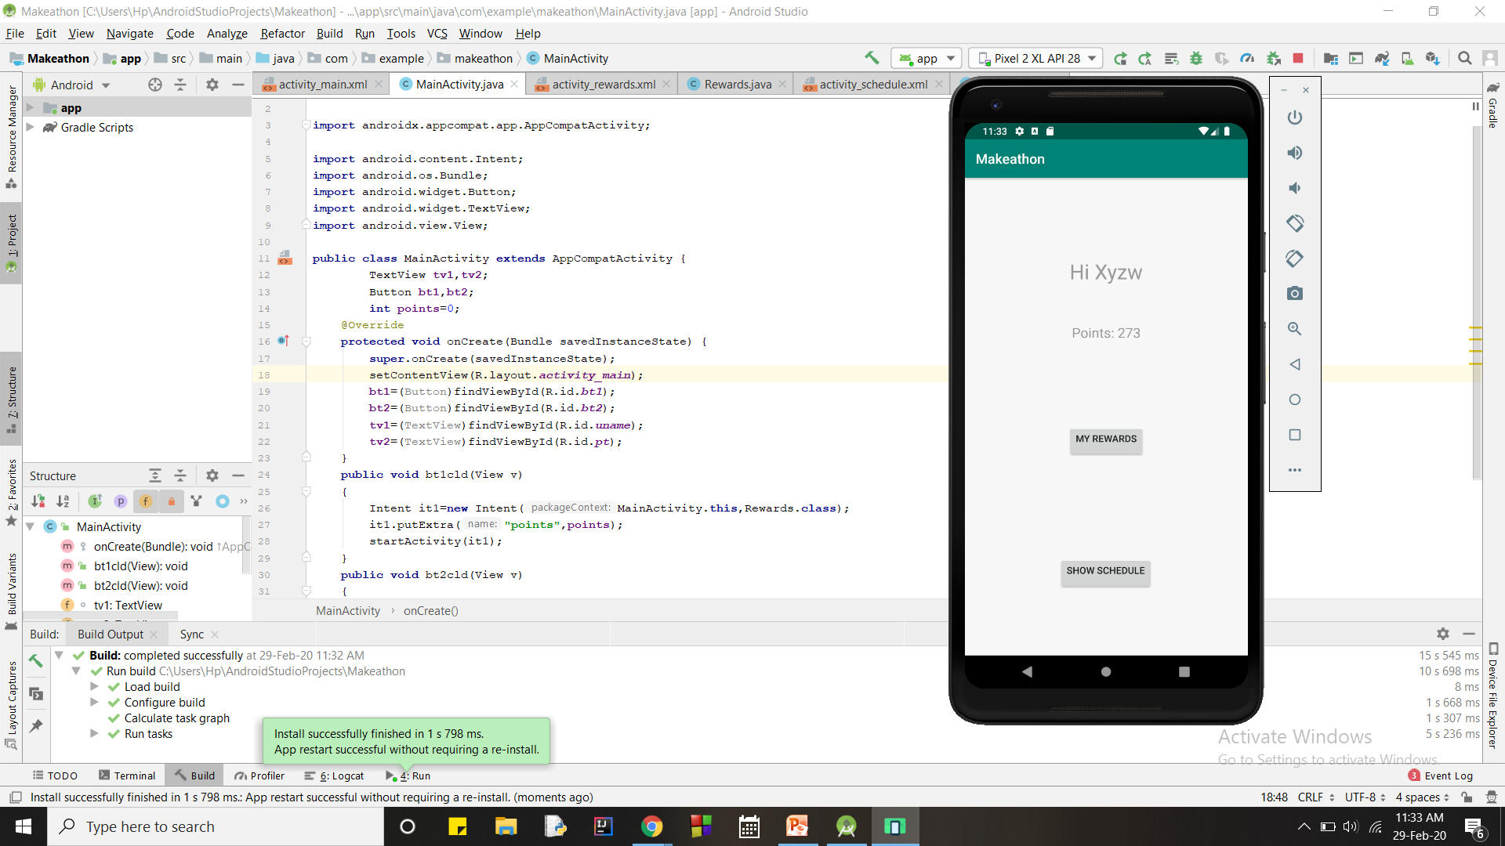

Slide 16


Slide 17


