Slide 1
[ Rear sprocket Line]
[Nagpur Plant ]

Slide 2
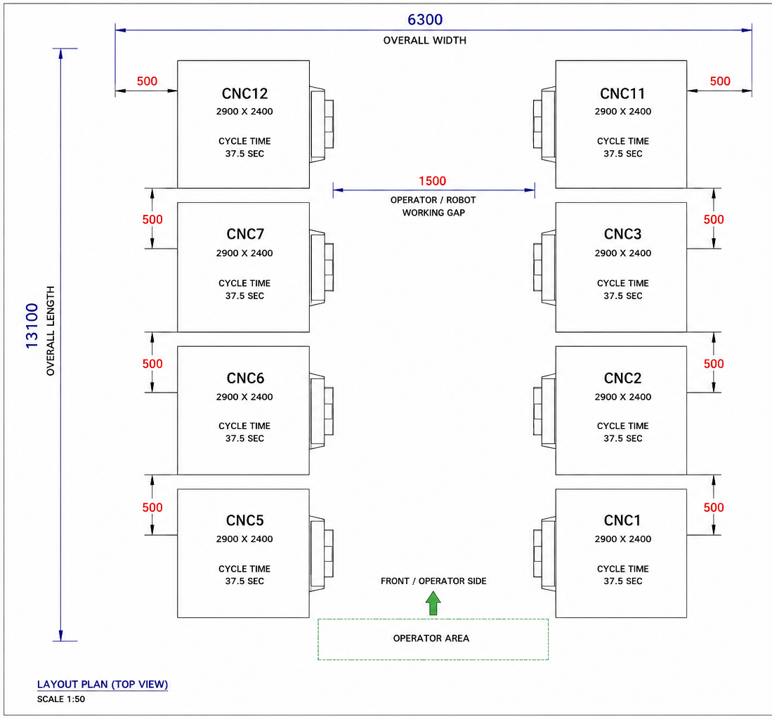
Current Machine Layout
LGB
NOTES
• Total CNC machines: 02
• No. of Chucks: 04 (2 Chuck facing eachother in a machine)
• There is only one varient and same operation for 2 chuck in a machine
• Current mode: JAEWOO (TWIN-G-200)
• Layout can be modified per vendor proposal
Machine layout

Slide 3
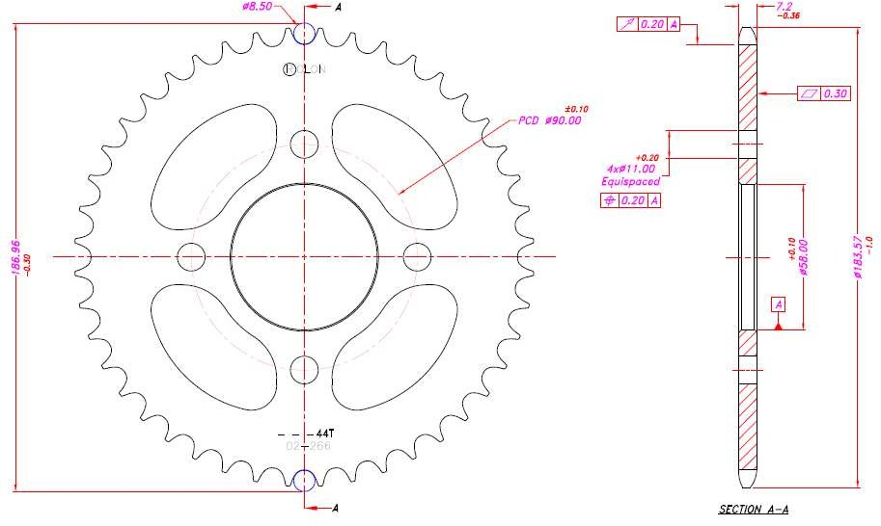
Part Details
LGB
[ INSERT COMPONENT IMAGE ]
COMPONENT IMAGE
MACHINE LAYOUT
Part No.
1398
OP 10 CNC Model
TWIN-G-200 ( JAEWOO )
Cycle Time OP 10
[37.5 sec]
Total No.of M/C in OP10
2

