Slide 1


Robotics & Automation Projects
Operations Technology
Sujith Muraleedaran

Slide 2

00
Line Automation - Cobot’s (Plan & Status)
S.No | Project | Plant | Process Scope | Robots / Cobots | Start Date | End Date | Man Power Reduced per shift | Current Status | Capex Cost | ROI
1 | Stellantis line 1-Phase | P.Palayam | OP10 , Ultrasonic washing , Vision , OilWashing | 2 × UR12e Cobots | 07-07-2025 | 20-07-2026 | From 15 to 6 = 9 operators reduced | Installation & commissioning inprogress | ₹62,00,000 | In 2.6 years
2 | BMW RAD Line | K.Palayam | OP10 → OP20→OP30→OP40 | 4 Cobots + 1 AMR | 05-06-2026 (PO 01-07-26) | 20-09-2026 | From 33 to 9 = 24 Operators Reduced | DAP Submission |  | In 1.93 years
3 | Helical Line | P.Palayam | OP10 → OP20 | 2 UR12e Cobot + 1 yaskava 20kg robot | 05-06-2026 (PO 01-07-26) | 20-09-2026 | From 24 to 6 = 18 Operators reduced | DAP Submission |  | In 1.96 years
4 | Ather Line | P.Palayam | OP10 → OP20 | 5 × ABB 12kg Cobots | 05-07-2026(PO Not Released) | 15-10-2026 | From 30 to 6 = 24 Operators Reduced | Kickoff documents preparing |  | In 2 years
5 | Daimler Line | P.Palayam | OP10 → OP20 | 4 × UR12e Cobots | 05-07-2026 (PO Not Released) | 15-10-2026 | From 24 to 6 = 18 Operators Reduced | Kickoff documents preparing |  | In 2.10 years
6 | Vallam | Vallam | - | - | - | - | - | RFQ in progress | - | -
₹1,23,71,600
₹1,23,71,600
₹93,52,000
₹93,52,000
₹1,29,82,000
₹1,29,82,000
₹1,00,00,000
P - Palayam , K - Palayam

Slide 3
AUGUST PLAN VS ACTUAL STATUS
S.No | Responsibility | Project | Task | Description | Tested | Status | Start date | End date
P.PALAYAM
1 | Anand & Mynthan | Robotics | 1018(Stellantis) line Automation | OP10 installation fully completed and Ultra wash installation inprogress | Anand & mynthan | Inprogress | 23.06.2026 | 10.09.2026
2 | Anand & Mynthan | Robotics | Diamler line Automation | I/P table and O/P table are in manafacturing | Anand & mynthan | Inprogress | 20.07.2026 | 20.09.2026
3 | Anand & Mynthan | Robotics | Helical Line Automation | Installation inprogress | Anand & mynthan | Inprogress | 28.08.2026 | 30.09.2026
4 | Anand & Mynthan | Robotics | Ather Line Automation | DAP inprogress | Anand & mynthan | Inprogress | 12.08.2026 | 10.09.2026
K.PALAYAM
5 | Anand & Mynthan | Robotics | RAD Line Automation | need to complete DAP | Anand & mynthan | Inprogress | 01.08.2026 | 31.08.2026
VALLAM
6 | Anand & Mynthan | Robotics | Chennai vallam plant | RFQ in progress | Anand & mynthan | Inprogress | 01.08.2026 | 10.09.2026
Vision 0

Slide 4
SEPTEMBER PLANNED TASKS
S.No | Plant | Project | Task | Status | Responsibility
1 | P.Palayam | Robotics | 1018(Stellantis) line Automation | Ultra wash installation need to complete | Anand & mynthan
2 | P.Palayam | Robotics | Diamler line Automation | Per one cell installation need to complete | Anand & mynthan
3 | K.Palayam | Robotics | RAD Line Automation | need to complete DAP | Anand & mynthan
4 | P.Palayam | Robotics | Helical Line Automation | Installation need to complete for 2 cobot cell | Anand & mynthan
5 | P.Palayam | Robotics | Ather Line Automation | DAP need to complete | Anand & mynthan
6 | Vallam | Robotics | Chennai vallam plant | Yet to get commerical from vendor | Anand & mynthan
7 | P.Palayam | HT | HT data collection | need to complete data collection furnace | Mynthan
Vision 0

Slide 5
1
STELLANTIS LINE - Machine Tending Operation using Cobots - Phase 1
Home
Transformation from manual or conventional robotic operations to collaborative cobot systems at Stellantis line .
Enables safe human–robot collaboration in shared workspaces without safety cages, improving flexibility and ergonomics.
Cobots handle repetitive tasks while humans focus on supervision, quality, and decision-making for higher productivity.
Note : OP10 compleetd and its successfully running in shopfloor
Plant : P - Palayam |Stellantis

Slide 6
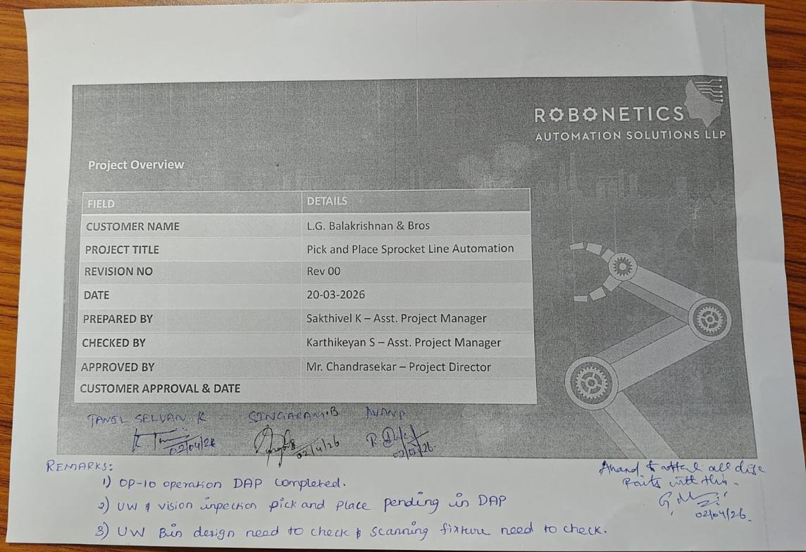
OPERATION 10 DAP APPROVAL - STELLANTIS LINE 1 PHASE
P - Palayam

Slide 7
PHASE 1 – 2 COBOTS, PHASE 2 – 4 COBOTS
PROJECT CAPEX PO DETAILS - STELLANTIS LINE 1 PHASE
INVOICING PLAN – STELLANTIS ROBOTIC LINE PROJECT
S No. | Milestone Payment % | Milestone Payment Description | Amount (₹) | Planned Invoice Date | Actual Invoice Date | Invoice No. | Payment Status | Remark
1 | 70% | Advance to Supplier | ₹₹43,40,000 | Mar-2026 (PO date) | 30-Mar-2026 |  | Paid | Advance paid
2 | 20% | Upon Delivery at Site | ₹12,40,000 | Jun-2026 | 19-Jun-2026 |  | Paid | Delivary at Site
3 | 10% | Upon Installation & Commissioning | ₹6,20,000 | Jul-2026 |  |  | Pending | Installation & Commissioning
Total | 100% |  | ₹62,00,000

Slide 8
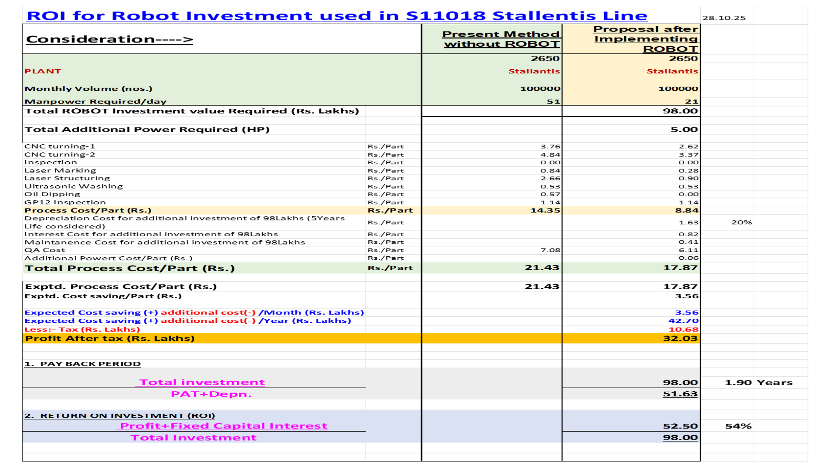
PHASE 1 – 2 COBOTS, PHASE 2 – 4 COBOTS

Slide 9
ACTIVITY IMPLEMENTATION STATUS
INSTALLATION SCHEDULE
Installation Schedule
S.No | Activity | Responsible | Start Date | Target Date | Duration | Status | Remarks
1 | Material Receipt at Customer Site | RNT + Customer | 22-06-2026 | 23-06-2026 | 2 | CLOSED | Verify delivered materials
2 | Unloading & Inspection | RNT | 23-06-2026 | 23-06-2026 | 1 | CLOSED | Check for transit damage
3 | Machine Positioning & Alignment | RNT Mechanical Team | 24-06-2026 | 25-06-2026 | 2 | CLOSED | As per approved layout
4 | Conveyor and Lifter Installation & Leveling | RNT Mechanical Team | 25-06-2026 | 25-06-2026 | 1 | CLOSED | Alignment and leveling
5 | Cobot Pedestal Installation | RNT Mechanical Team | 25-06-2026 | 25-06-2026 | 1 | CLOSED | Anchor and level
6 | Cobot Installation | RNT Automation Team | 26-06-2026 | 26-06-2026 | 1 | CLOSED | Robot mounting
7 | Gripper Installation | RNT Automation Team | 26-06-2026 | 26-06-2026 | 1 | CLOSED | Mechanical & pneumatic connections
8 | Pneumatic Line Installation | RNT Mechanical Team | 26-06-2026 | 26-06-2026 | 1 | CLOSED | FRL, tubing, valves
9 | Control Panel Installation | RNT Electrical Team | 27-06-2026 | 01-07-2026 | 4 | CLOSED | Panel mounting
10 | Electrical Wiring & Cable Dressing | RNT Electrical Team | 27-06-2026 | 01-07-2026 | 4 | CLOSED | Power and I/O wiring
11 | PLC, HMI & Network Connections | RNT Automation Team | 02-07-2026 | 06-07-2026 | 4 | CLOSED | Communication setup
12 | Power ON & I/O Verification | RNT Automation Team | 07-07-2026 | 08-07-2026 | 2 | CLOSED | Sensor and actuator checks
13 | Robot Calibration | RNT Robot Engineer | 09-07-2026 | 09-07-2026 | 1 | IN PROCESS | TCP and frame calibration
14 | PLC & Robot Program | RNT Automation Team | 10-07-2026 | 11-07-2026 | 2 | IN PROCESS
15 | Dry Run Trial | RNT Automation Team | 13-07-2026 | 15-07-2026 | 3 | CLOSED | Without production parts
16 | Production Trial | RNT + Customer | 16-07-2026 | 18-07-2026 | 3 | IN PROCESS | Actual component validation
17 | Cycle Time Optimization | RNT Automation Team | 20-07-2026 | 21-07-2026 | 2 | IN PROCESS | Performance tuning
18 | Safety Validation | RNT + Customer | 22-07-2026 | 22-07-2026 | 1 | IN PROCESS | Safety interlocks and E-stop testing
19 | Operator & Maintenance Training | RNT | 23-07-2026 | 23-07-2026 | 1 | IN PROCESS | Customer training
20 | Site Acceptance Test (SAT) & Handover | RNT + Customer | 24-07-2026 | 25-07-2026 | 2 |  | Final approval
S No. | Task Description | Planned Date | Actual Date | Status
1 | Requirement Date & Initial Feasibility | 30-Jun-2025 | 30-Jun-2025 | Closed
2 | Plant Input & Cycle Time Study | 03-Jul-2025 | 10-Jul-2025 | Closed
3 | Budgetary Estimation & RFQ | 25-Jul-2025 | 20-Aug-2025 | Closed
4 | Vendor Pre-Qualification & NDA | 09-Aug-2025 | 04-Sep-2025 | Closed
5 | RFQ Submission & Tech Discussion | 11-Aug-2025 | 11-Sep-2025 | Closed
6 | Vendor Site Evaluation | 10-Sep-2025 | 05-Oct-2025 | Closed
7 | Offer Evaluation & Tech Compliance | 15-Sep-2025 | 18-Oct-2025 | Closed
8 | Risk Assessment & Commercial Negotiation | 02-Oct-2025 | 06-Dec-2025 | Closed
9 | Techno-Commercial Comparison | 08-Oct-2025 | 30-Jan-2026 | Closed
10 | Vendor Finalization & Mgmt Approval | 12-Oct-2025 | 16-Feb-2026 | Closed
11 | Scope Freeze & PO Release | 02-Nov-2025 | 21-Mar-2026 | Closed
12 | Advance Payment & Design Kick-off | 30-Mar-2026 | 03-Apr-2026 | Closed
13 | Design Approval (Robotic + Gripper + Conveyor) | 15-Mar-2026 | 04-Apr-2026 | Closed
14 | Cobot Delivery | 17-Mar-2026 | 15-May-2026 | Closed
15 | Mechanical Fabrication (All Sub-systems) | 20-Mar-2026 | 20-May-2026 | Closed
16 | Electrical / Controls Build | 30-Mar-2026 | 20-May-2026 | Closed
17 | FAT | 25-May-2026 | 05-Jun-2026 | Closed
18 | Dispatch | 07-Jun-2026 | 19-Jun-2026 | Closed
19 | Installation & Commissioning | 13-Jun-2026 | 23-Jul-2026 | Open

Slide 10
2
BMW RAD LINE - Autonomous Moving Robot (AMR) with cobot
Home
Results
Problem Statement
Operators spend significant time transporting materials between CNC/VMC machines, reducing productive machine operation time.
Manual material handling can lead to delays, inefficient workflow, and increased production cycle times.
Solution
Deploy an Autonomous Mobile Robot (AMR) to automate the movement of raw materials, WIP, and finished goods across the shopfloor.
Improve machine utilization, reduce operator workload, and enable a more efficient and connected manufacturing process.
Plant : K-palayam (RAD)| Project : AMR(cobots)

Slide 11
ROI CALCULATION - BMW RAD LINE
Parameter | Unit Cost | Value
Total Machines Automated |  | 11
Total Cobots Used |  | 4Cobot + 1 AMR
Operators Required per Shift (Current) |  | 11
Total Shifts per Day |  | 3
Total Operators Required per Day (Current) | 11 × 3 | 33
Salary per Operator per Month |  | ₹ 22,000
Current Monthly Manpower Cost | 33 × 22,000 | ₹ 7,26,000
Current Annual Manpower Cost | 7,26,000 × 12 | ₹ 87,12,000
Operators Required After Automation |  | 9
Monthly Manpower Cost After Automation | 9 × 22,000 | ₹ 1,98,000
Annual Manpower Cost After Automation | 1,98,000 × 12 | ₹ 23,76,000
Annual Savings Due to Automation | 87,12,000 − 23,76,000 | ₹ 63,86,000
Total Automation Project Cost |  | ₹ 1,23,72,600
ROI Payback Period (Years) | 1,23,71,600 ÷ 63,86,000 | 1.93 Years
ROI Payback Period (Months) | 1.93 × 12 | 23 Months
Operator Reduction per shift | 11 - 3 | 8 Operators Reduced
Operator Reduction per day | 33 − 09 | 24 Operators Reduced
Savings After 5 Years | (63,86,000 × 5) − 1,23,71,600 | ₹ 1,95,58,400
PROJECT CAPEX PO details - BMW RAD LINE
INVOICING PLAN – STELLANTIS ROBOTIC LINE PROJECT
S No. | Milestone Payment % | Milestone Payment Description | Amount (₹) | Planned Invoice Date | Actual Invoice Date | Invoice No. | Payment Status | Remark
1 | 70% | Advance to Supplier | ₹₹28,05,600 | Jun-2026 (PO date) | 15-Jun-2026 |  | Paid | Advance paid
2 | 20% | Upon Delivery at Site | ₹60,78,800 | Oct -2026 |  |  | Pending | Delivary at Site
3 | 10% | Upon Installation & Commissioning | ₹4,67,600 | Nov-2026 |  |  | Pending | Installation & Commissioning
Total | 100% |  | ₹1,23,71,600
Plant : K-palayam (RAD)| Project : AMR(cobots)

Slide 12
ACTIVITY IMPLEMENTATION STATUS - BMW RAD LINE
BMW RAD LINE ACTIVITY CHART
 | Jun |  |  |  | Jul |  |  |  | Aug |  |  |  | Sep |  |  |  | Oct |  |  |  | Nov
Week | 1 | 2 | 3 | 4 | 5 | 6 | 7 | 8 | 9 | 10 | 11 | 12 | 13 | 14 | 15 | 16 | 17 | 18 | 19 | 20 | 21 | 22 | 23 | 24
Receipt of Purchase order / LOI |  |  | x | x
Detailed layout , Drawing and BOQ submission for Approval |  |  |  | x | x | x | x
Manufacturing - Mechanical |  |  |  |  |  |  | x | x | x | x | x | x | x | x
Manufacturing - Electrical |  |  |  |  |  | x | x | x | x | x | x | x | x | x
Assembly - Mechanical |  |  |  |  |  |  |  |  | x | x | x | x | x | x | x | x
Assembly - Electrical (including Panel interface) |  |  |  |  |  |  |  | x | x | x | x | x | x | x | x | x
Internal Trials (no load test) |  |  |  |  |  |  |  |  |  |  |  |  | x | x | x | x
FAT Test |  |  |  |  |  |  |  |  |  |  |  |  |  |  |  |  | x | x
I&C |  |  |  |  |  |  |  |  |  |  |  |  |  |  |  |  |  |  | x | x | x | x | x
Plant : K-palayam (RAD)| Project : AMR(cobots)

Slide 13
3
HELICAL LINE -
Machine Tending Operation using Cobots
Home
Transformation from manual or conventional robotic operations to collaborative cobot systems at Stellantis line .
Enables safe human–robot collaboration in shared workspaces without safety cages, improving flexibility and ergonomics.
Cobots handle repetitive tasks while humans focus on supervision, quality, and decision-making for higher productivity.
Note : Under DAP Submission , POC completed
Plant : P - Palayam |Helical Line

Slide 14
PROJECT BOM - HELICAL LINE
ROI CALCULATION - HELICAL LINE
Parameter | Unit Cost | Value
Total Machines Automated |  | 08
Total Cobots Used |  | 1yaskava + 2UR 12e
Operators Required per Shift (Current) |  | 8
Total Shifts per Day |  | 3
Total Operators Required per Day (Current) | 8 × 3 | 24
Salary per Operator per Month |  | ₹ 22,000
Current Monthly Manpower Cost | 24 × 22,000 | ₹ 5,28,000
Current Annual Manpower Cost | 5,28,000 × 12 | ₹ 63,36,000
Operators Required After Automation |  | 6
Monthly Manpower Cost After Automation | 6 × 22,000 | ₹ 1,32,000
Annual Manpower Cost After Automation | 1,32,000 × 12 | ₹ 15,84,000
Annual Savings Due to Automation | 63,36,000 − 15,84,000 | ₹ 47,52,000
Total Automation Project Cost |  | ₹ 93,52,000
ROI Payback Period (Years) | 93,52,000 ÷ 47,52,000 | 1.96 Years
ROI Payback Period (Months) | 1.96 × 12 | 23 Months
Operator Reduction per shift | 08 - 02 | 06 Operators Reduced
Operator Reduction per day | 24 − 06 | 18 Operators Reduced
Savings After 5 Years | (47,52,000 × 5) − 93,52,000 | ₹ 1,44,08,000
INVOICING PLAN – STELLANTIS ROBOTIC LINE PROJECT
S No. | Milestone Payment % | Milestone Payment Description | Amount (₹) | Planned Invoice Date | Actual Invoice Date | Invoice No. | Payment Status | Remark
1 | 30% | Advance to Supplier | ₹₹28,05,600 | Jun-2026 (PO date) | 15-Jun-2026 |  | Paid | Advance paid
2 | 65% | Upon Delivery at Site | ₹60,78,800 | Oct -2026 |  |  | Pending | Delivary at Site
3 | 5% | Upon Installation & Commissioning | ₹4,67,600 | Nov-2026 |  |  | Pending | Installation & Commissioning
Total | 100% |  | ₹93,52,000
Plant : p-palayam (Helical)| Project : cobots

Slide 15
ACTIVITY IMPLEMENTATION STATUS - HELICAL LINE
HELICAL LINE ACTIVITY CHART
 | Jun |  |  |  | Jul |  |  |  | Aug |  |  |  | Sep |  |  |  | Oct |  |  |  | Nov
Week | 1 | 2 | 3 | 4 | 5 | 6 | 7 | 8 | 9 | 10 | 11 | 12 | 13 | 14 | 15 | 16 | 17 | 18 | 19 | 20 | 21 | 22 | 23 | 24
Receipt of Purchase order / LOI |  |  | x | x
Detailed layout , Drawing and BOQ submission for Approval |  |  |  | x | x | x | x
Manufacturing - Mechanical |  |  |  |  |  |  | x | x | x | x | x | x | x | x
Manufacturing - Electrical |  |  |  |  |  | x | x | x | x | x | x | x | x | x
Assembly - Mechanical |  |  |  |  |  |  |  |  | x | x | x | x | x | x | x | x
Assembly - Electrical (including Panel interface) |  |  |  |  |  |  |  | x | x | x | x | x | x | x | x | x
Internal Trials (no load test) |  |  |  |  |  |  |  |  |  |  |  |  | x | x | x | x
FAT Test |  |  |  |  |  |  |  |  |  |  |  |  |  |  |  |  | x | x
I&C |  |  |  |  |  |  |  |  |  |  |  |  |  |  |  |  |  |  | x | x | x | x | x
Plant : p-palayam (Helical)| Project : cobots

Slide 16
4
ATHER LINE - Machine Tending Operation using Cobots
Home
ROI CALCULATION - ATHER LINE
Parameter | Unit Cost | Value
Total Machines Automated |  | 10
Total Cobots Used |  | 5 ABB 12kg
Operators Required per Shift (Current) |  | 10
Total Shifts per Day |  | 3
Total Operators Required per Day (Current) | 10 × 3 | 30
Salary per Operator per Month |  | ₹ 22,000
Current Monthly Manpower Cost | 30 × 22,000 | ₹ 6,60,000
Current Annual Manpower Cost | 6,60,000 × 12 | ₹ 79,20,000
Operators Required After Automation |  | 6
Monthly Manpower Cost After Automation | 6 × 22,000 | ₹ 1,32,000
Annual Manpower Cost After Automation | 1,32,000 × 12 | ₹ 15,84,000
Annual Savings Due to Automation | 79,20,000 − 15,84,000 | ₹ 63,36,000
Total Automation Project Cost |  | ₹ 1,29,82,000
ROI Payback Period (Years) | 1,29,82,000 ÷ 63,36,000 | 2.0 Years
ROI Payback Period (Months) | 2.0 × 12 | 24 Months
Operator Reduction per shift | 10 − 02 | 08 Operators Reduced
Operator Reduction per day | 30 - 06 | 24 Operator Reduced
Savings After 5 Years | (63,36,000 × 5) − 1,29,82,000 | ₹ 1,86,98,000
PROJECT CAPEX PO DETAILS - ATHER LINE
INVOICING PLAN – STELLANTIS ROBOTIC LINE PROJECT
S No. | Milestone Payment % | Milestone Payment Description | Amount (₹) | Planned Invoice Date | Actual Invoice Date | Invoice No. | Payment Status | Remark
1 | 50% | Advance to Supplier | ₹₹64,91,000 | 01-Jul-2026 (PO date) |  |  | Pending | Advance paid
2 | 40% | Upon Delivery at Site | ₹51,92,800 | 20-Oct -2026 |  |  | Pending | Delivary at Site
3 | 10% | Upon Installation & Commissioning | ₹12,98,200 | 10-Nov-2026 |  |  | Pending | Installation & Commissioning
Total | 100% |  | ₹1,29,82,000
Plant : p-palayam (Ather)| Project : cobots

Slide 17
ACTIVITY IMPLEMENTATION STATUS - HELICAL LINE
ATHER LINE ACTIVITY CHART
 | Jul |  |  |  | Aug |  |  |  | Sep |  |  |  | Oct |  |  |  | Nov |  |  |  | Dec
Week | 1 | 2 | 3 | 4 | 5 | 6 | 7 | 8 | 9 | 10 | 11 | 12 | 13 | 14 | 15 | 16 | 17 | 18 | 19 | 20 | 21 | 22 | 23 | 24
Receipt of Purchase order / LOI |  |  | x | x
Detailed layout , Drawing and BOQ submission for Approval |  |  |  | x | x | x | x
Manufacturing - Mechanical |  |  |  |  |  |  | x | x | x | x | x | x | x | x
Manufacturing - Electrical |  |  |  |  |  | x | x | x | x | x | x | x | x | x
Assembly - Mechanical |  |  |  |  |  |  |  |  | x | x | x | x | x | x | x | x
Assembly - Electrical (including Panel interface) |  |  |  |  |  |  |  | x | x | x | x | x | x | x | x | x
Internal Trials (no load test) |  |  |  |  |  |  |  |  |  |  |  |  | x | x | x | x
FAT Test |  |  |  |  |  |  |  |  |  |  |  |  |  |  |  |  | x | x
I&C |  |  |  |  |  |  |  |  |  |  |  |  |  |  |  |  |  |  | x | x | x | x | x
Plant : p-palayam (Ather)| Project : cobots

Slide 18
5
DAIMLER LINE - Machine Tending Operation using Cobots
Home
Transformation from manual or conventional robotic operations to collaborative cobot systems at Stellantis line .
Enables safe human–robot collaboration in shared workspaces without safety cages, improving flexibility and ergonomics.
Cobots handle repetitive tasks while humans focus on supervision, quality, and decision-making for higher productivity.
Note : Under DAP Submission , POC Completed
Plant : P - Palayam |Daimler Line

Slide 19
ROI CALCULATION - DAIMLER LINE
Parameter | Unit Cost | Value
Total Machines Automated |  | 08
Total Cobots Used |  | 4 UR12e
Operators Required per Shift (Current) |  | 08
Total Shifts per Day |  | 3
Total Operators Required per Day (Current) | 08 × 3 | 24
Salary per Operator per Month |  | ₹ 22,000
Current Monthly Manpower Cost | 24 × 22,000 | ₹ 5,28,000
Current Annual Manpower Cost | 5,28,000 × 12 | ₹ 63,36,000
Operators Required After Automation |  | 6
Monthly Manpower Cost After Automation | 6 × 22,000 | ₹ 1,32,000
Annual Manpower Cost After Automation | 1,32,000 × 12 | ₹ 15,84,000
Annual Savings Due to Automation | 63,36,000 − 15,84,000 | ₹ 47,52,000
Total Automation Project Cost |  | ₹ 1,00,00,000
ROI Payback Period (Years) | 1,00,00,000 ÷ 47,52,000 | 2.10 Years
ROI Payback Period (Months) | 2.10 × 12 | 25 Months
Operator Reduction per shift | 08 − 02 | 06 Operators Reduced
Operator Reduction per day | 24 - 06 | 18 Operators reduced
Savings After 5 Years | (47,52,000 × 5) − 1,00,00,000 | ₹ 1,37,60,000
PROJECT CAPEX PO DETAILS - DAIMLER LINE
INVOICING PLAN – STELLANTIS ROBOTIC LINE PROJECT
S No. | Milestone Payment % | Milestone Payment Description | Amount (₹) | Planned Invoice Date | Actual Invoice Date | Invoice No. | Payment Status | Remark
1 | 50% | Advance to Supplier | ₹50,00,000 | 01-Jul-2026 (PO date) |  |  | Pending | Advance paid
2 | 40% | Upon Delivery at Site | ₹40,00,000 | 20-Oct -2026 |  |  | Pending | Delivary at Site
3 | 10% | Upon Installation & Commissioning | ₹10,00,000 | 10-Nov-2026 |  |  | Pending | Installation & Commissioning
Total | 100% |  | ₹1,00,00,000
Plant : p-palayam (Daimler)| Project : cobots

Slide 20
ACTIVITY IMPLEMENTATION STATUS -DAIMLER LINE
ATHER LINE ACTIVITY CHART
 | Jul |  |  |  | Aug |  |  |  | Sep |  |  |  | Oct |  |  |  | Nov |  |  |  | Dec
Week | 1 | 2 | 3 | 4 | 5 | 6 | 7 | 8 | 9 | 10 | 11 | 12 | 13 | 14 | 15 | 16 | 17 | 18 | 19 | 20 | 21 | 22 | 23 | 24
Receipt of Purchase order / LOI |  |  | x | x
Detailed layout , Drawing and BOQ submission for Approval |  |  |  | x | x | x | x
Manufacturing - Mechanical |  |  |  |  |  |  | x | x | x | x | x | x | x | x
Manufacturing - Electrical |  |  |  |  |  | x | x | x | x | x | x | x | x | x
Assembly - Mechanical |  |  |  |  |  |  |  |  | x | x | x | x | x | x | x | x
Assembly - Electrical (including Panel interface) |  |  |  |  |  |  |  | x | x | x | x | x | x | x | x | x
Internal Trials (no load test) |  |  |  |  |  |  |  |  |  |  |  |  | x | x | x | x
FAT Test |  |  |  |  |  |  |  |  |  |  |  |  |  |  |  |  | x | x
I&C |  |  |  |  |  |  |  |  |  |  |  |  |  |  |  |  |  |  | x | x | x | x | x
Plant : P-palayam (Daimler)| Project : cobots

Slide 21
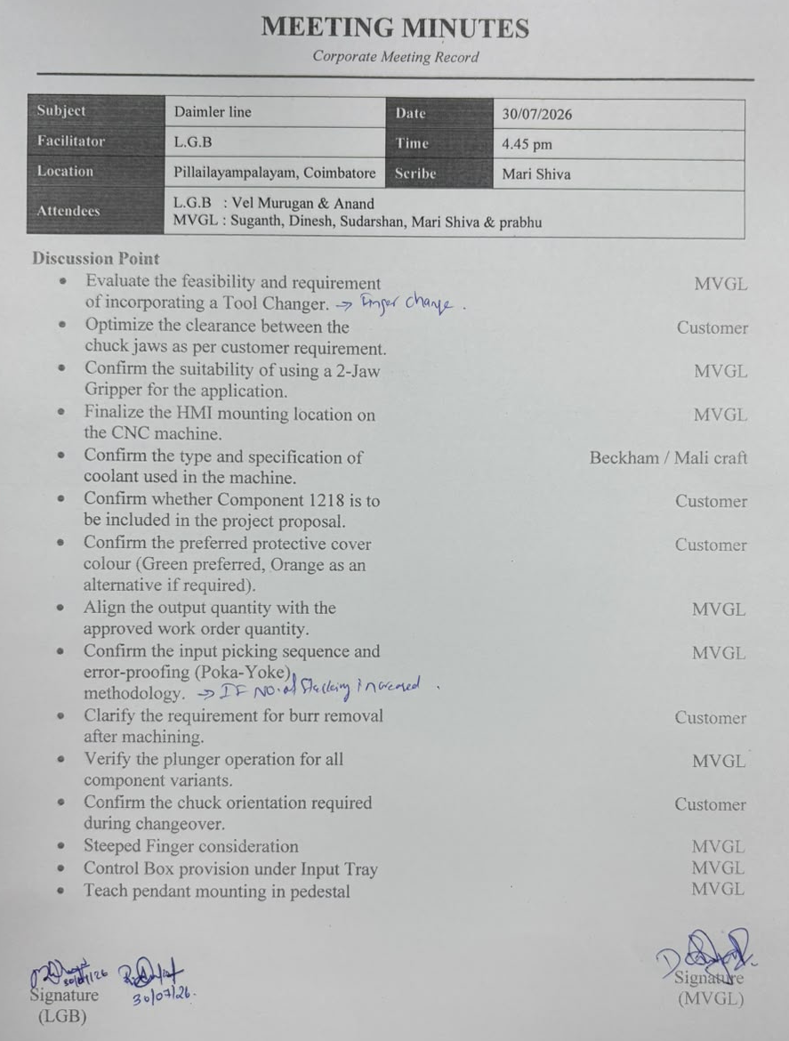
DAP APPROVAL
Plant : P-palayam (Daimler)| Project : cobots

Slide 22
Thank You

