Slide 1
Employee Attrition Analysis
at XYZ Oroftanization
www.gfl.co.in

Slide 2
Introduction
XYZ, a company experiencing high turnover rates, is particularly concerned about new hires who leave within the first 6 months ("Quick Quits"). The management seeks insights into the factors contributing to these Quick Quits and strategies to improve retention.

Slide 3
Objective:
Analyze the employee turnover data to identify patterns and trends related to Quick Quits. Provide actionable insights and recommendations for reducing turnover.
Tasks:
Data Cleaning and Preparation:
·Handle any missing or inconsistent data.
·Import the data into Power BI/Excel.
Exploratory Data Analysis (EDA):
·Calculate Quick Quit rates.
·Analyze turnover rates by position, gender, age, education level, and recruitment source, career graph, promotions etc.
Data Visualization/Trend & Pattern Analysis:
·Develop comprehensive visualizations/analysis to illustrate trends and patterns in turnover and Quick Quits, including comparisons across departments and positions, impact analysis using histograms and charts, and exploration of correlations among employee data variables related to Quick Quits.
Predictive Analytics:
·Using BI Tools/Excel prepare a predictive model to estimate the likelihood of an employee being a Quick Quit based on the provided features.
Provide actionable recommendations to reduce Quick Quits and improve employee retention, including suggestions for enhancing recruitment, onboarding, and support processes, and present your findings through a Power BI/Excel dashboard and a summary report with key insights.
Sample data is attached in the excel sheet.
Prepare graph where it is required.

Slide 4

data cleaning and prepration
New columan are added:
Employee_count - This columan contain number employee in the company
attrition1- This column contain emplyee which are coming from job portal and are bachelor indicated as “1” otherwise “0”
emp_tenure -This column data contain the duration of employee
emp_turnover-This column contain total income of each employee. This data is on yearly basis
comp_turnover-This columan provide the company turnover by each employee and note this data is on yearly basis
red_turnover -This column contain loss in company turnover due leaving of employee

Slide 5
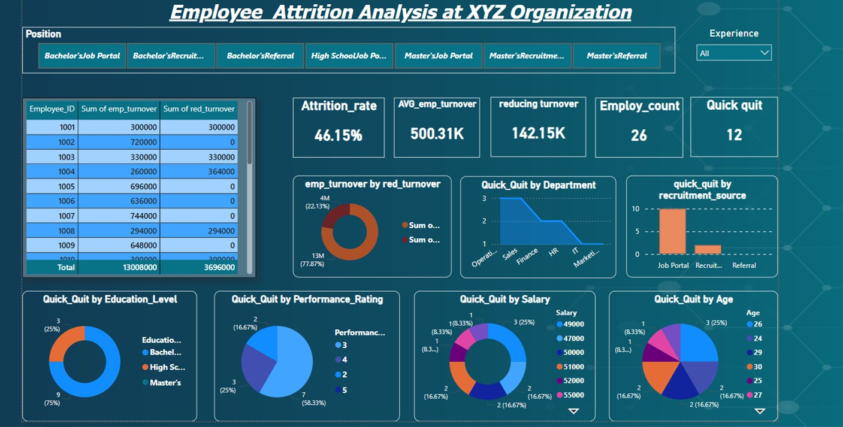
Power bi dashboard
01
03
Objective 02

Slide 6

Identify Root Causes of attrition:
Based on your analysis, identify the key factors contributing to turnover. Common causes include:
Low compensation and benefits
Lack of career development opportunities
Employee which are coming from job portal , maximum leave the company
Employee who’s performance rating is average ,leave the company May be work environment are not suitable
Leadership be a cause of attrition of employee

Slide 7
Develop Action Plans:
Based on the identified root causes, develop targeted action plans to address them. Examples include:
Reviewing compensation and benefits packages
Offering career development programs Implementing flexible work arrangements
Improving recruitment source
Increase interaction between employees by providing some fun activity Building a positive work culture
Providing leadership training

Slide 8

ThankYou
Contact- 8808253143
a8362@gmail.com https://github.com/anand232326 https://www.linkedin.com/in/anandkumar123/

