Slide 1
A project report on
Central Login Management with OpenLDAP
(Designed on Linux Administration)
B Y
K R I S H N A N A N D
S H R E Y A S U Y O G
HALDIA INSTITUTE OF TECHNOLOGY
HP EDUCATION SERVICES
University roll no:
Krishn – 10300212023
Shreya – 10300212051
HP Enrollment Id:
Krishn – HPER-125663
Shreya – HPER-125664
B.Tech
Information Technology
Supervisor:
Amit Agarwal
HP Education Services
RCPLIndia Ltd

Slide 2
1
CONTENTS
Contents 1
Project Letter 2
Evaluation Letter 4
Acknowledgment 6
Abstract 7
Understanding OpenLDAP 8
Types of Information in OpenLDAP 8
  The LDAP Name Schema 8
Configuring an OpenLDAP Server 9
  Installing OpenLDAP 9
  Configuring ‘slapd.conf’ file 10
  Configuring olcDatabase ldif file 12
Populating the OpenLDAP Database 14
  Ldapadd 15
  Sharing the home directory of the user 16
Configuring a client 17
  Master map configuration file 18
  Logging in as a client user on LDAP Server 19
VI. Conclusion 20
VII. Reference 21

Slide 3


Slide 4
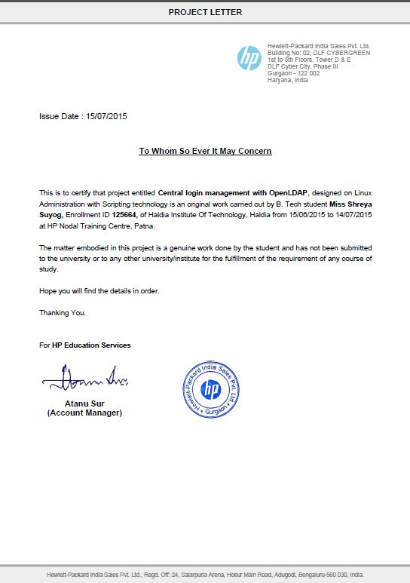

Slide 5
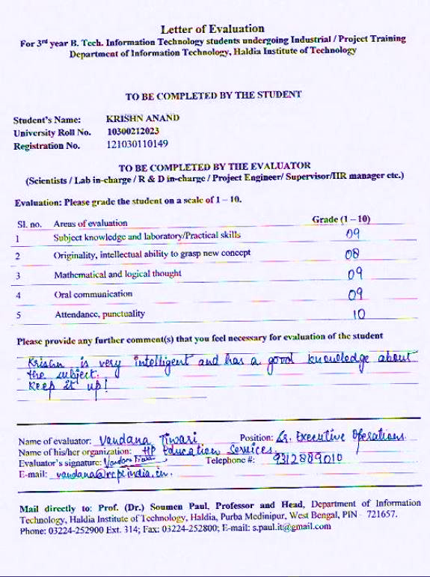

Slide 6


Slide 7
6
ACKNOWLEDGEMENT
It is a pleasure to acknowledge the help that we received from the project coordinator during the compilation of this project. We are particularly indebted to our mentor Mr. Amit Jaiswal for his guidance and constant supervision as well as for providing necessary information regarding the project & also for his support in completing the project. My thanks and appreciations also goes to our team in developing the project and people who have willingly helped us out with their abilities.
Shreya Suyog Krishn Anand

Slide 8
7
ABSTRACT
LDAP (Lightweight Directory Access Protocol) is a set of open protocols used to access centrally stored information over a network. It is based on the X.500 standard for directory sharing. LDAP is sometimes referred to as “X.500 Lite”.
LDAP organizes information in a hierarchical manner using directories, enabling anyone to access users account from any machine on the LDAP enabled network.
LDAP is commonly used for centrally managed users and groups, user authentication, or system configuration. It is most frequently used within individual organizations such as universities, government departments, and private companies.
If we are running a single Red Hat Enterprise Linux Server or
even just a few servers, there is no problem in managing configuration files on each individual server. However, if we are
responsible for operating dozens of servers, we will need a solution that helps us maintain essential system information from a single location in your network. An LDAP server is such a solution, and we will learn how to set up OpenLDAP for authenticating users on the network.

Slide 9
8
Understanding OpenLDAP
If we are running a single Red Hat Enterprise Linux Server or even just a few servers, there is no problem in managing configuration files on each individual server. However, if we are responsible for operating dozens of servers, we will need a solution that helps us maintain essential system information from a single location in our network. An LDAP server is such a solution.
LDAP is an acronym for Lightweight Directory Access Protocol (LDAP).
Cross Platform support (server and client may be using different OS windows/Linux).
Port number is 389.
Client must run lower version of Linux when client and server both are on Linux operating system.
Types of Information in OpenLDAP
OpenLDAP normally includes the following piece of information:
Users and groups.
Information about systems in the network.
The LDAP Name Schema
One of the typical properties in OpenLDAP is that it is organized in a hierarchical manner. The advantage of this approach is that information can be grouped into containers where it is really needed, and clients can refer to the actual location where this information is stored.
We can easily build an OpenLDAP hierarchy where objects in other locations are easily referred to without storing them on local servers. This makes OpenLDAP a lightweight Directory
If, for instance, there is a user eguser in the hierarchy hit.example.com, the fully distinguished name of this user is referred to as :
cn=eguser, dc=hit, dc=example, dc=com.
Here cn and dc are two different object types.
cn(common name) : It is a generic way to refer to leaf entries, which are the end objects, such as users and groups, that by themselves cannot contain anything else.
dc(domain component) : It is used to refer to one of the container entries in the LDAP hierarchy. If in a setup the LDAP hierarchy is mapped to a DNS hierarchy, typically all the DNS domains are referred to as dc objects.

Slide 10
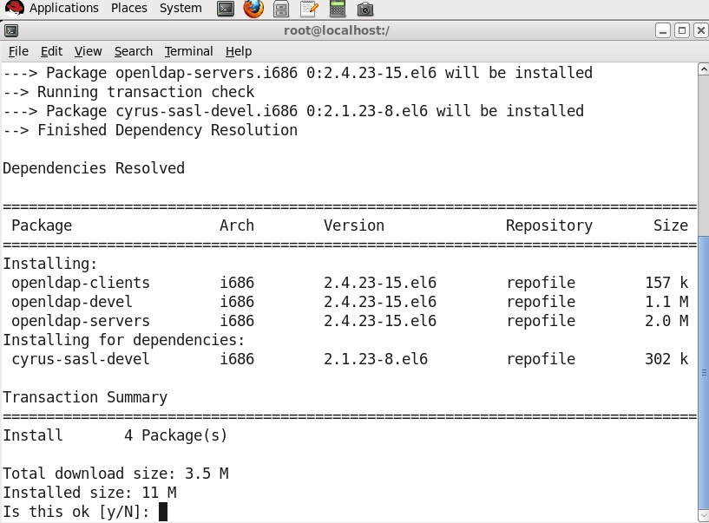
9
Configuring an OpenLDAP Server
We will just set up a single instance of an LDAP server that can be used by multiple clients in
our network for authentication. To configure an OpenLDAP server, we need to follow
these steps:
1. Install the OpenLDAP software.
2. Configure the LDAP process to service your needs.
3. Run the OpenLDAP server.
Installing OpenLDAP
To install OpenLDAP, we need to run the following command.
]# yum install openldap*
it will install three packages :
openldap-clients
openldap-devel
openldap-servers
OpenLDAP does not contain a single configuration file. Instead, it uses a configuration directory, which by itself is organized in a way that is typical for LDAP.
The default configuration file is /etc/openldap/slapd.d/cn=config.ldif

Slide 11
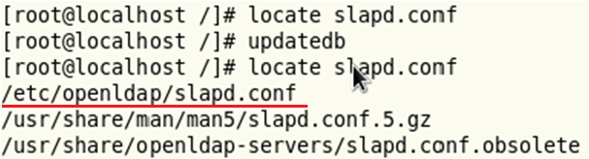
10
Configuring ‘slapd.conf’ file
After installing openldap packages we tried to get the location of slapd.conf file using the following command.
]# locate slapd.conf
Running this command just after the installation might not work as we need to update the database where locate command can search. We do so using the following command and then we tried locating the file.
]# updatedb
Now we need to copy some files in slapd.conf directory.
]# cp /usr/share/openldap-servers/slapd.conf/obsolete /etc/openldap/slapd.conf
The slapd.conf file consists of a series of global configuration options that apply to slapd as a whole (including all backends), followed by zero or more database backend definitions that contain information specific to a backend instance. Global options can be overridden in a backend (for options that appear more than once, the last appearance in the slapd.conf file is used). Blank lines and comment lines beginning with a `#' character are ignored. If a line begins with white space, it is considered a continuation of the previous line.
- The suffix line names the domain for which the LDAP server provides information and should be changed from.
- The rootdn entry is the Distinguished Name (DN) for a user who is unrestricted by access controls or administrative limit parameters set for operations on the LDAP directory. The rootdn user can be thought of as the root user for the LDAP directory.
When populating an LDAP directory over a network, change the rootpw line — replacing the default value with an encrypted password string. To create an encrypted password string, type the following command:
/]# slappasswd
When prompted, type and then re-type a password. The program prints the resulting encrypted password to the shell prompt.
we can set rootpw password as encryption or in plain text as it is.

Slide 12
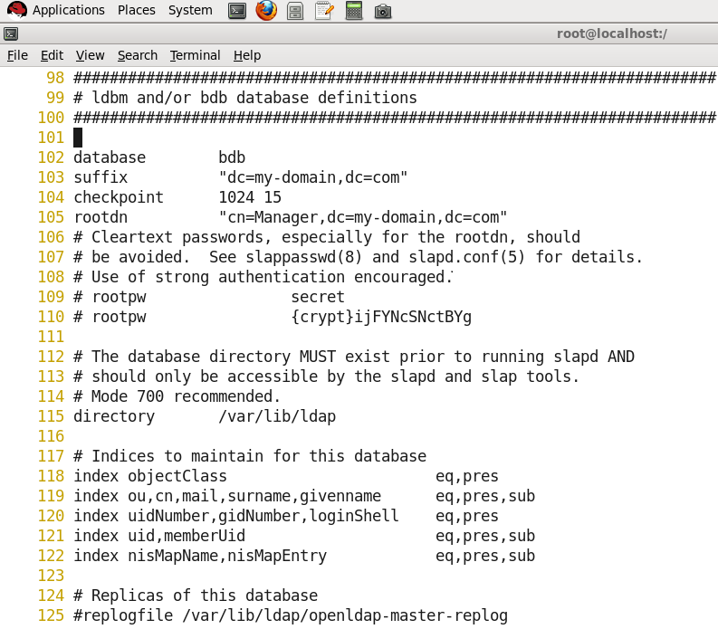
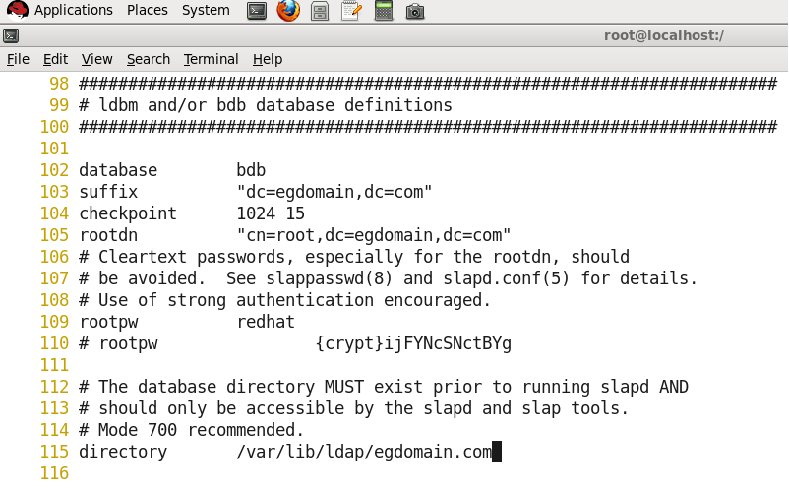
11
Now we are going to illustrate the changes in the configuration file:, to do this we need to open the configuration file in an editor.
]# vi /etc/openldap/slapd.conf
Fig : Actual configuration file
Fig: Modified configuration file.
Password of the root user

Slide 13
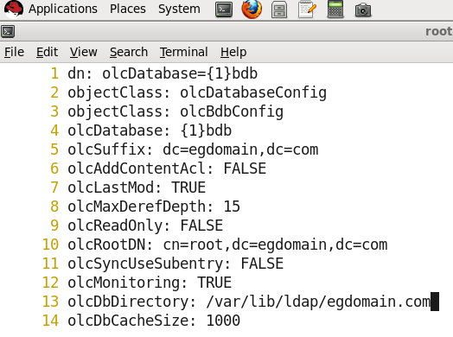
12
Configuring olcDatabase ldif file
LDIF: These are the standard LDAP input files in which the entries and all the properties that we want to define for these entries are specified. Before adding users and groups that we can use to authenticate on a Linux machine, we first need to create the base structure. In this base structure, we will create the LDAP domain (which often matches the name our organization uses in DNS).
At this point we will create a directory using the following command which will be used while configuring olcDatabase ldif file.
/]# mkdir /var/lib/ldap/egdomain.com
We need to change the olcDatabase 1 file of ldif extension. To create the OLC (cn=config) DIT you can EITHER create a series of LDIF files that describe the configuration and apply them using slapadd OR convert your existing slapd.conf. If the slapd.d directory is not found then slapd looks for slapd.conf.
/]# vi /etc/openldap/slapd.d/cn\=config/olcDatabase\=\{1\}bdb.ldif
Fig : Reflected changes in olcDatabase file.

Slide 14
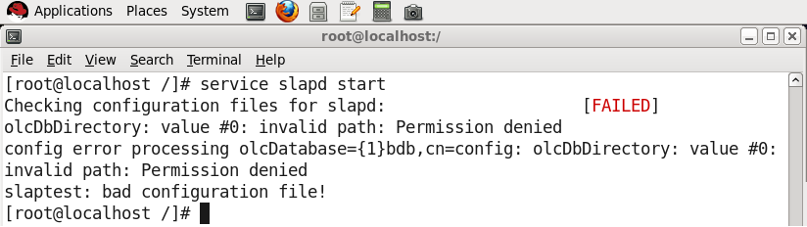
13
After creating ‘egdomain.com’ directory and updating our olcDatabase file, If we try to start slapd service, it fails as we need to first change the permission of egdomain.com directory.
The owner and group of it must be ldap. We accomplish this using the following set of commands, then starting the slapd service will not produce any permission related error.
]# chown ldpa:ldpa /var/lib/ldpa/egdomain.com
]# service slapd start
We now need to copy DB_CONFIG.example file in the directory we created ‘egdomain.com’.
DB_CONFIG.example file is a demo file used in egdomain.com.
This file should be placed in the same directory as specified by the directory configuration option in the slapd.conf file.
#]cp /usr/share/openldap-servers/DB_CONFIG.example /var/lib/ldap/egdomain.com/DB_CONFIG
We have to give DB_CONFIG some permissions specific to ldap using following command.
Since this file is stored in our created directory egdomain,.com so we will change the permission of all files contained in that directory.
]# chown ldap:ldpa /var/lib/ldap/egdomain.com/*

Slide 15
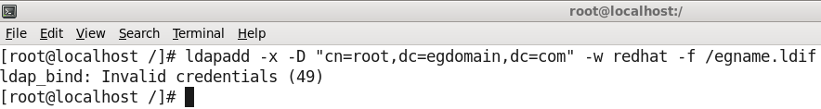
14
Populating the OpenLDAP Database
Now that the slapd process has its basic configuration, we are ready to start populating it. To do this, we need to create LDIF files. These are the standard LDAP input files in which the entries and all the properties that we want to define for these entries are specified. Before adding users and groups that we can use to authenticate on a Linux machine, we first need to create the base structure. In this base structure, we will create the LDAP domain (which often matches the name your organization uses in DNS).
]# vi /egname.ldif
dn : dc=egdomain, dc=com
objectClass: dcObject
objectClass: organization
dc : egdomain
o : egdomain1
In the LDIF fi le, you can see that each section defi nes one entry. To begin, you see the
top-level entry in this database, which is dc=example,dc=com. For each of these entries,
you’ll need to defi ne which objectClass they are members of. At the end of the three sections
that are added here, the actual object is created. This happens in the line dc: example
(which creates the dc example)
To add this information to the LDAP Directory, you’ll need to use the ldapadd command.
With this command, you’ll specify the name of the administrative user you’ve created
while setting up the LDAP Directory and the password you’ve set for this user.
]# ldapadd -x -D "cn=root,dc=egdomain,dc=com" -w redhat -f egname.ldif
Executing ldapadd command at this stage pops up with error showing Invalid Credentials(49)
This error occurs due to mismatch between configuration and database file of LDAP.
In order to eliminate this error we need to execute following set of commands.
]# rm –rf /etc/openldap/slapd.d/*
]#slaptest –f /etc/openldap/slapd.conf
]# chmod –R 777 /etc/openldap/slapd.d/
]# service slapd restart
Now we can run ldapadd command successfully.

Slide 16
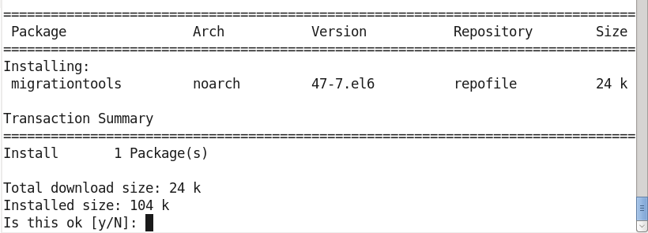
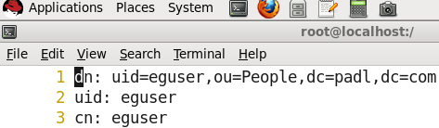
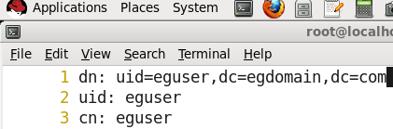
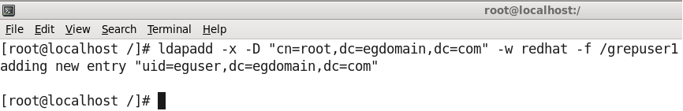
15
ldapadd
Now we need to install a package called migrationtools which are used to convert configuration files to LDIF format, making it compatible with the LDAP server.
]# yum install migrationtools*
We need some users which will be used later as client to login to server, so in next steps we are going to add a user named ‘eguser’ on our server.
]# useradd eguser
]# passwd eguser
All users information are stored in /etc/passwd file, we will use this file and grep information for our newly created user.
]# grep eguser /etc/passwd > /grepuser
]#cat /grepuser
eguser:x:501:501::/home/eguser:/bin/bash
Now we migrate user using migrationtool.
]# /usr/share/migrationtools/migrate_passwd.pl /grepuser > /grepuser1
we then open this grepuser1 file in an editor and configure the file to add our user.
]# vi /grepuser1
We only change the dc=egdomain field of line 1 and leave everything as it was.
Now we will add users using ldapadd as these users only can login from the client computer.
]# ldapadd –x –D “cn=root, dc=egdomain, dc=com” –w redhat –f /grepuser1

Slide 17
16
Sharing the home directory of the user
Since our user’s home directory is present on the server machine, so in order to make it available on the client machine we need to share the user’s home directory on the local network. We share any file or directory by adding the file name or path in /etc/exports file.
]# vi /etc/exports
/home *(rw)
As a last step to make our LDAP server running is that we start nfs service on the server system using following command.
]# service nfs restart

Slide 18
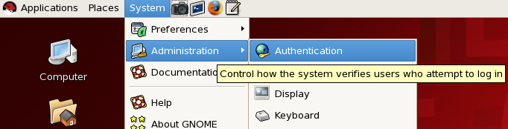
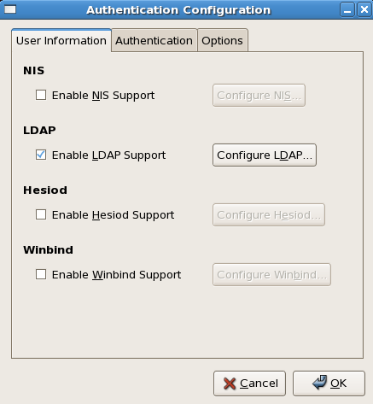
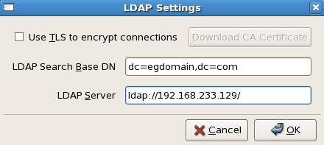
17
Configuring a client
Once we our server was set up, we tried to login as a client using a different lower version of Linux. In following example we used RHEL5 as a client.
We need to enable LDAP support on our client using system administration in the GUI (Graphical User Interface) mode.
Click on System --> Administration → Authentication
Click on configure LDAP under User Information and fill in the following details.
LDAP Search Base DN : dc=egdomain, dc=com
LDAP Server : ldap://192.168.233.129/
192.168.233.129 is the ip of server computer.
We can get the ip of a linux system by ipconfig command.
Click OK, and follow the same for Authentication tab as well.

Slide 19
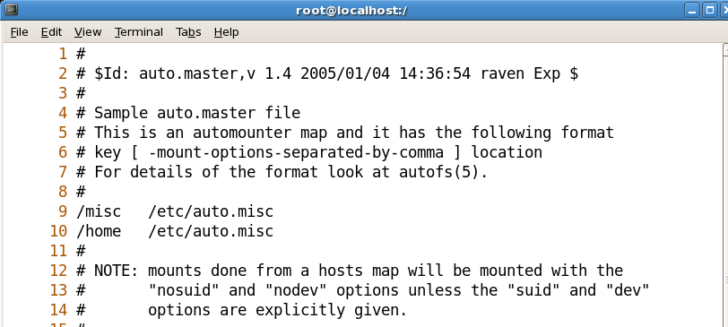
18
Master map configuration file
Autofs consults the master map configuration file /etc/auto.master to determine which mount points are defined. It then starts an automount process with the appropriate parameters for each mount point. Each line in the master map defines a mount point and a separate map file that defines the file systems to be mounted under this mount point. For example, the /etc/auto.misc file might define mount points in the /misc directory; this relationship would be defined in the /etc/auto.master file.
Each entry in auto.master has three fields. The first field is the mount point. The second field is the location of the map file, and the third field is optional. The third field can contain information such as a timeout value.
]# yum install autofs*
]# vi /etc/auto.master
/]# vi /etc/auto.misc
At the end of file add a line
* -fstype=nfs 192.168.233.129:/home/&
]# service autofs restart
Switch to a different terminal using chvt command or pressing Alt+F2 key combination.
]# chvt2

Slide 20
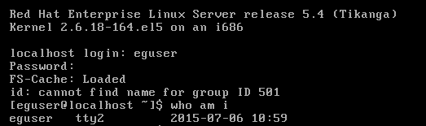
19
Logging in as a client user on LDAP Server.
On the server side, we can list all the user logged in or have logged previously on the server using this command.
[root@localhost /]# slapcat

Slide 21
20
CONCLUSION
Through this project we learned how to configure an OpenLDAP Server on our Red Hat
Enterprise Linux Server. First we learned how to set up OpenLDAP and how to use the
slapd process itself. After that, we learned how to configure the OpenLDAP server as a
directory that can be used on our network for user authentication. We also used our server by logging in as a client on a different version of Red Hat Enterprise Linux 5.
Throughout, the main objective of our project was to see how configuring OpenLDAP Server and services can help in any organisation where an administrator needs to keep a check on what is the progress going on any client computer.
This is very useful when in an organisation, for example say a Call Centre company, where there are a number of employees working in shifts. The employees get the freedom of choosing whichever available computer they can work on and the project or task they have been assigned is hidden from other employees in completion as whatever progress one employee does is saved not on the client’s system but on the server.
This also gives the employee an advantage of logging in from any system and whatever the work being done by them previously can be accessed in a very convenient manner, thus removing the burden of carrying their work in an external drive each time they logout.

Slide 22
21
REFERENCES
Book referred - Red Hat Enterprise Linux 6, Administration by Sander van Vugt.
RedHat online support –
https://access.redhat.com/documentation/en-US/Red_Hat_Enterprise_Linux/6/html/Deployment_Guide/ch-Directory_Servers.html

