Slide 1

Dynamic Analysis of Railway tracks with and without disabled fasteners and Ballast
M Dheeraj Varma(ME19MTECH11008)
Sachin Garg(ME19MTECH11010)
Tharun Reddi(ME19MTECH11011)
Patil Ajiket J (ME19MTECH11013)
M Anand Kumar(ME19MTECH 11027

Slide 2
Introduction to Rail fastening systems
A Rail fastening system is a means of fixing rails to railroad ties or sleepers
Rail fastening systems typically include rail anchors, tie plates, chairs and track fasteners
Rail fasteners keeps the rails fastened to the sleepers by transferring the forces
They provide a proper slope (1:20, 1:40) of the rail foot in the transverse plane and thus prevent the rail from longitudinal movement
Rail fasteners also damp vibrations and noise from the rails

Slide 3
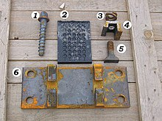
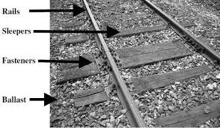
Layout of Railway Track

Slide 4
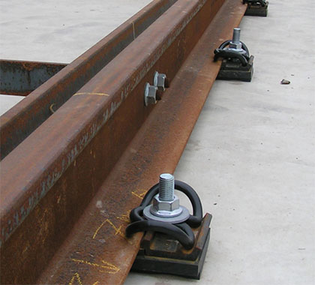
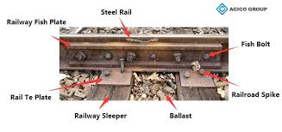
Rail Track Fastening components

Slide 5
Functions of Rail Fastenings
Hold rails securely in the rail seat
Limit the rotation of the rail about the outer edges of the rail foot
Minimise longitudinal movement of rails through creep and thermal forces
Assist in retention of track gauge
Prevent damage to the rail

Slide 6

What is Disabled and without Disabled Structure?
We know that rails are attached to sleeper with the help of fastening components. Load of the railway comes onto the track, goes to sleeper and ballast and ultimately goes to ground.
If in case the rail fastening gets loosened or the ballast which is in between the sleepers and below it gets collapsed or subsided, the resistance which they(rail fastening and ballast) offer gets reduced, and thus it increases the chances of derailment.
In other words if rail fastening and ballast are replaced by spring and damper, loosening of fastening and collapsing of ballast leads to decrease their stiffness and damping value. Hence they will carry less load and more vibrations will be there.
So disabled structure means loosening of fastening and collapsing of ballast, otherwise the structure is non-disabled.

Slide 7
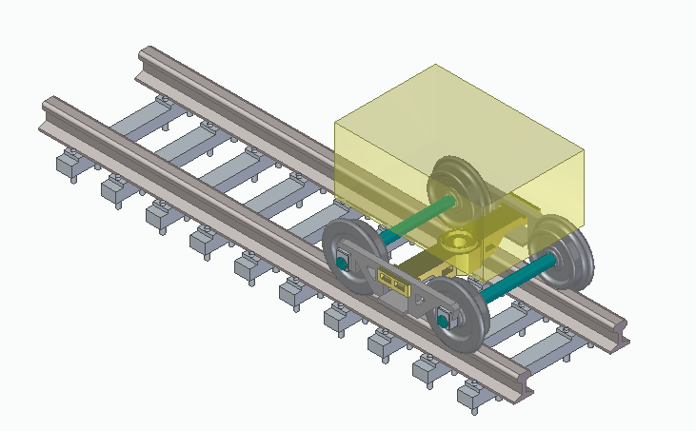
CAD MODELS (Isometric view)
Passenger Car running on track

Slide 8
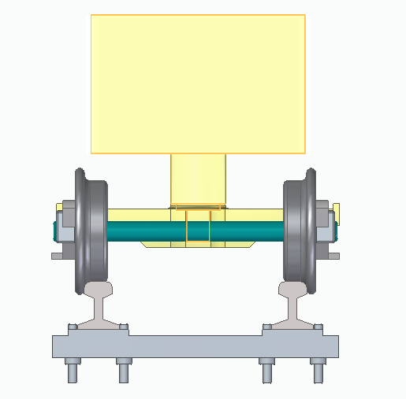
Front View

Slide 9
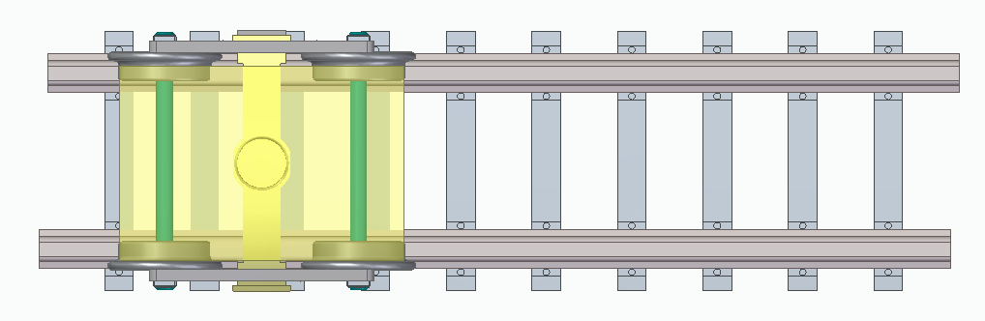
TOP view

Slide 10
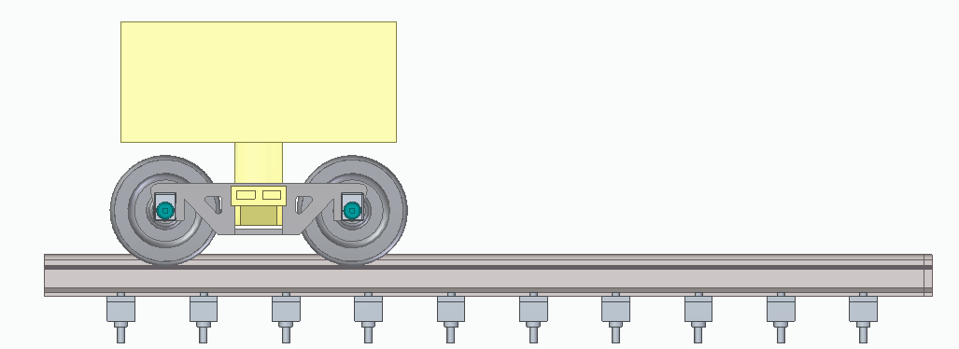
Side View

Slide 11
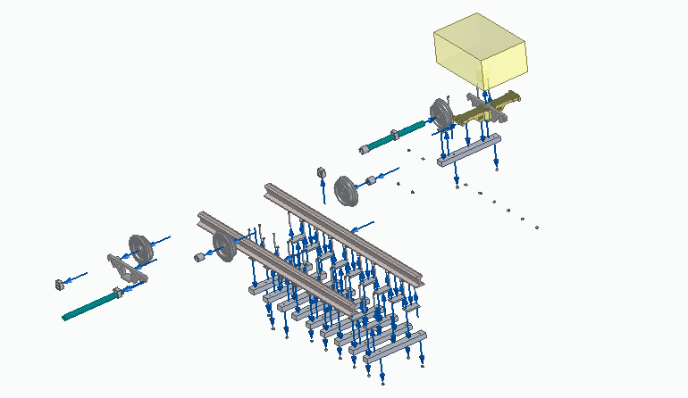
Explode View

Slide 12
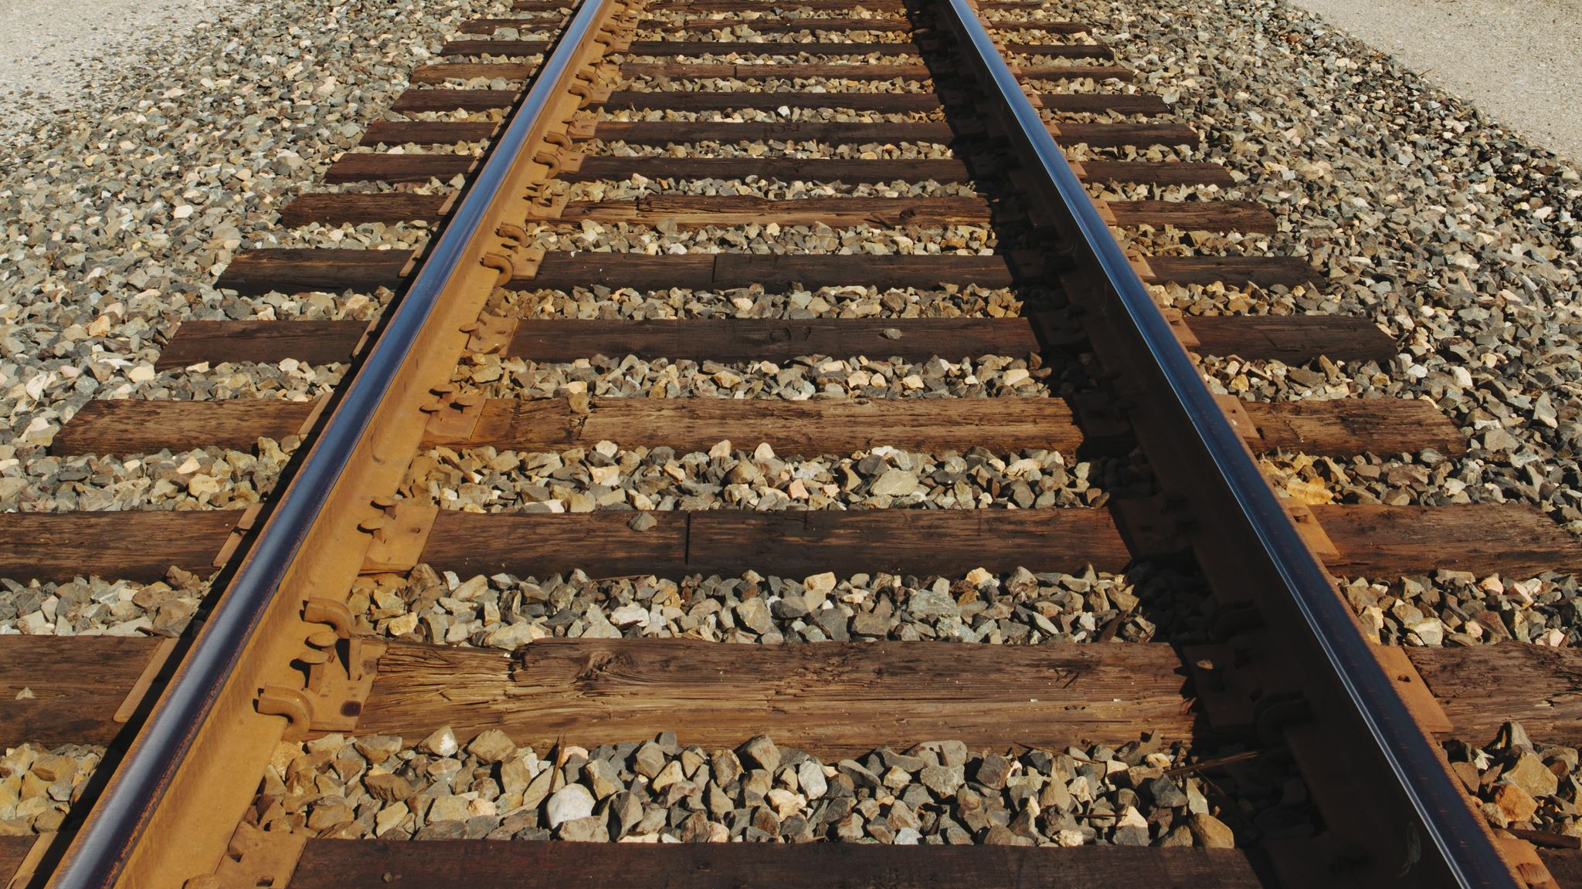
Components of the Railway track system
Carriage
Suspension II
Bogie frame
Suspension I
Wheelset
Rails
Sleepers
Ballast
Roadbed

Slide 13
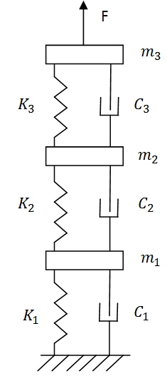
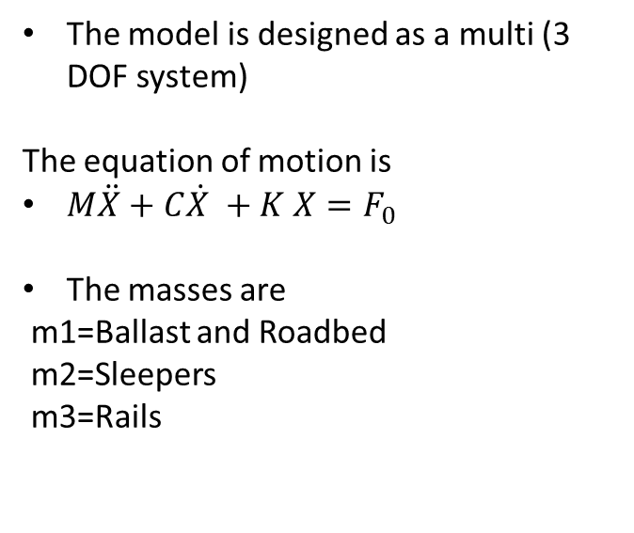
Mathematical Modelling
The model is designed as a multi (3 DOF system)
The equation of motion is
$M\ddot{X}+C\dot{X }+K X=F_{0}$
The masses are
m1=Ballast and Roadbed
m2=Sleepers
m3=Rails

Slide 14
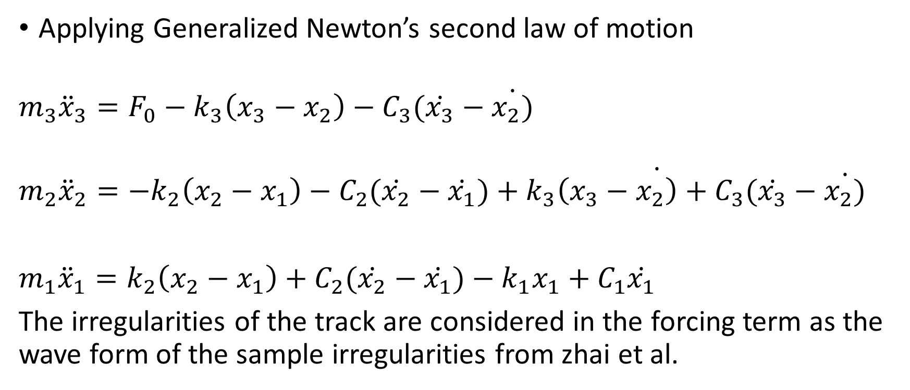
Equations of motion
Applying Generalized Newton’s second law of motion
$$m_{3}{\ddot{x}}_{3}=F_{0}−k_{3}\left(x_{3}−x_{2}\right)−C_{3}(\dot{x_{3}}−\dot{x_{2})}$$
$$m_{2}{\ddot{x}}_{2}=−k_{2}\left(x_{2}−x_{1}\right)−C_{2}(\dot{x_{2}}−\dot{\dot{x_{1}})+k_{3}\left(x_{3}−x_{2}\right)+C_{3}(\dot{x_{3}}−\dot{x_{2})}}$$
$m_{1}{\ddot{x}}_{1}=k_{2}\left(x_{2}−x_{1}\right)+C_{2}(\dot{x_{2}}−$ $\dot{x_{1}})−k_{1}x_{1}+C_{1}\dot{x_{1}}$
The irregularities of the track are considered in the forcing term as the wave form of the sample irregularities from zhai et al.

Slide 15
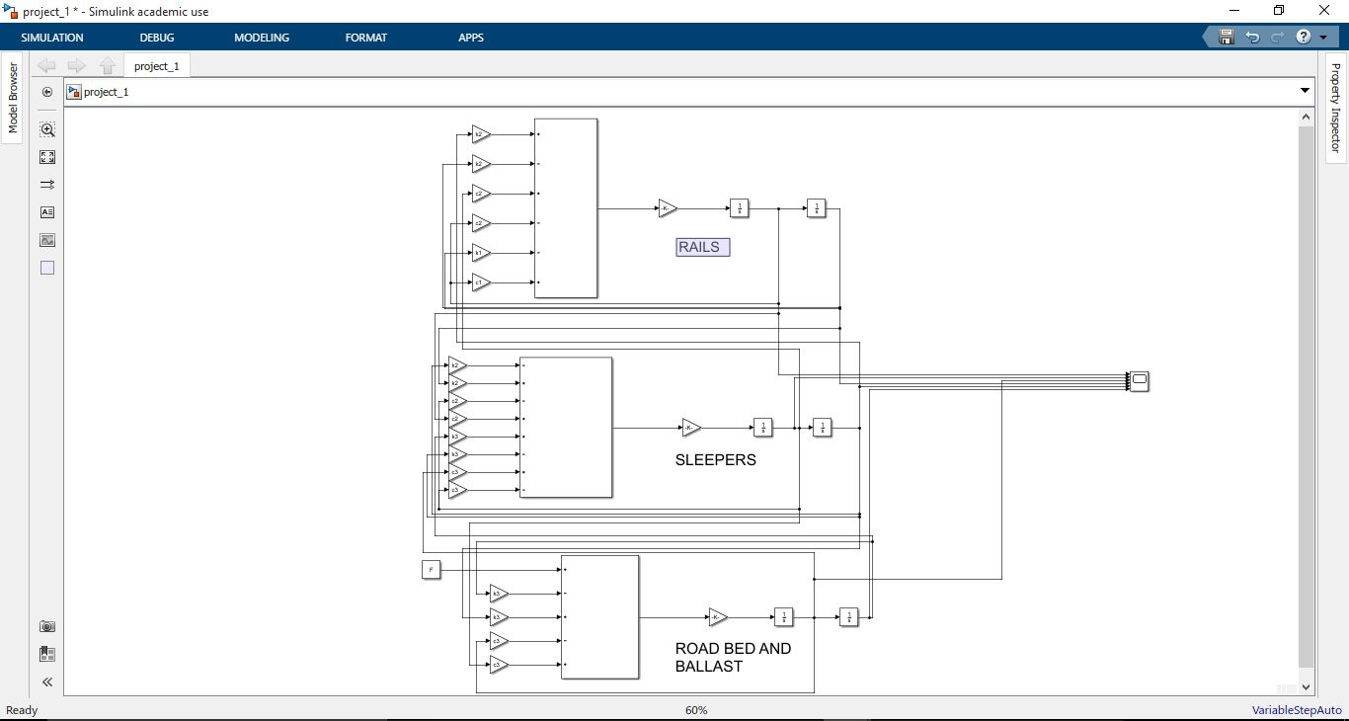
Simulink Model

Slide 16
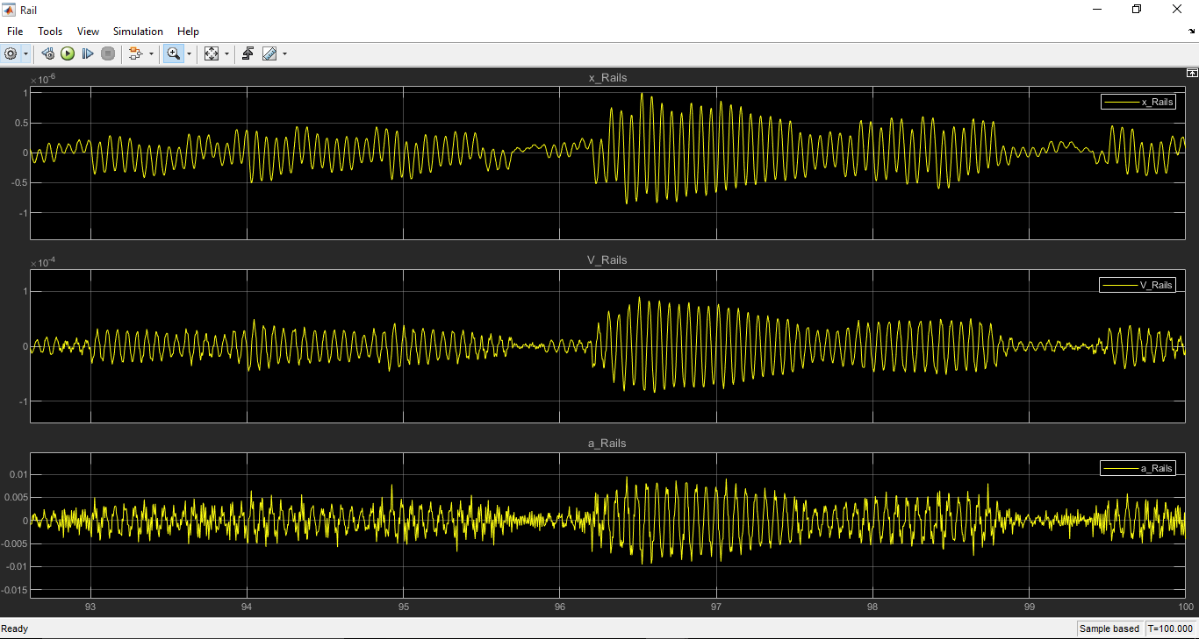
Displacement, Velocity and Acceleration of Rails

Slide 17
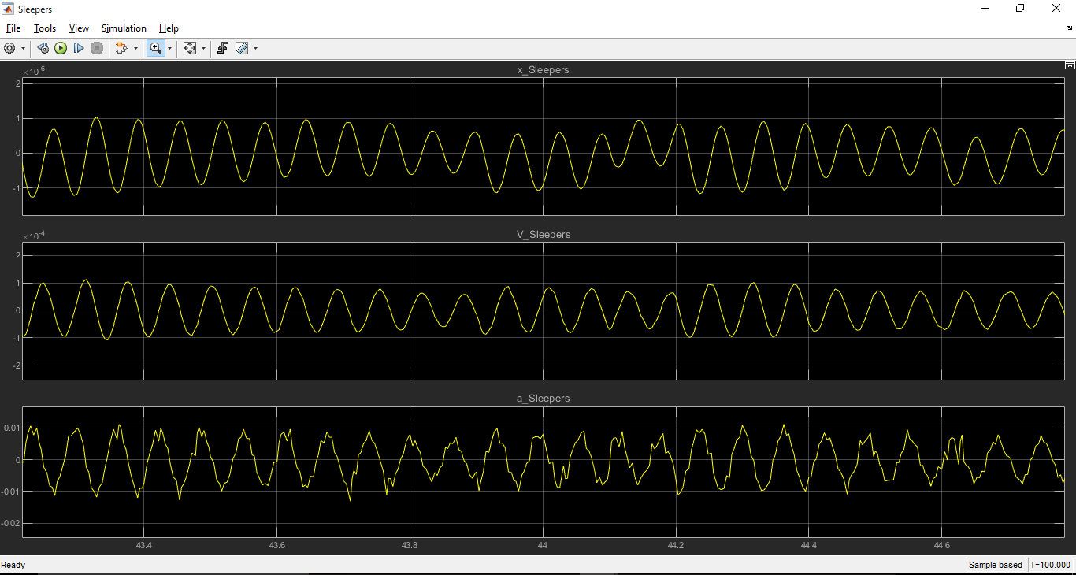
Displacement, Velocity and Acceleration of Sleepers

Slide 18
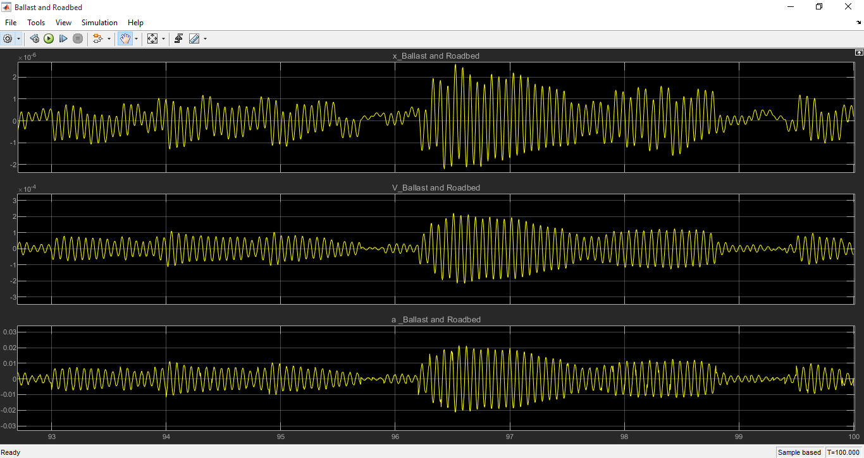
Displacement, Velocity and Acceleration of Ballast and Roadbed

Slide 19
Observations
The displacements, velocity and acceleration are all in phase for Rails, Sleepers, Ballast and Roadbed
The signals for Sleepers are uniform denoting the uniform spacing between the sleepers
The disabled fasteners lower the stiffness and damping coefficients of the tracks

Slide 20
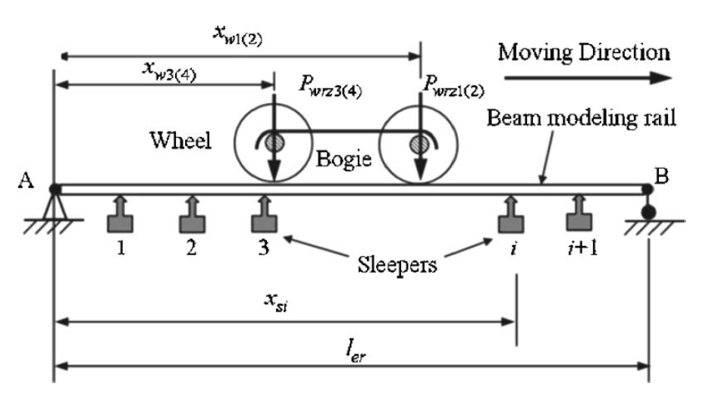
Vehicle track system excitation model

Slide 21
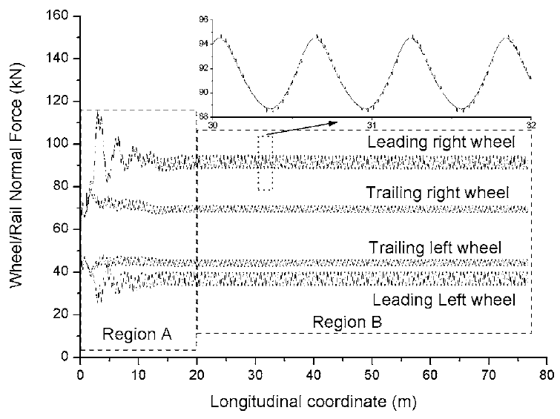
Normal Load without component failure

Slide 22
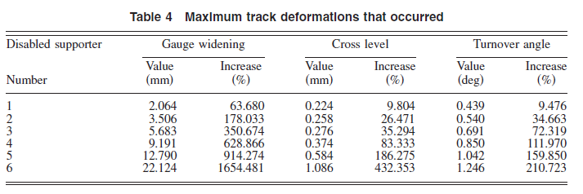
Results for Disabled fasteners

Slide 23
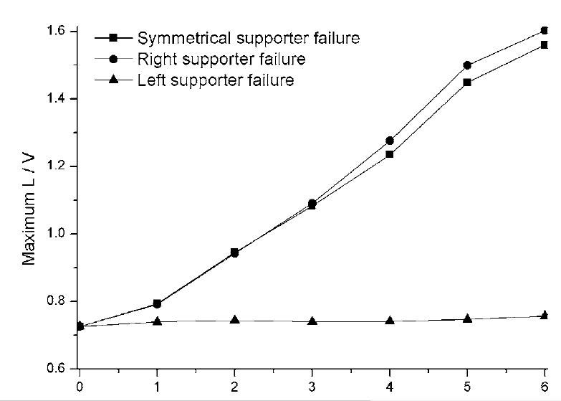
Maximum of L/V for disabled supporters

Slide 24
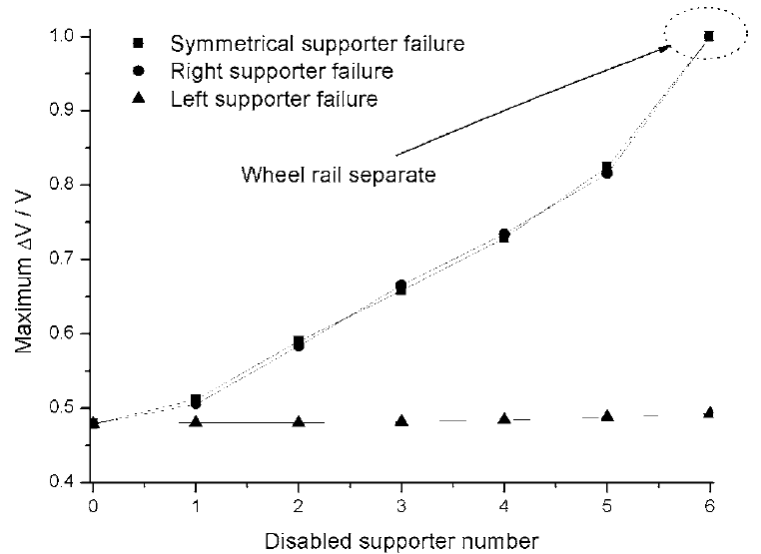

Maximum of $\frac{∆V}{V}$for disabled supporters

Slide 25
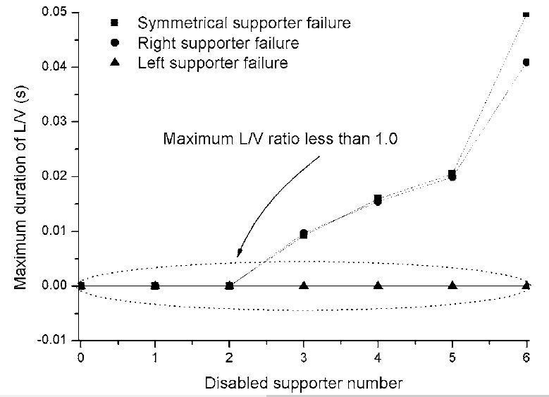
Duration of L/V for disabled supporters

Slide 26
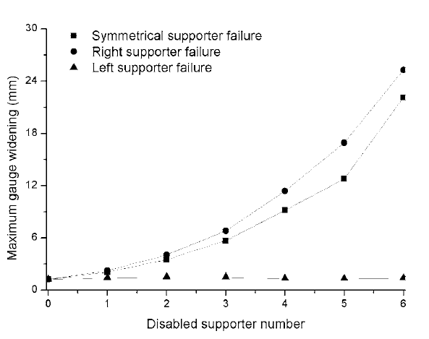
Maximum gauge widening for disabled fastener

Slide 27
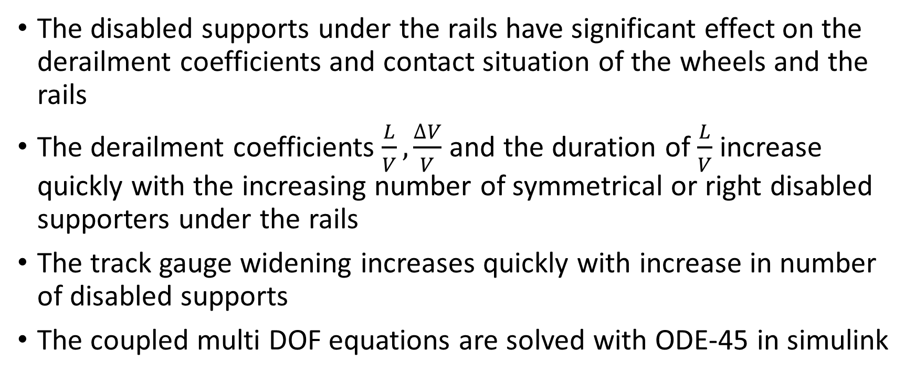
Conclusion
The disabled supports under the rails have significant effect on the derailment coefficients and contact situation of the wheels and the rails
The derailment coefficients $\frac{L}{V},\frac{∆V}{V}$and the duration of $\frac{L}{V}$increase quickly with the increasing number of symmetrical or right disabled supporters under the rails
The track gauge widening increases quickly with increase in number of disabled supports
The coupled multi DOF equations are solved with ODE-45 in simulink

Slide 28
References
Driveline lecture notes by Dr. Ashok Kumar Pandey
Xiao, X., Jin, X., and Wen, Z. (August 12, 2006). "Effect of Disabled Fastening Systems and Ballast on Vehicle Derailment." ASME. J. Vib. Acoust. April 2007; 129(2): 217–229. https://doi.org/10.1115/1.2424978
Wanming Zhai, Kaiyun Wang & Chengbiao Cai (2009) Fundamentals of vehicle–track coupled dynamics, Vehicle System Dynamics, 47:11, 1349-1376, DOI: 10.1080/00423110802621561
Zhai, W. M., 1996, “Two Simple Fast Integration Methods for Large-Scale
Dynamic Problems in Engineering,” Int. J. Numer. Methods Eng., 394, pp.
4199–4214.
Matlab help

