Slide 1


Object Oriented Programming with JAVA
NAME OF Facutly, Assistant Professor
Computer Science & Engineering

Slide 2
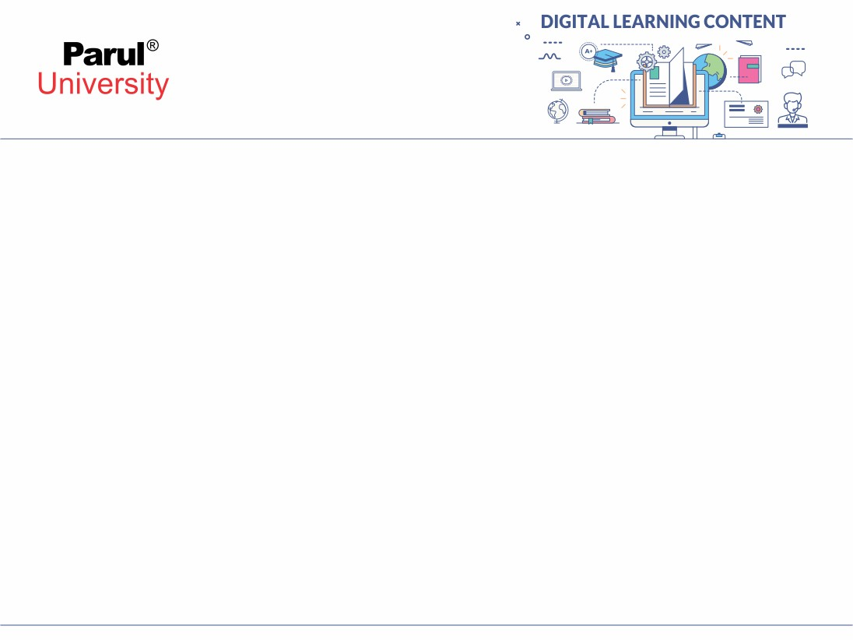

UNIT-1
Introduction

Slide 3
Design introduction:
Object oriented programming,
oops principles,
encapsulation,
inheritance and polymorphism java as a oops &
internet enabled language,
importance of java,
java usage in industry,
the byte code,
compiling,
And running of simple java program,
Jvm ,
Jdk ,
Jre

Slide 4
Object-oriented programming:
An object-oriented programming language (OOP) is a programming language that supports the concept of objects, which are entities that can contain data and code. Objects can interact with each other through messages, methods, and inheritance.
Some of the benefits of using an OOP language are:
It allows for modularity and reusability of code, as objects can be defined once and used in different contexts².
It allows for abstraction and encapsulation of data, as objects can hide their internal details and expose only their interfaces².
It allows for polymorphism and dynamic binding, as objects can behave differently depending on their types and contexts².
It allows for modeling complex systems and real-world entities, as objects can represent concepts, properties, and behaviors³.

Slide 5
Object-oriented programming:
Some of the challenges of using an OOP language are:
It can introduce complexity and overhead, as objects may have multiple dependencies and interactions³.
It can require more memory and processing power, as objects may have additional attributes and methods³.
It can be difficult to design and maintain, as objects may have conflicting or inconsistent behaviors and responsibilities³.

Slide 6
Object-oriented programming:
Some of the examples of OOP languages are:
C++, which is a multi-paradigm language that supports object-oriented, procedural, generic, and functional programming¹.
Java, which is a class-based, object-oriented language that runs on a virtual machine and supports concurrency, generics, and reflection¹.
Python, which is a multi-paradigm language that supports object-oriented, imperative, functional, and procedural programming¹.
JavaScript, which is a prototype-based, object-oriented language that runs on web browsers and supports dynamic typing, closures, and event-driven programming¹

Slide 7
Oops principles:
Object-Oriented Principles mainly include the 4 pillars that together make the OOP a very powerful concept. That is –
Abstraction
Encapsulation
Inheritance
Polymorphism
OOP is based on real-life engineered things. Like the approaches followed in the other engineering – Electronic Engineers are making some device, Automobile engineers are making some vehicle, etc. So the design approaches followed their, the same replicated to the software engineering with the concept of these 4 Object-Oriented Programming principles.

Slide 8
Encapsulation:
Encapsulation can be defined as the binding of data and attributes or methods and data members in a single unit. In classes, we have Data and attributes that perform operations on that data. So according to the OOPs principle of Encapsulation, that data can be merged into a single unit. Encapsulation enhances more security of the data as everything related to a single task must be grouped and access to the data is given as per need.
And this can be achieved using the concept of Data Hiding.
Encapsulation = Data Hiding + Abstraction.

Slide 9
Encapsulation:
public class Person {
private String name;
// private = restricted access
//
Getter public String getName()
{
return name;
}
// Setter public void setName(String newName)
{
this.name = newName;
}
}

Slide 10
Inheritance:
In Java, it is possible to inherit attributes and methods from one class to another.
We group the "inheritance concept" into two categories:
subclass (child) - the class that inherits from another class
superclass (parent) - the class being inherited from
To inherit from a class, use the extends keyword.
In the example below, the Car class (subclass) inherits the attributes and methods from the Vehicle class (superclass):

Slide 11
Example:
class Vehicle {
protected String brand = "Ford";
Vehicle attribute public void honk(){
Vehicle method System.out.println("Tuut, tuut!");
} }
class Car extends Vehicle {
private String modelName = "Mustang";
Car attribute public static void main(String[] args) {
Create a myCar object Car myCar = new Car();
Call the honk() method (from the Vehicle class)
on the myCar object myCar.honk(
Display the value of the brand attribute (from the Vehicle class)and
the value of the modelName from the
Car class System.out.println(myCar.brand + " " + myCar.modelName);
}}

Slide 12
Polymorphism java as a oops:
Polymorphism means "many forms", and
it occurs when we have many classes that are related to each other by inheritance.
Like we specified in the previous chapter; Inheritance lets us inherit attributes and
methods from another class.
Polymorphism uses those methods to perform different tasks.
This allows us to perform a single action in different ways.
For example, think of a superclass called Animal that has a method called animalSound().
Subclasses of Animals could be Pigs, Cats, Dogs, Birds – And
they also have their own implementation of an animal
sound (the pig oinks, and the cat meows, etc.):

Slide 13
Example:
class Animal {
public void animalSound()
{ System.out.println("The animal makes a sound");
}
}
class Pig extends Animal {
public void animalSound()
{ System.out.println("The pig says: wee wee");
}
}
class Dog extends Animal { public void animalSound() {
System.out.println("The dog says: bow wow");
}
}

Slide 14
Internet enabled language:
Certainly! Internet linguistics is a fascinating domain that explores new language styles and forms influenced by the Internet and other digital media. Let’s delve into it:
Definition: Internet linguistics refers to the study of language produced and displayed through computer-mediated communication (CMC) systems. These systems include text-based platforms like email, chat, instant messaging, blogs, and wikis. It encompasses both human-generated language and language produced by artificial intelligence agents ¹.
Perspectives:
Sociolinguistic Perspective: Examines how society views the impact of Internet development on languages.
Educational Perspective: Considers language learning and teaching in the digital age.
Stylistic Perspective: Investigates variations in language style due to the Internet’s influence.
Applied Perspective: Focuses on practical applications, such as web usability and translation ¹.
Multilingualism: While English remains dominant online, other languages are gradually gaining users. The Internet provides a platform for diverse linguistic expression

Slide 15
Importance of java:
Mobile Applications:
For the development of mobile apps, Java is the preferred
Programming language . It works with Kotlin and Android
Studio, among other software.
Web-based
Applications:
It’s also used to create web-based applications. And because of
the wide support for web development via Struts, JSP, and
Servlet. Java considers as a server-side computer language for
this reason.
Scientific
Applications:
When it comes to scientific computations and mathematical
processes, software engineers consider Java programming
language as the weapon of choice. These programs are
intended to be extremely safe and quick.

Slide 16
Importance of java:
Game development:
Because it is supported by the open-source most compelling 3D
technology, Java is commonly applied by game production
companies. When it comes to building 3D games, the engine has
unmatched capabilities.

Slide 17
Java usage in industry:
The IT industry, especially in India, heavily uses Java in most of their projects. Being a Java developer , on should have the knowledge about the Java-based tools and technologies used by the most of the IT industries such as
Android application development, Web Development
Classification of Java Tools/Technologies Based on Different Fields
1. Web Development
Web development refers to the development of a
website(collection of web pages) or a web
application(collection of
smaller apps/ modules.. similar to a website). For example:- The site
you are currently viewing is a website.
2. Android Application
Android applications are . apk applications which run
on Android devices. More and more devices are
having Android kernel nowadays.

Slide 18
Java usage in industry:
Big Data:
As the data is growing day by day, the appropriate handling of data has become
necessary for every organization. Be it training the statistical model or anything else,
handling big data isn’t easy and hence requires some tools for the same.
DevOps:
Java DevOps is simply following the DevOps practices and philosophies
for Java app development to obtain better and rapid development
Desktop
Applications:
Following tools/technology/features can be used to build Desktop
applications using Java. These are packages in Java that can be
imported and used easily.
Swing
AWT
JavaFX

Slide 19
The byte code:
Java bytecode is the instruction set for the Java Virtual Machine (JVM). It plays a crucial role in executing programs written in the Java language and other JVM-compatible languages. Here are some key points about Java bytecode:
What is Java Bytecode?
Java bytecode consists of a series of instructions that the JVM interprets.
Each bytecode operation is represented by a single byte, which is why it’s called “bytecode.” This compact form of instruction allows for efficient execution.
How Is Bytecode Generated?
When you write a Java program, you create source code (e.g., .java files).
The compiler converts this source code into bytecode (or machine code). This bytecode is stored in a .class file.
The Java Virtual Machine (JVM) then executes this bytecode.
Why Is Bytecode Important?
Java bytecode makes Java a platform-independent language.
Here’s how it works:
You write your program in a high-level language like Java.
The compiler translates your Java source code into bytecode.
The JVM (interpreter) executes this bytecode on any platform.
As long as there’s a compatible JVM, your Java program can run on different operating systems without modification.

Slide 20
The byte code:
Byte Code can be defined as an intermediate code generated by the
compiler after the compilation of source code(JAVA Program). This
intermediate code makes Java a platform-independent language.
import java.io.*;
class GFG {
public static void main (String[] args) {
System.out.println("GFG!");
}
}

Slide 21
Compiling:
When compiling a Java program, there are two main steps: compilation and execution. Let’s break it down:
Compilation:
You write your Java code in a .java file (also known as the source file).
The Java compiler (javac) processes this source code and converts it into bytecode.
Each class in your source file gets stored in a separate .class file.
The bytecode is platform-independent and can run on any system.
Execution:
The class files generated during compilation are machine-independent.
To run your program, you pass the main class file (the one containing the main method) to the Java Virtual Machine (JVM).
class GFG {
// Main driver method
public static void main(String[] args)
{
// Print command
System.out.print("Welcome to Geeks");
}
}

Slide 22
Running of simple java program:
class Test
{
public static void main(String []args)
{
System.out.println("My First Java Program.");
}
};

Slide 23
JVM:
Java Virtual Machine (JVM). 🚀
The JVM is an essential component in the Java ecosystem. Here’s a concise overview:
What is JVM?
The Java Virtual Machine (JVM) is an abstract computing machine that enables computers to execute Java programs.
When you run a Java application, the JVM reads the compiled bytecode (generated by the JDK) and interprets it into machine code for execution

Slide 24
JVM:
JVM Architecture:
The JVM consists of several key components:
Classloader: Responsible for loading class files. There are three built-in classloaders: Bootstrap, Extension, and System/Application.
Class (Method) Area: Stores per-class structures like the runtime constant pool, field and method data, and method code.
Execution Engine: Executes the bytecode.
Memory Areas: Include the heap, stack, and method area.
Native Interface: Allows interaction with native libraries.
Garbage Collector: Manages memory by reclaiming unused objects.
Runtime Data Areas: Include the method area, heap, stack, and PCregister.
PC Register: Holds the address of the currently executing instruction.
Stack: Stores method call frames.
Heap: Stores objects and arrays.
Method Area: Stores class-level data.
Program Counter (PC): Keeps track of the currently executing instruction.

Slide 25
JVM:
2.JVMs are available for various hardware and software platforms, making Java applications
truly WORA (Write Once, Run Anywhere)²³.
JVM Operations:
When you execute a Java class, an instance of the JVM is created.
The JVM performs the following operations:
Loads code: Loads class files.
Verifies code: Ensures bytecode integrity.
Executes code: Interprets bytecode or compiles it to native code.
Provides runtime environment: Manages memory, threads, and other resources.

Slide 26
Jdk:
The Java Development Kit (JDK) is a cross-platformed software development environment that offers a collection of tools and libraries necessary for developing Java-based software applications and applets. It is a core package used in Java, along with the JVM (Java Virtual Machine) and the JRE (Java Runtime Environment).
Beginners often get confused with JRE and JDK, if you are only interested in running Java programs on your machine then you can easily do it using Java Runtime Environment. However, if you would like to develop a Java-based software application then along with JRE you may need some additional necessary tools, which is called JDK.
JDK contains:
Java Runtime Environment (JRE),
An interpreter/loader (Java),
A compiler (javac),
An archiver (jar) and many more.

Slide 27
Jre:
Java Runtime Environment (JRE) is an integral part of the Java Development Kit (JDK). It’s a software distribution that includes a Java class library, specific tools, and a standalone Java Virtual Machine (JVM)¹².
Here are some key points about JRE:
Role: JRE is the most common environment available on devices for running Java programs¹². Java source code is compiled and converted to Java bytecode, and to run this bytecode on any platform, you need JRE¹².
Components: JRE includes integration libraries (like Java Database Connectivity (JDBC), Java Naming, Interface Definition Language (IDL), Directory Interface (JNDI), Remote Method Invocation Over Internet Inter-Orb Protocol (RMI-IIOP), Remote Method Invocation (RMI)), user interface libraries (like Swing, Java 2D, Abstract Window Toolkit (AWT), Accessibility, Image I/O, Print Service, Sound, drag, and Drop (DnD), and input methods), and base libraries (like lang and util, zip, Collections, Concurrency Utilities, management, Java Archive (JAR), instrument, reflection, versioning, Preferences API, Ref Objects, Logging, and Regular Expressions)¹².

Slide 28
Working with JVM: JRE works closely with JVM. The JRE loads classes, verifies memory access, and retrieves system resources¹². It also includes a ClassLoader that dynamically loads all the classes necessary to run a Java program¹.
In essence, JRE acts as a software layer on top of the operating system, enabling Java-based applications to run seamlessly on any operating system¹

Slide 29

www.paruluniversity.ac.in

