Slide 1


Object Oriented Programming with JAVA
Department of Computer Science & Engineering, PIET

Slide 2


UNIT-6
Inheritance

Slide 3
Contents
Basic concepts
Implementation in java
Member access modifiers and rules
Usage of super key word
Types of inheritance
Method Overriding
Abstract classes
Dynamic method dispatch
Using final with inheritance

Slide 4
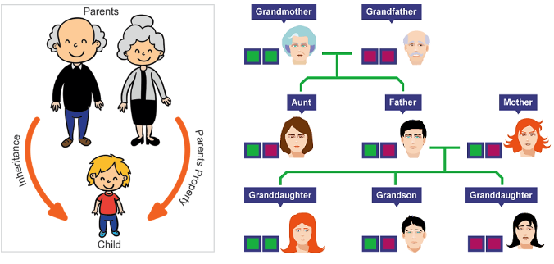
Inheritance: Basic concepts

Slide 5
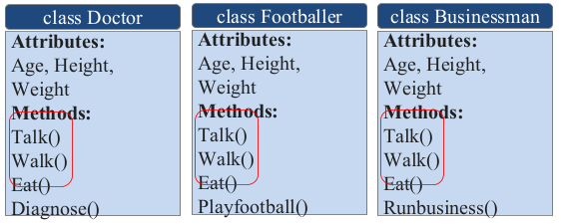

Slide 6
All of the classes have common attributes (Age, Height, Weight) and methods (Walk, Talk, Eat).
However, they have some special skills like Diagnose, Play football and Run business.
In each of the classes, you would be copying the same code for Walk, Talk and Eat for each character.

Slide 7
The mechanism of a class to derive properties and characteristics from another class is called Inheritance.
It is the most important feature of Object Oriented Programming.
Inheritance is the process, by which class can acquire (reuse) the properties and methods of another class.
Now the subclass will contain its own variables and methods as well as the variables and methods of a super class.

Slide 8
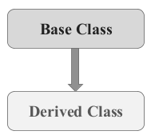
Base Class: The class whose properties are inherited by sub class is called Base class/Super class/Parent class.
Derived Class: The class that inherits properties from another class is called Sub class/Derived class/Child class.
Inheritance is implemented using super class and sub class relationship in object-oriented languages.

Slide 9
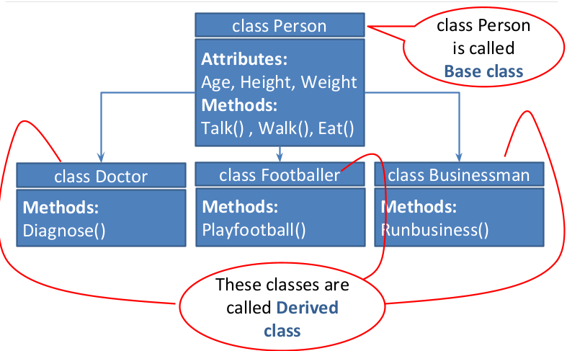
Inheritance example:

Slide 10
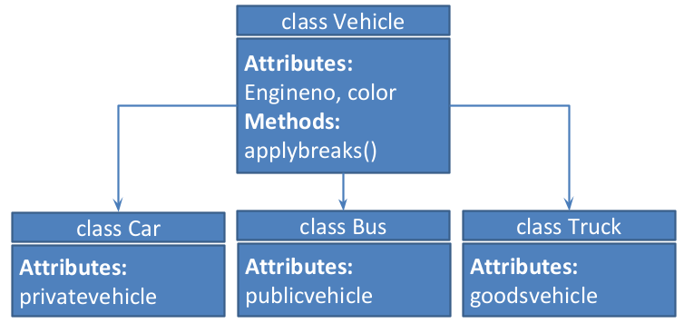
Another example:

Slide 11
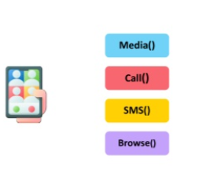

Why do we need inheritance?

Slide 12
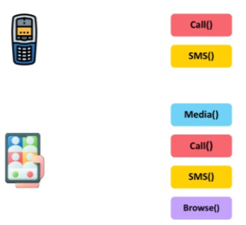
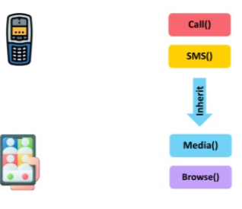

Slide 13
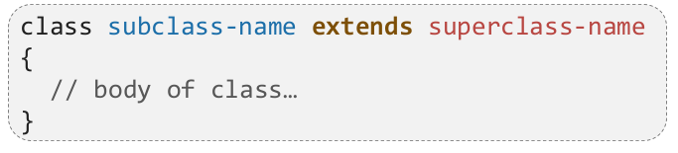
How to implement Inheritance in java
To inherit a class, you simply incorporate the definition of one class into another by using the extends keyword.
The term extends is a predefined keyword in a java, that allows you to create a new child class by deriving the variables and methods from the parent class to reduce code length and improve performance.
Syntax:

Slide 14
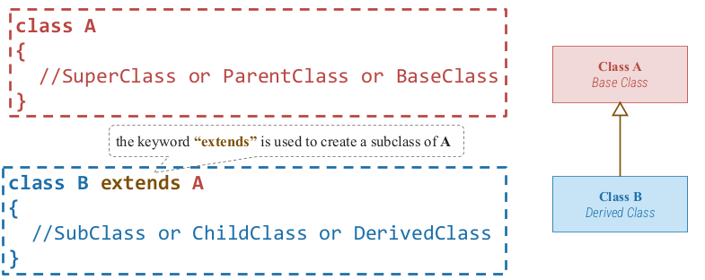
Implementing Inheritance in java

Slide 15
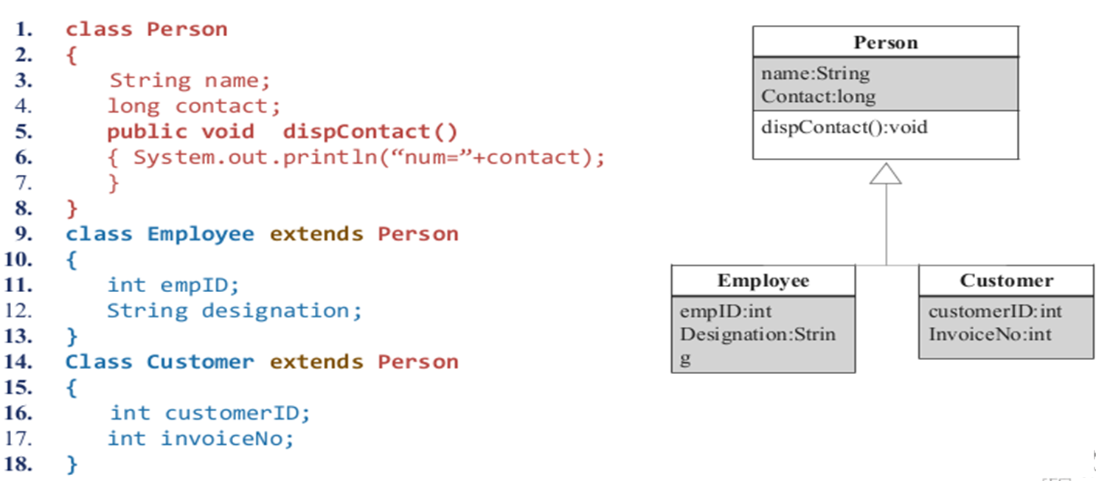

Slide 16
Access modifiers
public – Public members are visible to all classes.
private – Private members are visible only to the class to which they belong.
protected – Protected members are visible only to the class to which they belong, and derived classes.

Slide 17
Protected access modifier
Protected access modifier plays a key role in inheritance.
Protected members of the class can be accessed within the class and from derived class but cannot be accessed from any other class or program.
It works like public for derived class and private for other class.

Slide 18
Access Control
Access Modifiers | Description
Private | The access level of a private modifier is only within the class. It cannot be accessed from outside the class.
Default | The access level of a default modifier is only within the package. It cannot be accessed from outside the package. If you do not specify any access level, it will be the default.
Protected | The access level of a protected modifier is within the package and outside the package through child class. If you do not make the child class, it cannot be accessed from outside the package.
Public | The access level of a public modifier is everywhere. It can be accessed from within the class, outside the class, within the package and outside the package.

Slide 19
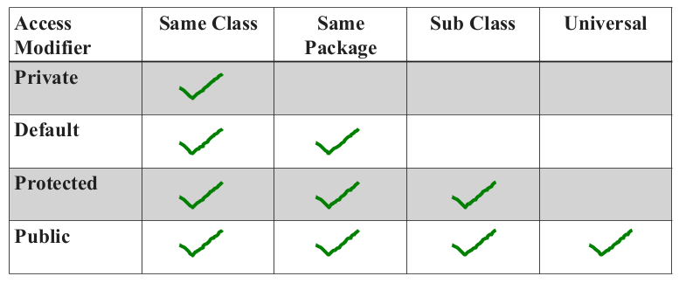

Slide 20
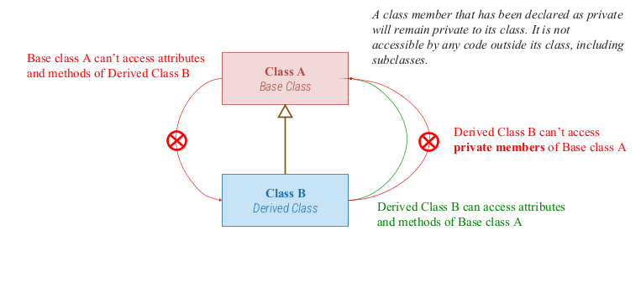
Inheritance: Property

Slide 21
Inheritance: Advantages
Promotes reusability
When an existing code is reused, it leads to less development and maintenance costs.
It is used to generate more dominant objects.
Avoids duplicity and data redundancy.
Inheritance makes the sub classes follow a standard interface.

Slide 22
Inheritance: Disadvantages
The main disadvantage of the inheritance is that the two classes are dependent on each other.
If the functionality of the base class is changed then the changes have to be done on the child classes also.
It increases the time and efforts take to jump through different levels of the inheritance.
If the methods in the super class are deleted then it is very difficult to maintain the functionality of the child class.

Slide 23
Types of Inheritance
Single Inheritance
Multilevel Inheritance
Multiple Inheritance
Hierarchical Inheritance
Hybrid Inheritance (also known as Virtual Inheritance)

Slide 24
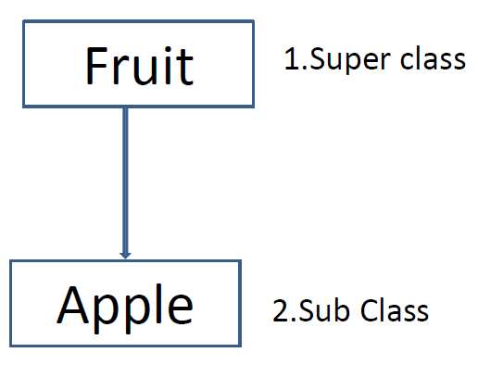
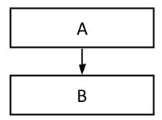
1. Single Inheritance
If a sub class is derived from a single super class then it is called single inheritance.
Class Apple is derived from class Fruit.
Class B is derived from class A.
Here A is a Parent or base class
of B and B would be a child
class of A.

Slide 25
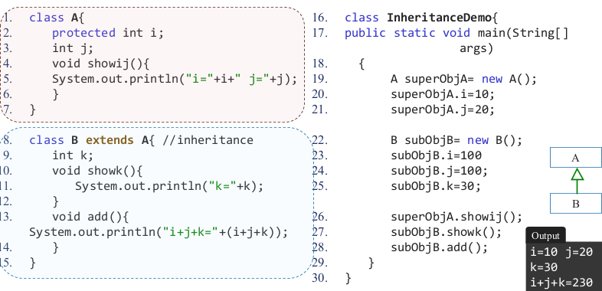

Slide 26
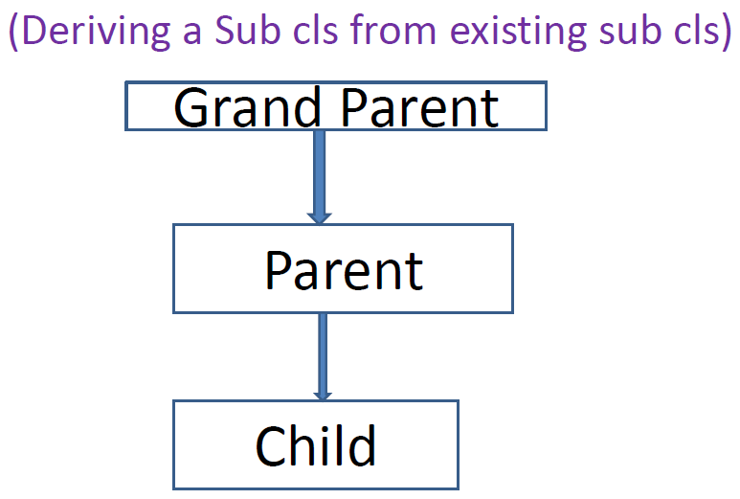
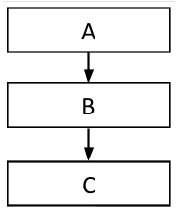
2. Multilevel Inheritance
Any class is derived from a class which is already derived from another class then it is called multilevel inheritance.
Here, class C is derived from class B and class B is derived from class A, so it is called multilevel inheritance.

Slide 27
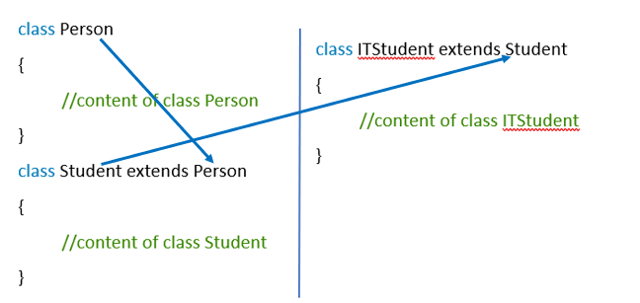
Person
Student
IT Student

Slide 28
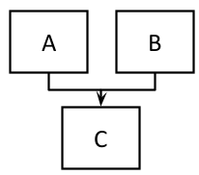
3. Multiple Inheritance
If a class is derived from more than one class then it is called multiple inheritance.
Here, class C is derived from two classes, class A and class B.
Note: Multiple Inheritance is not supported in Java with the Class Inheritance, we can still use those Inheritance with Interface.

Slide 29
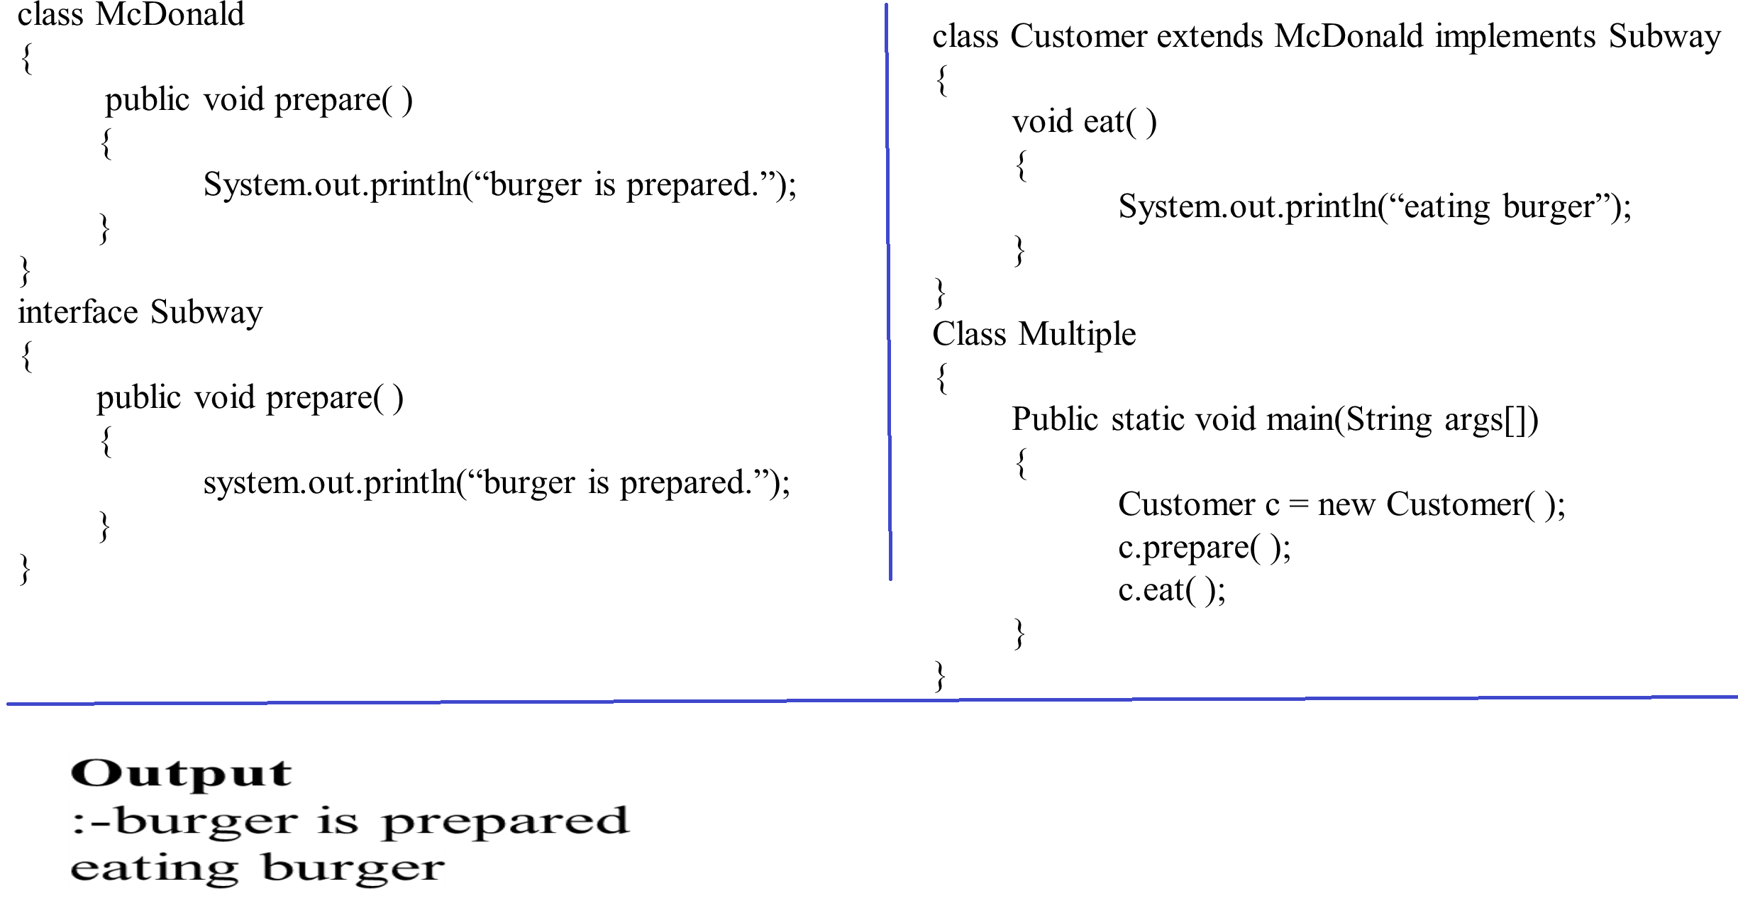

Slide 30
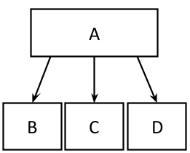
4. Hierarchical inheritance
If one or more classes are derived from
one class then it is called hierarchical
inheritance.
Here, class B, class C and class D are
derived from class A.

Slide 31
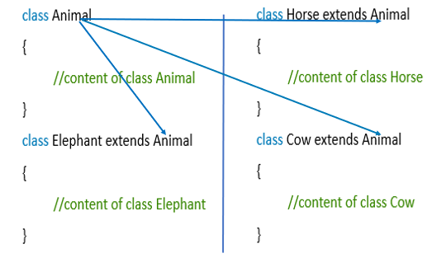

Slide 32
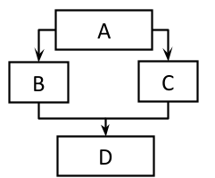
5. Hybrid Inheritance
It is a combination of any other inheritance types. That is either multiple or multilevel or hierarchical or any other combination.
Here, class B and class C are derived from class A and class D is derived from class B and class C.
Class A, class B and class C is example of Hierarchical Inheritance and class B, class C and class D is example of Multiple Inheritance so this hybrid inheritance is combination of Hierarchical and Multiple Inheritance.

Slide 33
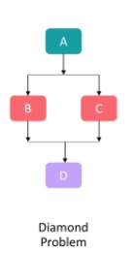
Diamond Problem
Java programming language does not support Multiple Inheritance as it ends up with a serious ambiguity.

Slide 34
Super Keyword
Whenever a subclass needs to refer to its immediate superclass, it can do so by use of the keyword super.
Super has two general forms:
1. Calls the superclass constructor.
2. Used to access a members(i.e. instance variable or method) of the
superclass.

Slide 35
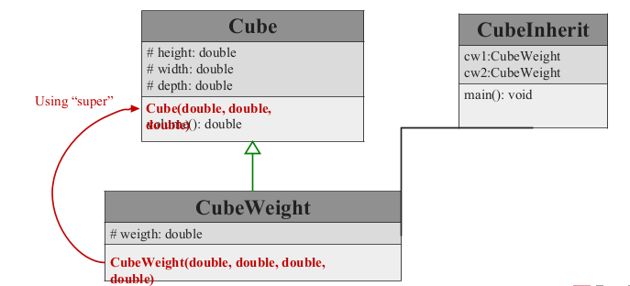
Using super to Call Superclass Constructors
Call to super must be first statement in constructor

Slide 36
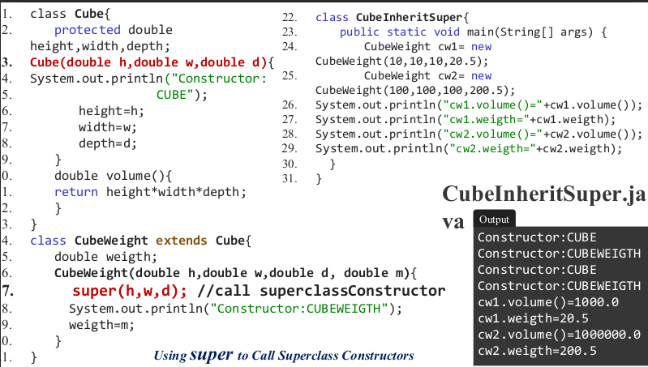

Slide 37

Using super to access members
The second form of super acts somewhat like this, except that it always refers to the superclass of the subclass in which it is used.
Syntax:
This second form of super is most applicable to situations in which member names of a subclass hide members by the same name in the superclass.

Slide 38
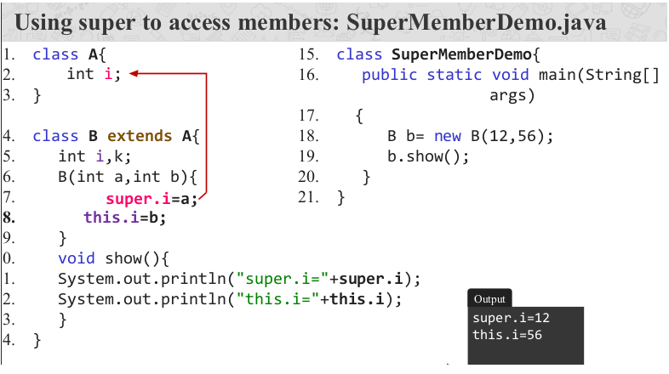

Slide 39
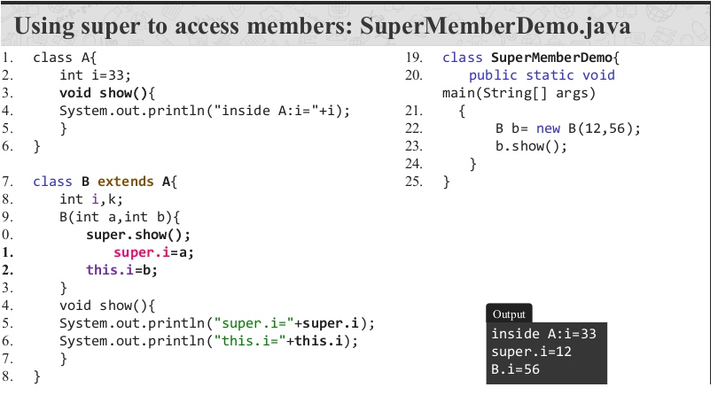

Slide 40
Points to remember for super keywords
When a subclass calls super( ), it is calling the constructor of its immediate superclass.
This is true even in a multileveled hierarchy.
super( ) must always be the first statement executed inside a subclass constructor.
If a constructor does not explicitly call a superclass constructor, the Java compiler automatically inserts a call to the no-argument constructor of the superclass.
The most common application of super keyword is to eliminate the ambiguity between members of superclass and sub class.

Slide 41
Method Overriding: Run-time Polymorphism
In a class hierarchy, when a method in a subclass has the same name and type signature as a method in its superclass, then the method in the subclass is said to override the method in the superclass.
Definition: If subclass (child class) has the same method as declared in the parent class, it is known as method overriding in Java.
Method overriding is used to provide the specific implementation of a method which is already provided by its superclass.

Slide 42
Method overriding is used for runtime polymorphism.
By combining inheritance with overridden methods, a superclass can define the general form of the methods that will be used by all of its subclasses.
Dynamic, run-time polymorphism is one of the most powerful mechanisms that object-oriented design brings to bear on code reuse and robustness.

Slide 43
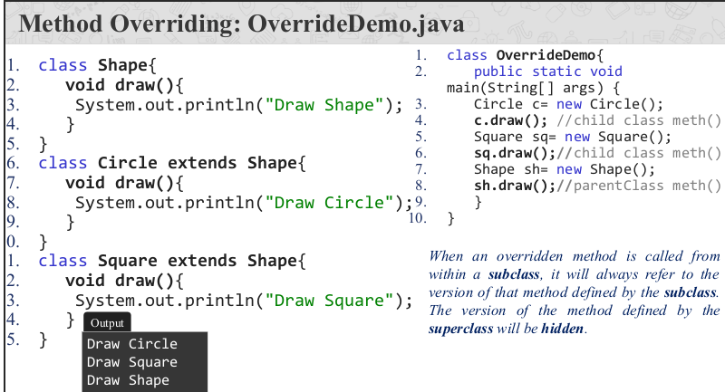

Slide 44
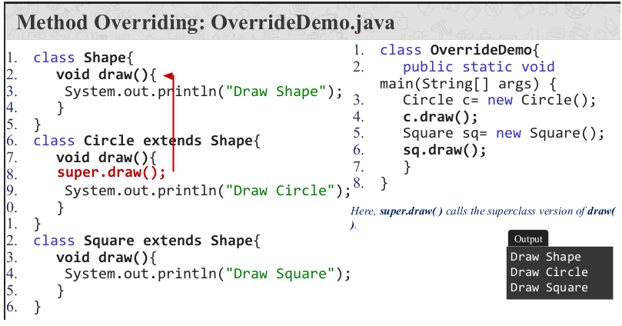

Slide 45
Points to remember for method overriding
Method overriding occurs only when the names and the type signatures of the two methods are identical. If they are not, then the two methods are simply overloaded.
RULES:
The method must have the same name as in the parent class
The method must have the same parameter as in the parent class.
There must be an IS-A relationship (inheritance).

Slide 46
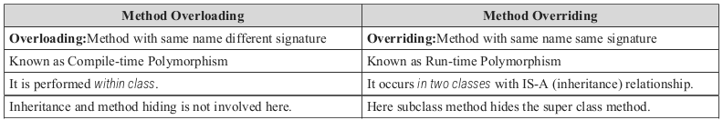
Overloading vs Overriding: Java Methods

Slide 47

Abstraction
Data abstraction is also termed as information hiding.
Abstraction is the concept of object-oriented programming that “represents” only essential attributes and “hides” unnecessary information.
Abstraction is all about representing the simplified view and avoid complexity of the system.
It only shows the data which is relevant to the user.

Slide 48

In object-oriented programming, it can be implemented using Abstract Class.
Advantage: It reduces programming complexity.
Example: A car is viewed as a car rather than its numerous individual components.

Slide 49
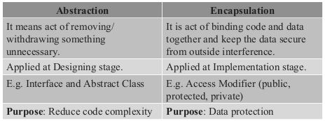
Abstraction vs. Encapsulation

Slide 50
Abstract class
Abstraction is a process of hiding the implementation details from the user, only the functionality will be provided to the user.
In other words, the user will have the information on what the object does instead of how the object will do it.
Abstraction is achieved using Abstract classes and interfaces.
A class which contains the abstract keyword in its declaration is known as abstract class.

Slide 51
Abstract classes may or may not contain abstract methods, i.e., methods without body ( public void get(); )
But, if a class has at least one abstract method, then the class must be declared abstract.
If a class is declared abstract, it cannot be instantiated.
To use an abstract class, we have to inherit it to another class and provide implementations of the abstract methods in it.

Slide 52
Sometimes, we need to define a superclass that declares the structure of a given abstraction without providing a complete implementation.
The superclass will only define a generalized form, that will be shared by all the subclasses.
The subclasses will fill the details of every method.
When a superclass is unable to create a meaningful implementation for a method.

Slide 53
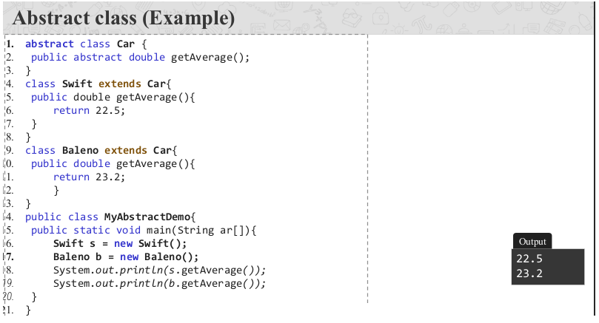

Slide 54
Points to remember for Abstract Class
To declare a class abstract, you simply use the abstract keyword in front of the class keyword at the beginning of the class declaration.
There can be no objects of an abstract class. That is, an abstract class cannot be directly instantiated with the new operator. Such objects would be useless, because an abstract class is not fully defined.
Cannot declare abstract constructors, or abstract static methods.
Any subclass of an abstract class must either implement all of the abstract methods in the superclass, or be itself declared abstract.

Slide 55
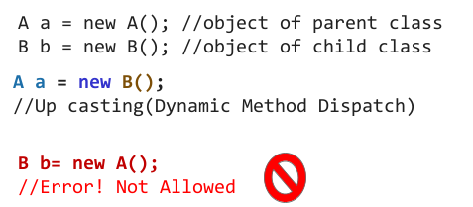
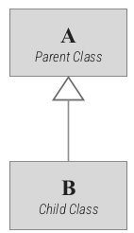
Dynamic Method Dispatch
Dynamic method dispatch is the mechanism by which a call to an overridden method is resolved at run time, rather than compile time.
Dynamic method dispatch is important because this is how Java implements run-time polymorphism.

Slide 56
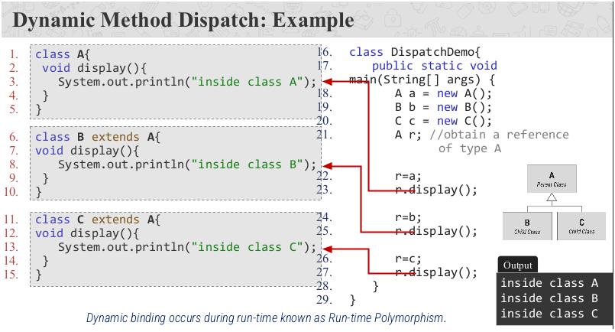
Method Overriding: Run-time Polymorphism

Slide 57
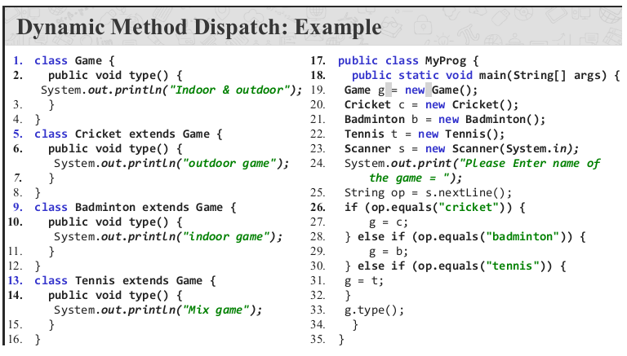

Slide 58
“final” keyword
The final keyword in java has three main applications with inheritance.
Final can be:
1. Variable
2. Method
3. Class

Slide 59
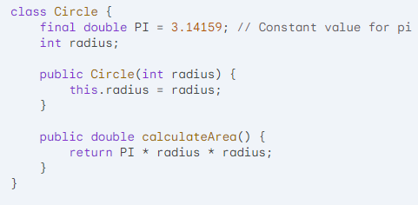
Final Variables:
.
When you declare a variable as final, its value cannot be changed after initialization. This is useful for creating constants within a class or inheritance hierarchy.

Slide 60
Here, PI is a final variable ensuring its value remains consistent throughout the Circle class and any subclasses

Slide 61
Final Methods:
Declaring a method as final prevents subclasses from overriding that method. This is useful for core functionalities that shouldn't be altered in derived classes.
In this example, draw() is declared as final in the Shape class, preventing the Square class from overriding it. However, getArea() is not final, allowing Square to provide its specific area calculation.

Slide 62
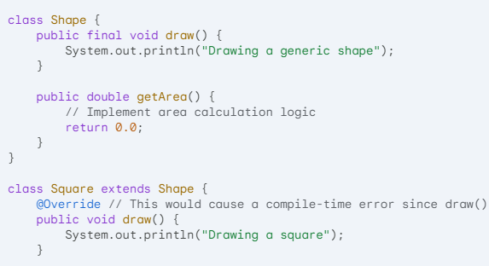
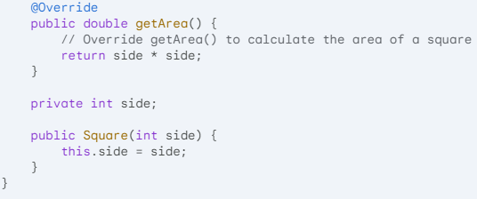

Slide 63

Final Classes:
Declaring a class as final prevents any other class from inheriting from it. This is typically used for utility classes or classes that represent a fixed concept.
The String class in Java is final, meaning you cannot create subclasses that extend its functionality.

Slide 64
Points to remember for final keywords
Using final with inheritance helps enforce consistency and prevent unintended modifications.
final variables ensure constants remain constant.
final methods prevent core functionalities from being overridden.
final classes restrict inheritance from a specific class.

Slide 65

www.paruluniversity.ac.in

