Slide 1
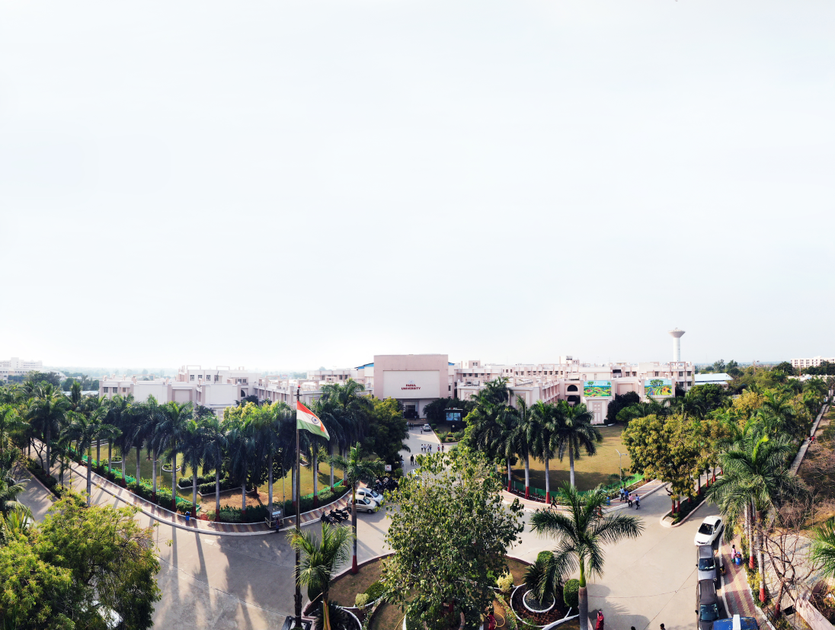

Object oriented programming with Java
Computer Science and Engineering

Slide 2
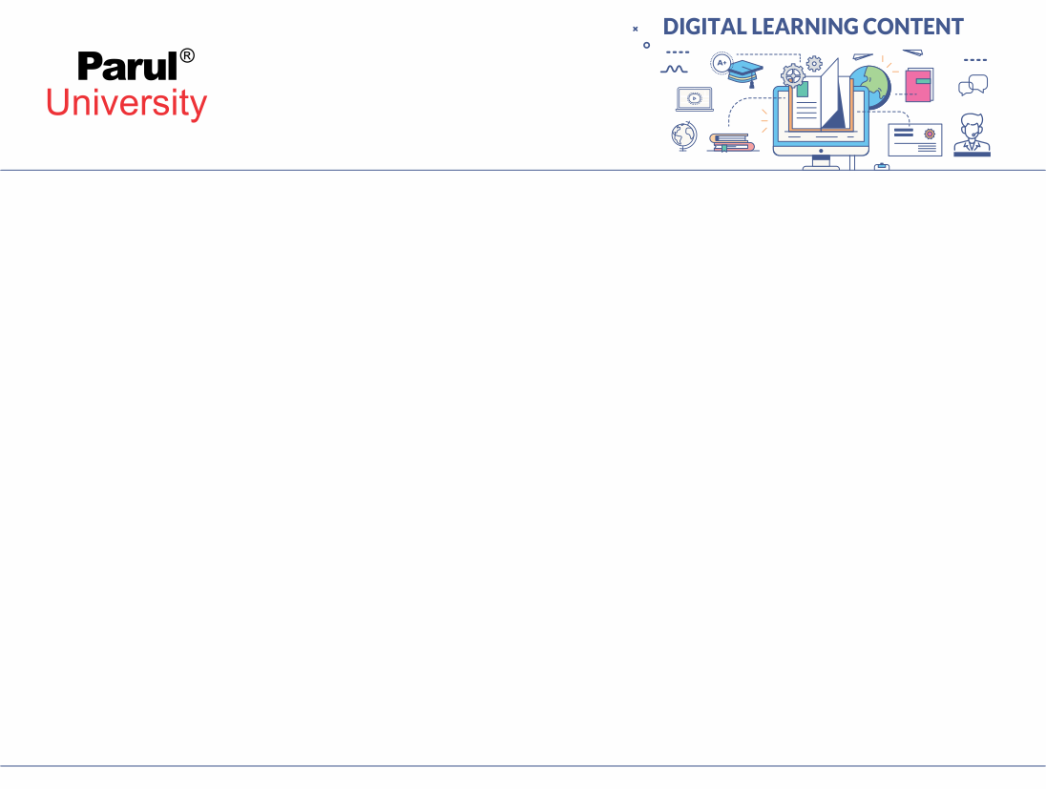
Unit 8
Exception Handling

Slide 3
Contents
Errors
Types of Error
Exception and its types
Difference between Error and exception
tryCatch method
Difference between Final, Finally and Finalize
Difference between Throw and Throws

Slide 4
What is an Error in Java?
In Java, an error is a subclass of Throwable that tells that something serious problem is existing and a reasonable Java application should not try to catch that error.
Generally, it has been noticed that most of the occurring errors are abnormal conditions and cannot be resolved by normal conditions.

Slide 5
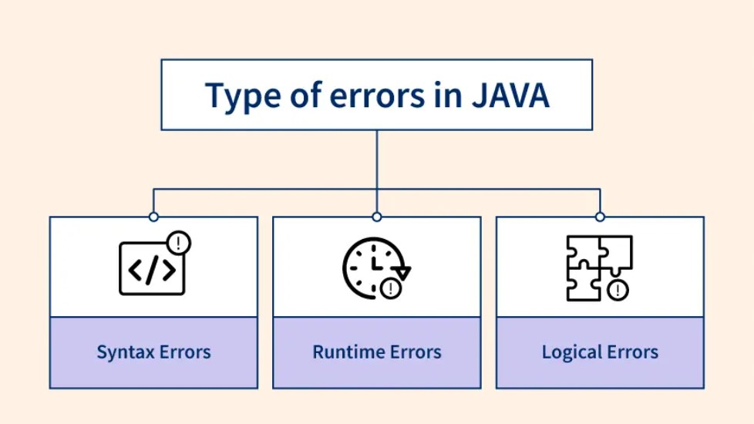
Types of Errors

Slide 6
Syntex error
A syntax error in Java is like a grammatical mistake in your code. It's a violation of the strict rules that Java uses to understand your instructions.
Just like a misspelled word can confuse someone reading a sentence, a syntax error prevents the Java compiler (the program that translates your code into machine code) from making sense of your program.
For example :Mismatched parentheses, Incorrect keyword
Missing semicolon:
int age = 25 // Missing semicolon here
System.out.println("Hello!");

Slide 7
Syntax error
Types of Syntax Errors
Missing Parentheses or Brackets: Forgetting to include closing parentheses ), square brackets ], or curly braces {} can lead to syntax errors, especially in
expressions, function calls, or data structures.
Missing Semicolons: In languages that use semicolons to terminate statements (e.g., C, Java, JavaScript), omitting a semicolon at the end of a statement
can result in a syntax error.
Mismatched Quotes: Forgetting to close quotation marks ' or " around strings can lead to syntax errors, as the interpreter/compiler will interpret everything
until the next matching quote as part of the string.
Incorrect Indentation: In languages like Python, incorrect indentation can cause syntax errors, especially within control structures like loops, conditional
statements, or function definitions.
Misspelled Keywords or Identifiers: Misspelling keywords, variable names, function names, or other identifiers can result in syntax errors. The
interpreter/compiler won’t recognize these misspelled names, leading to errors

Slide 8
Syntex error
Fixing syntax errors:
The good news is that syntax errors are usually easy to fix! Once you identify the error from the compiler message, you can simply correct the mistake according to Java's grammar rules. Many development environments (IDEs) also help by highlighting syntax errors as you type.
Example
Mismatched parentheses
if (age > 18) { // Missing closing parenthesis here
System.out.println("You are an adult");
}

Slide 9
Syntax error
Real world Syntax Error Problems:
Configuration Files: Syntax errors can occur in configuration files (e.g., XML, JSON, YAML) used by applications. For instance, a missing closing tag in an XML file or a misplaced comma in a JSON file can lead to syntax errors.
Markup Languages: In markup languages like HTML or Markdown, syntax errors can occur due to missing or mismatched tags. For example, forgetting to close a <div> tag or using incorrect indentation in Markdown can result in syntax errors.
SQL Queries: Syntax errors are common in SQL queries, especially when writing complex statements. Errors can occur due to missing commas, incorrect table aliases, or improper placement of keywords like SELECT, FROM, WHERE, etc.
Regular Expressions: Writing regular expressions with incorrect syntax can lead to errors. Common mistakes include missing escape characters, mismatched parentheses, or invalid quantifiers.
Command Line Syntax: Incorrect usage of command-line tools and utilities can result in syntax errors. For example, providing the wrong option or argument format when executing commands can lead to errors.

Slide 10
Runtime error
Runtime Errors:
A runtime error in a program is an error that occurs while the program is running after being successfully compiled.
Runtime errors are commonly called referred to as “bugs” and are often found during the debugging process before the software is released.
When runtime errors occur after a program has been distributed to the public, developers often release patches, or small updates designed to fix the errors.
While solving problems on online platforms, many run time errors can be faced, which are not clearly specified in the message that comes with them. There are a variety of runtime errors that occur such as logical errors, Input/Output errors, undefined object errors, division by zero errors, and many more.

Slide 11
Runtime error
Types of Runtime Errors:
Example:
int num1 = 10;
int num2 = 0;
int result = num1 / num2; // This will cause an ArithmeticException
ArrayIndexOutOfBoundsException:
This error pops up when you try to access an element in an array that's beyond its defined bounds. Imagine reaching for an item on a shelf that doesn't exist.
Example:
int[] numbers = {1, 2, 3};
int element = numbers[4]; // This will cause an ArrayIndexOutOfBoundsException (trying to access index 4 in a 3-element array)
Arithmetic Exceptions:
These errors arise during mathematical operations. A classic example is the infamous java.lang.ArithmeticException caused by dividing by zero.

Slide 12
Runtime error
Types of Runtime Errors:
NullPointerException: This error occurs when you attempt to use a variable that hasn't been assigned a value (it's null). It's like trying to call a method on an empty object, like using a null cup to pour water.
Example:
String name = null;
System.out.println(name.toUpperCase()); // This will cause a NullPointerException (calling a method on a null object)
ClassCastException: This error happens when you try to cast an object to a type that it's not compatible with. It's like forcing a square peg into a round hole – the object's type just doesn't match what you're expecting.
Example:
Object obj = new String("Hello");
Integer num = (Integer) obj; // This will cause a ClassCastException (casting a String to an Integer)
NumberFormatException: This error arises when you try to convert a string to a number format that it's not valid in. It's like trying to interpret a word as a number – it just doesn't make mathematical sense.
Example:
String numberString = "abc";
int number = Integer.parseInt(numberString); // This will cause a NumberFormatException (trying to parse a non-numeric string)

Slide 13
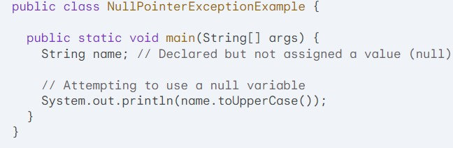
Runtime error
Example of a runtime error in Java, specifically a NullPointerException
Explanation
1.We declare a String variable named name but don't assign it any value. This means it remains null.
2. The line System.out.println(name.toUpperCase()); tries to call the toUpperCase() method on the name variable.
3. Since name is null, attempting to use its method results in a NullPointerException. This error occurs because you're trying to call a method on an object that doesn't exist (it's null).

Slide 14
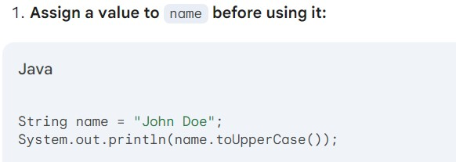
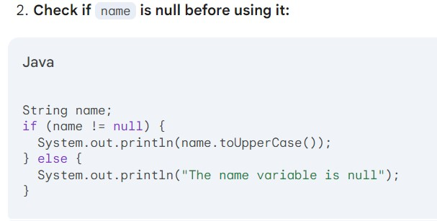
Runtime error
There are two ways to fix this error:

Slide 15
Logical error
Logical Errors in Java
Logical errors, also known as semantic errors, are flaws in a program's code that cause it to produce incorrect results or behave unexpectedly, even though it compiles and runs without crashing.
These errors can be particularly frustrating because the Java compiler or runtime environment (JVM) won't explicitly point them out.
They stem from flaws in the programmer's logic or understanding of the problem being solved.

Slide 16
Logical error
Types of Logical Errors:
Incorrect Operator Precedence: Java follows a specific order of operations when evaluating expressions. Misusing this order can lead to unexpected results.
Example: int result = x * y + z; // This might not be what you intended
Correction: Use parentheses to enforce the desired order, e.g., int result = (x * y) + z;
Conditional Statement Errors: Faulty logic in if, else if, and switch statements can lead the program down the wrong path.
Example: if (age >= 18) { // Might miss out on 18-year-olds
Correction: Use if (age > 17) to include 18-year-olds.
Off-by-One Errors: These occur when loops or calculations iterate one more or less time than intended.
Example: for (int i = 0; i < 10; i++) { // Prints numbers 0-9, not 1-10
Correction: Use i < 10 to print up to 9 (inclusive).

Slide 17
Logical error
Floating-Point Precision Issues: Floating-point numbers can introduce slight inaccuracies due to their internal representation. Be cautious about comparing them using exact equality (==).
Example: if (value == 0.1) { ... } // Might not work as expected
Correction: Use a comparison with a small tolerance, e.g., if (Math.abs(value - 0.1) < 0.001) { ... }
Integer Division: Dividing integers results in another integer, discarding any remainder. Use type casting or floating-point division for exact results.
Example: int average = total / count; // Might lose precision if count is not 1
Correction: Use floating-point division, e.g., double average = (double)total / count;
Unintended Variable Scope: Variables declared within a loop or block might not be accessible outside of that scope.
Example: for (int i = 0; i < 10; i++) { int sum = 0; ... } // sum is not accessible outside the loop
Correction: Declare sum before the loop if needed outside.
Array Index Out of Bounds: Accessing elements outside the valid range of an array leads to runtime errors.
Example: int[] numbers = {1, 2, 3}; int last = numbers[numbers.length]; // ArrayIndexOutOfBoundsException
Correction: Use numbers[numbers.length - 1] to access the last element.

Slide 18
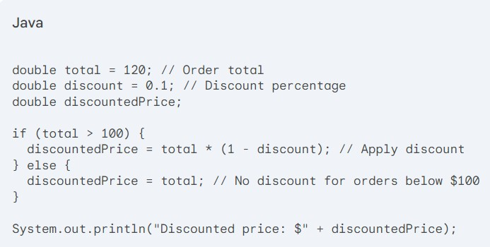
Example of Logical error
Scenario:
An e-commerce website offers a discount of 10% on orders above $100. The programmer implements the following code to calculate the discounted price:

Slide 19
Example of Logical error
Logical Error:
The intended behavior is to apply a 10% discount if the order total is above $100. However, the code
uses the > operator in the if condition. This means the discount will be applied only if the order total is strictly greater than
$100 (i.e., $100.01 or higher). Orders exactly equal to $100 will not receive the discount.
Impact:
Customers with an order total of exactly $100 will pay the full price, even though they should have received
a discount. This can lead to customer dissatisfaction and lost revenue for the store.

Slide 20
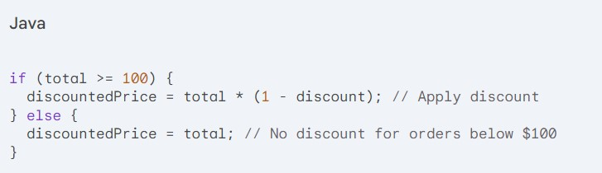
Example of Logical error
Correction:
To fix the error, change the > operator to >= in the if condition:

Slide 21
Exception
What are Java Exceptions?
In Java, Exception is an unwanted or unexpected event, which occurs during the execution of a program, i.e. at run time, that disrupts the normal flow of the program’s instructions. Exceptions can be caught and handled by the program. When an exception occurs within a method, it creates an object. This object is called the exception object. It contains information about the exception, such as the name and description of the exception and the state of the program when the exception occurred.
Major reasons why an exception Occurs
Invalid user input
Device failure
Loss of network connection
Physical limitations (out-of-disk memory)
Code errors
Opening an unavailable file

Slide 22
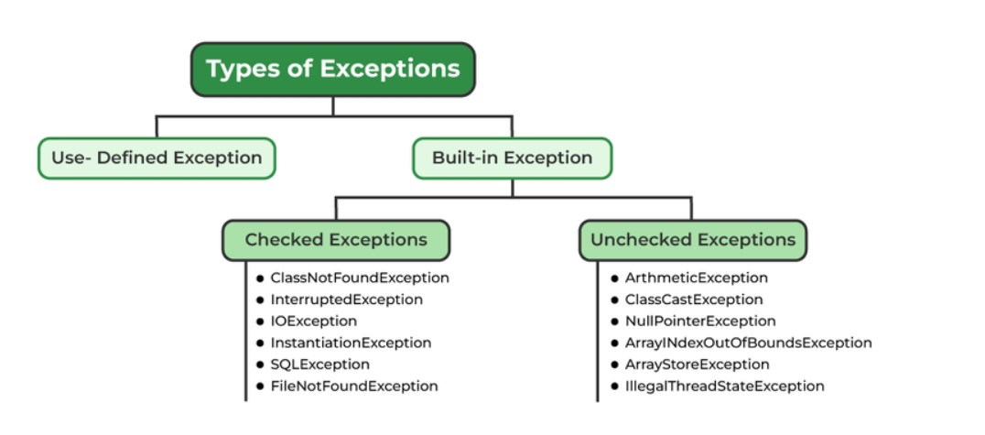
Types of Exceptions

Slide 23
Exception
Exceptions can be categorized in two ways:
Built-in Exceptions
Checked Exception
Unchecked Exception
User-Defined Exceptions
1. Built-in Exceptions
Built-in exceptions are the exceptions that are available in Java libraries. These exceptions are suitable to explain certain error situations.
Checked Exceptions: Checked exceptions are called compile-time exceptions because these exceptions are checked at compile-time by the compiler.
Unchecked Exceptions: The unchecked exceptions are just opposite to the checked exceptions. The compiler will not check these exceptions at compile time. In simple words, if a program throws an unchecked exception, and even if we didn’t handle or declare it, the program would not give a compilation error.

Slide 24
Exception
User-Defined Exceptions:
Sometimes, the built-in exceptions in Java are not able to describe a certain situation. In such cases, users can also create exceptions, which are called ‘user-defined Exceptions’.
Advantages of Exception Handling in Java
Provision to Complete Program Execution
Easy Identification of Program Code and Error-Handling Code
Propagation of Errors
Meaningful Error Reporting
Identifying Error Types

Slide 25
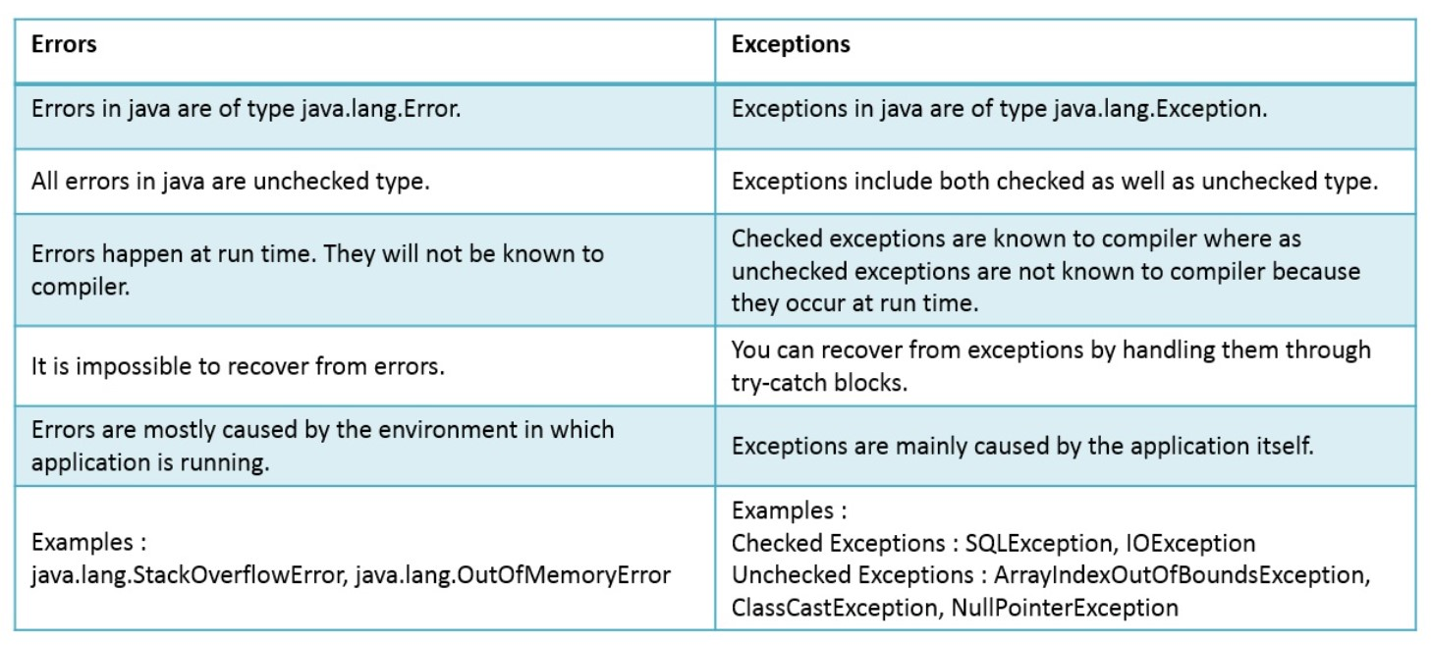
Errors vs Exceptions

Slide 26
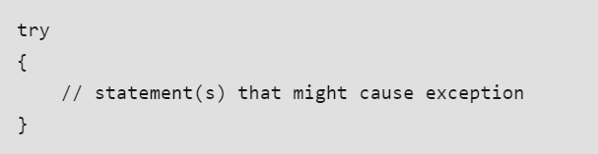
tryCathch
In Java exception is an “unwanted or unexpected event”, that occurs during the execution of the program. When an exception occurs, the execution of the program gets terminated. To avoid these termination conditions we can use try catch block in Java.
Why Does an Exception occur?
An exception can occur due to several reasons like a Network connection problem, Bad input provided by a user, Opening a non-existing file in your program, etc.
Blocks and Keywords Used For Exception Handling
1. try in Java
The try block contains a set of statements where an exception can occur.

Slide 27
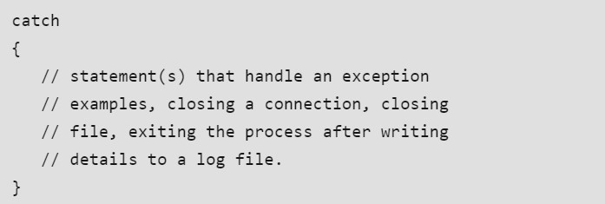
tryCathch
2. catch in Java
The catch block is used to handle the uncertain condition of a try block. A try block is always followed by a catch block, which handles the exception that occurs in the associated try block.
3. throw in Java
The throw keyword is used to transfer control from the try block to the catch block.
4. throws in Java
The throws keyword is used for exception handling without try & catch block. It specifies the exceptions that a method can throw to the caller and does not handle itself.
5. finally in Java
It is executed after the catch block. We use it to put some common code (to be executed irrespective of whether an exception has occurred or not ) when there are multiple catch blocks.

Slide 28
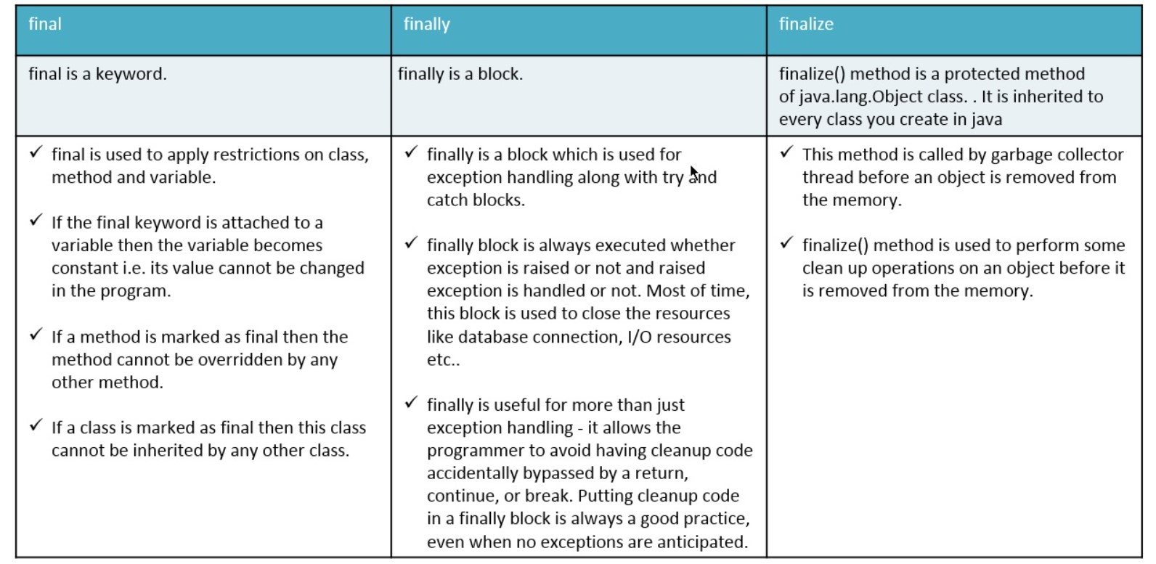
Difference between Final, Finally and Finalize

Slide 29
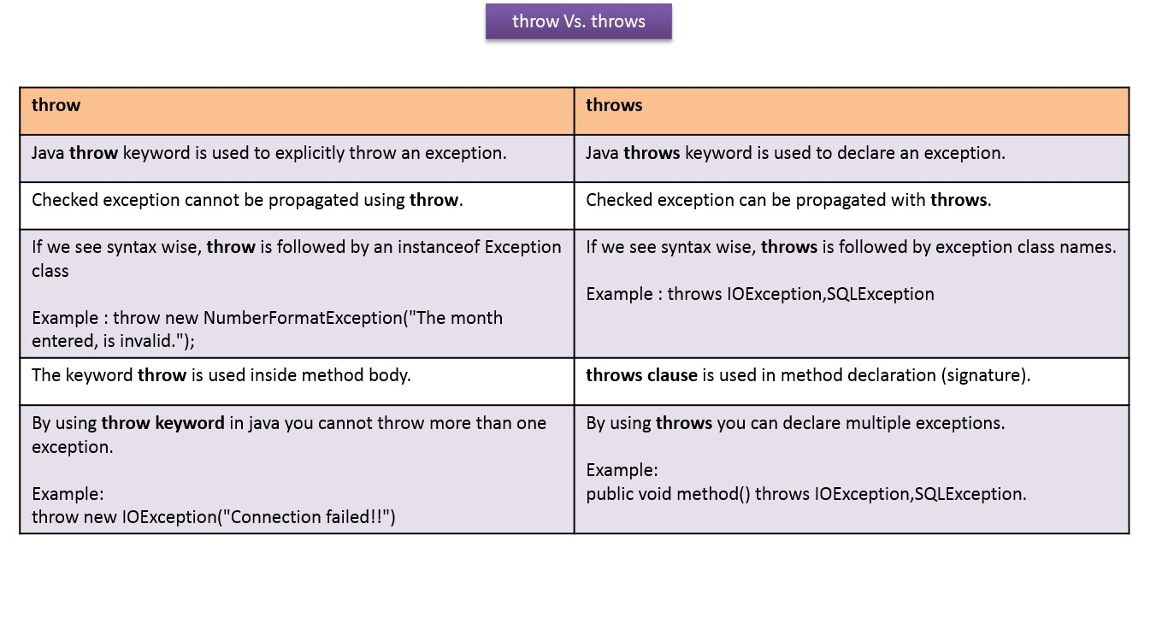
Difference Between Throw and Throws

Slide 30
References
[1] https://www.geeksforgeeks.org/exceptions-in-java/?ref=header_search
[2] https://images.app.goo.gl/aWDptkcFsi7U9Ltd8
[3] https://www.shiksha.com/online-courses/articles/difference-between-errors-and-exceptions-in-java
[4] https://www.geeksforgeeks.org/exceptions-in-java/?ref=header_search
[5] https://www.geeksforgeeks.org/flow-control-in-try-catch-finally-in-java/?ref=lbp
[6] https://www.geeksforgeeks.org/try-catch-throw-and-throws-in-java/?ref=lbp
[7] https://stackify.com/specify-handle-exceptions-java/
[8] https://www.programiz.com/java-programming/exception-handling

Slide 31


