Slide 1
Ready for Physics Class
( Mini Project)
Reporter:

Slide 2
Basic Concept:
1
Py varivable concept
2
Py keyword concept
3
Py Function concept

Slide 3
Mini_project
Ready for Physics Class

Slide 4

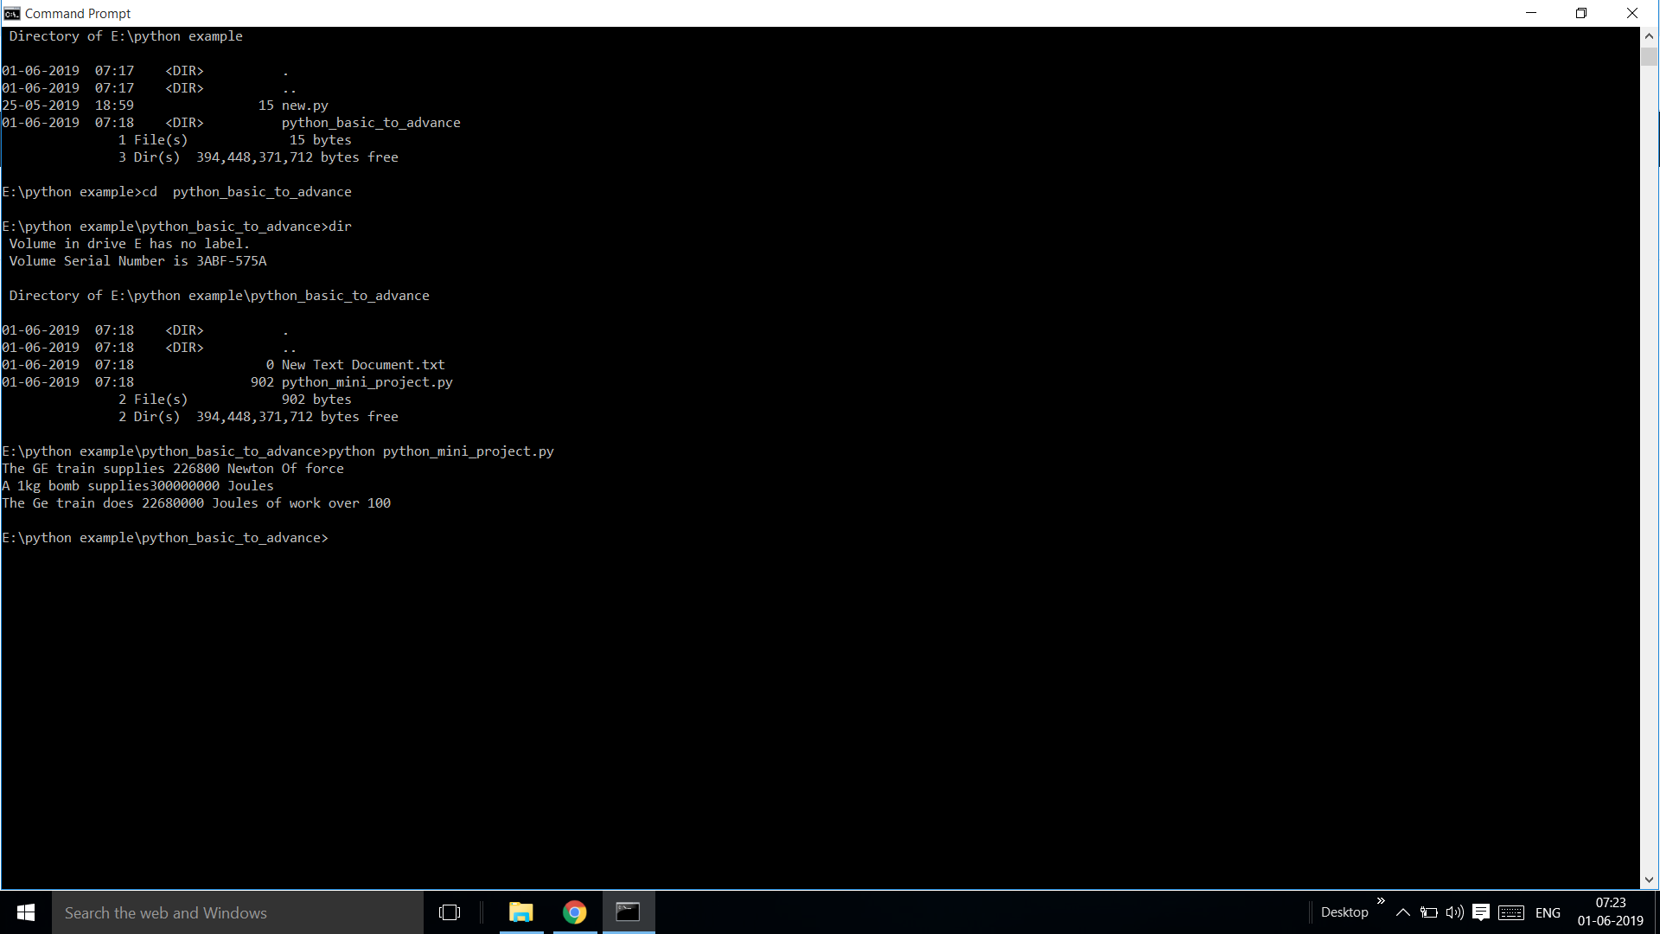
output

